Slide 1

Network Services Interface
Discovery Service
John MacAuley, ESnet
19th February 2014

Slide 2
Requirements
Aggregator NSA have restricted peer connectivity
  Peer connectivity is based on administrative policies (mutually authenticated TLS).
  As a result, signaling plane graph is not fully connected.
Chain deployment requirements
  NSA Discovery Documents from its directly connected peers.
  NML Topology Documents of all interconnected networks.
Tree deployment requirements
  uRA can optionally require NSA Discovery Document.
  uPA are end nodes in the tree and and only advertise information.
  Each Aggregator NSA requires NSA discovery documents for all NSA within the network.
  Aggregator NSA need a full view of network topology to perform advanced "intelligent" routing decisions.

Slide 3
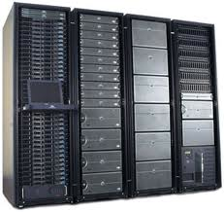
Chain-based signaling model
uRA
Signaling Flow
AG
AG
AG
uPA
uPA
uPA
Source STP
Destination STP
A
B
C
D
E
F
Host
Host
Every NSA associated with network resources must be an Aggregator capable of propagating a reservation request to the local uPA component and at most one adjacent (child) NSA associated with the next connection segment in the data path.

Slide 4
Tree-based signaling model
Signaling Flow
uRA
AG
AG
AG
uPA
uPA
uPA
Source STP
Destination STP
A
B
C
D
E
F
Host
Host
An Aggregator involved in a connection reservation does not have to be associated with any network resources involved in creation of that service. A uRA can issue a service request to an Aggregator NSA anywhere in the network if authorized to do so, and the NSI CS protocol with handle creating the reservation.

Slide 5
Discovery Service
The NSI Discovery Service is part of the NSF suite of protocols, and is a simple peer-to-peer flooding protocol for exchange and distribution data documents between NSA within the interconnected network or “document space”.
It supports both polling and subscription based notification mechanisms for exchange of documents.

Slide 6
What is a document?
A document is any piece of information that needs to be distributed to all peers participating in the Discovery Service. A document is rapped in meta-data within the space to allow for identification and maintenance.
The original document contents and associated meta-data are propagated untouched throughout the document space.

Slide 7
Documents
Parameter | Description
nsa | The source NSA associated with the generation and management of the document within the network. This is assumed to be the NSA to which the document relates, however, there may be situations where this assumption is not true.
type | The unique string identifying the type of this document. A document type is defined by the type and release of a data document. application/vnd.ogf.nsi.topology.v1+xml application/vnd.ogf.nsi.topology.v2+xml
id | The identifier of the document. This value must be unique in the context of the nsa and type values.
version | The version of the document, or more specifically, the date this version of the document was created. Any updates to the document must be tagged with a new version.
expires | The date this version of the document expires and should be deleted from document space and any clients caching the document.
signature | An OPTIONAL digital signature of the document contents.
content | The content of the document modeled by this document meta-data.

Slide 8
Subscriptions
Parameter | Description
id | The provider assigned subscription identifier that uniquely identifies the subscription in the context of the provider.
href | The direct URI reference to the resource.
version | The version of the subscription. Indicates the last time the subscription was modified by the requester.
requesterId | The identifier of the requester client that created the subscription. An NSA must use its unique NSA identifier for requesterId.
callback | The protocol endpoint on the requester that will receive the notifications delivered for this subscription.
filter | The OPTIONAL filter criteria to apply to document events to determine if a notification should be sent to the client.

Slide 9
Operations
getDocuments([nsa], [type], [id], [lastDiscoveredTime])
getLocalDocuments([type], [id], [lastDiscoveredTime])
getDocument(nsa, type, id, [lastDiscoveredTime])
addDocument(nsa, type, id, version, expires, [signature], contents)
updateDocument(nsa, type, id, version, expires, [signature], contents)
addSubscription(requesterId, callback, filter)
editSubscription(id, requesterId, callback, filter)
deleteSubscription(id)
getSubscriptions([requesterId], [lastDiscoveredTime])
getSubscription(id, [lastDiscoveredTime])
getAll([lastDiscoveredTime])

Slide 10
Basic Request/Response
getDocuments()
Requester
NSA
Provider
NSA
<documents />
Document space

Slide 11
Basic Request/Response
Discovery Service uses a basic request/response messaging model with an HTTP binding:
  HTTP GET carries the discovery request operation
  HTTP 200 OK response carries result of the operation
  HTTP socket blocks until result it returned (synchronous)
HTTP GET /documents
Requester
NSA
Provider
NSA
200 OK <documents />

Slide 12
Subscriptions
addSubscription(filter)
Requester
NSA
Provider
NSA
Document space
<notifications />

Slide 13
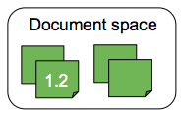
Flooding through notifications
uPA
B
AG
B
Requester
<notifications />
updateDocument(1.2)
1.2
1.2
<notifications />
<notifications />
1.2
AG
E
AG
D
uPA
A
Document space
<notifications />
Document space
1.2
1.2
<notifications />
1.2
1.2
AG
C

Slide 14
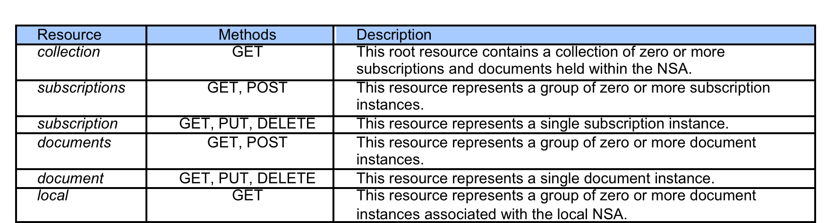
Resource Model

Slide 15
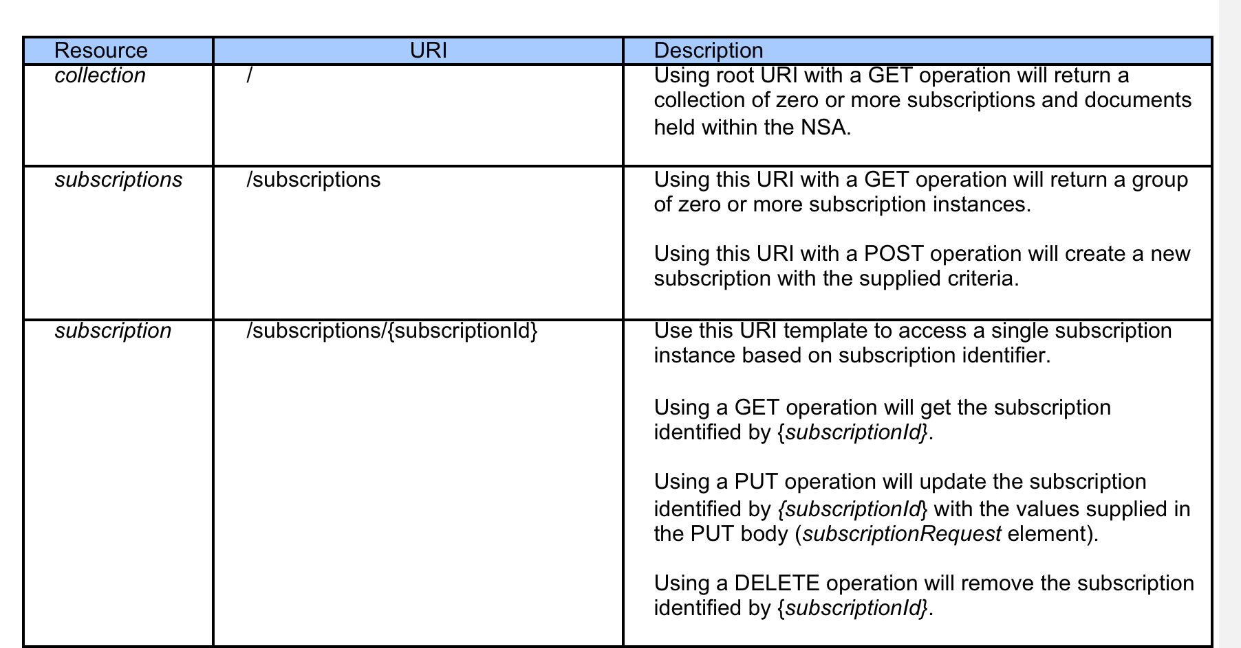
URI definitions

Slide 16
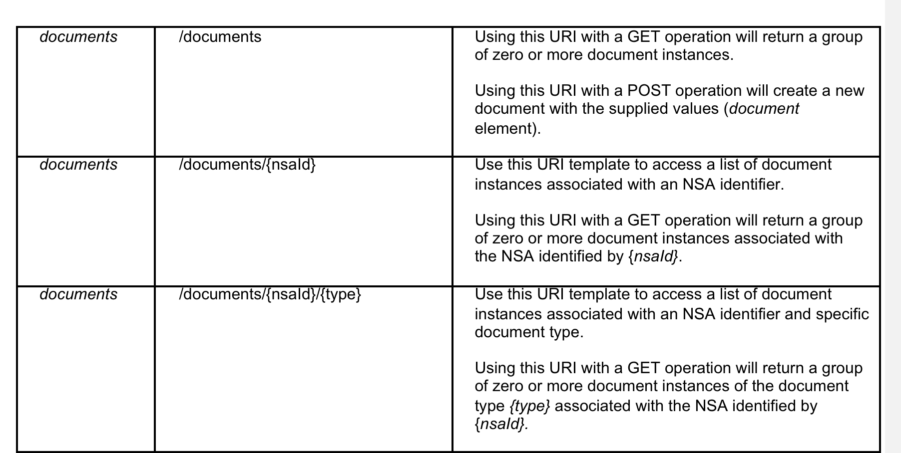
URI definitions

Slide 17
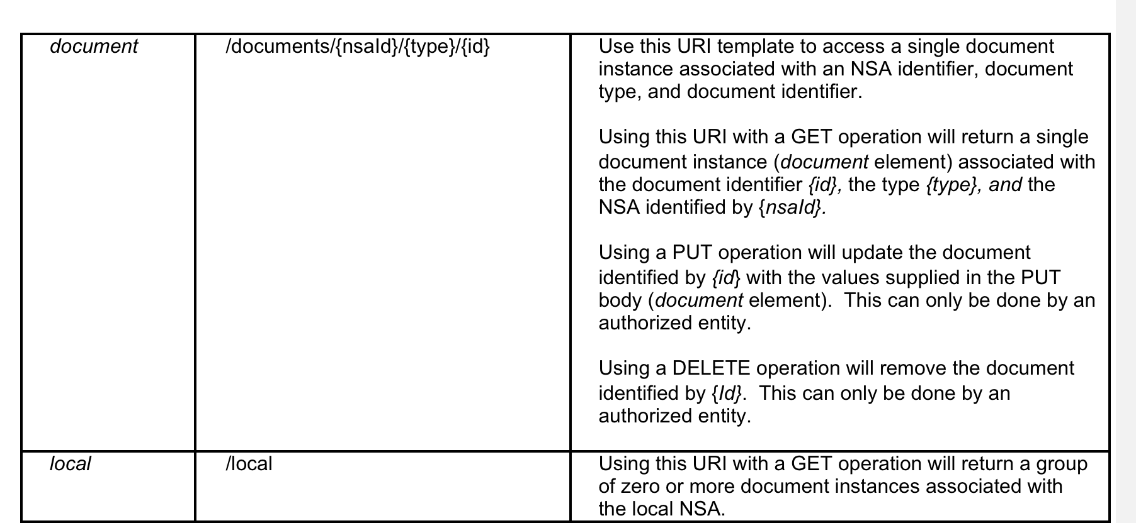
URI definitions

Slide 18
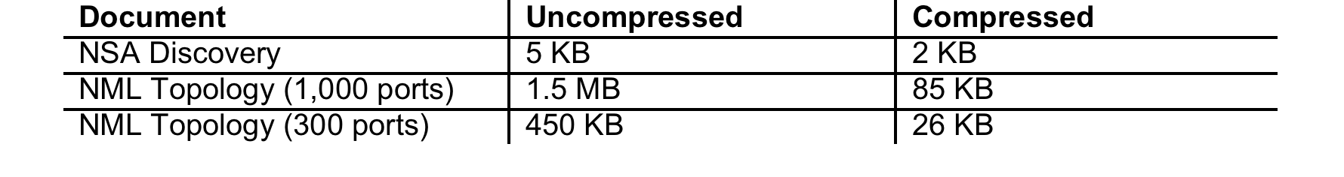
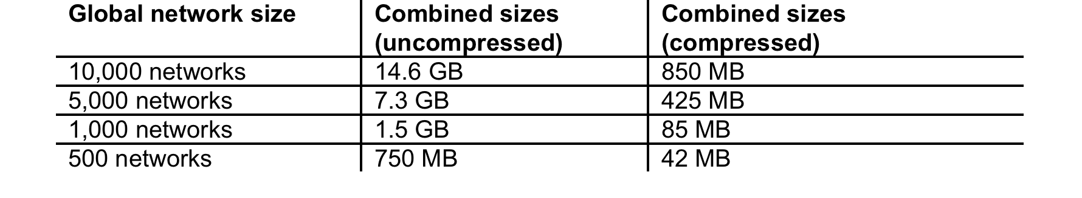
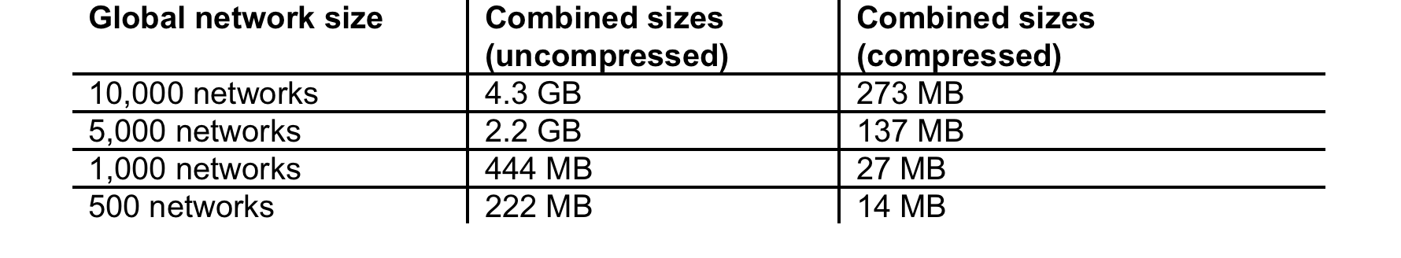
Numbers

