Slide 1
GLUE 2.0: JSON Rendering
Shiraz Memon,
Jülich Supercomputing Center
OGF 35, TU Delft, 17.06.2012

Slide 2
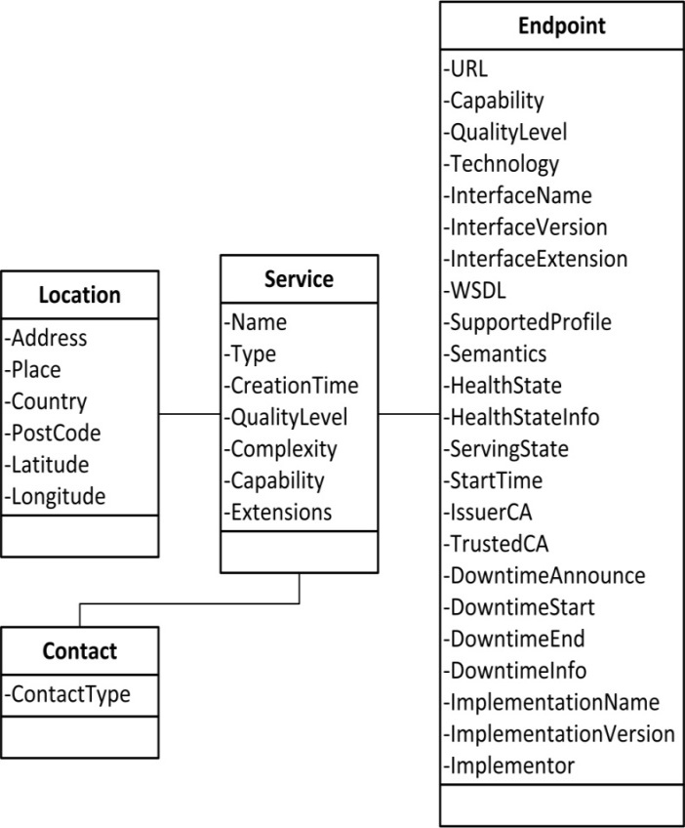
Glue 2.0 Adoption in EMIR
Subset of the GLUE2 Entities: Service, Endpoint, Location, Contact
Introduced Metadata: Lifetime, Owner, Last Update
Every Service Endpoint is JSON Document

Slide 3
JSON Rendering
Flattened Style: Name Value Pairs
<ClassName>_<AttributeName>
Service_ID, Service_Name, etc…
<ClassName>_<SubclassName>_<AttributeName>
Service_Endpoint_ID, Service_Endpoint_URL, etc…
Restricted to two levels of hierarchy (Specific Use Case)

Slide 4
Example
[
{
"Service_Name": “EMI Execution Service",
"Service_CreationTime": {"$date": "2011-10-16T11:47:24Z"},
"Service_Type": “eu.emi.es",
"Service_Capability": [“activity submission", “activity creation"],
"Service_QualityLevel": "production",
"Service_Endpoint_URL": "http://eu-emi.eu/emi-es",
"Service_Endpoint_Technology": “SOAP over HTTP",
"Service_Endpoint_InterfaceName": “ActivityManagement",
"Service_Endpoint_InterfaceVersion": ["1.0“ ],
"Service_Endpoint_WSDL": "http://eu-emi.eu/emi-es ?wsdl",
"Service_Endpoint_HealthState": "ok",
"Service_Endpoint_HealthStateInfo": “it is OK, I can see it",
"Service_Endpoint_ServingState": "production",
"Service_Endpoint_StartTime": {"$date": "2011-07-21T11:47:24Z"},
"Service_Endpoint_DowntimeAnnounce": {"$date": "2011-07-21T11:47:24Z"},
"Service_Endpoint_DowntimeStart": {"$date": "2011-07-21T11:47:24Z"},
"Service_Endpoint_DowntimeEnd": {"$date": "2011-07-21T11:47:24Z"},
"Service_Endpoint_QualityLevel": "production",
"Service_ExpireOn": {"$date": "2011-07-21T11:47:24Z"},
"Service_UpdateOn": {"$date": "2011-07-21T11:47:24Z"},
"Service_OwnerDN": “CN=Shiraz Memon,O=FZJ,OU=JSC”
}
]

Slide 5
Other Approaches?
XSEDE?

