Slide 1

OpenFlow in GN3’s Network Factory
GN3 OpenFlow Facility
Joan A. García-Espín on behalf of JRA2-T5 Partners
i2CAT, Barcelona
OGF36 – Chicago.IL
October 8th, 2012

Slide 2




Participants
GRNET / ICCS
(Greece)
SWITCH
(Switzerland)
Fundació i2CAT
(Catalonia, Spain)
DANTE
(United Kingdom)
A perfect-fit collaboration of two European NRENs, a Research Institute
and a pan-European R&D Infrastructure Operator

Slide 3

Key Facts about OpenFlow in JRA2-T5
Network Factory
A software-switch based facility
  Architected so that OpenFlow-enabled hardware switches can be introduced seamlessly
Functionality delivered to end-users:
  Slice request submission
  Slice instantiation
  Slice management
  Slice decommissioning functionalities
Experimenting within a slice is not disrupted, while the GÉANT production environment remains unaffected

Slide 4
GN3 OpenFlow PoP
Design Principles
5 OpenFlow PoPs interconnected with a full mesh of L2VPNs over GÉANT
  Co-located with GÉANT PoPs
2 general purpose servers per PoP for:
  Open vSwitch
  XEN hypervisor to deliver user VMs
Using OpenFlow v1.0 -> VLAN-based slicing
  Limited capabilities for non-VLAN slicing for VLAN-based experimentation
Orchestration software: FP7 OFELIA Control Framework (OCF)
  Resource allocation and instantiation (per slice)
  Authentication/Authorization (AA) and policy framework
  Web-based user interface for slice access and management
  Robustness, stability and scalability in terms of number of users, support for concurrent experiments and number of managed resources.
  Monitoring of slices and the OCF components themselves

Slide 5
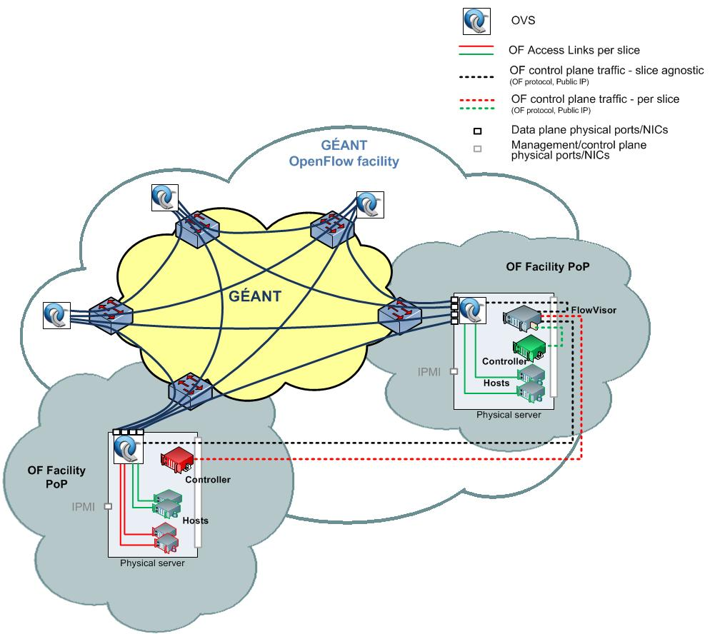
GN3 OpenFlow PoP
Implementation over GEANT
London
Amsterdam
Frankfurt
Zagreb
Vienna

Slide 6
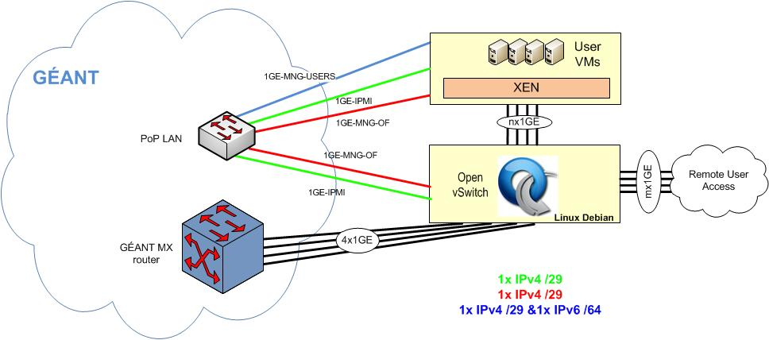
GN3 OpenFlow PoP
A closer look at the setup

Slide 7
GN3 OpenFlow PoP
Use cases
UC#1
Using OpenFlow as a TE mechanism to manage the backbone capacity, paths, etc. to serve specialized applications and protocols at the end systems. Examples:
  DC live migration middleware
  Ultra-high bandwidth data transport
UC#2
Using OpenFlow to deliver L2 slices for experimentation at L2 and above on the data and control plane. Examples:
  Ethernet OAM testing
  Protocol development/research

Slide 8
OpenFlow in EU Projects and Initiatives
FP7 OFELIA project / EU-Brazil FIBRE project
  8 OpenFlow-enabled islands at academic institutions. Objective:
    Create a pan-European OpenFlow testbed
    Offer Openflow as a service for European experimenters
FP7 CHANGE project
  Enabling Innovation in the Internet Architecture through flexible flow-processing Extensions
FP7 SPARC project
  Implementing a new split in the architecture of Internet components to better support network design and operation in large-scale networks.
FP7 OFERTIE project
  Explore QoS and SLA management in Real-time Online Interactive Applications
I2T Basque testbed (Basque Country, Spain)
  Broadening the experimentation in networking, while assuring the transport of production traffic.
SEROFON
  Exploit network virtualization techniques to enable entrance of new stakeholders (Virtual Network Providers) for testing novel services/network management tools.
Notes:
CHANGE
CHANGE: Enabling Innovation in the Internet Architecture through
Flexible Flow-Processing Extensions
SPARC Split Architecture for Carrier grade networks
http://i2t.ehu.es/resources/ehu-oef
http://www.fp7-ofelia.eu/assets/ICT2010/20100928-ICT2010-I2T-EHU-OpenFlow.pdf
SEROFON: advanced SERvices for OpenFlOW
http://www.fp7-ofelia.eu/assets/ICT2010/20100928-ICT2010-SerofonESalvadori.pdf

Slide 9
Questions?
Joan A. García-Espín
jage@i2cat.net
(+34) 93 553 2518
skype: janange
Moltes Gràcies! Thank you!

Slide 10
BACK-UP SLIDES

Slide 11
GN3 OpenFlow PoP
Operational Issues
Data plane
Management and control plane
  IPMI
  User access
Addressing-DNS
Virtualization layer management
Monitoring
Backup
Firewalling
AAI:
  OCF LDAP interoperability with Active Directory

