Slide 1
GNS-WSI3
Grid Network Service -
Web Services Interface, version 3 basic concept and some parameters
G-lambda project
http://www.g-lambda.net/
National Institute of Advanced Industrial Science and Technology (AIST)
KDDI R&D Laboratories,
NTT Network Innovation Laboratories,
National Institute of Information and Communications Technology (NICT)

Slide 2
Basic operations
Information and availability queries
getAvailableResources | Discovery of available resources
checkResourceAvailability | Checks availability of specified resources
Basic operations
reserve | Makes advance reservation
modify | Modifies specified reservation resources
modifyAll | Modifies reservation time of all the reserved resources
release | Releases specified reservation resources
releaseAll | Releases all the reserved resources
getReservationStatus | Returns the reservation status
getResourceProperty | Returns specified ReservationResource property
Two phase commit operations
commit | Commits the request
abort | Aborts the request
getCommandStatus | Returns the command status

Slide 3
Reserve operation (an example)
Client
(E.g. GRS,
Resource
Coordinator)
Create reservation request instance for WSRF
NRM
Reference of the instance
Booking request (netResourceReservation)
Site IDs, Reservation Time, Bandwidth(, availability, latency)
(Example: Site A-B, 15:00-18:00, 1Gbps)
Reference of the requested reservation
Get command status
"Prepared"
Non-blocking
operations
to avoid deadlock
Commit the requested reservation
Get reservation status
"Reserved"

Slide 4
modify and modifyAll operations
modify #1
Resource 3
Resource 3
Resource 2
Resource 2
modify #2
Resource 1
Time
Resource 1
Time
modifyAll
Resource 3
Resource 3
Resource 2
Resource 2
Resource 1
Time
Resource 1
Time

Slide 5
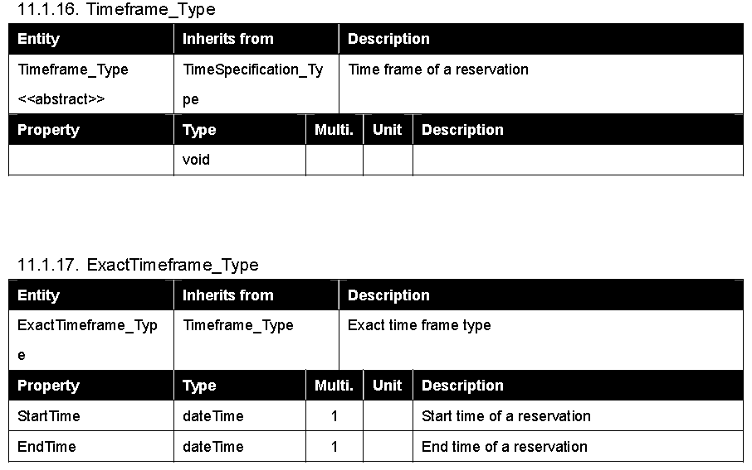
Reservation timeframe parameters (11.1.16-19)

Slide 6
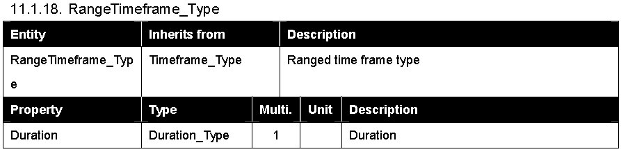
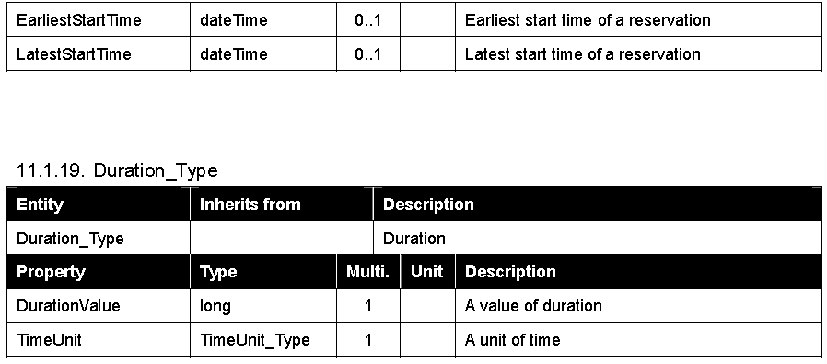
Reservation timeframe parameters (11.1.17-19)

Slide 7
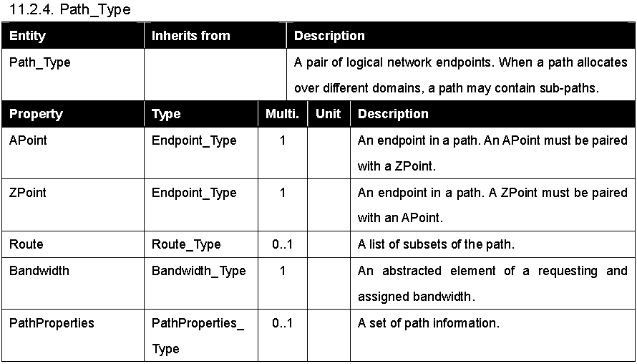
Path specifiction (11.2.4)

Slide 8
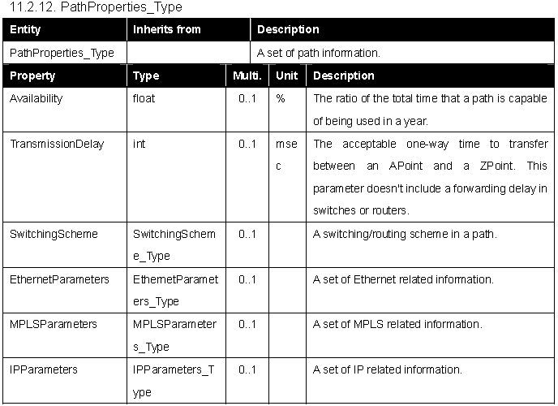
PathProperties (11.2.12)

Slide 9
Other network related parameters
MediaTypeName
  IANA-MAU-MIB: b10GbaseER, b1000BaseLX10 etc.
SwitchingScheme
  LAMBDA, ETHERNET, ATM, MPLS, IP
EthernetParameters
  MTU, VLANTagID, CoS
MPLSParameters
  LSPID, Exp
IPParameters
  Loss, Error, Jitter, Latency….
NetworkResourceSLADocument

