Slide 1

Gigi Karmous-Edwards
gigi@mcnc.org
GLIF/NLR
GGF13
March 15th 2005

Slide 2
Agenda
Update on Grid OBS draft (GOBS)
NLR
GLIF

Slide 3
Grid Optical Burst Switched Networks (GOBS)
Editors:
Dimitra Simeonidou and Rezza Nejab
Contributors:
University of Essex (UK), MCNC (USA), North Carolina State University (USA) , University of Tokyo (Japan), Fujitsu Laboratories (Japan), BUPT (China), University of Gent (Belgium), University of Patras (Greece), AIT (Greece), Politecnico di Torino (Italy), SSSUP (Italy), TUW (Austria)

Slide 4
Grid Optical Burst Switched Networks (First Draft)
Purpose: to suggest solutions towards a realistic optical transport technology using OBS concepts for the emerging and evolving Grid services
  λ services , e-science or data intensive users
  dynamic photonic network for the large and the smaller users
16 institutes and universities have expressed their interest for contribution
  USA, Europe, Asia
  11 contributors have contributed in the draft
First draft is due to be circulated in GHPN list by the April 15th

Slide 5
Draft Outlines
Optical burst switching, a realistic optical transport technology for the near future
Optical burst switching for Grid applications
  Grid-OBS network elements
  Reliable transport & control technology for Grid-OBS
  QoS provisioning in Grid-OBS networks
  Security issues in Grid-OBS networks
Definition of Grid services for optical burst switching
Advanced network concepts and solutions - programmable, active, self organised Grid OBS network
Open for contributions
  Express interest to: ghpn-wg@gridforum.org, or dsimeo@essex.ac.uk

Slide 6
What is National Lambda Rail?
Not a single network but a set of facilities, capabilities and services to build both experimental and production networks at various layers, allowing members to acquire dedicated (project specific) facilities or shared (community specific) facilities as appropriate.
NLR is lighting the first fiber pair with an optical Dense Wavelength Division Multiplexing (DWDM) network capable of transmitting 32 or 40 simultaneous light wavelengths or lambdas. Each of these wavelengths is capable of transmitting 10 gigabits per second.

Slide 7
National Lambda Rail
Mission statement
Putting the Promise of Experimental Network Infrastructure into the Hands of Our Nation's Scientists and Researchers
National LambdaRail (NLR) is a major initiative of U.S. research universities and private sector technology companies to provide a national scale infrastructure for research and experimentation in networking technologies and applications.
NLR aims to catalyze innovative research and development into next generation network technologies, protocols, services and applications.

Slide 8
NLR Footprint & PoP Types – Phase 1 and 2
SEA
POR
BOI
SYR
STA
NYC
OGD
DEN
PIT
SVL
SLC
KAN
CHI
CLE
WDC
RAL
LAX
ALB
TUL
PHO
SAN
ATL
ELP
DAL
PEN
JAC
SAA
BAT
HOU
NLR owned fiber
Managed waves
PoP for primary connection point by a member (“MetaPoP”)
PoP needed because of signal regeneration requirements
but can also be used for secondary connection by a member
PoP established by NLR for members regional needs
PoP established at exchange points
NLR WaveNet, FrameNet & PacketNet PoP
NLR WaveNet & FrameNet PoP
NLR WaveNet PoP

Slide 9
How will we as a community use NLR?
  Two categories of users:
  Black box user - Application and Middleware researchers needing high-speed network to transfer data to and from different parts of the Nation
    At SC2004 - all point-to-point connections GigE
  Gray (combination of black and white parts) Box user- Network Researcher
    part of the box will be black (or none)
    The rest will be white - experiment with network protocols and control plane
      Different layers in the stack

Slide 10
Challenges for NLR
Educating the user community on access to high capacity lambdas for point-to-point usage
For black and gray box users - we need a lambda scheduler
  John Towns working on that
Need more infrastructure for layer one network experimentation (all-photonic switches)

Slide 11
What is GLIF?
It is a world-scale Lambda-based Laboratory for application and middleware development on emerging LambdaGrids, where applications rely on dynamically configured networks based on optical wavelengths.
GLIF was established at the third annual LambdaGrid Workshop organized by Kees Neggers of SURFnet and Cees de Laat of the University of Amsterdam, and hosted by NORDUnet at their annual conference in Reykjavik, Iceland, in August 2003.
In Reykjavik with 33 participants from Europe, Asia and North America it was agreed to continue under the name:
GLIF: Global Lambda Integrated Facility

Slide 12
What is GLIF?
Cont’d
GLIF is a collaborative initiative among worldwide NRENs, consortia and institutions with lambdas, as such GLIF is clearly positioned on the demand side of the market
GLIF is a world-scale Lambda-based Laboratory to facilitate application and middleware development
GLIF will be managed as a cooperative activity
WWW.GLIF.IS will be the home for all interested in the GLIF activities
    Courtesy of both C/K ees(s)

Slide 13
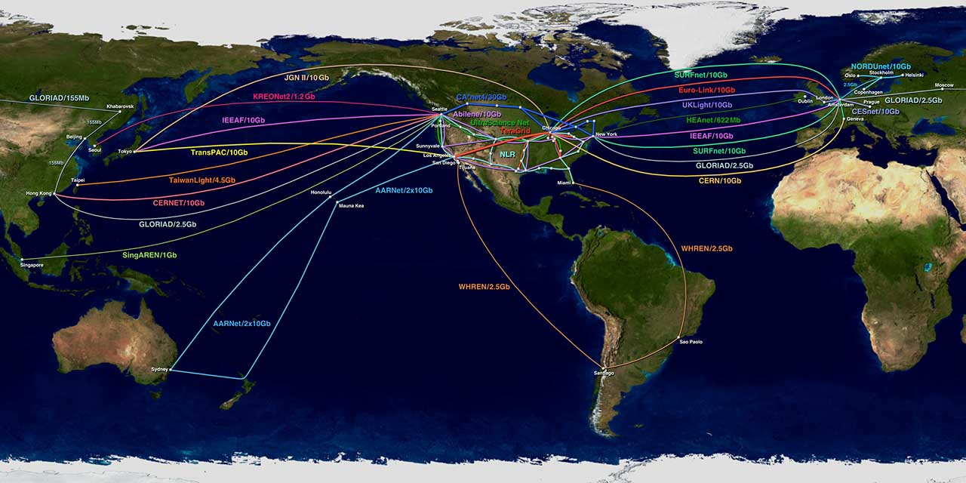
Global Lambda Integrated Facility
World Map – December 2004
Predicted international Research & Education Network bandwidth, to be made available for scheduled application and middleware research experiments by December 2004.
www.glif.is
Visualization courtesy of Bob Patterson, NCSA.

Slide 14
GLIF today
GLIF is an open community
GLIF has participants, not members
GLIF “glues” together the networks and resources of its participants
TERENA to serve as the GLIF Secretariat
Appropriate to their mission and the spirit of community cooperation, GLIF participants implemented a “lightweight” governance structure.
    Courtesy of both C/K ees(s)

Slide 15
GLIF working groups
Governance and Growth
Research and Applications
Technical Issues
Control Plane and Grid Integration
    Courtesy of both C/K ees(s)

Slide 16
GLIF Control Plane and
Grid Integration working group
Mission
To agree on the interfaces and protocols that talk to each other on the
control planes of the contributed Lambda resources. People working in this
field already meet regularly in conjunction with other projects, notably the
NSF-funded OptIPuter and MCNC Controlplane initiatives.
several key areas we need to focus on.
-Define and understand real operational scenarios
-Defining a set of basic services:
*precise definitions
*developing semantics the whole community agrees to
-Interdomain exchange of information
*determine what information needs to be monitored
*how to abstract monitored information to share
-Determine what existing standards are useful vs. where Grid requirements
are unique and new services and concepts.
* how do we standardize mechanisms and protocols that are unique to the Grid community
*Define a Grid control plane architecture
*Work closely with E-science applications to provide vertical integration

Slide 17
GLIF 5th Annual Workshop
The name of the list is controlplane@glif.is
To subscribe, people should send an email to majordomo@glif.is with the
following text:
subscribe controlplane
, USA,
i
Grid 2oo5
T H E G L O B A L L A M B D A I N T E G R A T E D F A C I L I T Y
September 26-30, 2005
University of California, San Diego
California Institute for Telecommunications and Information Technology [Cal-(IT)²]
United States

Slide 18
One Definition of Control Plane
“Infrastructure and distributed intelligence that controls the establishment and maintenance of connections in the network, including protocols and mechanisms to disseminate this information; and algorithms for engineering an optimal path between end points.”
Draft-ggf-ghpn-opticalnets-1

Slide 19
Another definition of Optical
Control plane
Moving centralized Network management functions (FCAPS) down to the network elements in a distributed manner…
  This speeds up reaction time for most functions
  Reduces operational time and costs
  Allows the optical network to be more agile
  Interacts with Grid middleware

Slide 20
Optical Control Plane Research Areas
Advanced Optical technology architectures -OPS, OBS
Optical connection signaling and provisioning
Optical layer Recovery (protection and Restoration)
Layer interactions - optical interacting w/ transport protocol layer
Optical network performance monitoring, metrics and analysis
Resource availability monitoring (network, CPU, storage)
Security - AAA -
Resource discovery
Topology state information dissemination
Intra-domain and Inter-domain Routing
Centralized vs. Distributed control functionality
OGSA integration and WEB services
Interaction and coordination with other Grid resources - CPU, Storage
Advanced resource reservation

Slide 21
Optical Control Plane initiatives
Many Global initiatives have been discussed at
“International Optical Control Plane for the Grid Community” Workshops:
www.mcnc.org/mcncopticalworkshop/nov04/

Slide 22
CALL FOR PAPERS
GridNets 2005
www.gridnets.org
Co-located with BroadNets
Boston October 6th and 7th, 2005
The Thursday and Friday before
GGF in Boston!

Slide 23
CALL FOR PAPERS
IEEE Communications Magazine
Feature Topic
Optical Control Plane for Grid Networks: Opportunities, Challenges and the
Vision
http://www.comsoc.org/pubs/commag/cfpcommag306.htm
Guest Editors: Gigi Karmous-Edwards and Admela Jukan
Manuscripts due: June 20, 2005

