Slide 1
GRAAP Futures - Proposal
Wolfgang Ziegler
GRAAP-WG #3
28-30 June, 2005 (GGF14 in Chicago)

Slide 2
GGF Intellectual Property Policy
All statements related to the activities of the GGF and addressed to the GGF are subject to all provisions of Appendix B of GFD-C.1, which grants to the GGF and its participants certain licenses and rights in such statements. Such statements include verbal statements in GGF meetings, as well as written and electronic communications made at any time or place, which are addressed to any GGF working group or portion thereof,
Where the GFSG knows of rights, or claimed rights, the GGF secretariat shall attempt to obtain from the claimant of such rights, a written assurance that upon approval by the GFSG of the relevant GGF document(s), any party will be able to obtain the right to implement, use and distribute the technology or works when implementing, using or distributing technology based upon the specific specification(s) under openly specified, reasonable, non-discriminatory terms. The working group or research group proposing the use of the technology with respect to which the proprietary rights are claimed may assist the GGF secretariat in this effort. The results of this procedure shall not affect advancement of document, except that the GFSG may defer approval where a delay may facilitate the obtaining of such assurances. The results will, however, be recorded by the GGF Secretariat, and made available. The GFSG may also direct that a summary of the results be included in any GFD published containing the specification.

Slide 3
Future work in GRAAP
WS-Agreement
Mid July: Finalise Spec & submit to Editor
End September: Work on comments
GGF 15: Final work on WS-Agreement 1.0
October: Submit version 1.0 to editor
Then: Start implementing
Gather experience & work on WS-Agreement 1.x

Slide 4
Future work in GRAAP
Defining the Negotiation Protocol
GRAAP has kicked-off with this activity
We already did some work before focussing on the Agreement
Is a standardised way to negotiate between resource/service providers and consumers
Several requests from the community to have such a protocol
WS-Negotiation plus WS-agreement =
WS-Reservation
Update Charter

Slide 5
Use-Case: Co-allocation (VIOLA project)
Co-allocating different resources/services in most cases may need negotiation
  Negotiating a common time-slot may need several steps to be accomplished
  Resource providers won’t publish resource availability
  -> careful negotiation necessary to match with request

Slide 6
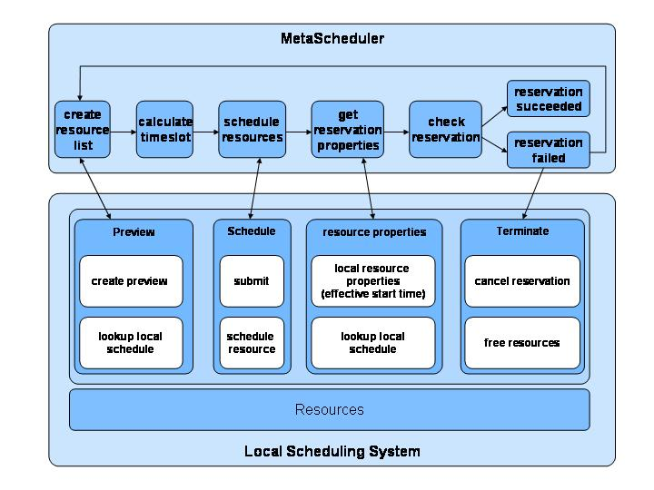
Allocation Agreement Protocol
Notes:
This figure shows the basic allocation agreement protocol, as it has been implemented in our prototype. For a meta application, local and meta scheduler implement the protocol by using a defined set of states.
For a local EASY, the allocation algorithm and the previewer have been changed to support this protocol for a meta-type job. For the meta EASY, in addition to submit and release operation, only a previewer had to be implemented, which keeps control of the states of all local schedulers involved. The goal is to agree with the local schedulers in the allocation of resources at the same time.
M-submit calls a specialized L-submit operation which sets the initial Accepted/Rejected state. A local preview will calculate a proposed „CouldRun“ time, which the meta scheduler will change to „ShouldRun“ (this uses the start time option of local scheduler) as result of analyzing all meta components. The local scheduler will agree with a „WillRun“ answer.
The „ReadyToRun“ state, set by the local scheduler, indicates that local allocation is being prepared. The local resources are allocated, once the meta scheduler has found common agreement by indicating the „Go“ state.

Slide 7
Use-case: Changing Agreements
Agreements may have to change
  Availability of one or more resources changes
  -> the common timeslot may/has to be re-negotiated
  The reservation time is over but the resources/services are still needed to complete important work
  -> negotiation on extension of agreement necessary

Slide 8
Suggested Next Steps
Revisit the negotiation protocol use-case document
Update it & add new use-cases, send it to the editor as informal document
Pass it to Craig Lee for the use-case library
Start work on protocol

Slide 9
Milestones
GGF 15 Use-case document ready
Oct 2005 Document sent to editor & use-case library
GGF 16 First draft of protocol (text)
GGF 18 First draft of Protocol (wsdl)
GGF 20 Protocol ready to be sent to the editor

Slide 10
Make it happen
Volunteers to work on the protocol?

