Slide 1
The VIOLA MetaScheduling Service (MSS)
Co-allocating Arbitrary Types of Resources
Wolfgang Ziegler, Oliver Waeldrich
GRAAP-WG
10. September, 2006 (GGF18 in Washington)

Slide 2
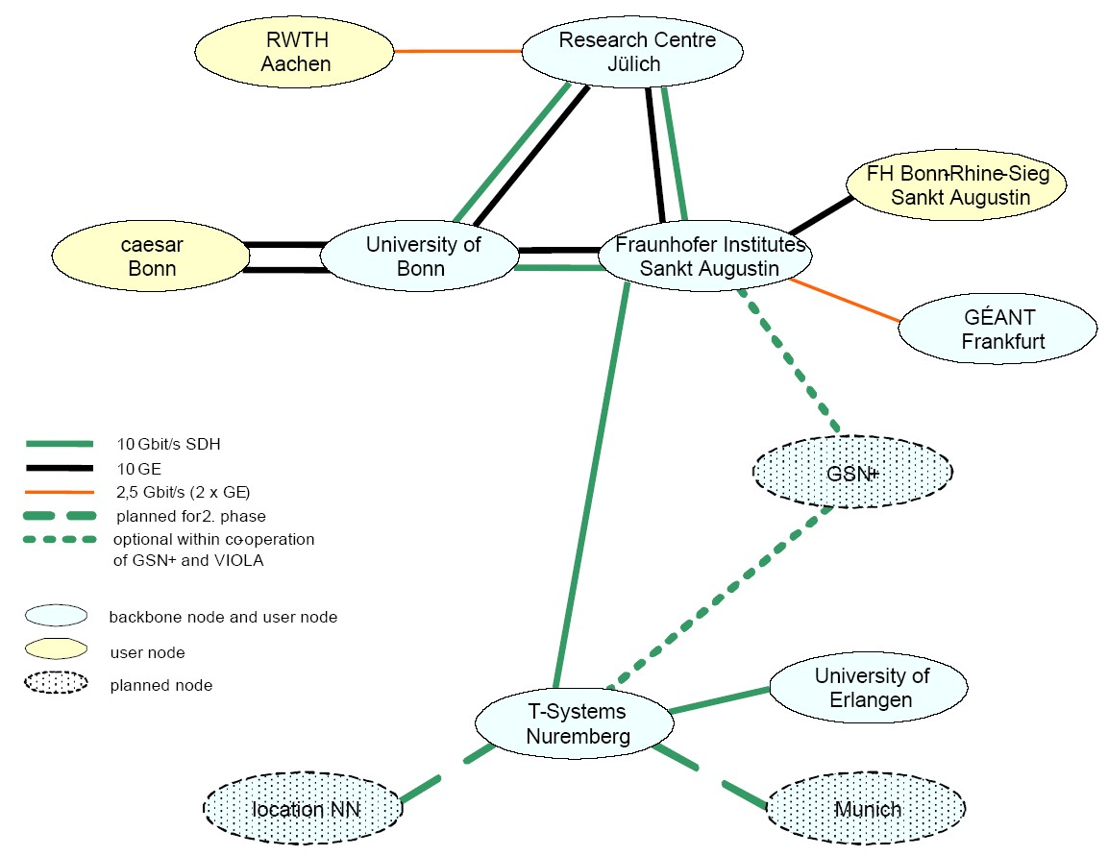
VIOLA Network
VIOLA-Networking
  Deployment and operation of the testbed,
  test of advanced network equipment
  Signaling and reservation
    bandwidth- and
    QoS-reservations
    in the network
    interfaces for user-driven
    reservation:
    immediate and in advance

Slide 3
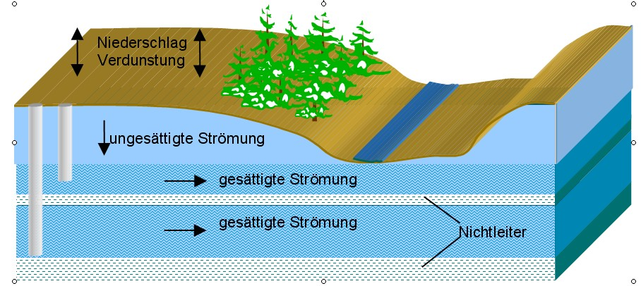
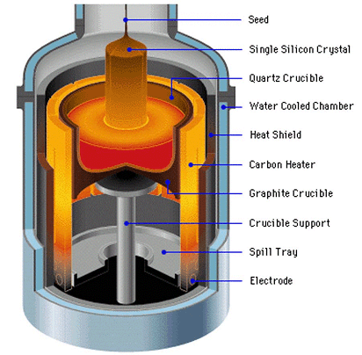
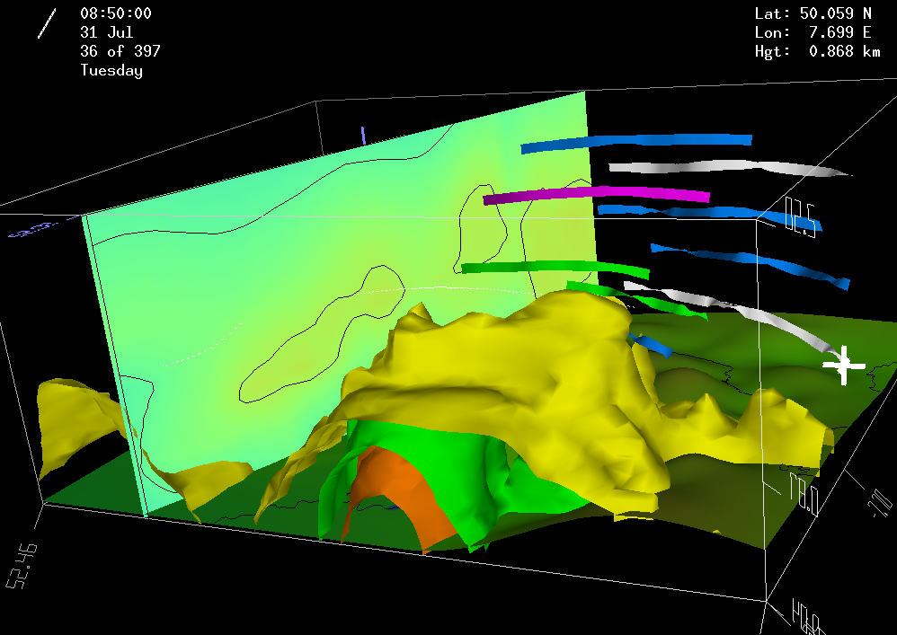

VIOLA Subprojects:
Distributed Parallel Simulations
VIOLA-Applications (Multi-physics, Tele-collaboration)
MetaTrace: Simulation of pollutant transport in groundwater with distributed SMP-Clusters (FZJ)
TechSim: Distributed simulation of crystal growth and biosensors (Caesar)
AMG-OPT: Parameter optimization and optimal algebraic solvers – Mechanical structure (SCAI)
KoDaVis-Atmo: Collaborative visualization of huge atmospheric datasets (FZJ)

Slide 4
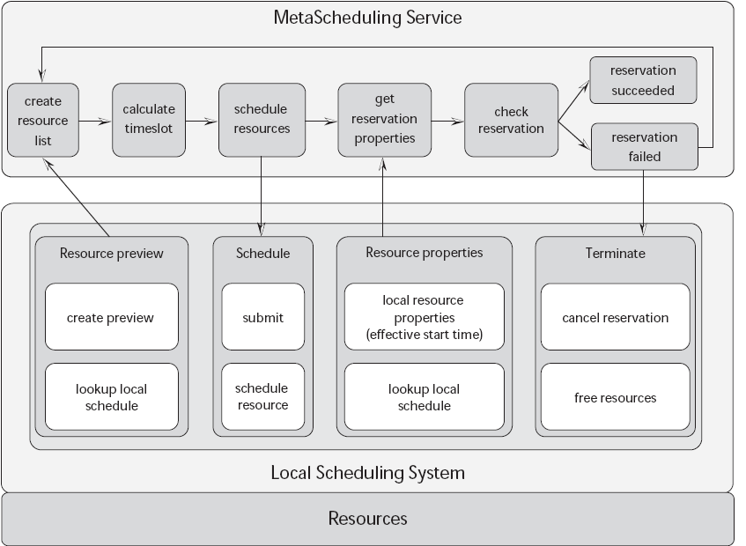
VIOLA MSS - Allocation Agreement Protocol
MSS negotiation process using local RMS advance reservation capability
Notes:
This figure shows the basic allocation agreement protocol, as it has been implemented in our prototype. For a meta application, local and meta scheduler implement the protocol by using a defined set of states.
For a local EASY, the allocation algorithm and the previewer have been changed to support this protocol for a meta-type job. For the meta EASY, in addition to submit and release operation, only a previewer had to be implemented, which keeps control of the states of all local schedulers involved. The goal is to agree with the local schedulers in the allocation of resources at the same time.
M-submit calls a specialized L-submit operation which sets the initial Accepted/Rejected state. A local preview will calculate a proposed „CouldRun“ time, which the meta scheduler will change to „ShouldRun“ (this uses the start time option of local scheduler) as result of analyzing all meta components. The local scheduler will agree with a „WillRun“ answer.
The „ReadyToRun“ state, set by the local scheduler, indicates that local allocation is being prepared. The local resources are allocated, once the meta scheduler has found common agreement by indicating the „Go“ state.

Slide 5
MetaScheduler - Integration in UNICORE
Vsite A
Vsite B
UNICORE Client sends request to MetaScheduler (WS-Agreement template)
MetaScheduler negotiates earliest time to run this job, requests the reservation of the requested resources and returns the WS-Agreement with additional Status, ID
UNICORE Client creates Abstract Job Object (AJO) and sends it to the Primary Network Job Supervisor (NJS)
NJS incarnates the AJO according to the information in the AJO and the UIDB, forwards it to the local Target System Interface (TSI) and sends the AJO to all other NJSs
TSI creates the entry for the Meta-Job in the UNICORE Job Queue, and creates the UNICORE wrapper in the User-directory
Scheduler triggers job at start time
UNICORE Client
Submission of the
abstract job object
(AJO)
MetaScheduling
Request and
Scheduler URIs
UNICORE
Gateway
UNICORE
Gateway
MetaScheduling
Response
(WS-Agreement)
NJS
NJS
Primary NJS
MetaScheduler
TSI
TSI
TSI
Ressource
Negotiation and
Reservation
Local
Scheduler
Local
Scheduler
Local
Scheduler
Job Queue
Job Queue
Job Queue
Job
invocation
Adapter
Adapter
Adapter

Slide 6
MSS
Running MetaMPICH Jobs
Lokale Site
UNICORE
Wrapper
UNICORE: Submission of Job Data
and Generation of Job Wrapper
UNICORE generates UNICORE Wrapper with Job Data
Local adapter generates local wrapper for the MetaScheduler and for the execution of the UNICORE Job
MSS submits Job with MSS Wrapper through local adapters
Local Scheduler may generate Wrapper for the Execution of the MSS Wrapper
MetaScheduler
Wrapper
Generation
Local
Wrapper
Local
Scheduler
Reservation
Request for
MetaScheduling
Generation
and
Execution
Adapter
Local Wrapper
MetaScheduler Wrapper
UNICORE Wrapper

Slide 7
Network Resource Management System
Submit of Reservation with QoS specification and acknowledgement of reservation
Network
Resource Manager
1.) Reservation of required Resources
Submit of a Reservation to the Network Resource Manager
Acknowledgement of Reservation
2.) Bind of IP-Addresses at Run-time
IP-Addresses are published at run-time of the job through the local Adapter
Bind of the IP-Addresses by the Network Resource Manager
Without explicit Bind the QoS Parameters for the Site-to-Site Interconnection are used
Bind of IP-Addresses at run-time
MetaScheduler
Local
Scheduler
Site A
R
Site n
Netz
R
R
Site B
2 GB/s
1 GB/s

Slide 8
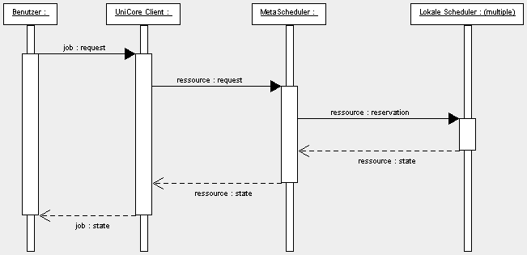
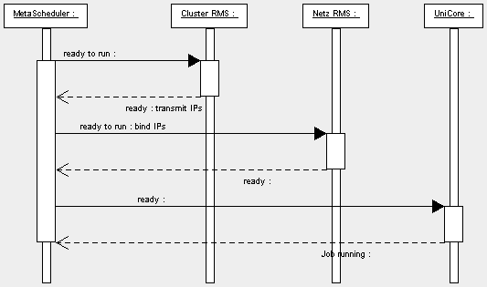
Scheduling of Network Resources
User :
UNICORE Client:
MetaScheduler:
Local Scheduler : multiple
Reservation
User describes Job Request with UNICORE Client
Resolution of URIs of Resources und User names
UNICORE client sends Resource Request to MetaScheduler (WS-Agreement template)
MetaScheduler negotiates possible time for the Job and requests reservation of the Resources (Network, Nodes,…)
MetaScheduler sends EPR of the created WS-Agreement back to UNICORE Client
MetaScheduler :
Cluster RMS :
Network RMS:
UNICORE :
Start of Job
At run-time the individual RMS know IP Addresses of local nodes that will be used for the job
The MetaScheduler requests Status und IP Addresses from the local RMS and generates the global list of IP-Addresses
Request of status of the Network RMS for the Job (ready to run)
Dynamic Binding of IP-Addresses by Network RMS
Generation of the global MetaMPI configuration and transfer to the individual sites

Slide 9
Network RMS ARGON
Supported Features
Immediate Reservation / Advance Reservation
Reservation: within the „book ahead“-Timeframe (i.e. the timeframe the system manages reservations in future)
Class: Determines the QoS-Level
Network User: id of user the QoS shall be guaranteed
Data for a Reservation:
  Job ID, Start-time, Duration, Network user
  List of 3-Tupels {Start-/Endpoint, Class}
reservations
available bandwidth
t
current
time
book ahead
time

Slide 10
Applikation Interface of the Network Resource Manager
Necessary Functions:
ResourceAvailableAt (Preview)
  Returns time slots when a Resource (End-to-end connection with QoS Level) will be available
Submit
  Start-time, Duration, Class, Start-/End-pointt (Site), User,
  Returns a Resource Identifier (RESID)
Cancel <RESID>
  Resource Manager frees the Resources attached to Resource Identifier (RESID)
Status <RESID>
  Returns state of a connection (submitted, active, released, Class, start-time, end-time, user, etc.)
Bind <RESID>
  Binding of IP-Addresses of nodes
Network
Resource Manager
Ressource
AvailableAt
Submit
Cancel
Status
Bind

Slide 11
MetaScheduler – UNICORE Client Interface

Slide 12
WS-Agreement based negotiation
Our problem: WS-Agreement does not provide native support for agreement negotiation
Our goal: use WS-Agreement throughout the whole negotiation process
Our idea: use different agreement types to achieve reliable co-allocation of resources
Declaration of Intention Agreement
  Intention to provide
  in principle unreliable, short living
  may be changed by the provider to reflect current resource availability
  no costs, rewards, or penalties associated
Preparation Agreement
  restricted lifetime
  more reliable than DoIA
  represents a pre-reservation of resources
  costs, rewards, and penalties may be associated with (depending on charging policy)
Commit Agreement
  References PA
  Confirms that a resource user is going to use the resources pre-reserved in PA
  Costs, rewards, and penalties become effective

Slide 13
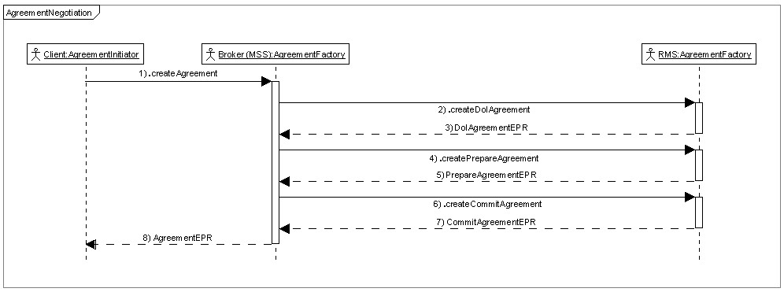
WS-Agreement based negotiation
WS-Agreement based negotiation process

Slide 14
Thank you for your attention!

