Slide 1

Grid Scheduling Architecture
GSA-RG working session
Thursday, 28 February, 2008
Boston, US

Slide 2

OGF IPR Policies Apply
“I acknowledge that participation in this meeting is subject to the OGF Intellectual Property Policy.”
Intellectual Property Notices Note Well: All statements related to the activities of the OGF and addressed to the OGF are subject to all provisions of Appendix B of GFD-C.1, which grants to the OGF and its participants certain licenses and rights in such statements. Such statements include verbal statements in OGF meetings, as well as written and electronic communications made at any time or place, which are addressed to:
    the OGF plenary session,
    any OGF working group or portion thereof,
    the OGF Board of Directors, the GFSG, or any member thereof on behalf of the OGF,
    the ADCOM, or any member thereof on behalf of the ADCOM,
    any OGF mailing list, including any group list, or any other list functioning under OGF auspices,
    the OGF Editor or the document authoring and review process
Statements made outside of a OGF meeting, mailing list or other function, that are clearly not intended to be input to an OGF activity, group or function, are not subject to these provisions.
Excerpt from Appendix B of GFD-C.1: ”Where the OGF knows of rights, or claimed rights, the OGF secretariat shall attempt to obtain from the claimant of such rights, a written assurance that upon approval by the GFSG of the relevant OGF document(s), any party will be able to obtain the right to implement, use and distribute the technology or works when implementing, using or distributing technology based upon the specific specification(s) under openly specified, reasonable, non-discriminatory terms. The working group or research group proposing the use of the technology with respect to which the proprietary rights are claimed may assist the OGF secretariat in this effort. The results of this procedure shall not affect advancement of document, except that the GFSG may defer approval where a delay may facilitate the obtaining of such assurances. The results will, however, be recorded by the OGF Secretariat, and made available. The GFSG may also direct that a summary of the results be included in any GFD published containing the specification.”
OGF Intellectual Property Policies are adapted from the IETF Intellectual Property Policies that support the Internet Standards Process.
Notes:
IPR Notices Note Well for OGF meetings

Slide 3
Outline
Quick introduction to GSA
  Status and perspectives
Grid Scheduling Requirements: Requirements and Recommendations
  Goal of the GWD-I
  Discussion of document structure
  Recommendations
Where does it all lead to? Interoperability!
  Existing work
  Next steps

Slide 4
GSA Overview
In general: Grid Scheduling Architecture
Overall objectives
  Foster interoperation of Grid schedulers
  Drawing the OGF landscape wrt scheduling based on existing OGF activities
    By providing input to existing WGs
    By spawning new WGs for non-covered issues
Documents
  Grid Scheduling Architecture Requirements
  Grid Scheduler Interoperation
  Scheduling Description Language

Slide 5
Re-focus
GSA-RG “drifted” a bit over the last OGFs
  Long history of “Requirements” document
  Interop. missed close link to use case work
Therefore RE-FOCUS …
  … documents …
  … objectives …
… towards support for the Grid scheduling community within (and outside) OGF

Slide 6
Document Status
Grid Scheduling Use Cases
  GFD.64
Grid Scheduling Architecture – Requirements
  Major refactoring
  More details and discussion later
Grid Scheduling Interoperation
  No document yet
  JSDL Interop. Profile draft
  Scheduling Description Language draft

Slide 7
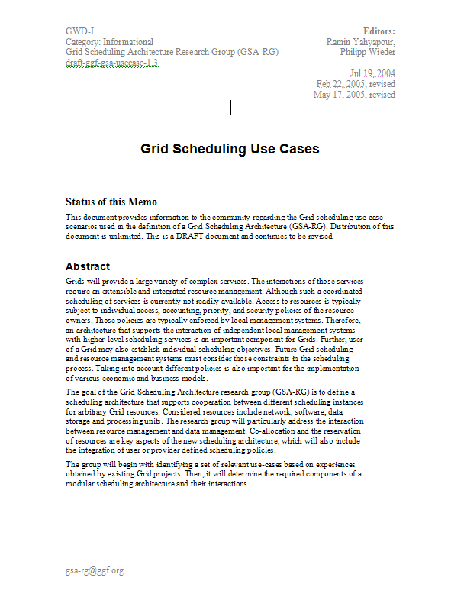
Roadmap
Use case document
Foundation
Doc. 1: GFD.64
Common scheduling
scenarios
Describe requirements
for scheduling architecture
Ongoing process
for further revisions
Gap analysis and
recommendations per scenario
Doc 2: Requirements &
Recommendations
Ongoing process
for different scenarios
Scheduling interoperation
Doc 3: Scheduling
Interoperation

Slide 8
Interop. Scenario I
Start simple: Basic HPC job scheduling use case
  Submission
  Getting advice from RSS where to execute
  Execute in BES container
  Write out UR
Questions
  How to submit initially? BES?
Timeline: ?

Slide 9
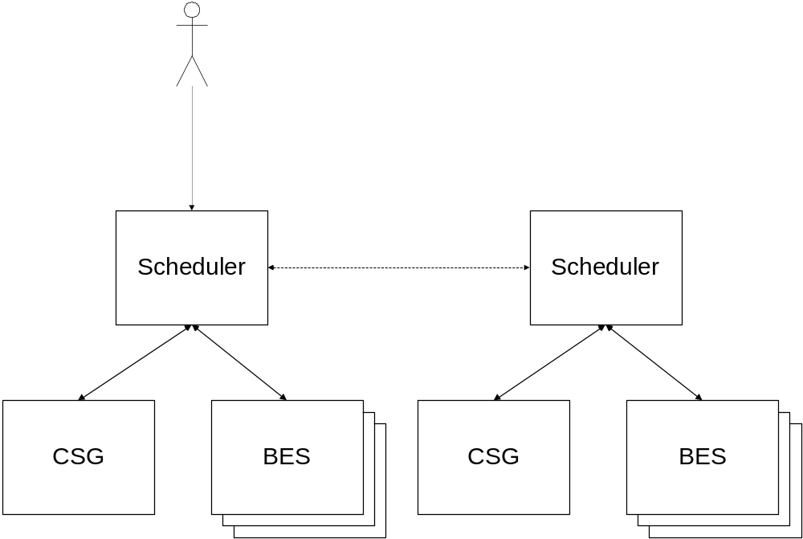
Scenario I

Slide 10
Interop. Scenario II
Scenario I plus WS-Agreement
  Submission
  Getting advice from RSS where to execute
  Negotiate and agree SLA
  Execute in BES container
  Write out UR
Questions
  Can GRAAP interop. be re-used?
Timeline: ?

Slide 11
Interop. Scenario III+
Co-allocation
Work flow scheduling
Inclusion of data scheduling into one of the above
…

Slide 12
To be discussed
Submission interface to scheduler?
Interface between schedulers ?
Interface to execution host?
Optional specifications (GLUE, WS-Agreement, …)?
Does it make sense to actually implement Scenario 1?
How to find out about other schedulers?
Implementation candidates (and volunteers)?

Slide 13
Future steps
Towards OGF 23
  Finalise use case descriptions
  Come up with recommendations for the core set of standards
After OGF 23
  Decide which scenario to implement …
  … and implement it
  Provide feedback and recommendations
  …

Slide 14
Full Copyright Notice
Copyright (C) Open Grid Forum (2007, 2008). All Rights Reserved.
This document and translations of it may be copied and furnished to others, and derivative works that comment on or otherwise explain it or assist in its implementation may be prepared, copied, published and distributed, in whole or in part, without restriction of any kind, provided that the above copyright notice and this paragraph are included on all such copies and derivative works.
The limited permissions granted above are perpetual and will not be revoked by the OGF or its successors or assignees.
Notes:
OGF Full Copyright Notice if necessary

