Slide 1
Data Disclosure Technology for the Grid
Tyrone W A Grandison PhD
Notes:
Intelligent Information Systems Group, IBM Almaden Research, 650 Harry Road, San Jose, CA, 95110, USA
Contact: Tyrone Grandison (tyroneg@us.ibm.com)

Slide 2
Data Disclosure
The release of information for processing
Security & privacy concerns critical for Grid
One way to address this:
  Hippocratic Databases

Slide 3
GOAL
Create a new generation of information systems that protect the privacy, security, and ownership of data while not impeding the information flow.
Disclosure Control
Database-enforced disclosure control at cell-level of an organization’s data policy and user preferences
Privacy Preserving Data Analytics
Preserve privacy at the individual level, while still building accurate data mining models at the aggregate level
Sovereign Information Sharing
Selective, minimal sharing across database separated due to statutory, competitive or security reasons
Compliance Auditing
Audit if data has been disclosed in violation of the specified policy to help enterprises cope with increasing pace of legislations
Notes:
Speaker Notes:
Hippocratic Database (HDB) technology is focused on how to enable businesses to perform standard data operations, in a manner that is compliant with the data disclosure policy in place.
Privacy, security, organizational and compliance policies are all instances of disclosure policies.
At the conceptual level and for a privacy scenario, HDB technology consists of components that allow an organization to provide:
A mechanism to enable privacy-compliant data release
A mechanism that allow for privacy-preserving data mining/analytics
Middleware that allows for privacy-preserving collaborations between entities with differing privacy constraints
Technology that allows them to ascertain who disclosed information.

Slide 4
What is Hippocratic Database technology?
Technology that facilitates automated non-intrusive, high-performance, fine-grained data disclosure (at the database level).
Functional Components:
Active Enforcement – enabling the database to reveal only data compliant with policy.
Eunomia Compliance Auditing – enabling verification and monitoring of compliance with policy (e.g., legislation, privacy, security).
Sovereign Information Integration – enabling two parties to securely and privately share common information without a third party involved.
Order Preserving Encryption – enabling the protection of data from medium theft, while allowing encrypted data to be usable.
Watermarking Databases – deterring data theft and asserting ownership of pirated copies.
Privacy Preserving Data Mining – preserving privacy at the individual level, while enabling the construction of accurate data mining models at the aggregate level.
BA k-anonymity – enable data release, while preventing linking attacks and preserving data integrity
Notes:
Speaker Notes:
This highlights the value proposition for all the HDB components.
Automated means that once the policy is in place, the eco-system magically works. However, now everything is done in a manner compliant with one’s disclosure policy.
Non-intrusive means that because this is middleware that this technology does not intrude/affect your application code or your data system.
High-performance means that we recognize the clients’ need for speed. For example, the Active Enforcement component improves query processing speed in the average case and only suffers a 5-10% performance hit in the worst case.
Fine-grained refers to the fact that we focus on cell-level disclosure, which is functionality that no one else offers today (Apr 20, 2005). Others provide row or column level access controls, which are not sufficient for complex disclosure policies (e.g. in the privacy space, Mary wants only her name and age to be disclosed to a market research firm, all her other information should be disclosed)
At the database level refers to the fact that this technology can sit either right on top of or inside of the data system and thus abstract away the disclosure issue from applications.
It should be noted that each of these HDB functional components can be used independently or packaged together to address the particular client pain-point.

Slide 5
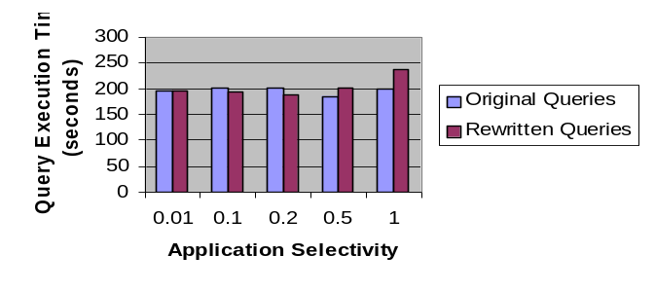
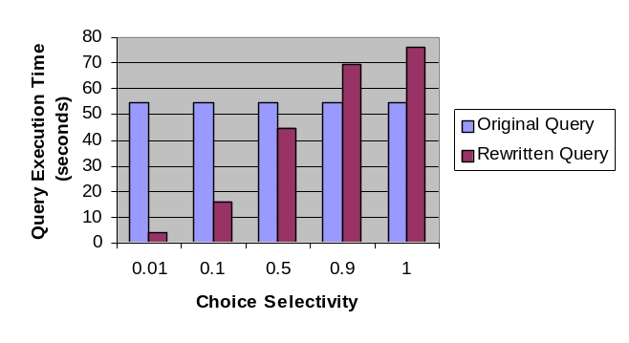

Active Enforcement
Database-enforced disclosure control at cell-level of an organization’s data policy and user preferences.
Applications do not require any modification.
Database agnostic, does not require any change in the database engine.
Implementation intercepts and rewrites incoming queries to factor in policy, user choices, and context (e.g. purpose).
Rewritten queries benefit from all the optimizations and performance enhancements provided by underlying engine (e.g. parallelism).
Demo available for HIPAA enforcement
# | Name | Age | Phone
1 | Adams | 25 | 111-1111
3 | - | - | 333-3333
4 | Daniels | 40 | -
10 million, choice selectivity = 1.0
Policy
Creation
User Preferences
& Data Collection
Application Data
Retrieval
Installation
Policy
Parser
Negotiation
User Preferences
& Policy Matching
Enforcement
SQL Interface
DATABASE
Installed Policy
User Data
Notes:
Speaker Notes:
This slide describes the HDB Active Enforcement component.
The diagram at the bottom right hand corner illustrates the entire process, from the specification of policy to the

Slide 6
Compliance Auditing
Problem: Many laws require companies to account for their handling of sensitive or secured information.
How does a company ensure and show that it has complied with such requirements?
  Existing database systems and tools provide only rudimentary query logging which is rarely sufficient.
  Other add-on applications can also log query results, but this has a huge performance impact and still does not reveal certain disclosures of sensitive information.
Solution: An efficient auditing system that tracks disclosures down to the cell level in the database.
  Allow determining precisely who accessed designated data, for what purpose, when it was accessed, and what changes were made.
  With minimal impact on the company’s operations.

Slide 7
Eunomia In-House Model
Query with purpose, recipient
IDs of log queries having accessed data specified by the audit query
Audit query
Updates, inserts, delete
Database
Layer
Audit if some data has been disclosed in violation of the specified policy
Audit queries specify what potential data disclosures need monitoring
Identify logged queries which have accessed the compromised data
Analyze circumstances of the violation
Make necessary corrections to procedures, policies, security
Audit
Database triggers track updates to base tables
Database
Layer
Data
Tables
Backlog
Generate audit record
for each query
Query Audit Log
ID | Timestamp | Query | User | Purpose | Recipient
1 | 2004-02… | Select … | Jane | Current | Ours
2 | 2004-02… | Select … | John | Telemarketing | public
Notes:
Database results are not logged; queries are kept. Updates are kept in the backlog. 90% reads to 10% writes. But can reconstruct state of database at any time. Smaller footprint.

Slide 8


Eunomia Outsourced Model
Company
Audit reports, alerts
Eunomia Audit Application
Data Reconstruction
Almost zero Impact on Current Process
Secure communication
DB2
Query Logs
Backlog Tables
Queries
Recovery log

Slide 9
Sovereign Information Sharing
Separate databases due to statutory, competitive, or security reasons.
  Selective, minimal sharing on need-to-know basis.
Example: Among those who took a particular drug, how many had adverse reaction and their DNA contains a specific sequence?
  Researchers must not learn anything beyond counts.
Algorithms for computing joins and join counts while revealing minimal additional information.
Minimal Necessary Sharing
R
R  S
R must not know that S has b & y
S must not know that R has a & x
a
u
v
x
R  S
u
v
S
b
u
v
y
Count (R  S)
R & S do not learn anything except that the result is 2.

Slide 10
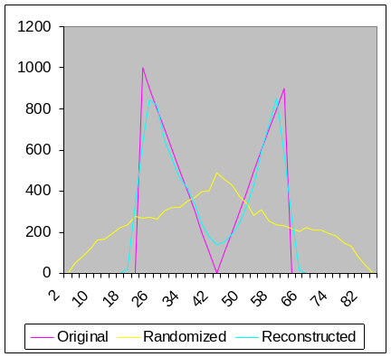
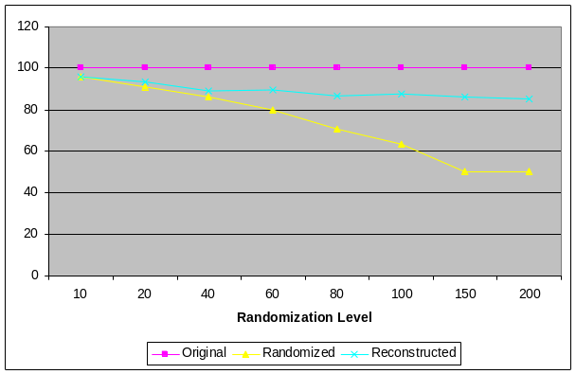
Privacy Preserving Data Mining
Alice’s age
Alice’s salary
Bob’s age
Insight: Preserve privacy at the individual level, while still building accurate data mining models at the aggregate level.
Add random noise to individual values to protect privacy.
EM algorithm to estimate original distribution of values given randomized values + randomization function.
Algorithms for building classification models and discovering association rules on top of privacy-preserved data with only small loss of accuracy.
30 | 70K | ...
50 | 40K | ...
Randomizer
Randomizer
30+35
65 | 20K | ...
25 | 60K | ...
Reconstruct
distribution
of Age
Reconstruct
distribution
of Salary
Data Mining Algorithms
Data Mining Model

Slide 11
Conclusion
Data Disclosure will have to address Security and Privacy concerns for Grid applications
There is technology that allows this to be done without impeding information flow.

Slide 12
Technical Papers
R. Agrawal, P. Bird, T. Grandison, J. Kieman, S. Logan, W. Rjaibi. Extending Relational Database Systems to Automatically Enforce Privacy Policies. Proc. of the 21st Int'l Conf. on Data Engineering (ICDE 2005), Tokyo, Japan, April 2005.
R. Bayardo, R. Agrawal. Data Privacy Through Optimal k-Anonymization. Proc. of the 21st Int'l Conf. on Data Engineering (ICDE 2005), Tokyo, Japan, April 2005.
R. Agrawal, J. Kiernan, R. Srikant, Y. Xu. Order Preserving Encryption of Numeric Data. ACM Int’l Conf. On Management of Data (SIGMOD), Paris, France, June 2004.
R. Agrawal, A. Evfimievski, R. Srikant. Information Sharing Across Private Databases. ACM Int’l Conf. On Management of Data (SIGMOD), San Diego, California, June 2003.
R. Agrawal, J. Kiernan, R. Srikant, Y. Xu. An Xpath Based Preference Language for P3P. 12th Int'l World Wide Web Conf. (WWW), Budapest, Hungary, May 2003.
R. Agrawal, J. Kiernan, R. Srikant, Y. Xu. Implementing P3P Using Database Technology. 19th Int'l Conf.on Data Engineering(ICDE), Bangalore, India, March 2003.
R. Agrawal, J. Kiernan, R. Srikant, Y. Xu. Server Centric P3P. W3C Workshop on the Future of P3P, Dulles, Virginia, Nov. 2002.
R. Agrawal, J. Kiernan, R. Srikant, Y. Xu. Hippocratic Databases. 28th Int'l Conf. on Very Large Databases (VLDB), Hong Kong, August 2002.
R. Agrawal, J. Kiernan. Watermarking Relational Databases. 28th Int'l Conf. on Very Large Databases (VLDB), Hong Kong, August 2002.
A. Evfimievski, R. Srikant, R. Agrawal, J. Gehrke. Mining Association Rules Over Privacy Preserving Data. 8th Int'l Conf. on Knowledge Discovery in Databases and Data Mining (KDD), Edmonton, Canada, July 2002.
R. Agrawal, R. Srikant. Privacy Preserving Data Mining. ACM Int’l Conf. On Management of Data (SIGMOD), Dallas, Texas, May 2000.
http://www.almaden.ibm.com/software/quest/Publications/ByDate.html
Notes:
All of the group’s technical papers can be found at:
http://www.almaden.ibm.com/software/quest/Publications/ByDate.html
Active Enforcement
R. Agrawal, P. Bird, T. Grandison, J. Kieman, S. Logan, W. Rjaibi. Extending Relational Database Systems to Automatically Enforce Privacy Policies. Proc. of the 21st Int'l Conf. on Data Engineering (ICDE 2005), Tokyo, Japan, April 2005.
K. LeFevre, R. Agrawal, V. Ercegovac, R. Ramakrishnan, Y. Xu, D. DeWitt. Limiting Disclosure in Hippocratic Databases. 30th Int'l Conf. on Very Large Databases (VLDB), Toronto, Canada, August 2004.
R. Agrawal, J. Kiernan, R. Srikant, Y. Xu. Hippocratic Databases. 28th Int'l Conf. on Very Large Databases (VLDB), Hong Kong, August 2002.
Compliance Auditing
R. Agrawal, R. Bayardo, C. Faloutsos, J. Kiernan, R. Rantzau and R. Srikant. Auditing Compliance with a Hippocratic Database". Proc. of the 30th Int'l Conf. on Very Large Databases (VLDB 2004), Toronto, Canada, August 2004
Sovereign Information Integration
R. Agrawal, D. Asonov, P. Baliga, L. Liang, B. Prost, and R. Srikant "A reusable platform for building sovereign information sharing applications". Proc. of the First Workshop on Databases In Virtual Organizations (DIVO 2004), Paris, June, 2004. [PDF]
R. Agrawal, D. Asonov and R. Srikant. "Enabling Sovereign Information Sharing Using Web Services". Proc. of the ACM SIGMOD Conference on Management of Data, Paris, France, June 2004
R. Agrawal, A. Evfimievski, R. Srikant. Information Sharing Across Private Databases. ACM Int’l Conf. On Management of Data (SIGMOD), San Diego, California, June 2003.
Order Preserving Encryption
R. Agrawal, J. Kiernan, R. Srikant, Y. Xu. Order Preserving Encryption of Numeric Data. ACM Int’l Conf. On Management of Data (SIGMOD), Paris, France, June 2004.
Database Watermarking
R. Agrawal, P. Haas and J. Kiernan. "Watermarking Relational Data: Framework, Algorithms and Analysis". The VLDB Journal, 2003
R. Agrawal, J. Kiernan. Watermarking Relational Databases. 28th Int'l Conf. on Very Large Databases (VLDB), Hong Kong, August 2002.
Privacy-preserving Data Mining
A. Evfimievski, J. Gehrke and R. Srikant. "Limiting Privacy Breaches in Privacy Preserving Data Mining". Proc. of the ACM SIGACT-SIGMOD-SIGART Symposium on Principles of Database Systems, San Diego, California, June 2003
A. Evfimievski, R. Srikant, R. Agrawal, J. Gehrke. Mining Association Rules Over Privacy Preserving Data. 8th Int'l Conf. on Knowledge Discovery in Databases and Data Mining (KDD), Edmonton, Canada, July 2002.
R. Agrawal, R. Srikant. Privacy Preserving Data Mining. ACM Int’l Conf. On Management of Data (SIGMOD), Dallas, Texas, May 2000.
Data De-identification
R. Bayardo, R. Agrawal. Data Privacy Through Optimal k-Anonymization. Proc. of the 21st Int'l Conf. on Data Engineering (ICDE 2005), Tokyo, Japan, April 2005.
General Privacy
R. J. Bayardo and R. Srikant. Technological Solutions for Protecting Privacy. IEEE Computer, 115-118, Sept. 2003
R. Agrawal, J. Kiernan, R. Srikant, Y. Xu. An Xpath Based Preference Language for P3P. 12th Int'l World Wide Web Conf. (WWW), Budapest, Hungary, May 2003.
R. Agrawal, J. Kiernan, R. Srikant, Y. Xu. Implementing P3P Using Database Technology. 19th Int'l Conf.on Data Engineering(ICDE), Bangalore, India, March 2003.
R. Agrawal, J. Kiernan, R. Srikant, Y. Xu. Server Centric P3P. W3C Workshop on the Future of P3P, Dulles, Virginia, Nov. 2002.

