Slide 1

Grid & Virtualization Working Group
OGF21 gridvirt-wg
Erol Bozak, Chair
SAP, Development Architect
Wolfgang Reichert, Co-Chair
IBM, Senior Technical Staff Member
October 2007
Seattle, WA

Slide 2

OGF IPR Policies Apply
“I acknowledge that participation in this meeting is subject to the OGF Intellectual Property Policy.”
Intellectual Property Notices Note Well: All statements related to the activities of the OGF and addressed to the OGF are subject to all provisions of Appendix B of GFD-C.1, which grants to the OGF and its participants certain licenses and rights in such statements. Such statements include verbal statements in OGF meetings, as well as written and electronic communications made at any time or place, which are addressed to:
    the OGF plenary session,
    any OGF working group or portion thereof,
    the OGF Board of Directors, the GFSG, or any member thereof on behalf of the OGF,
    the ADCOM, or any member thereof on behalf of the ADCOM,
    any OGF mailing list, including any group list, or any other list functioning under OGF auspices,
    the OGF Editor or the document authoring and review process
Statements made outside of a OGF meeting, mailing list or other function, that are clearly not intended to be input to an OGF activity, group or function, are not subject to these provisions.
Excerpt from Appendix B of GFD-C.1: ”Where the OGF knows of rights, or claimed rights, the OGF secretariat shall attempt to obtain from the claimant of such rights, a written assurance that upon approval by the GFSG of the relevant OGF document(s), any party will be able to obtain the right to implement, use and distribute the technology or works when implementing, using or distributing technology based upon the specific specification(s) under openly specified, reasonable, non-discriminatory terms. The working group or research group proposing the use of the technology with respect to which the proprietary rights are claimed may assist the OGF secretariat in this effort. The results of this procedure shall not affect advancement of document, except that the GFSG may defer approval where a delay may facilitate the obtaining of such assurances. The results will, however, be recorded by the OGF Secretariat, and made available. The GFSG may also direct that a summary of the results be included in any GFD published containing the specification.”
OGF Intellectual Property Policies are adapted from the IETF Intellectual Property Policies that support the Internet Standards Process.
Notes:
IPR Notices Note Well for OGF meetings

Slide 3
Agenda
Goals, Milestones & Status
Recap of Previous Sessions
Refine One Selected Use Case
Working Streams & Next Steps

Slide 4
Goals of the WG
Verification that within existing Grid standards the specifications are neutral to virtualized systems and resources
  The request for “resources” may be satisfied either by “virtualized resources” or “physical resources”
  Is virtualization “transparent to the current Grid standards”?
Explore how virtualization technologies can be exploited to better support Grid use cases
  Define the use cases / scenarios wherein the Grid infrastructure is seen interacting with system virtualization platforms and making use of its capabilities
  Exploit existing concepts and work, e.g.
    System Virtualization, Partitioning and Clustering (SVPC) – (DMTF)
    “Virtual Workspaces” (http://workspace.globus.org/papers/)

Slide 5
Goals of the WG
Define the requirements to the Grid architecture for integration with system virtualization platforms
Define profile(s)
  Align with existing standards:
    DMTF - System Virtualization, Partitioning and Clustering (SVPC)
    etc.

Slide 6
Milestones and Status
√
Milestone 1 (OGF 19)
  Introduction of the workgroup
Milestone 2 (OGF 20)
  Terminology definition
  Collection of use cases
  Determine relations to other OGF WGs and SDOs
Milestone 3 (OGF 21)
  Requirements collection
  Determine relation to other standards
  First draft of a profile
Milestone 4 (OGF 22)
  Augmented profile for broader (external) review (e.g. DMTF)
...
√

Slide 7



Recap: Virtualization Concept
Virtual Machine
Virtual Machine
Hardware
Application
Application
Expand or
Contract
Guest
Systems
Operating System
Operating System
Dynamic
Virtual Resources
…
Hypervisor
Dynamic Sharing
Dynamic Virtual-to-Physical
Allocation
Hardware
Hardware
Host
System
Dynamic Physical Resources
Expand or
Contract
Virtualization decouples presentation of resources to consumers (applications) from actual resources through a virtualization layer (Hypervisor)
Several virtual machines (VMs) may run on a single physical host
Each VM has its own installed operating system and applications

Slide 8
Recap: Virtualization Concept
Virtual Machine
Virtual Machine
Virtual Machine
Virtual Machine
…
…
Sharing
Aggregation
Hardware
Hardware
Virtual Machine
Virtual Machine
Virtual Machine
Virtual Machine
…
…
Emulation
Insulation
Hardware
Hardware

Slide 9
Recap:
Key Capabilities of Virtualization
Creation of virtual systems on-demand
  Specify the environment the application / jobs needs to run
  The environment of the allocating can be pre-configured an persisted as images that can be activated on creation (multiple times if necessary)
Dynamic resizing
  Change the configuration of virtual system
Isolation
  Applications / jobs can run isolated from each other
Snapshotting
  Suspending the virtual system and persisting the state which can be reactivated again
Migration
  Movement of virtual system among host systems (physical systems)

Slide 10
Recap: Scenario Examples
„The Grid“ (Job / Execution Managers, Resource Managers etc.) does not only react on the „static“ configuration of the landscape → it may requests to create the proper environment for the applications / jobs
The job manager may request that the application / job should run isolated because of security policies, to isolate the job malware etc.
The application / job may require more resources to run → the Grid can dynamically adjust resource allocation (e.g. insulate more memory, CPU capacity, network bandwidth etc.)
etc.

Slide 11
Recap: Use Cases Overview
Virtualization use cases
Power saving
Planned maintenance
Changing capacity requirements
Changing capacity offering/availability
Stateful cloning
Protecting long running jobs from system failures
Reproducing situations
Metering of job resource consumption
Resource consumption enforcement
Protection against malware
Ensuring Security
Avoiding conflicts
Emulating an environment for legacy jobs
Virtualization capabilities
Live migration
Dynamic resizing
Snapshotting
Isolation
Provisioning

Slide 12
Recap: Use Cases & Capabilities
Create / Discover
Image(s)
Provision Virtual
System(s)
Configure
Image(s)
Deploy Virtual
System(s)
System
Virtualization
Migration
Dynamic
Re-sizing
Manage Virtual
System(s)
Monitoring
Snapshotting
Decommission
Virtual System(s)

Slide 13
OGF Reference Model
Enterprise
Grid Components & Dependencies
GC
GC
GC
…
GC
Policies
Accounting / Billing
Logical GME
Manage
Grid Management
Entity
Grid Component
Monitor
Policies
Accounting / Billing
Manage
GC
Other GME
GC
GC
…
GC
Monitor

Slide 14
OGF Reference Model
Service Level Management
Enterprise
Policies
Accounting / Billing
Assigns / Provisions
Grid Management
Entity
Reconciles
Resources
(other GCs)
Metrics
Manage
Monitor
Consumed
Grid Component
Generates
Notes:
Figure xiii expands on the role of the GME to emphasize its role in dynamically managing the life cycle and attributes of grid components as part of closed feedback loop SLM. The GME enables a grid component to deliver value by provisioning it or assigning/binding those grid components it depends upon to it (see also Figure xii). In the general or traditional sense the GME assigns resources (i.e. other grid components), which are then consumed (in some sense) by the grid component. Telemetry associated with the grid component usually allows metrics to be generated. These are then used as input by the GME, which reconciles them with its policies, as well as additional input (for example patch notifications from a vendor) before doing any necessary reassignment or re-provisioning.

Slide 15
OGF Reference Model
Lifecycle of a Grid Component
Create / Discover
Destroy
Unconfigured
Configure
Unconfigure
Provision
Inactive
Decommission
Start
Stop
Active
Manage

Slide 16
Refine Selected Use Cases
Use cases
Dynamically changing capacity requirements
  During runtime the job may require additional capacity (e.g. CPU capacity, Memory capacity, I/O bandwidth etc.).
  If the underlying physical system is able to serve the requirements more capacity for the job / virtual system can be provided locally on the same physical system. If the requirements can be better fulfilled on another physical system the virtual system might be migrated.
Dynamically changing capacity offering / availability
  Capacity availability may change in the physical system (e.g. CPU capacity, Memory capacity, I/O bandwidth etc.) because of recently freed resources by the completed jobs. In these situations available capacity can be utilized for the running jobs.
  Additional resources might become available on another physical systems which can be utilized.
Related virtualization capabilities
Dynamic system resizing
Live migration of virtual system during runtime

Slide 17
Remarks
Two related use cases have been selected: Dynamic Resizing and Live Migration. Both are about dynamic resource availability and changing environments during the lifetime of an application.
Any management capabilities and communication with the ComputerSystem should be handled by the GME. The GME needs to be virtualization aware and enabled. The application code should not have any “intelligence” or knowledge to manage dynamic environments. This is in accordance with the OGF Reference Model.
It might be desired that the application is “virtualization friendly”. The application shall allocate resources only when needed and deallocate them if no longer needed. It shall not assume that any allocated resources are physical and dedicated.
The Virtualization Platform GME is considered to be an CIM Object Manager, i.e. an implementation of CIM profiles and classes (like CIM_ComputerSystem). It is assumed that the application GME understands CIM to the extent it exploits system capabilities. It directly communicates with the respective CIM Object Manager(s).

Slide 18
Managing Hierarchy
Enterprise
Datacenter
GME
1
1
Policies
Accounting
& Billing
Policies
Accounting
& Billing
*
*
Application
GME
Virtualization
Platform GME
According to CIM
1
1
MANAGE
MONITOR
MANAGE
MONITOR
*
*
Host System
Application /
Grid Component
ComputerSystem
(Virtual System)
APPLICATION VIEW
SERVER VIEW

Slide 19
Use Relationship
Enterprise
1
1..*
Datacenter
GME
USES
Application
GME
Virtualization
Platform GME
According to CIM
Host System
1
ComputerSystem
(Virtual System)
Application /
Grid Component
1
USES
OWNED BY
VirtualSystemSettingData
VirtualSystemManagementCapabilities
ResourceAllocationSettingData:PROC
ResourceAllocationSettingData:MEM

Slide 20
Relation to CIM System Virtualization Profile
CIM System Virtualization Profile
Application /
Grid Component
Uses
Virtual System
ComputerSystem
HostedBy
Host System
ComputerSystem
CPU Pool
CPUs
CPUs
CPUs
Virtual
CPUs
AllocatedFromPool
Memory Pool
Mem
Mem
Mem
Virtual
Memory
AllocatedFromPool

Slide 21
Communication Paths
Enterprise
1
COMMUNICATION
1..*
Datacenter
GME
Query avail servers
Query avail resources
Notification when resource is changed
Application
GME
1
1..*
Virtualization
Platform GME
According to CIM
Query avail resources
Query capabilities
Change settings
Request resources
Host System
ComputerSystem
(Virtual System)
Application /
Grid Component
VirtualSystemSettingData
No direct communication between Application and Computer System
VirtualSystemManagementCapabilities
ResourceAllocationSettingData:PROC
ResourceAllocationSettingData:MEM

Slide 22
Policy Hierarchy
Enterprise
Business Policy
Service Level
End-to-end response time / overall throughput
Max/min resource allocation (processor, memory, …)
Business priority
Security level
Availability level
1
*
Application
GME
Derived Policy
Response time / throughput
Max/min resource allocation (processor, memory, …)
Relative priority / weight
Security settings (isolation, encryption)
Availability settings (HighAvailability, multipathing)

Slide 23
Workload Management
Enterprise
COMMUNICATION
Datacenter
GME
Enterprise Work-
load Manager
Business Policy
Business priority
1
*
Application
GME
Virtualization
Platform GME
Local Workload
Manager
Derived Policy
Relative priority
MONITOR
Application /
Grid Component
Host System
ComputerSystem
(Virtual System)

Slide 24
Workload Management
Load Balancer
GRAM
Enterprise
Datacenter
GME
Enterprise Work-
load Manager
1
*
Dispatcher
Application
GME
Virtualization
Platform GME
Local Workload
Manager
MONITOR
Application /
Grid Component
Host System
ComputerSystem
(Virtual System)

Slide 25
Workstreams
Workstream 1: High-level Use Cases Description & Alignment of Grid Reference Architecture in the Context of System Virtualization
  Define the requirements to the grid architecture for integration with system virtualization platforms
Workstream 2: Refine the Resizing and Migration Use Case
  Define Interaction among the components in the architecture to create / discover, configure and start a Virtual System
  Describe relationship to SVPC Model
Workstream 3: Refine the Provisioning Use Case
  Define Interaction among the components in the architecture to create / discover, configure and start a Virtual System
  Describe relationship to SVPC Model & OVF (Open Virtual Machine Format)

Slide 26
Appendix

Slide 27
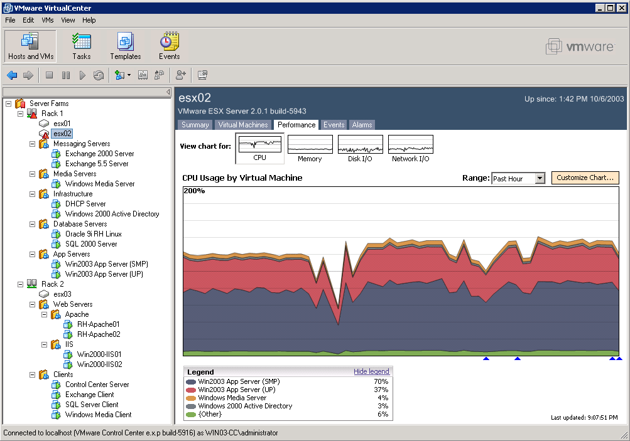
Recap:
Evolution of Server Virtualization
3rd Gen…
Infrastructure-wide Virtualization
2006 + ...
2nd Generation
Virtual Infrastructure
  Automation
  Aggregation
  Availability
  Optimization
1st Generation
Single System Hypervisor-based
Stack
2003-2006
1999-2003
Central
Management
Central
Management
Enterprise-Class
Virtualization
Enterprise-Class
Virtualization
VM
…
VM
VM
…
VM
VM
…
VM
HW
HW
HW
Source: VMWare

