Slide 1

Grid Datafarm and File System Services
Osamu Tatebe
Grid Technology Research Center,
National Institute of Advanced Industrial Science and Technology (AIST)

Slide 2
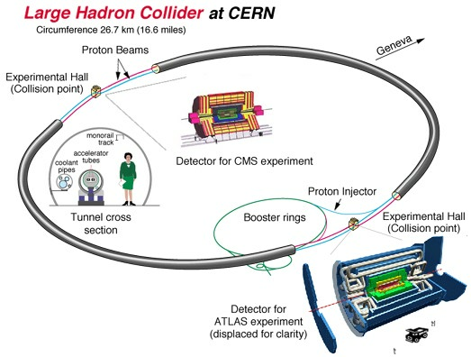

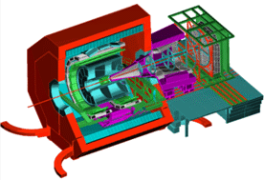
ATLAS/Grid Datafarm project:
CERN LHC Experiment
~2000 physicists from 35 countries
ATLAS Detector
40mx20m
7000 Tons
Detector for
LHCb experiment
LHC
Perimeter 26.7km
Truck
Detector for ALICE experiment
Collaboration between KEK, AIST, Titech, and ICEPP, U Tokyo

Slide 3
Petascale Data-intensive Computing Requirements
Peta/Exabyte scale files
Scalable parallel I/O throughput
  > 100GB/s, hopefully > 1TB/s within a system and between systems
Scalable computational power
  > 1TFLOPS, hopefully > 10TFLOPS
Efficiently global sharing with group-oriented authentication and access control
Resource Management and Scheduling
System monitoring and administration
Fault Tolerance / Dynamic re-configuration
Global Computing Environment

Slide 4
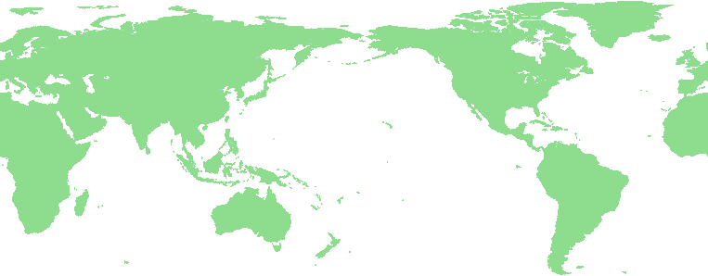


Grid Datafarm (1): Global virtual file system [CCGrid 2002]
World-wide virtual file system
  Transparent access to dispersed file data in a Grid
    Map from virtual directory tree to physical file
  Fault tolerance and access-concentration avoidance by file replication
Virtual Directory
Tree
/grid
ggf
jp
aist
gtrc
file1
file2
mapping
file1
file2
file3
file4
File replica creation
Grid File System

Slide 5
Grid Datafarm (2): High-performance data processing [CCGrid 2002]
World-wide parallel and distributed processing
  Aggregate of files = superfile
  Data processing of superfiles = parallel and distributed data processing of member files
    Local file view
    File-affinity scheduling
World-wide
Parallel &
distributed
processing
Virtual CPU
Grid File System
Newspapers in a year
(superfile)
365 newspapers

Slide 6
Extreme I/O bandwidth support example: gfgrep - parallel grep
gfmd
gfarm:input
Host1.ch Host2.ch Host3.ch
Host4.jp Host5.jp
% gfrun –G gfarm:input gfgrep
–o gfarm:output regexp gfarm:input
File affinity scheduling
open(“gfarm:input”, &f1)
create(“gfarm:output”, &f2)
set_view_local(f1)
set_view_local(f2)
Host2.ch
Host4.jp
gfgrep
gfgrep
input.2
input.4
output.2
output.4
Host1.ch
gfgrep
Host5.jp
grep regexp
Host3.ch
gfgrep
input.1
gfgrep
output.1
input.5
close(f1); close(f2)
input.3
output.5
output.3
CERN.CH
KEK.JP

Slide 7
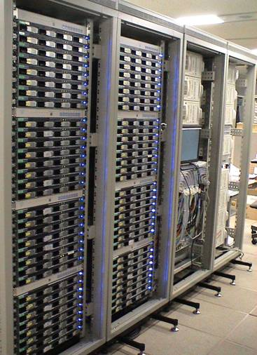
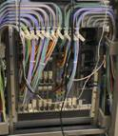
Design of AIST Gfarm Cluster I
Cluster node (High density and High performance)
  1U, Dual 2.8GHz Xeon, GbE
  800GB RAID with 4 3.5” 200GB HDDs + 3ware RAID
    97 MB/s on writes, 130 MB/s on reads
80-node experimental cluster (operational from Feb 2003)
  Force10 E600
  181st position in TOP500 (520.7 GFlops, peak 1000.8 GFlops)
  70TB Gfarm file system with 384 IDE disks
    7.7 GB/s on writes, 9.8 GB/s on reads for a 1.7TB file
    1.6 GB/s (= 13.8 Gbps) on file replication of a 640GB file with 32 streams

Slide 8
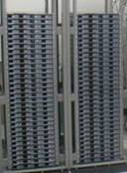

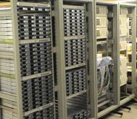

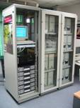
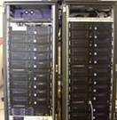

World-wide Grid Datafarm Testbed
Titech
Tsukuba U
AIST
KEK
Kasetsert U, Thiland
SDSC
Indiana U
Total disk capacity: 80 TB, disk I/O bandwidth: 12 GB/s

Slide 9
Gfarm filesystem metadata
File status
  File ID
  Owner, file type, access permission, access times
  Num. of fragments, a command history
File fragment status
  File ID, fragment index
  Fragment file size, checksum type, checksum
Directories
  List of file IDs and logical filenames
Replica catalog
  File ID, fragment index, filesystem node
Filesystem node status
  hostname, architecture, #CPUs, . . .
File status
Virtual
File system
Metadata
Services
File fragment
Directories
Replica
Location
Services
Replica catalog
Filesystem node
Gfarm filesystem metadata

Slide 10
Filesystem metadata operation
No direct manipulation
Metadata is consistently managed via file operations only
  open() refers to the metadata
  close() updates or checks the metadata
  rename(), unlink(), chown(), chmod(), utime(), . . .
New replication API
  Creation and deletion
  Inquiry and management

