Slide 1
Grid File System Group
Proposal BOF
Osamu Tatebe (AIST)
Jane Xu (IBM)
Arun Jagatheesan (SDSC)

Slide 2
Introduction Outline
Follow up actions after GGF8 GFS BOF
Charter
Relation with other groups
RG / WG vote
Administration Staff

Slide 3
Actions after GGF8 BoF
[GGF8 BoF] Proposal for a GFS-RG
  Big interest, many participants (67 persons)
[7/24] GFS-WG mailing list created (gfs-wg@ggf.org)
[8/22] GFS-WG proposal submitted
  2-year timeframe allows for a recommendation document
[9/4] GFSG comment: scope too broad (from survey to specification) for a WG
  Status: pending WG
Technology survey is in progress
Requirements are being collected

Slide 4
Decision to Make
Choice 1
  Start as a Research Group first
  Spin off a Working Group
Choice 2
  Narrow down the scope
  Become a Working Group

Slide 5
Charter for RG
Objective: federation of data through a virtual file system infrastructure for grid computing.
Discuss approaches to facilitate:
  File-oriented data sharing using a hierarchical logical name space
  Data access using file system semantics
  Use of common services provided by other working groups.
Focusing on a virtual file system infrastructure for federating existing physical file systems and other types of data sources through the application of service oriented architecture.

Slide 6
RG Deliverables
Informational Document:
"A Survey of the Major Grid File Systems"
  Finalized by GGF 11
Community Practice:
"Requirements and use cases for Grid File System"
  Finalized by GGF 11

Slide 7
Charter for WG (Scope)
Define Grid File System Services to provide features:
  Virtualized hierarchical namespaces for files or potentially other type of data (such as live data feeds),
  Efficient and transparent file sharing,
  Flexible management of inter-organizational data access controls
  Ability to describe and manage file-system and application-specific metadata

Slide 8
WG Deliverables
Recommendation Document:
"Virtual File System Directory Services Specification"
  Finalized by GGF 13
Recommendation Document:
"Grid File System Services Specification"
  Finalized by GGF 14

Slide 9
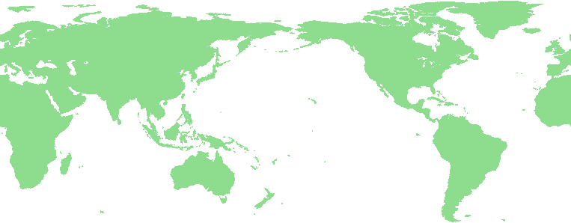
Grid File System Services
Grid File System federates and shares virtualized data from file systems in a Grid
  Virtual hierarchical namespace with access permission and metadata
  Reliable POSIX-like I/O interfaces for the Grid file system
Virtual Directory
Tree
/grid
Grid File System services
ggf
jp
Replica services
Data services
aist
gtrc
file1
file2
Mapping
file1
file2
file3
file4
Grid File System

Slide 10
Proposed Services
Virtual File System Directory Services (VFDS)
  File system metadata management services
    Virtual file system directory
    owner, file type, ACL, access times, size, checksum type, checksum, . . .
    MIME data type, . . .
  Look-up services with ACLs
    Directory-based pathname (or URI) to a GSH (or a so-called inode number)
Grid File System Services
  Extends VFDS and File Access Services
  Provides reliable POSIX-like I/O interfaces for the Grid File System
    Virtual pathname, virtual filename

Slide 11


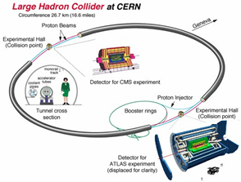
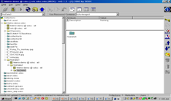


Grid File System Architecture
browser
Applications (Astronomy, Physics, Life Science, business apps, . . .)
Hierarchical Logical Name space + ACL + metadata
Grid File System Service (POSIX-like Interface)
NFS/CIFS …
Virtual Directory Service
(Management of virtualization)
Data Services
Coordinated with other groups
Data Sources

Slide 12
Relationship with Other WGs
OGSA WG
  Provide input to and follow the architecture
OGSI WG
  Follow the spec and develop OGSI-compliant file system services
DAIS WG
  Collaborate through providing input on Data Services from file system perspectives
OREP WG
  Leverage proposed Replication Services in GFS
GridFTP WG
  Include GridFTP as a possible transport mechanism
PA RG
  PA will provide input and use the GFS Specification for persistent archival of digital entities

Slide 13
To be WG or RG?
Working Group:
+ Standard specifications for the community
+ Impact and use in development of grid applications
Requirements and survey done by individuals as informational documents
Research Group:
+ Cover more topics
+ Provide informational document through group discussion
+ WG could be spawned
- Delivery of standards will be delayed (projects already waiting)

Slide 14
Proposed Group
Administration Staff
Proposed Chairs
  Osamu Tatebe (AIST)
  Jane Xu (IBM)
  Arun Jagatheesan (SDSC)
Proposed Secretaries
  Yves Denneulin (IMAD/INRIA)
  Pradeep Padala (UFL)

