Slide 1
Grid File System RG BoF
GGF8
Seattle
June 2003
Osamu Tatebe
Grid Technology Research Center, AIST

Slide 2
Introduction of proposed chair
Osamu Tatebe
  Grid Technology Research Center, AIST
  Grid Datafarm
    Grid file system – world-wide virtual file system
    High-performance data processing support
      Superfile (Gfarm file), file-affinity scheduling, access method to superfiles (global / local file view)
    CHEP 2001, CCGrid 2002, CHEP 2003, HPDC-12 (2003)
    http://datafarm.apgrid.org/

Slide 3
Several examples of large-scale (proprietary) file system technology
Legion, Avaki
Storage Resource Broker (SRB)
Grid Datafarm
EDG (w/ Replica Location Service)
Farsite, OceanStore
AFS, DFS, . . .
It is time to investigate and explore a Grid file system through the application of service oriented architecture

Slide 4
Relationship to grid services
File management and access control issues
  How to manage millions or billions of Grid Service Handles?
  How to control access permission with various requirements?
    Group readable and/or group writable with flexible group management for set of files
  How to share the file management in a virtual organization?
Consistency management issues
  Consistent access control among services, e.g. replica location service, and GridFTP
  A standard loophole to access and modify files using underlying standard services, e.g. GridFTP
Security issues
  Authentication, authorization, privacy, and integrity

Slide 5
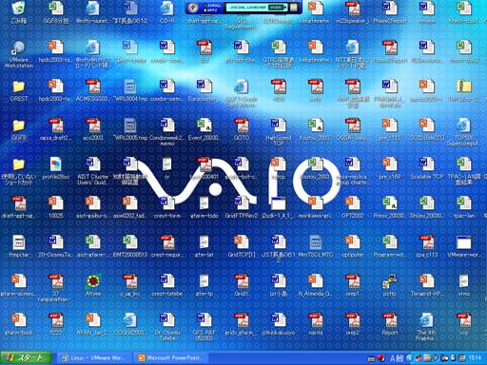
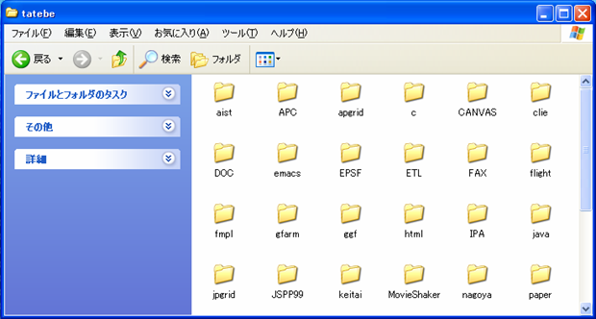
with a good search engine
(google style)
vs
(yahoo directory style)

Slide 6
Example: Reliable File System Services
/grid
Virtual Filesystem
Directory Service
ggf
jp
Hierarchical namespace
with filesystem metadata
Unique path name
Access control
Write lock
Other metadata
aist
gtrc
file1
file2
file1
file2
file3
pub
Replica Location Service
gsiftp://aist.go.jp/
http://u-tokyo.ac.jp/
ftp://meti.go.jp/
File Transport
Service
/a/b/file3
/a/b/file1
/a/b/file2
/b/file1
/c/file3
/d/file1
/pub/

Slide 7
Proposed Charter
Grid File System Research Group explores issues related to file system data in grid computing environment.
We are interested in the possibility of federating namespace of existing physical file system, and individual files, and managing files through the application of service oriented architecture for file system infrastructure and objects.
The objective of the group is to provide a forum for discussing approaches to facilitate file sharing and to promote the use of common services provided by other working groups.

Slide 8
Proposed Charter (Cont’d)
Initially, the proposed research group aims to identify the requirements and functionalities for Grid file systems. To achieve this goal, we undertake the following tasks:
  Survey research projects and products related to the Grid and wide-area filesystems
  Organize and document requirements of Grid filesystems from application's perspective

Slide 9
The 1-year milestone
Jun 2003 GGF8
  BOF
Oct 2003 GGF9
  First draft of a survey document
  First draft of a requirement document
Feb 2004 GGF10
  Revised version of documents
  Provide examples of service oriented file system federation
Jun 2004 GGF11
  Final version of documents will be submitted

Slide 10
Relationship to other GGF groups
OREP-WG
GridFTP-WG, DT-RG, GHPN-RG
DAIS-WG
OGSI-WG, OGSA-WG

Slide 11
Administrative issue
Chair
  Osamu Tatebe o.tatebe@aist.go.jp
  U.S.?
  Europe?
Secretary
  Need a volunteer
http://phase.hpcc.jp/ggf/gfs-rg/

Slide 12
The document
Survey research projects and products related to the Grid and wide-area filesystems
  Legion, Avaki, SRB(Regan Moore), Grid Datafarm, EDG(RLS)
  Farsite, OceanStore
  AFS, DFS, . . .
  Distributed StorageTank (Leo Luan)
  Slash Grid (Andrew Mcnab)
  Description, filesystem metadata management, access control, features, further requirement
Organize and document requirements of Grid filesystems from application's perspective
  High-energy physics, Astronomic Observatory, Astronomic Data Analysis, Bio-informatics, . . .
  Business apps
  Jane Xu, EDG

Slide 13
Follow-on meeting
Face-to-face meeting co-located with OREP-WG?

Slide 14
Discussion
is the focus sufficiently narrow that work can get done?
where there are suggested changes in focus, how do they impact the milestones and objectives? I.e. do the changes weaken the focus or strengthen it?
discussion about what documents might be produced, and soliciting folks who are interested in working on the documents as authors. If no one volunteers to do something, it's not realistic to include it in a charter.

