Slide 1


Porting GRID superscalar to GridRPC
Pieter Bellens, Rosa M. Badia, Josep M. Perez, Raul Sirvent, Vasilis Dialinos, Jesús Labarta
GGF16, Athens, Greece,
13-16 February 2006
Rosa M. Badia
Grid Computing and Clusters Manager

Slide 2
Outline
  GRID superscalar overview
  Comparison between GRID superscalar and GridRPC programming models
  Porting GRID superscalar on top of GridRPC
  Performance results
  Conclusions

Slide 3
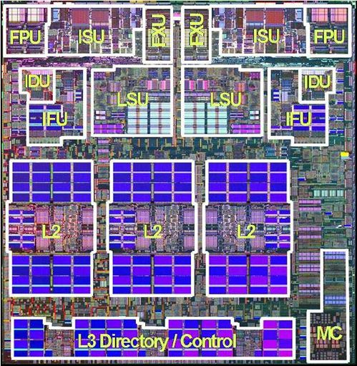
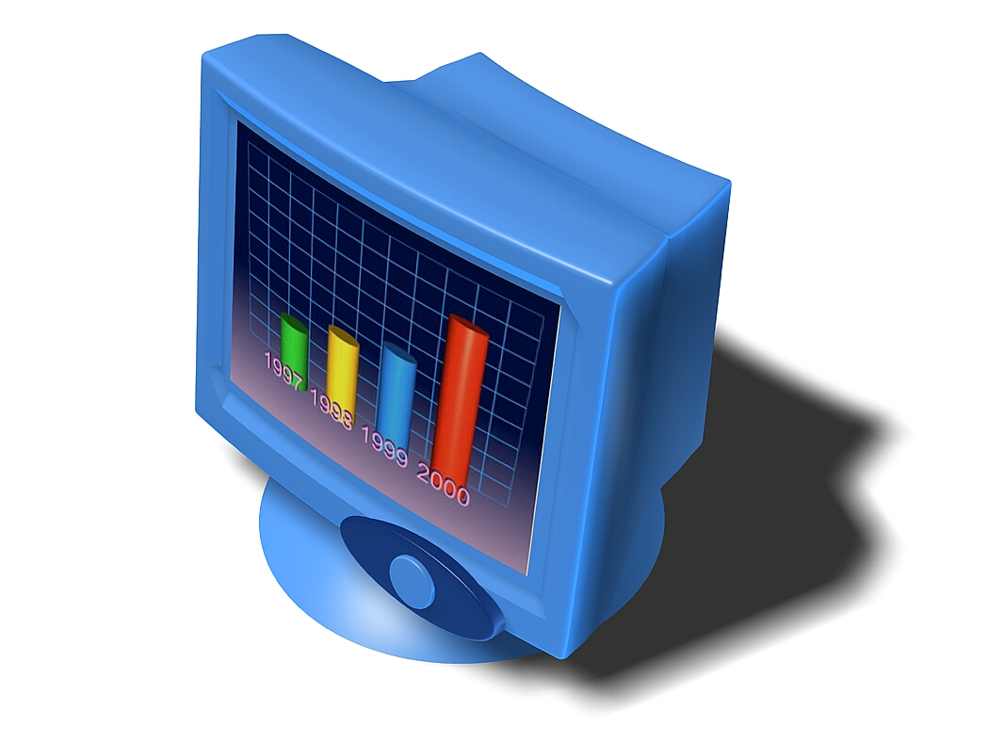

1. GRID superscalar Overview
Objective:
  Ease the programming of GRID applications
  Basic idea:
≅
ns ➔ seconds/minutes/hours

Slide 4
1. GRID superscalar Overview
Input: sequential program with calls to a reduce set of GS library functions
    GS_On();
    for (int i = 0; i < MAXITER; i++) {
    newBWd = GenerateRandom();
    subst (referenceCFG, newBWd, newCFG);
    dimemas (newCFG, traceFile, DimemasOUT);
    post (newBWd, DimemasOUT, FinalOUT);
    if(i % 3 == 0) Display(FinalOUT);
    }
    fd = GS_Open(FinalOUT, R);
    printf("Results file:\n"); present (fd);
    GS_Close(fd);
    GS_Off();

Slide 5
1. GRID superscalar Overview
Coarse grain functions to be executed in the Grid
  Identified by the user in an IDL file
    interface MC {
      void subst(in File referenceCFG, in double newBW, out File newCFG);
      void dimemas(in File newCFG, in File traceFile, out File DimemasOUT);
      void post(in File newCFG, in File DimemasOUT, inout File FinalOUT);
      void display(in File toplot)
    };

Slide 6
1. GRID superscalar Overview
Code generation
app.idl
gsstubgen
client
server
app.c
app-stubs.c
app.h
app-worker.c
app-functions.c
app_constraints.cc
app_constraints_wrapper.cc
app_constraints.h

Slide 7
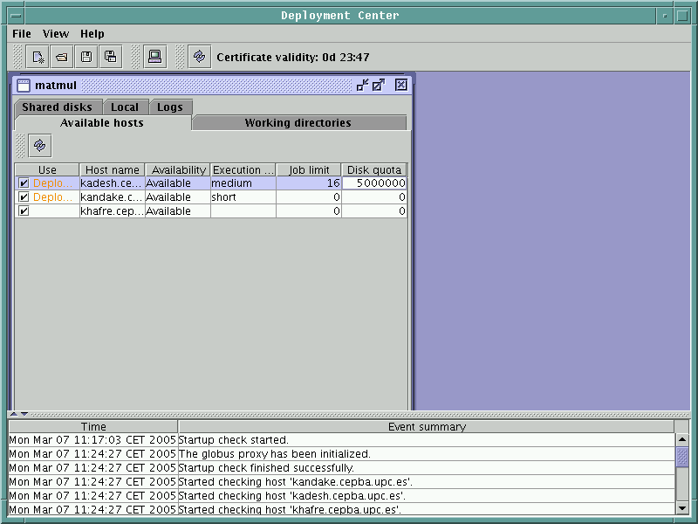
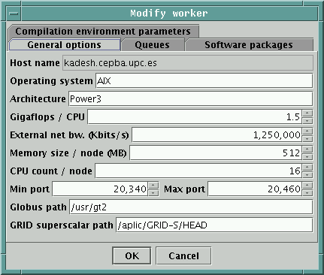
1. GRID superscalar Overview
Automatic configuration check and deployment: deployment center

Slide 8
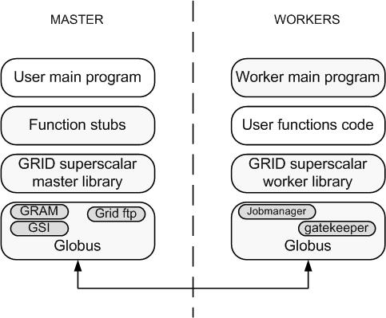
1. GRID superscalar Overview
GRID superscalar applications architecture

Slide 9
1. GRID superscalar Overview
GRID superscalar runtime features
  Dependency analysis (between the functions listed in the IDL file)
  Task graph creation
  Concurrency exploitation at task level
  File renaming
  Scheduling, resource management, file transfer
  File locality exploitation by lazy file transfer
  Checkpointing at task level
  Exception handling

Slide 10
2. Comparison between GRID superscalar and GridRPC programming models
int main{int argc,char **argv)
{
...
for(i=0;i<10;i=i+1)
foo(f_in[i],f_out[i]);
...
}
f_in[0]
f_in[1]
f_in[2]
f_in[8]
f_in[9]
foo
foo
foo
  ...
foo
foo
f_out[0]
f_out[1]
f_out[2]
f_out[8]
f_out[9]

Slide 11
2. Comparison between GRID superscalar and GridRPC programming models
GRID superscalar user code
Small amount of changes to the original code
Application is Grid unaware
The runtime exploits the existent concurrency, building at execution time the data dependence graph
  int main{int argc,char **argv)
  {
  ...
  GS_On();
  for(i=0;i<20;i++)
  foo(f_a[i],f_a[i+1]);
  GS_Off();
  ...
  }
f_in[0]
f_in[1]
f_in[2]
f_in[8]
f_in[9]
foo
foo
foo
  ...
foo
foo
f_out[0]
f_out[1]
f_out[2]
f_out[8]
f_out[9]

Slide 12
2. Comparison between GRID superscalar and GridRPC programming models
GridRPC: synchronous calls
Does not exploit possible concurrency
int main{int argc,char **argv)
{
grpc_object_handle_t_np h;
...
grpc_initialize("config_file");
grpc_object_handle_init_np("A",&h,"class");
for(i=0;i<10;i=i+1)
grpc_invoke_np(h,"foo",f_in[i],f_out[i]);
grpc_object_handle_destruct_np(&h);
grpc_finalize();
...
}

Slide 13
2. Comparison between GRID superscalar and GridRPC programming models
  GridRPC: asynchronous calls
  Exploits concurrency
  Application is grid-aware
...
grpc_initialize("config_file");
grpc_object_handle_init_np("A",&A_h,"class");
grpc_object_handle_init_np("B",&B_h,"class");
for(i=0;i<5;i=i+1)
{
grpc_invoke_async_np(A_h,"foo",&sid,f_in[2*i],f_out[2*i]);
grpc_invoke_async_np(B_h,"foo",&sid,f_in[2*i+1],f_out[2*i+1]);
grpc_wait_all();
}
grpc_object_handle_destruct_np(&A_h);
grpc_object_handle_destruct_np(&B_h);
grpc_finalize();
...

Slide 14
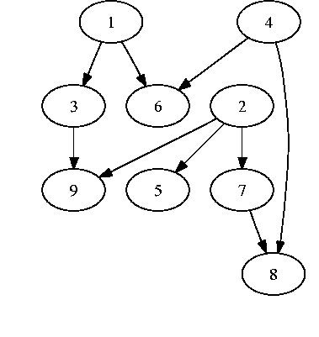
2. Comparison between GRID superscalar and GridRPC programming models
...
foo(f_a[0],f_a[1]); //1
foo(f_a[2],f_a[3]); //2
foo(f_a[1],f_a[4]); //3
foo(f_a[5],f_a[6]); //4
foo(f_a[2],f_a[8]); //5
foo(f_a[6],f_a[0]); //6
foo(f_a[9],f_a[2]); //7
foo(f_a[9],f_a[5]); //8
foo(f_a[3],f_a[4]); //9
...
}
...
GS_On();
foo(f_a[0],f_a[1]); //1
foo(f_a[2],f_a[3]); //2
foo(f_a[1],f_a[4]); //3
foo(f_a[5],f_a[6]); //4
foo(f_a[2],f_a[8]); //5
foo(f_a[6],f_a[0]); //6
foo(f_a[9],f_a[2]); //7
foo(f_a[9],f_a[5]); //8
foo(f_a[3],f_a[4]); //9
GS_Off();
...

Slide 15
3. Porting GRID superscalar on top of GridRPC
Motivations for the port of GRID superscalar on top of GridRPC:
  GridRPC offers higher-level services than Globus Toolkit
    A large part of the GT based GRID superscalar code is dedicated to build the RSL strings
  Ninf-G offers an advanced file transfer protocol
  We wanted to test the differences between transient and persistent workers, and GridRPC offer a good platform for this idea
GRID superscalar as a GridRPC application
  Final applications remains unaware of GridRPC

Slide 16
3. Porting GRID superscalar on top of GridRPC
GridRPC

Slide 17
3. Porting GRID superscalar on top of GridRPC
Limitation:
  GridRPC lack of support for direct communication between workers
  However, this is an important feature for GRID superscalar to enable the file locality exploitation
  Solved by spawning a daemon process in the workers machines
    on demand, only when a worker-worker file transfer is required
  This daemon behaves as a GridRPC master and it is specialized in transfering files
  This daemon can transfer files from any other worker to the machine where it is running
  Problem of this scheme: is not scalable
    Up to N-1 daemon processes, being N the number of worker machines
Worker machine 1
Worker machine 2

Slide 18
3. Porting GRID superscalar on top of GridRPC
New concepts: handles to contact worker machines
Calls used
  grpc_object_handle_t_np A_h;
  grpc_object_handle_init_np("A",&A_h,"class");
  grpc_invoke_async_np(A_h,"method",&sid,f_in[i],f_out[i]);
  grpc_wait_any();
  grpc_object_handle_destruct_np(&A_h);
Designed to reduce the number of handle creation and destruction
  Handle reuse: enables persisten workers
All handles created at the beginning of the GRID superscalar aplication
Encapsulated in two classes: mother_pool and handle_pool

Slide 19
3. Porting GRID superscalar on top of GridRPC
The object mother-pool is the interface with the GRID superscalar runtime
Each handle object administers the handles of a worker machine
Handle object
Handle object
GRID superscalar
runtime
Handle requests
Mother-pool
object
Handle pool
forwarding
Handle object
Handle object

Slide 20
3. Porting GRID superscalar on top of GridRPC
User programming details:
  Single Ninf-G IDL file for all GRID superscalar applications
  Everything encapsulated in a Worker module that translates the Ninf-G calls to the corresponding GRID superscalar application calls
  Main method:
    gs_ww_exe:
      Receives all the parameters from the Ninf-G master
      Stages in the required files
      Calls the GRID superscalar worker, with the corresponding parameters
  The user code is exactly the same that with other GRID superscalar versions.
    Ninf-G remains transparent to the user
  The code generated by GRID superscalar is the same also: gsstubgen remained unchanged

Slide 21
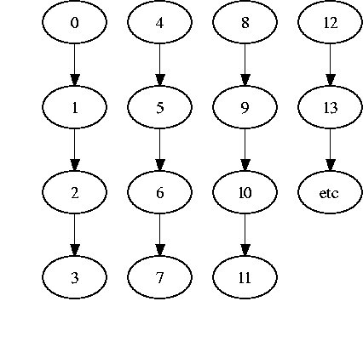
4. Performance results
Comparison:
  A GRID superscalar version based in Globus 2.4 (GS1)
  A GRID superscalar version based in Ninf-G 2.4 (GS2)
  Besides the middleware code, the rest of the GRID superscalar code remains unchanged
  Application: hyper-matrix multiply
    Tasks of the application operates with a
    matrix block

Slide 22
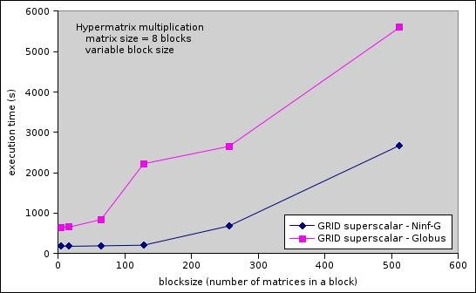
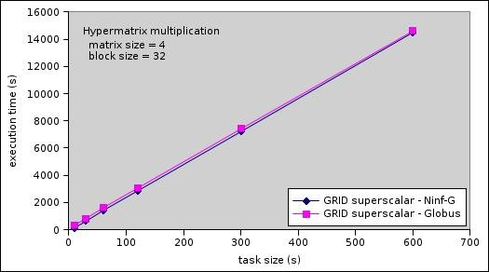
4. Performance results

Slide 23
Summary
Faster for applications fine-grain tasks
Simplication of the runtime code (25 % less)
The file transfer daemon, the handle mechanism and the callback technique are essentially extensions to the Ninf-G runtime
This version also supports persistent worker processes

Slide 24
THANKS!

Slide 25
Buscar codi amb crides asincrones
Buscar si la transferencia de fitxers apareix en altres GridRPC implementations
GRID superscalar implementat com una aplicació GridRPC. GridRPC transparent a les aplicacions de GRID superscalar

Slide 26
Worker machine 1
Master machine
callback
?
Worker machine 2

Slide 27
2. Comparison between GRID superscalar and GridRPC programming models
...
grpc_initialize("config_file");
grpc_object_handle_init_np("A",&A_h,"class");
grpc_object_handle_init_np("B",&B_h,"class");
grpc_object_handle_init_np("C",&C_h,"class");
grpc_object_handle_init_np("D",&D_h,"class");
for(i=0;i<17;i=i+4)
{
grpc_invoke_async_np(A_h,"foo",&sid,f_a[i],f_a[i+1]);
grpc_invoke_async_np(B_h,"foo",&sid,f_a[i+2],f_a[i+3]);
grpc_invoke_async_np(C_h,"foo",&sid,f_a[i+4],f_a[i+5]);
grpc_invoke_async_np(D_h,"foo",&sid,f_a[i+6],f_a[i+7]);
grpc_wait_all();
}
grpc_object_handle_destruct_np(&A_h);
grpc_object_handle_destruct_np(&B_h);
grpc_object_handle_destruct_np(&C_h);
grpc_object_handle_destruct_np(&D_h);
grpc_finalize();
...

Slide 28
main(int argc, char **argv){
double pi;
long times, count[NUM_HOSTS], sum;
char * config_file;
int i;
...
for (i = 0; i < NUM_HOSTS; i++) {
/* Parallel non-blocking remote function invocation. */
if (grpc_call_async(&handles[i], &ids[i], i, times,
&count[i]) != GRPC_NO_ERROR){
grpc_perror_np("pi_trial");
exit(2);
}
}
/* Sync. */
if (grpc_wait_all() != GRPC_NO_ERROR) {
grpc_perror_np("wait_all");
exit(2);
}
...

Slide 29
3. Porting GRID superscalar on top of GridRPC
Can GRID superscalar benefit from the GridRPC API?
Ninf-G's interface is more abstract than the Globus Toolkit (GT) interface
  Can we lower the complexity of the GRID superscalar libraries?
  Can we decrease the amount of GRID superscalar code?
Ninf-G boasts an advanced (though proprietary) filetransfer protocol
  can we speed up the GRID superscalar runtime
Although the general speedup due to faster filetransfers in an application with coarse-grained tasks will be small...

Slide 30
2. Comparison between GRID superscalar and GridRPC programming models
...
int A_free=1;
int B_free=1;
...
grpc_initialize("config_file");
grpc_object_handle_init_np("A",&A_h,"class");
grpc_object_handle_init_np("B",&B_h,"class");
while(i<20)
{
if(A_free)
{
grpc_invoke_async_np(A_h,"foo",&sid,f_a[i],f_a[i+1]);
A_free=0;
i++;
}
if(B_free)
{
grpc_invoke_async_np(B_h,"foo",&sid,f_a[i+2],f_a[i+3]);
B_free=0;
i++;
}
grpc_wait_any();
/*Identify the task that has finished
and toggle the corresponding flag*/
}
...

