Slide 1
GridFTP vs. the Firewall
Bill Allcock, ANL

Slide 2
GridFTP problems with Firewalls
Firewall administrators don’t want to open 1002 holes in their firewall
ANY QUESTIONS?

Slide 3
Why 1002?
Port 2811 for the control channel
Our standard recommendation is to open ports 50,000-51,000 (1001).
This range is actually shared by all of Globus (GLOBUS_TCP_PORT_RANGE)
However, GridFTP takes the lions share.
  50 transfers at 8 streams each is 400 sockets.
  If people are experimenting and running 32 streams…

Slide 4
but FTP defines a single data port
Yes, it does
  and no one implements it because it doesn’t work unless you only want to run one transfer at a time.
The control channel works because
  there is one process accepting all the connections (inetd, xinetd, or the server daemon)
  There is only one port (2811)

Slide 5
The data channel is a different…
One server instance per connection (fork/exec)
It is the server that accepts the data channel connections
Can’t have multiple processes listening on the same port.
Can’t dup a file descriptor and hand it off to an existing process.

Slide 6
To make a single port work…
Listener would have to accept connections on the data port
Protocol would have to be modified to have a GUID for each server.
The GUID would have to be sent as the first item on the data channel.
Listener would read the guid, decide which server it belonged to, keep count until all the streams were connected, then it would dup the fds, fork, exec.
Protocol allows for dynamic streams, so even this is not a complete solution

Slide 7
It is actually worse than it appears
The GridFTP protocol *requires* the sending side to initiate the TCP connect.
Obviously, this makes the problem worse since you don’t have the option of turning the connection around to get around firewall restrictions.

Slide 8
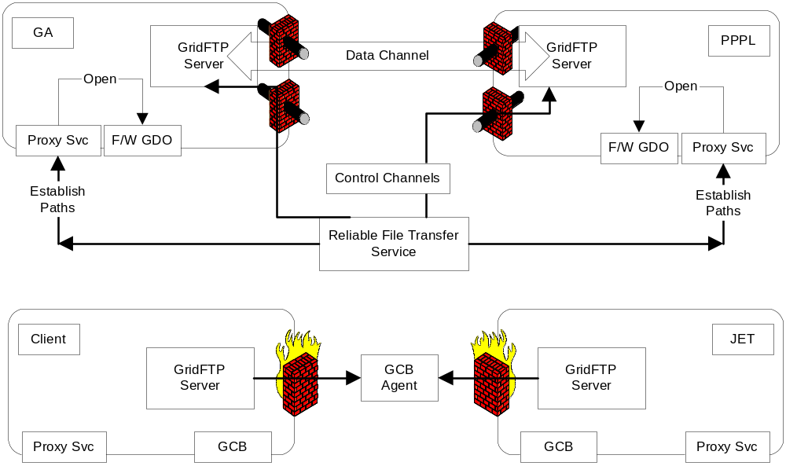
Work around the firewall

