Slide 1

Network Services Interface
APAN
Co-chairs: Guy Roberts, Tomohiro Kudoh, Inder Monga
23rd Feb 2011

Slide 2
OGF IPR Policies Apply
“I acknowledge that participation in this meeting is subject to the OGF Intellectual Property Policy.”
Intellectual Property Notices Note Well: All statements related to the activities of the OGF and addressed to the OGF are subject to all provisions of Appendix B of GFD-C.1, which grants to the OGF and its participants certain licenses and rights in such statements. Such statements include verbal statements in OGF meetings, as well as written and electronic communications made at any time or place, which are addressed to:
    the OGF plenary session,
    any OGF working group or portion thereof,
    the OGF Board of Directors, the GFSG, or any member thereof on behalf of the OGF,
    the ADCOM, or any member thereof on behalf of the ADCOM,
    any OGF mailing list, including any group list, or any other list functioning under OGF auspices,
    the OGF Editor or the document authoring and review process
Statements made outside of a OGF meeting, mailing list or other function, that are clearly not intended to be input to an OGF activity, group or function, are not subject to these provisions.
Excerpt from Appendix B of GFD-C.1: ”Where the OGF knows of rights, or claimed rights, the OGF secretariat shall attempt to obtain from the claimant of such rights, a written assurance that upon approval by the GFSG of the relevant OGF document(s), any party will be able to obtain the right to implement, use and distribute the technology or works when implementing, using or distributing technology based upon the specific specification(s) under openly specified, reasonable, non-discriminatory terms. The working group or research group proposing the use of the technology with respect to which the proprietary rights are claimed may assist the OGF secretariat in this effort. The results of this procedure shall not affect advancement of document, except that the GFSG may defer approval where a delay may facilitate the obtaining of such assurances. The results will, however, be recorded by the OGF Secretariat, and made available. The GFSG may also direct that a summary of the results be included in any GFD published containing the specification.”
OGF Intellectual Property Policies are adapted from the IETF Intellectual Property Policies that support the Internet Standards Process.
Notes:
IPR Notices Note Well for OGF meetings

Slide 3
Dynamic circuits - motivation
The emergence of Big Science projects is driving demand for highly reliable multi-gigabit flows that cross continents.
This is testing the research networking infrastructure and has led to a new paradigm in networking.
Proliferation of BoD projects such as:
  ION service (Esnet and Internet2)
  AutoBAHN (GÉANT)
  G-lambda (AIST, KDDI, NTT etc)
Need has emerged for a standardized interface to support global circuit creation – NSI is addressing this need.

Slide 4
Network Service Interface
NSI is designed to allow Grid, Cloud and other applications to mange network connectivity.
NSI also supports provider-to-provider circuit request
NSI can also allows existing BoD systems to interoperate
Oriented to creating and managing L1/L2 connection-oriented circuits.

Slide 5
Connections in NSI
  Primary goal of NSI is to define an interface over which Connections can be established
  Connections are point to point
  Connections have:
    Performance characteristics (capacity, framing, etc)
    Authorization policy (defined by domain)
    Book-ahead schedule (“now” for on demand)
    All characteristics are optional except Source and Destination
    All characteristics have a default value
© 2006 Open Grid Forum

Slide 6
Establishing a Connection
  Connection establishment is broken into two phases:
    Reservation- includes PathFinding and Resource allocation
    Provisioning- includes re-configuration of the network elements along a pre-computed path
  Connections are managed by exchanging messages (primitives) over the NSI interface:
    Request a connection (creates a reservation)
    Provision the connection (enable on transport plane)
    Release the connection (releases connection)
    Cancel the connection (removes the reservation)
© 2006 Open Grid Forum

Slide 7
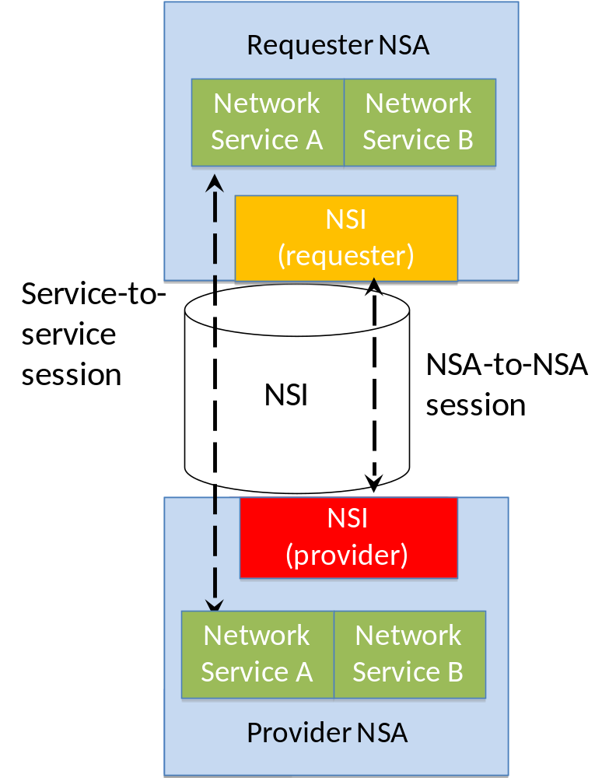
Network Service Framework (NSF)
  NSF defines a framework for supporting services
  Services are managed on the NSI interface
  NSI Requester-Provider session established between NSAs
  Services sessions established between service instances

Slide 8
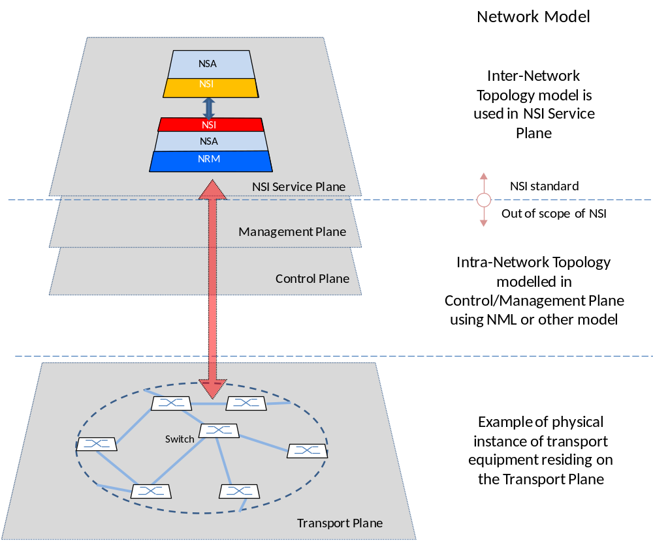
NSI assigned to ‘Service Plane’
RA

Slide 9
Delivering Network Services
Network
Services
Interface (NSI)
Network Service A
Network Service B
Network Service A
Network Service B
NSI
Provider
NSI Requester
NSI Provider
NSA
NSA
NRM
Service plane
NSA = Network Services Agent
NRM = Network Resource Manager
Transport plane
NSI used to communication requests between Agents
Provider Agent delivers circuit via Network Resource Manager
Notes:
1. Connection Service, a service used to request and manage transport connections. Another example is the Topology Service; this is used to exchange network topologies.

Slide 10
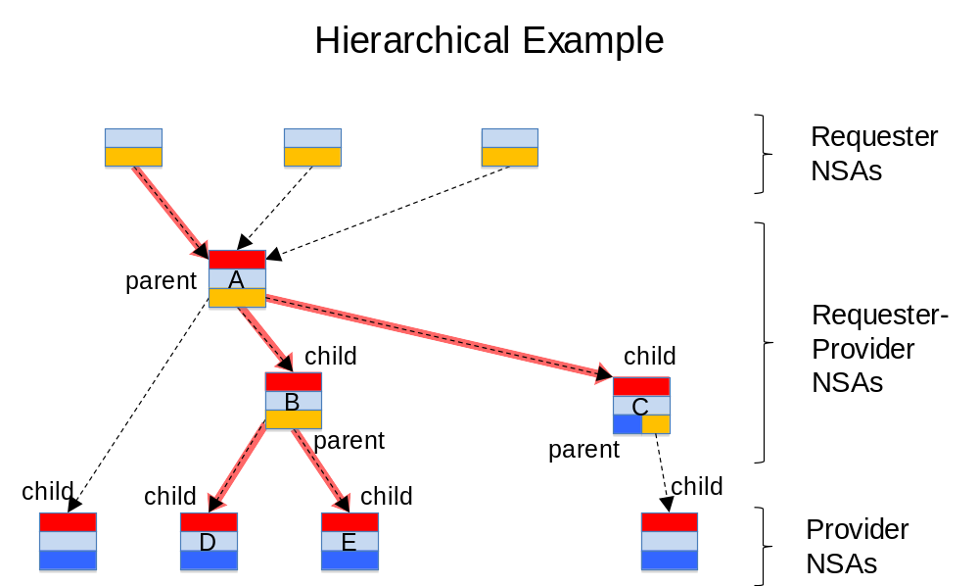
Hierarchical comms model
NSI request forwarding flexible – supports both tree and chain models
Request forwarding does not need to follow route of the circuit

Slide 11
Building complex Connections
Network
Services
Interface (NSI)
Network
Services
Interface (NSI)
Network Service A
Network Service B
Network Service A
Network Service B
Network Service A
Network Service B
NSI Requester
NSI Provider
NSA
NSI Requester
NSI Provider
NSA
NRM
NSA
NRM
Service plane
Transport plane
NSI allows complex multi-domain connections to be created
Notes:
1. Connection Service, a service used to request and manage transport connections. Another example is the Topology Service; this is used to exchange network topologies.

Slide 12
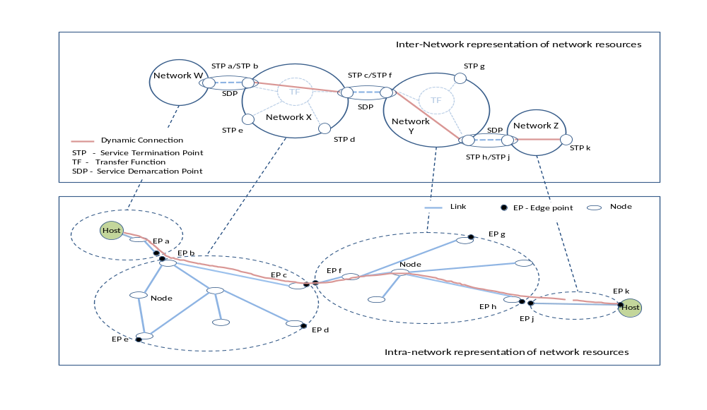
NSF: Network topology
NSF describes method for aggregating topology into ‘Networks’

Slide 13
Requestor Agent (RA) messaging state machine
Initial
Provisioning
>reserve_start
>rsv.rq
>provision_start
<prov.cf
>prov.rq
<provision_complete
Reserving
Reserved
In
Service
<rsv.gr
<reserve_ok
<rel.cf
>release_start
<release_complete
Releasing
>rel.rq
<rsv.ng
<reserve_ng
Terminated
Canceling
Any
state
<cncl.cf
>cancel_start
<cancel_complete
>cncl.rq
RA SM
red : an input/output event which is an NSI message
blue : an input/output event which is not an NSI message
>: Downstream input/output
<: Upstream input/output
rsv: reserve, prov: provision, rel: release, cncl: cancel
.rq : request, .cf: confirm, gr: granted, ng: not granted
Input
Output

Slide 14
Provider Agent (PA) messaging state machine
Initial
Provisioning
>rsv.rq
>reserve_start
>prov.rq
<provision_complete
>provision_start
<prov.cf
Reserving
Reserved
In
Service
<reserve_ok
<rsv.gr
<release_complete
>rel.rq
<rel.cf
Releasing
>release_start
<reserve_ng
<rsv.ng
Terminated
Canceling
Any
state
<cancel_complete
>cncl.rq
<cncl.cf
>cancel_start
PA SM
red : an input/output event which is an NSI message
blue : an input/output event which is not an NSI message
>: Downstream input/output
<: Upstream input/output
rsv: reserve, prov: provision, rel: release, cncl: cancel
.rq : request, .cf: confirm, gr: granted, ng: not granted
Input
Output

Slide 15
NSI documents
GFD.173 Network Services Framework
The NSF is a framework to support Network Services
Supports many services – initial service is Connection Service
Possible future services, e.g.: Network Topology Exchange Service
Status – NSF v1.0 has been published
GFD.XXX Connection Service Architecture
Allows an application or network provider to request and automatically reserve and provision circuits from other network providers
Designed to support circuits that transit multiple service providers
Status – draft
GFD.XXX NSI Protocol
Normative definition of the NSI protocol.
Status: protocol is in process of being defined

Slide 16
NSI implementation timeline
  Aiming to demonstrate first protocol implementations at SuperComputing in November 2011
  GLIF is aiming to use NSI as the API for their GOLEs.
  OSCARS (Esnet), AutoBAHN (GÉANT), DRAC (SURFnet), G-lambda (JGN) are all actively investigating implementing NSI when it has been released.
  LHCONE is planning to implementing NSI in exchange points

Slide 17
Full Copyright Notice
Copyright (C) Open Grid Forum (2008-2010). All Rights Reserved.
This document and translations of it may be copied and furnished to others, and derivative works that comment on or otherwise explain it or assist in its implementation may be prepared, copied, published and distributed, in whole or in part, without restriction of any kind, provided that the above copyright notice and this paragraph are included on all such copies and derivative works.
The limited permissions granted above are perpetual and will not be revoked by the OGF or its successors or assignees.
Notes:
OGF Full Copyright Notice if necessary

