Slide 1
Illinois Health Network
The 14th Global Grid Forum
Chicago, Illinois
June 27, 2005

Slide 2
Illinois Health Network
Todd W. Hart, Director
217-541-1179
thart@ihastaff.org
www.IllinoisHealthNetwork.org

Slide 3
Agenda
Health Information Technology Background
Patient Centered vs. Consumer Centered
Health Care
US Government & HIT
Roles of the Illinois Health Network
Potential Applications on the IHN
Talisen Technologies

Slide 4
From Patient Centered
“Health care is kind of like a rental car, you never wash it.”

Slide 5
To Consumer Centered
Goal is to Create a More Intelligent and Proactive U.S. Healthcare System.

Slide 6
To Consumer Centered
Who is the Only Person Concerned About Your Health When You’re Healthy?
Prevention and Wellness System
  WWW.HealthTransformation.net
  WWW.RealAge.com
  WWW.iHealthRecord.com

Slide 7
Dentistry vs. Health Care
Dentistry
  Limited Options--Extractions
  20th Century Fluoride in the Water
  Cleaning Teeth
Health Care
  Disparity in Technology
  Disparity in Health Information

Slide 8
Health Information Technology (HIT) Landscape
June 13, 2005
The Secretary of Health and Human Services, Michael O. Leavitt, and National Coordinator for Health IT, Dr. David Brailer, both announced the formation of an American Health Information Community (AHIC) and the release of four requests for proposal (RFPs) designed to advance interoperability of health information and achieve widespread adoption of HIT.

Slide 9
AHIC
The Federal Government Will Charter a Market-based, Public-Private Effort to Advise the Industry on Building and Adopting Health-Information Technology Standards.

Slide 10
AHIC
“The AHIC will help nationwide transition to electronic health records – including common standards and interoperability – in a smooth, market-led way. The AHIC, which will be formed under the auspices of the Federal Advisory Committee Act, will provide input and recommendations to HHS on how to make health records digital and interoperable, and assure that the privacy and security of those records are protected.”

Slide 11
AHIC Goals
Recommending ways to safeguard patient privacy and ensure the security of electronic data;
Prioritizing health-IT "achievements" such as laboratory reporting and public health surveillance tools; helping the industry develop a process for private-sector standards
Identifying a process for product certification

Slide 12
A Need for Health Privacy
A 1999 California HealthCare Foundation survey showed that 1 of every 6 Americans withdraws from full participation in their health care out of fear that their information will be used without their knowledge or permission.
www.healthprivacy.org

Slide 13
Privacy Concerns and EHRs
70% of Americans are concerned that the personal health information could be disclosed due to weak security.
65% are concerned that some people will not disclose important information because of computerized records
47% say privacy outweighs EHRs
www.healthprivacy.org

Slide 14
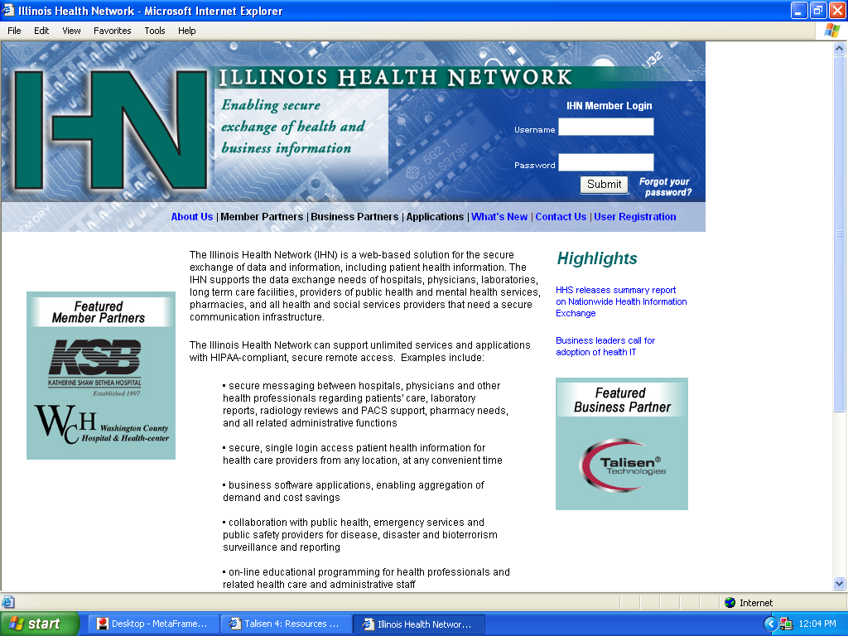

Slide 15
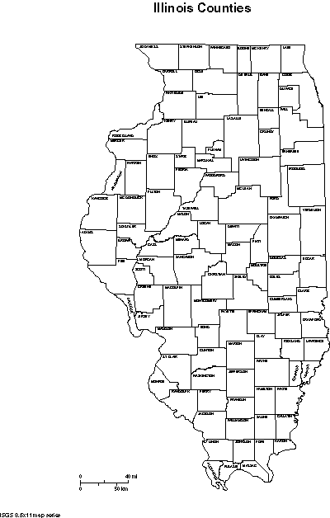
102 Illinois Counties
200+Hospitals
94 Local Health Departments
27,000 physicians
8 Medical Schools with 12 Campuses
Metropolitan vs. Suburban vs. Rural

Slide 16
Who has a Vested Interest in the Illinois Health Network?
Providers--Hospitals, Physicians, Long Term Care, Public Health, Labs, etc.
Business Partners--Commercial Interests, Payers, Government, Technology Partners, etc.
Participants—Patients, Families, Advocates, etc.

Slide 17
Goal of the IHN-
Connect Illinois stakeholders within a federated system creating the ability to offer better, faster, more convenient and cost effective health care solutions.

Slide 18
Roles of the Illinois Health Network
Secure IHN Gateway
Access to Commercial Applications and Other Health Care Offerings
Technology-enabler
Private/Public Partnerships (RHIO)

Slide 19

Partners
Radiology
Billing
Pharmacy
Government
Other Hospitals
Health Records
Technical Support
Service Vendors
Ambulatory Medical Clinics
Public Health Agencies
Educational Providers
Health Professionals of All Disciplines
Community at Large
Your Organization
Firewall
Internet

Slide 20









IDPH NET
Current Options
Hospital B
VPNs
Your Organization
First Responder
Firewall
Home Health
Long Term Care
Internet
University
Primary Care
Hospital C
Support Staff
Community

Slide 21


The IHN Option
Your Organization
Firewall
Secure Gateway
Internet

Slide 22

The IHN Option
Your Organization
Firewall
Secure Gateway
Internet

Slide 23
The IHN Option
Your Organization
Firewall
Secure Gateway
Internet
All your Partners

Slide 24
The IHN Option
Your Organization
Centralized
Data
Firewall
Secure Gateway
Data Stored
Locally
Internet
All your Partners

Slide 25
Roles of the Illinois Health Network
Secure IHN Gateway
Access to Commercial Applications and Other Health Care Offerings
Technology-enabler
Private/Public Partnerships (RHIO)

Slide 26
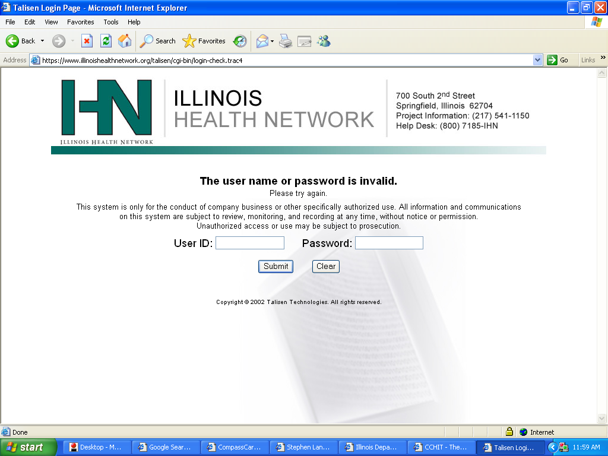

Slide 27
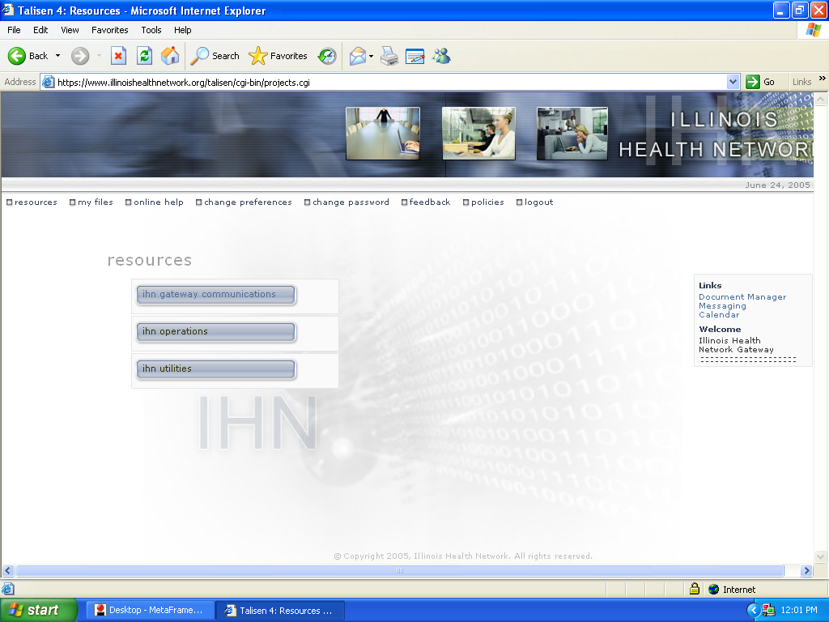

Slide 28
Potential Applications
Educational Calendar – “TV Guide”
Patient/Physician Secure Messaging
Electronic Commerce
Virtual Pharmacy
Electronic Health Records
Computerized Provider Order Entry
QI/Evidence Based Medicine
Scorecard
Radiology Reviews/PACS
Personal Health Records

Slide 29
IHN Examples
Washington County Hospital
KSB Hospital
Family Physicians Group
Health Care Employment Website
HIT Learning Module for Residency Programs
Franklin Hospital
Richland Hospital
Vendor Marketing

Slide 30
Secure IHN vs. Public IHN
Secure IHN Gateway https://www.IllinoisHealthNetwork.org
Public Web Pages
http://www.IllinoisHealthNetwork.org

