Slide 1
International Grid Trust Federation Session
GGF 19
Chapel Hill, NC, USA
Thursday, Feb. 1 2007
CAOPS-WG session #1

Slide 2
Agenda
Updates from regional PMAs (5”)
  APGrid PMA (Yoshio)
  EUGrid PMA (David)
  TAGPMA (Darcy)
IGTF Key Registry and TACAR (20”)
  Background (Yoshio)
  TACAR experiences (Licia)
Authentication Profiles
  Classic AP (David) (10”)
  Member Integrated Credential Services AP (Darcy?) (10”)
  Portal-based Credential Services AP (Yoshio) (10”)
Levels of Assurance in certs (15”)
  Report from the LoA BOF (Yoshio)
What exactly are Host/Service certificates? (Mike) (15”)

Slide 3
Agenda
Updates from regional PMAs (5”)
  APGrid PMA (Yoshio)
  EUGrid PMA (David)
  TAGPMA (Darcy)
IGTF Key Registry and TACAR (20”)
  Background (Yoshio)
  TACAR experiences (Licia)
Authentication Profiles
  Classic AP (David) (10”)
  Member Integrated Credential Services AP (Darcy?) (10”)
  Portal-based Credential Services AP (Yoshio) (10”)
Levels of Assurance in certs (15”)
  Report from the LoA BOF (Yoshio)
What exactly are Host/Service certificates? (Mike) (15”)

Slide 4
IGTF Key Registry
Proposal by Mike
  Should we establish a registry of email certs (a key registry) for members/operators?
Agree?
How?
  Can we take advantage of Milan’s key-ring?
  Can we borrow TACAR’s efforts?
Where?
See Licia’s experience on TACAR

Slide 5
Agenda
Updates from regional PMAs (5”)
  APGrid PMA (Yoshio)
  EUGrid PMA (David)
  TAGPMA (Darcy)
IGTF Key Registry and TACAR (20”)
  Background (Yoshio)
  TACAR experiences (Licia)
Authentication Profiles
  Classic AP (David) (10”)
  Member Integrated Credential Services AP (Darcy?) (10”)
  Portal-based Credential Services AP (Yoshio) (10”)
Levels of Assurance in certs (15”)
  Report from the LoA BOF (Yoshio)
What exactly are Host/Service certificates? (Mike) (15”)

Slide 6
Agenda
Updates from regional PMAs (5”)
  APGrid PMA (Yoshio)
  EUGrid PMA (David)
  TAGPMA (Darcy)
IGTF Key Registry and TACAR (20”)
  Background (Yoshio)
  TACAR experiences (Licia)
Authentication Profiles
  Classic AP (David) (10”)
  Member Integrated Credential Services AP (Darcy?) (10”)
  Portal-based Credential Services AP (Yoshio) (10”)
Levels of Assurance in certs (15”)
  Report from the LoA BOF (Yoshio)
What exactly are Host/Service certificates? (Mike) (15”)

Slide 7
Reports from the LoA BOF
Date: Jan 31, 14:00-15:30
#participants: 18
Ning Zhang (Manchester Univ.) lead the discussion.
Summary
  OGSA-AuthN WG: conveyance of LoA in AuthN in protocols, consumption.
  CAOPs: CP/CPS guidance
  IGTF: Defining the identity levels.
  LoA WG (new):
    criteria that go into LoA assessing & risk vs gap
      Authors: MH
    identification of the gaps between NIST&like standards and grid usage of Ids and assersion
      Authors: MJ, NZ
      Use case gathering: MH
    Co-chairs:
      Ming Zhang, Yoshio Tanaka

Slide 8
What’s the next step?
Todo: Define the identity levels.
What should we do before the criteria document will be available?
  Survey other definitions (NIST, etc.)?

Slide 9
Agenda
Updates from regional PMAs (5”)
  APGrid PMA (Yoshio)
  EUGrid PMA (David)
  TAGPMA (Darcy)
IGTF Key Registry and TACAR (20”)
  Background (Yoshio)
  TACAR experiences (Licia)
Authentication Profiles
  Classic AP (David) (10”)
  Member Integrated Credential Services AP (Darcy?) (10”)
  Portal-based Credential Services AP (Yoshio) (10”)
Levels of Assurance in certs (15”)
  Report from the LoA BOF (Yoshio)
What exactly are Host/Service certificates? (Mike) (15”)

Slide 10
Updates of the APGrid PMA
OGF19 IGTF
Yoshio Tanaka

Slide 11
Events since OGF18
F2F
  October 15th, in Osaka
Audit
  KISTI CA (September)
IGTF CA distribution
  available from the APGrid PMA web site (mirror of EUGrid PMA web site).
  http://www.apgridpma.org/distribution/

Slide 12
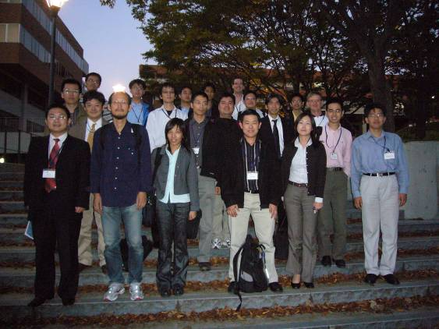
2nd APGrid PMA F2F Meeting
Date: October 15th
Place: Osaka, Japan
Participants: 26
Co-located with PRAGMA 11 Workshop

Slide 13
Agenda of the F2F meeting
09:00 - 09:15 | Welcome | Shinji Shimojo
09:15 - 09:45 | Status Updates | All CAs
09:45 - 10:30 | Recap of PMA/IGTF | Yoshio Tanaka
11:00 - 11:45 | Accreditation | NECTEC GOC CA
11:45 - 12:30 | In Depth Report | KISTI Grid CA
13:30 - 14:15 | Invited Talk | Yasuo Okabe
14:15 - 17:20 | Open Discussions - Procedures for Incident Response - Grid Certificate Profile - Classic Authentication Profile - Short Lived Credential Services AP - Member Integrated Credential Services AP

Slide 14
Highlights of the meeting
NECTEC GOC CA (Thailand) was accredited as an IGTF-Classic compliant Certificate Authority.
Agreed that KISTI Grid CA will be removed from a list of accredited CAs due to some fundamental problems
  Yoshio reported the results of auditing
  Sangwan gave a presentation on how to improve their operation
    No concrete procedures, timeline were presented
  We decided to remove KISTI CA by voting
    All members agreed
  Recommended to launch a new CA (re-accreditation is required).
Approved the proposed Classic AP version 4.1-b4 under the two conditions
  “keyUsage of CA Cert. MUST be marked as critical”
    “MUST” should be drop-off to “SHOULD”.
  Retention period of audit log
In PRAGMA WS
  Discussions on writing a new Authentication Profile appropriate for Portal architecture (e.g. GAMA, PURSE).

Slide 15
Members (13 + 4)
9 Accredited CAs
  In operation
    AIST (Japan)
    APAC (Australia)
    ASGCC (Taiwan)
    CNIC (China)
    IHEP (China)
    KEK (Japan)
    NAREGI (Japan)
    NECTEC (Thailand)
  Will be in operation
    NCHC (Taiwan)
1 CA under review
  NGO (Singapore)
Will be re-accredited
  KISTI (Korea)
Planning
  PRAGMA (USA)
  ThaiGrid (Thailand)
General membership
  Osaka U. (Japan)
  U. Hong Kong (China)
  U. Hyderabad (India)
  USM (Malaysia)

Slide 16
Portal-based Credential Services (tentative) Profile
Yoshio Tanaka
International Grid Trust Federation
APGrid PMA
AIST

Slide 17
Motivation
There are many Grid project which provide portal-based user registration system.
  GEON Grid, Earth System Grid, etc.
These portals issue certificates for users using credential management systems such as GAMA and PURSE, but there is no appropriate profile recognized by IGTF.
  Key pair is generated not at the client side but at the centralized server.
  Users do not need to take care about their certificates and private keys.
  Method of identity vetting can be flexible, but these portals are not doing strict vetting.
  They use online CA without HSM. Furthermore, some portals do not have a dedicated CA server.
  No CP/CPS.
  …

Slide 18
Motivation (cont’d)
Some projects are going to collaborate with the other projects.
  Need trust federation.
PRAGMA is planning to develop a PRAGMA Grid portal which is a single entry point to various PRAGMA applications (e.g. bio, geo science, telescience, etc.).
My interest is to define IGTF profile for portal-based credential services to classify their assurance level.

Slide 19
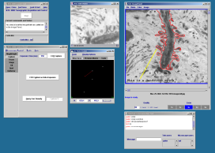
GAMA architecture
gama
create user
CACL
gridportlets
DB
GridSphere
import user
MyProxy
AXIS Web Services wrapper
Servlet container
retrieve credential
CAS
Java keystore
…
Portal server 1
retrieve credential
Portal server 2
Servlet container
Java keystore
GAMA server
Stand-alone applications

Slide 20
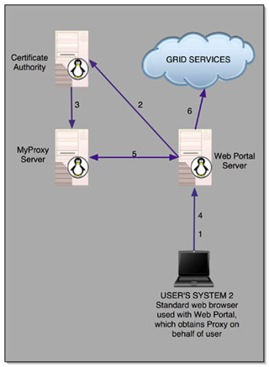
PURSE (Portal-based User Registration Service)

Slide 21
Issues need to be considered (1/2)
Key generation
  Not at the client’s side but at the central server.
  Login password for the portal is used as a ass phrase of the private key
CA operational requirements
  Online, but may not use HSM.
  CA signing machine may not be a dedicated machine.
    PURSE running the CA signing and MyProxy on the same machine.
Identity Vetting
  GEON uses email address as a source of identity.
  ESG requests users to put information about PI.
  But I could obtain a test account (and my certificate) on ESG by email verification.
    I could not see my certificate…
  Appropriate ID vetting may differ between projects.
    How can we define in the profile?

Slide 22
Issues need to be considered (2/2)
Lifetime of EE cert.
  Should depend on the identity vetting.
  If identity vetting is time consuming, it should be long lived. Otherwise, it should be short-lived.
Revocation
  May not be necessary for short-lived certs.
Publication and repository
  Current portals do not provide information about the CA (CP/CPS, CA cert, CRL, etc.)
    These are completely hidden from users.
  These must be available as the first step of trust federation.
Probably more issues…

