Slide 1

Innovations for Grid Security from Trusted Computing
Wenbo Mao
Trusted Systems Lab
Hewlett-Packard Laboratories, Bristol
United Kingdom
Joint work with
Hai Jin, Huazhong Univ. of Sci. & Tech., China
Andrew Martin, Oxford University, UK

Slide 2
What’s in this Presentation
Overview of Trusted Computing
TC Working Principle
TC for Grid Security

Slide 3
Trusted Computing in a Nutshell
A temper-resistant hardware based system
for a systematic fix of security problems with open platforms, while remaining in open-platform architecture
preventing release of critical data into undesired software environments
conformed platform/user security policies: even sys-administrator can’t override policies
An important requirement:
  low cost (target: < $5 per platform)

Slide 4
From TCPA to TCG
Founded in 1999 as
Trusted Computing Platform Alliance (TCPA) by:
  Compaq
  HP
  IBM
  Intel
  Microsoft
Renamed to Trusted Computing Group (TCG) in 2003
when TCPA reached 190+ member companies
https://www.trustedcomputinggroup.org/

Slide 5
TCG: not-for-profit, vendor neutral and industrial & open standards
The Board
Technical Committee
Marketing Committee
TPM
Conformance
PC-specific
PDA
Mobile ‘phone
Servers
Infrastructure
Peripherals
HDD
Keyboard
Promoted by: AMD, HP, IBM, Intel, Microsoft, Sony, Sun

Slide 6
Trusted Platform Architecture
TPM --- Trusted Platform Module ---
a tamper-resistant hardware module mounted in a platform
App1
App2
App3
.……
App n
protected
encrypted
executables
files
OS
TPM
Boot Processes
keys &
passwords
measurement & reporting

Slide 7
Deployment Status
TPM
v1.1b
First generation platforms from
HP and IBM – available since 2004
This notebook machine has one
TPM
v1.2
Second generation platforms based on
new offerings (eg, measurement, attestation)
from AMD, Intel, MS – available 2006 ?
TPM (security chip) vendors
Atmel, Infineon, National Semiconductor, Sinosun

Slide 8
TCG Benefits
  TCG is designed so that platform identities and Integrity Metrics can be proven reliably to remote parties
  Secure storage of crypto keys in TPM
  X.509 to be widely deployed in the vast client environment
  Secure online discovery of platforms and services: confidence in the information about the software environment and identity of a remote party
  Protection against hacker scripts, by automatically preventing access to data if unauthorised programs are executed

Slide 9
What’s in this Presentation
Overview of Trusted Computing
TC Working Principle
TC for Grid Security

Slide 10
How it Works….
TCG mechanisms for:
  Protected Storage and Execution
    Protect private and secret data
    Protected environment against malicious code subversion
  Platform Integrity Measurement and Storage
    Reliably measure software integrity property
    Securely store measured platform and s/w integrity
  Platform Status Attestation
    Report integrity properties to a remote challenging party
      Using crypto challenge-response mechanism and digital signature

Slide 11
Trusted Platform Module (TPM, Hardware): Protected (tamper-resist) Storage and Execution
Hash
Processor
NV-memory
Asymmetric
key generation
RNG
Memory
Power detection
Digital sign &
asymm crypto
Clock/Counter
Communications
I/O
MAC
PCR

Slide 12
TPM Crypto
Systems on the Chip:
SHA-1 hash, HMAC (hashed msg authentication code)
Random number generation (physical)
Asymmetric key generation (2048-bit RSA)
Asymmetric crypto encryption and signing(RSA PKCS#1v2)
Symmetric crypto is performed off-chip
(to achieve high performance and avoid exportation control)

Slide 13
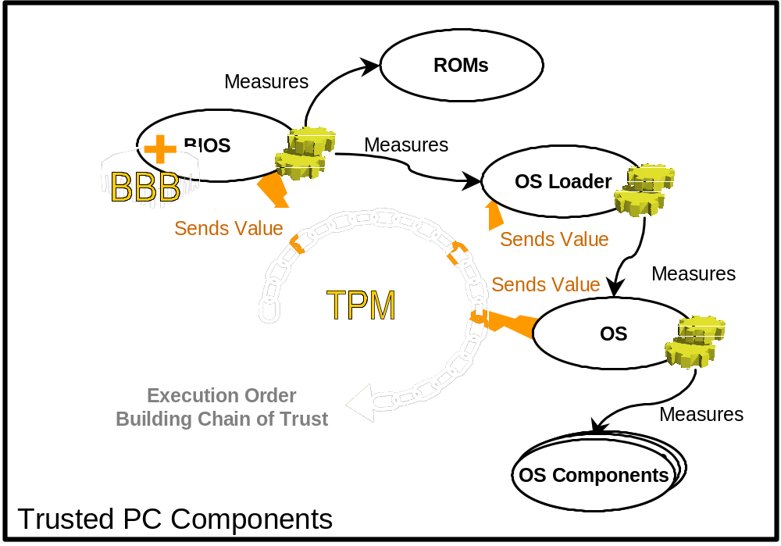
Core Root of Trust for Measurement (CRTM): Authenticated Boot

Slide 14
Integrity Measurement and Storage:
Platform Configuration Register (PCR)
An integrity measurement of an executable is a SHA-1 hash of 160-bit checksum (aka “crypto digest”)
The integrity measurement of executables is cumulatively stored in a PCR:
    PCR ← H( executable || PCR )
What can be measured and cumulatively stored (cannot be overwritten until reboot):
  BIOS, ROMs, MBR (static PCRs: no 0-4)
  OS loaders (static PCRs: no 5-7)
  Trusted OS’s (static PCRs: no 8-15)
  Trusted Applications (dynamic PCRs: no 21-22)

Slide 15
Platform Attestation: Reporting System Integrity Status to a Remote Party
Stored system integrity status can be reported to a remote party using crypto challenge-response mechanism and digital signature
TPM will use a user’s “attestation identity key (AIK)” to sign the system integrity report
  1 Alice → TPM-for-Bob: RandomN, “Status quo for PCR3?”
  2 TPM-for-Bob → Alice: Sign(PrivateAIK, RandomN, PCR3)
  3 Alice verifies signature using Bob’s PublicAIK

Slide 16
What’s in this Presentation
Overview of Trusted Computing
TC Working Principle
TC for Grid Security

Slide 17
TC for Grid Security “Offer I”:
Secure Key Storage
Tamper-resistant TPM is a natural place to store crypto keys, no need of using short-lived keys and “proxy certificates” with private key stored in file space
TPM of a client can be for multi users, each user can have a user key which can’t even be accessed by sys-admin
Secure key storage permits a longer lifetime for a certificate; it can be easier to achieve IPSec for Grid security at the node level, rather than being confined to “identity certificate” at the user level as in the case of the current GSI

Slide 18
TC for Grid Security “Offer II”: group-oriented security from distributed FW
A conventional firewall is based on network topology: one-side is all trusted, the other side is assumed all enemies; but a Grid VO has no such network topology
Distributed firewall (Bellovin et al):
  With secure means for key storage by each IP node, IPSec can be in place
  IP packets can be filtered or accepted according to VO policy and IPSec signatures (in IPSec, each packet is signed)
With distributed firewall, a Grid VO forms a trust domain and achieves good group-oriented security

Slide 19
TC for Grid Security “Offer III”:
Attestation of Secure Guest Environment
Attestation of secure virtualization:
A remote platform (eg, a Grid server) is attested by a guest such that it has the following behaviour of “virtualized OS in curtained memory”:
    (1) a memory area is allocated to run a virtualized secure OS environment which cannot even be accessed by the platform owner (eg, system administrator);
    (2) a proprietary code of a guest is encrypted under a public key where the matching private key is in the TPM; the encrypted code is sent to the TPM;
    (3) TPM decrypts and loads the proprietary code to run in the virtualized OS for the guest …
No conventional security mechanism can offer a solution to this typical Grid computing scenario. It is the remote platform attestation that has played the trick.

Slide 20
It’s time to work on “TC for Grid Security”
“Offer I” is available now (this machine has a TPM v1.1b)
  so “Offer I” is readily compatible with GSI (Security Area RG started in GGF13)
  node level certificate is ready for realizing IPSec
  user level certificate is ready for property-based credentials
“Offers II & III” address exactly fundamental limitations of GSI; the issue here is to augment GSI
  IPSec deployment will be sped up by TC, hence distributed firewall should start consideration for GSI
  integrity attestation is with TPM v1.2 and beyond (available in 2006); virtualization work is now underway
IDC predicts: 20 million TPM platforms to be delivered by end of 2005, and by 2007, 70% of the platforms world wide will have TPMs
Microsft “Longhorn” OS will use TPM, available in 2006
Future: with Grid & TC both in open-platform architecture, they can co-develop without major obstacle

Slide 21
Work in GGF
A GGF new project, TC-RG, has been created:
https://forge.gridforum.org/projects/tc-rg
  Offer I (i.e., augmenting GSI with TPM for crypto key repository) has been planned for completion in one-year timeframe
  Offers II & III are to be researched further
A paper version of this presentation can be downloaded from the above URL

Slide 22


