Slide 1
Grid File System WG
GGF11, Honolulu
June 8-9, 2004

Slide 2
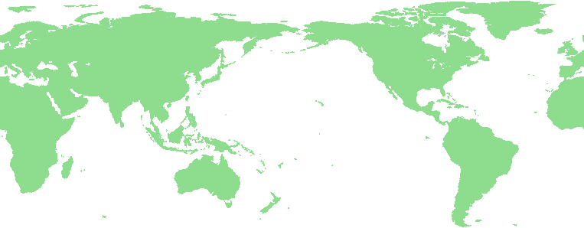
[Big picture] Grid File System
Grid File System federates and shares virtualized data from file systems in a Grid
  Virtual hierarchical namespace with access permission and metadata
  POSIX I/O interfaces, legacy file system servers for the Grid file system
Virtual Directory
Tree
/grid
Grid File System services
ggf
jp
Replica services
Data services
aist
gtrc
file1
file2
Mapping
file1
file2
file3
file4
Grid File System

Slide 3
Charter of GFS-WG
Two goals (two recommendation documents)
  File System Directory Services
    Manage namespace for files, access control, and metadata management
  Architecture for Grid File System Services
    Provides functionality of virtual file system in grid environment
    Facilitates federation and sharing of virtualized data
    Uses File System Directory Services and standard access protocols
GFS-WG#1
GFS-WG#2
8am,
Tomorrow

Slide 4
GFS-WG #1 File System Directory Services
Tuesday, June 8 from 6pm-7:30pm in room South Pacific 4
“File System Directory Services Specification”
by Manuel Pereira [IBM Almaden]
  manage virtual file system directories in association with access permission, and other application-specific metadata
http://www.ggf.org/Meetings/GGF11/Documents/File_System_Directory_Service_Specification.pdf
(will be submitted in GGF13, March 2005)

Slide 5
Grid File System Services
Provides virtual file system by integrating and federating file systems in a grid
Service oriented architecture using several services
Architecture document
  Provide a way of composition of services to realize Grid file system
    What kind of functionalities each service should have
    How these services relate with each other

Slide 6
Architecture of Grid file system
File System Directory Services
POSIX APIs
/grid
File System Services
Client Library
ggf
jp
data
gfs
file1
file2
file1
file2
file3
file4
ReplicaSet Service
File System Server
file4
file4
file2
Applications,
Users, . . .
File Access Services, . . .
NFSv4, . . .

Slide 7
Access control issues
Access control provided by file system directory services
(Access control provided by ReplicaSet Service)
Access control provided by file access services
 | Allow | Deny
Allow | OK | Cannot access
Deny | Security violation | OK
Access
Directory

Slide 8
[Possible solution] Enforcement of access permission
Community Authority Server (CAS)
  Too heavy overhead for fine grain access control
File System Directory Services grant access permission
  File System Directory Services act like a CAS
  File Access Services trust a File System Directory Services

Slide 9
Other possible issues
Security issue
  Security level mismatch, bypath access
Space management
  To create a new file via Grid file system, it needs to determine the place to create a file
  When one of physical disk space becomes full, it needs to migrate files or delete unnecessary file replica
Replica management
  Automatic selection of most appropriate file replicas for load balancing and fault tolerance
  Automatic replica creation and placement
Performance issue
  Compound (Bulk) operation
Locking and transaction

Slide 10
GFS-WG #2 Architecture of Grid File System Services
Wednesday, June 9 from 8am - 9:30am in room South Pacific 3
Introduction of “Architecture for Grid File System Services”
by Osamu Tatebe [AIST]
  provide a functionality of Grid file system using the File System Directory Services and other common services
Proposed outline
by Arun Jagatheesan [SDSC]

