Slide 1


Introduction to International Virtual Observatory Projects
Dr. Peter Quinn
European Southern Observatories
IVOA Chairman

Slide 2
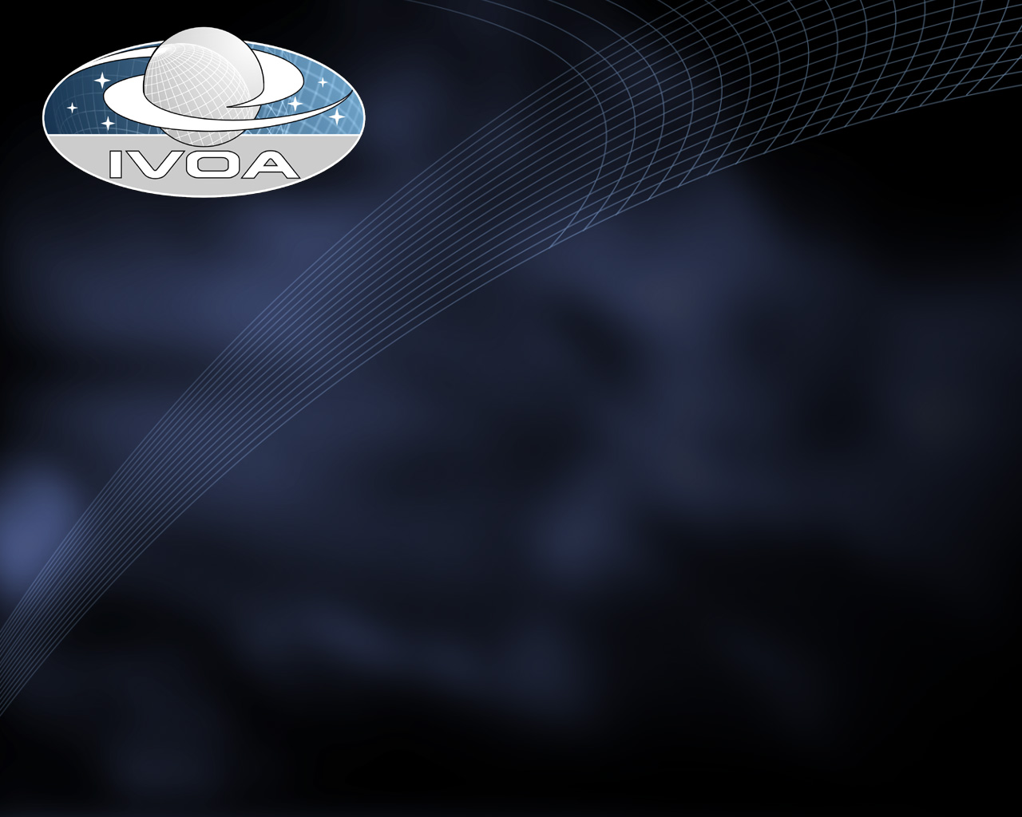
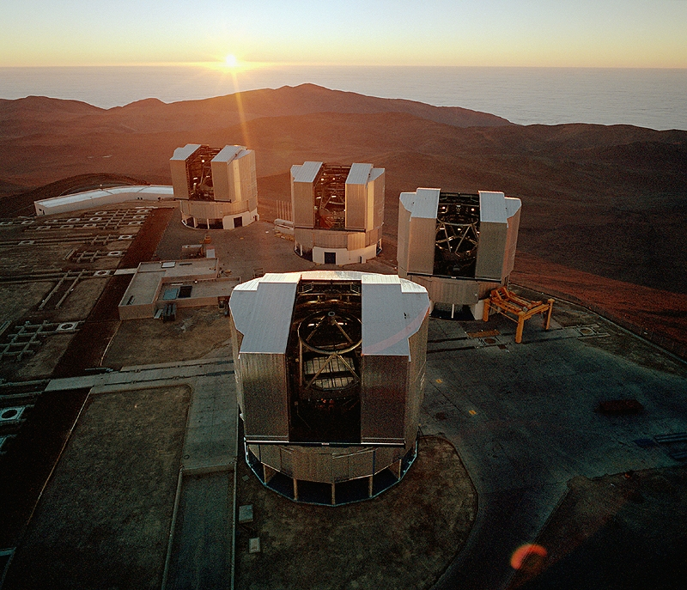
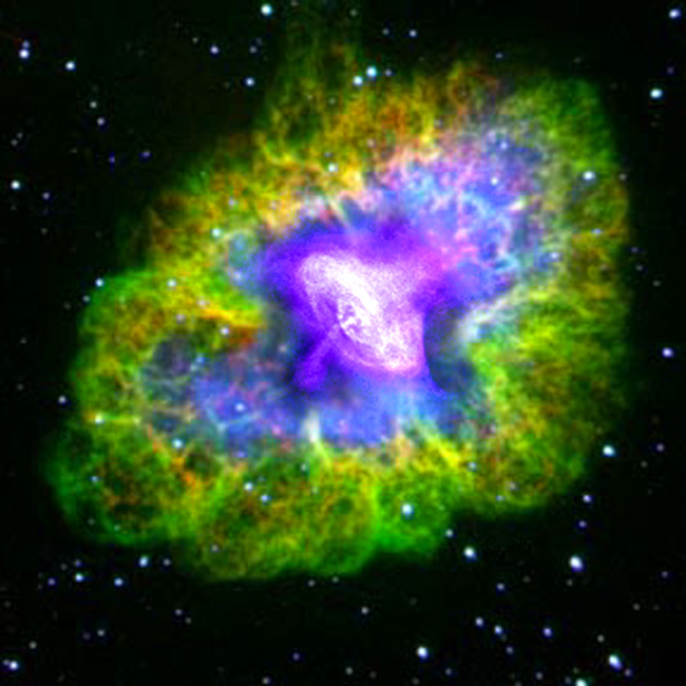
What has the Grid got to do with astronomy?
Astronomy has become a BIG international science with similar challenges to other physical sciences
Astronomy projects involve
  International coordinated research efforts
  Distributed multi-wavelength teams, resources & data
  Data volumes with doubling times < 12 months
Astronomy service organizations need to
  provide users with access to software tools, high quality raw and processed data in the face of user computing power and network bandwidths with doubling times > 18 months
Opportunities exist for new scientific capabilities (the IVO)

Slide 3
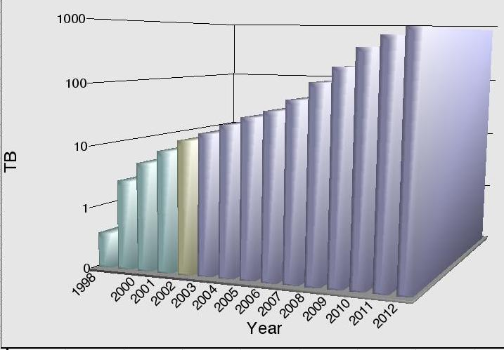
Astronomical Data Growth
T₂ < 6 months
T₂ < 12 months
ESO Science Archive
Facility

Slide 4
Astronomy Data Utilization
10000
2
9000
Archive Input
1.8
8000
Archive output
1.6
Output/Input
7000
1.4
6000
1.2
Gigabytes
Data Output/Data
(compressed)
Input
5000
1
4000
0.8
3000
0.6
2000
0.4
1000
0.2
0
0
1998
1999
2000
2001
2002
Period

Slide 5

Distributed Computing at Work in Astronomy
Virtual and collaborative exploration of the Universe
  Build instruments
  Work with researchers
  Find the unknown
  Boldly go...
Total
Last 24 Hours
Users
3675440
5075
Results received
491854017
1092374
Total CPU time
954229.737 years
1662.448 years
Floating Point Operations
1.502416e+21
4.260259e+18
49.31 TFLOPs/sec

Slide 6
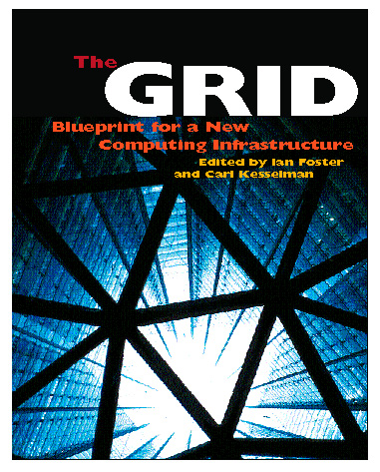
Astronomical
Problems & Solutions
PROBLEM SOLUTION
Slow CPU growth Distributed Computing
Limited storage Distributed Data
Limited bandwidth Information Hierarchies
- Move only what you need
Data diversity Data Interoperability
VO

Slide 7
The Virtual Observatory
“The Virtual Observatory will provide a ‘virtual sky’ based on the enormous data sets being created now and the even larger ones proposed for the future. It will enable a new mode of research for professional astronomers and will provide to the public an unparalleled opportunity for education and discovery.”
—Astronomy and Astrophysics in the New Millennium

Slide 8
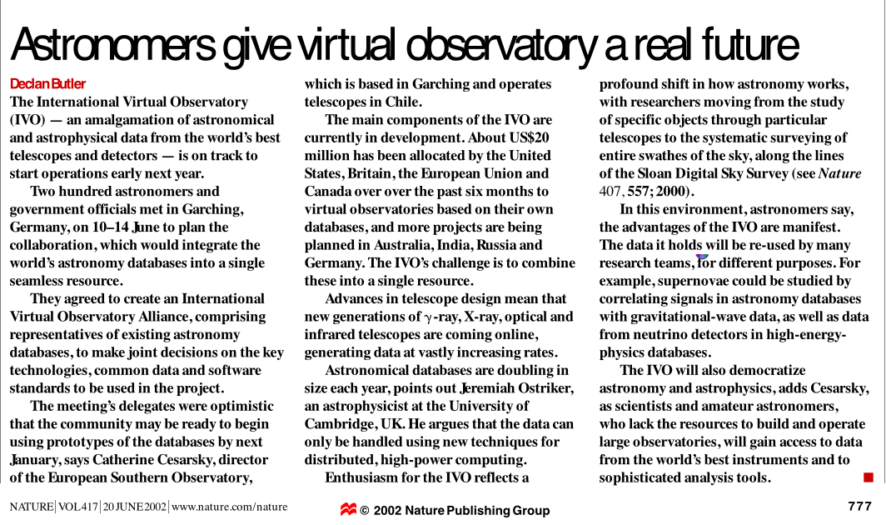
In the press
Nature 21 November 2002

Slide 9
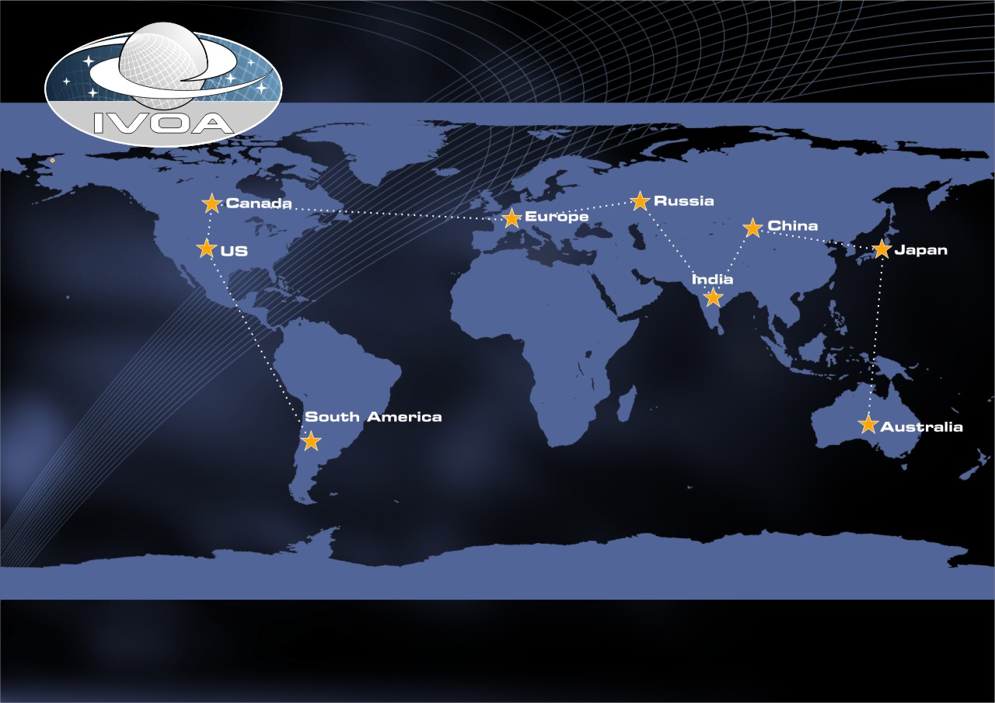
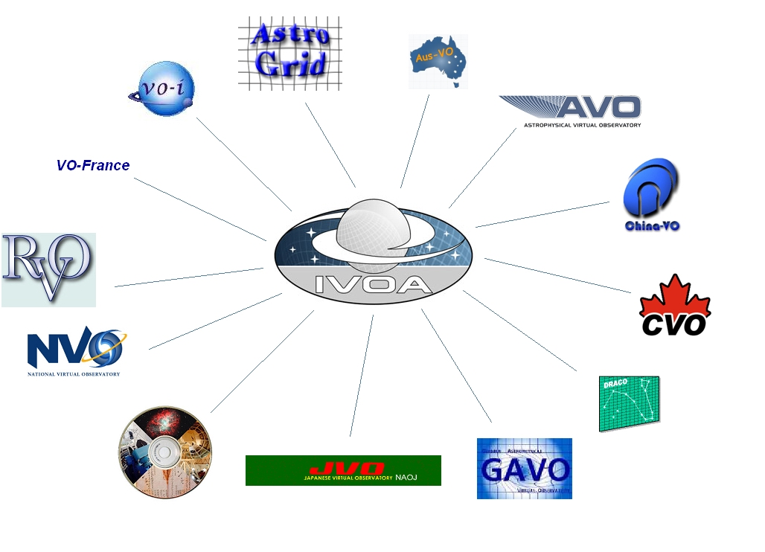
International Virtual Observatory Alliance
Resources
Formed July 2002
25 million € over the next 3-5 years
13 projects
Mission
To facilitate the international coordination and collaboration necessary for the development and deployment of the tools, systems and organizational structures necessary to enable the international utilization of astronomical archives as an integrated and interoperating virtual observatory

Slide 10
Roadmap
June 2002 - IVOA formed
January 2003 Coordinated Demo 1
  New, introductory functionality (VOtable)
August 2003 International Demo
  IAU Sydney, international access
January 2004 Coordinated Demo 2
  Definition of new standards for data access and data discovery
January 2005 Coordinated Demo 3
  Complex new functions for knowledge discovery + the Grid
http://www.ivoa.net

Slide 11
Key VO Infrastructures
Registries
Data Models
Uniform Content Descriptors
Data Access Layer
VO Query Language
VOTable

