Slide 1
CIM Grid Services –
Model Demo
Andrea Westerinen and Julie Schott
Cisco Systems And DMTF

Slide 2
Agenda
Why CIM?
Environment of the Demo
Example Scenario
Issues

Slide 3
Why CIM?
Not starting from scratch
  Internet- and enterprise-wide management
  Wide breadth of objects + repository independent
  Unifies and extends existing standards (MIBs, X.500, M.3100, …)
Much thought has been put into use cases and debugging the model
Model evolving and continually being expanded
  DMTF very interested in requirements, questions and feedback
Open-source available
  www.wbemsource.org

Slide 4
Environment
Open-source infrastructure
  Java WBEMServices CIM Server and CIM Workshop
  www.wbemsource.org
SNIA tool, CIM Miner
  Storage Networking Industry Association
  Executable available from www.snia.org
  Source available to SNIA members
Simulated environment
  Data input via XML tagged files

Slide 5
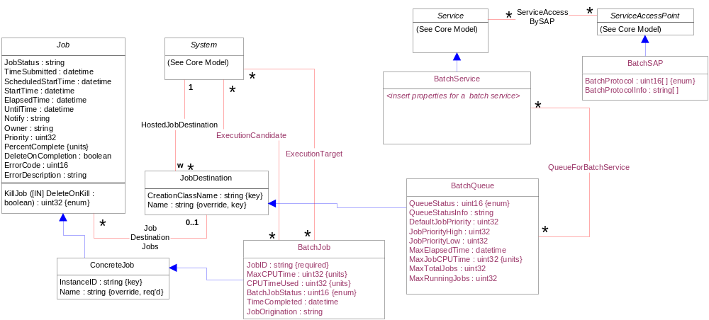
Model Overview
+ JobScheduleSettingData
+ QueueStatisticalData

Slide 6
Example Scenario - ComputerSystems
4 ComputerSystems
  CS1 hosts BatchSAP-A, BatchService-A and Queue1
  CS2 hosts BatchSAP-B, BatchService-B, BatchSAP-C, BatchService-C and Queue2
  CS3 hosts Queue3
  CS4 is available for execution of jobs
QueueForBatchService
  Service-A can use Queues 1 and 3
  Service-B can use Queues 2 and 3
  Service-C can use Queue 3

Slide 7
Example Scenario - Jobs
5 Jobs
  Jobs 1 and 4 come into SAP-A (for Service-A) with priorities 100 and 10 respectively
  Job4 specifies DeleteUponCompletion
  Jobs 2 and 5 come into SAP-B (for Service-B) with priorities 100 and 10 respectively
  Job 3 comes into SAP-C (for Service-C)
JobDestinationJobs
  Job1 is placed on Queue1
  Jobs 2 and 5 are placed on Queue2
  Jobs 3 and 4 are placed on Queue3
  Consistent with QueueForBatchService

Slide 8
Example Scenario – Job Scheduling
All Jobs can execute on CS1 or CS4
  ExecutionCandidate associations are defined for each Job to CS1 and CS4
JobScheduleSettingData
  User information is supplied for Jobs 2 and 5
  Job2 specifies a start time (Time 3)
  Job5 is a recurring job that has an UntilTime
  Associated via ElementSettingData

Slide 9
Job Execution
Highest priority jobs come off each Queue and go to CS1 or CS4 / Other jobs are taken from Queues if processing cycles are available
  ExecutionTarget is set appropriately
  Status via OperationalStatus (OK, Error, Completed, …), JobStatus (Pending, Running, Completed, …) and EnabledState (Enabled, Disabled, …)
Time 1
  Job1 comes off Queue1, Job5 comes off Queue2, and Job4 comes off Queue3
Time 2
  Queue1 is empty, Job5 comes off Queue2 (recurring), and Job3 comes off Queue3
Time 3
  Queues 1 and 3 are empty, Job5 comes off Queue2, and Job2 comes off Queue2

Slide 10
Questions and Issues
Job needs RecurringElapsedTime – DMTF issue
  What is actually set for the Job, versus what is requested
JobScheduleSettingData not Scoped – DMTF issue
  Tied to Job via ElementSettingData, no need for multiple associations
JobScheduleSettingData better named as JobSettingData – DMTF issue
  Not just about “scheduling”
Address meaning of Priority and conversions of the priorities of submitted jobs vs the queue’s ordering
BatchJobGroup – Need a use case
Need job completion statistics

Slide 11
Questions and Issues From Demo Session
Resolve DeleteOnCompletion with OGSA lifecycle
BatchService
  Does it manage input to a Queue and removal from a Queue (ie, scheduling), or are there different services for this?
  How do you characterize the service and determine criteria for submitting a job to a particular Service?
Examine brokering use case and discovery (versus just submission)
Resolve statuses (OperationalStatus, JobStatus and EnabledState) and how/whether they are used in the grid environment
Do we need more job information/detail?

