Slide 1
Grid-enabled drug discovery to address neglected diseases
N. Jacq
Laboratoire de Physique Corpusculaire – CNRS
HealthGrid session of LSG-RG - GGF12 - Brussels September 22nd 2004
Credit: authors of White Paper chapter 5

Slide 2
Content
The challenges of drug discovery
A pharmaceutical grid for drug discovery
A pharmaceutical grid for neglected diseases

Slide 3
Phases of a pharmaceutical development
Understanding Disease
  Therapeutic Targets identification
  Determination of sequence, function, structure, pathways…
  Target validation
Choice or modeling of compounds
Leads finding and optimization
Clinical Phases (I-III)
Average of 12 years, +/- $200 millions
Difficult and random work

Slide 4
Selection of the potential drugs
28 million compounds currently known
Drug company biologists screen up to 1 million compounds against target using ultra-high throughput technology
Chemists select 50-100 compounds for follow-up
Chemists work on these compounds, developing new, more potent compounds
Pharmacologists test compounds for pharmacokinetic and toxicological profiles
1-2 compounds are selected as potential drugs

Slide 5
Dataflow and workflow in a virtual screening
compounds database
docking
MD-simulation
hit
Structure
optimization
junk
Reranking
target structure

Slide 6
Computational aspects of Drug Discovery : virtual screening
Growing:
  Number of targets
  Number of known and registered 3D structures (PDB database)
  Computing power available
  Quality of prediction for protein-compound interactions
Experimental screening very expensive : not for academic or small companies
The aim of virtual screening is :
  Enable scientists to quickly and easily find compounds binding to a particular target protein
Actives molecules
Tested molecules

Slide 7
Success with virtual screening
Dihydrofolate reductase inhibitor (1992)
HIV-protease (1992)
Phospholypase A2 (1994)
FKBP-12 (1995)
Thrombine (1996)
Abl-SH3 (1996)

Slide 8
Pharmaceutical R&D enterprise
Multi-years, multi-person, multi-millions of euro investments
New scientific territory and intellectual property
Diversity and complexity of information required to arrive at well founded decisions
  Scientific data (images, sequences, models, scientific reports…)
  Critical organizational information (project, financial management)
  Internal proprietary, external commercial, open-source data

Slide 9
Problems range
Knowledge-representation and integration
Distributed systems search and access control
Data mining and knowledge management
Real-time modeling and simulations
Algorithm development and computational complexity
Virtual communities and e-collaboration

Slide 10
Content
The challenges of drug discovery
A pharmaceutical grid for drug discovery
A pharmaceutical grid for a neglected disease

Slide 11
Grid: shared in silico resources
Guarantee and preserve knowledge in the areas of discovery, development, manufacturing, marketing and sales of next drug therapies
Provide extremely large CPU power to perform computing intense tasks in a transparent way by means of an automated job submission and distribution facility
Provide transparent and secure access to store and archive large amounts of data in an automated and self-organized mode
Connect, analyze and structure data and metadata in a transparent mode according to pre-defined rules (science or business process based)

Slide 12
A pharmaceutical grid
Perspective of cheaper and faster drug development
Parallel processes could improve
  In silico science platforms for target identification and validation,
  Compounds screening and optimization,
  Clinical trials simulation for detection of deficiencies in drug absorption, distribution, metabolism and elimination.

Slide 13
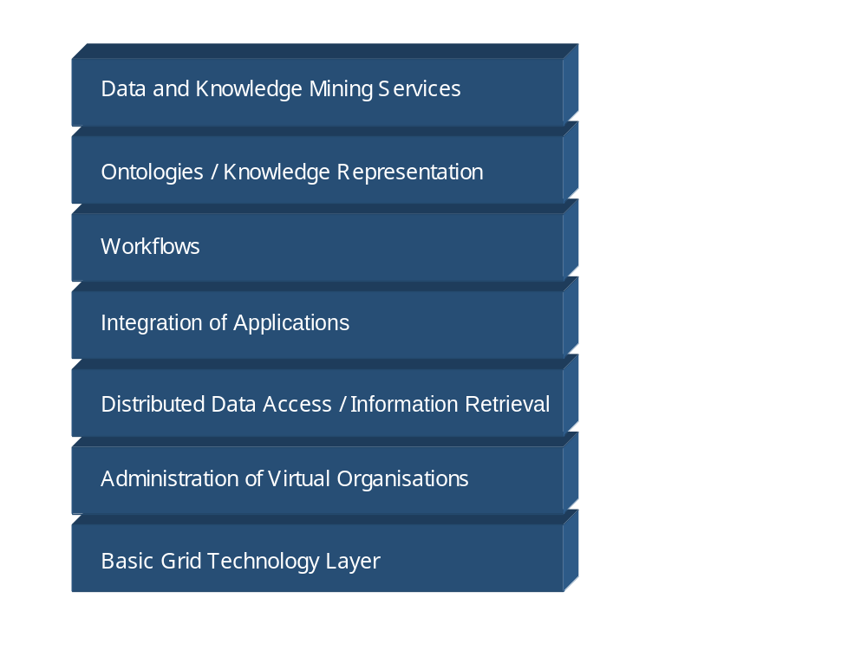
Structure of a grid for drug discovery
Statistical models, optimisation
Construction in function of the disease/subject of the grid
Virtual screening machine with formal description
Meta-information on softwares and formats
Semantic inconsistence between biological and chemical databases
=> ontology-based mediation services
Users integration from different and heterogeneous organisations
Grid engine

Slide 14
Consequences on the pharmaceutics' world
Pharmaceutical grids will predominantly be private enterprise-wide internal grids with strict control and standard
  Competitive and intellectual property protection reasons
Effective virtual organizations based on efficient secure and trusted-collaborations
  Foundation for new forms of partnerships amongst commercial, academic government and international R&D organizations.

Slide 15
Content
The challenges of drug discovery
A pharmaceutical grid for drug discovery
A pharmaceutical grid for a neglected disease

Slide 16
Overview on neglected diseases
Infectious diseases kill 14 million people each year, more than 90% of whom are in the developing world.
Access to treatment is problematic
  the medicines are unaffordable,
  some have become ineffective due to drug resistance,
  others are not appropriately adapted to specific local conditions and constraints.
Neglected diseases represent grave personal tragedies and substantial health and economic burdens even for the wealthiest nations.
Drug discovery and development targeted at infectious and parasitic diseases in poor countries has virtually ground to a standstill, so that these diseases are neglected.

Slide 17
Drug discovery for neglected diseases
Lack of ongoing or well coordinated R&D
  Research often takes place in university or government labs
  Development is almost exclusively done by the pharmaceutical and biotech industry
  Critical point is the launching of clinical trials for promising candidate drugs.
Producing more drugs for neglected diseases requires
  building a focussed, disease-specific R&D agenda including short-, mid- and long-term projects.
  a public-private partnership through efficient, secure and trusted collaborations that aim to improve access to drugs and stimulate discovery of easy-to-use, affordable, effective drugs.
The goal is to lower the barrier to such substantive interactions in order to increase the return on investment for the development of new drugs.

Slide 18
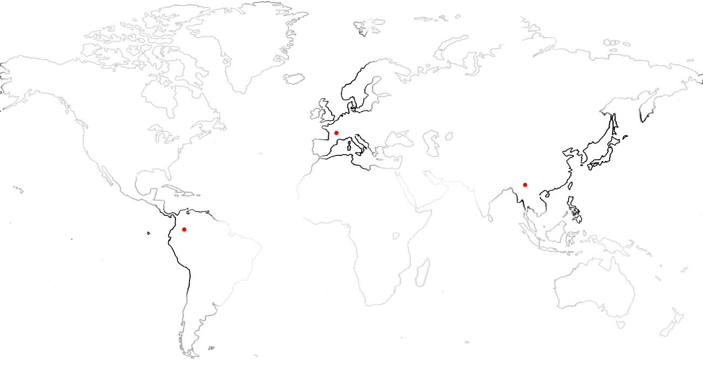
Grids for neglected diseases and diseases of the developing world
In silico drug discovery process (EGEE, Swissgrid, …)
SCAI Fraunhofer
Clermont-Ferrand
Support to local centres in plagued areas (genomics research, clinical trials and vector control)
Swiss Biogrid consortium
Local research centres
In plagued areas
The grid impact :
Computing and storage resources for genomics research and in silico drug discovery
cross-organizational collaboration space to progress research work
Federation of patient databases for clinical trials and epidemiology in developing countries

Slide 19
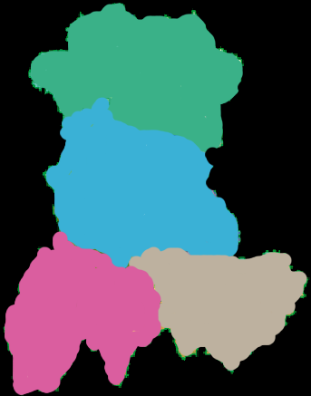
Federation of patient databases for clinical trials and epidemiology in developing countries
Clermont-Ferrand
INSTRUIRE
collaboration
Map of Auvergne
Regional grid
Patient data
Request for
2nd diagnostic
Second diagnostic
Patient follow-up
Shanghaï
Hospital n°9
Life science park
(20 biotech SMEs)
Chuxiong
Clermont-Ferrand
University campuses
Preparation and follow-up of medical missions in developing countries of the french NPO “Chaîne de l’Espoir”
Support to local medical centres in terms of second diagnosis, patient follow-up and e-learning
Bioinformatics
College, Aurillac
Medical imaging
Le Puy
Technology: Relational DB, SRB

Slide 20
Collaborative environment
A pharmaceutical grid will support such processes as:
  search of new drug targets through post-genomics requiring data management and computing
  massive docking to search for new drugs requiring high performance computing and data storage
  handling of clinical tests and patient data requiring data storage and management
  overseeing the distribution of the existing drugs requiring data storage and management
  trusted exchange of intellectual properties

Slide 21
Virtual organisation
Motivate and gather together in an open-source collaboration :
  drug designers to identify new targets and drugs
  healthcare centres involved in clinical tests
  healthcare centres collecting patent information
  organizations involved in distributing existing treatments
  informatics technology developers
  computing and computer science centres
  biomedical laboratories working on vaccines, genomes of the virus and/or the parasite and/or the parasite vector

Slide 22
Perspectives
Interest group set up at last Pharmagrid conference
  Contact point: Howard Bilofsky, bilofsky@pcbi.upenn.edu
Deployment on european grid infrastructures of an in silico screening platform for neglected diseases
  Collaboration between SIMDAT, EGEE and the Swiss BioGrid initiative
  Proof of concept on 2 tropical diseases: malaria and Dengue
  Proposal to EGEE applications advisory panel in November 2004
For GGF13, description of use case

Slide 23
Acknowledgement
H. Bilofsky – University of Pensylvania
V. Breton – IN2P3/CNRS
M. Hofmann – SCAI Fraunhofer
C. Jones – CERN
R. Ziegler, M. Peitsch – Novartis
T. Schwede, Univ. Basel
HealthGrid White Paper : www.healthgrid.org

