Slide 1

Status of perfSONAR Tools
Jason Zurawski
April 23, 2007
Spring Member Meeting

Slide 2
Outline
What is perfSONAR?
Who is perfSONAR?
Current Tools/Development Status
Looking Ahead

Slide 3
What is perfSONAR?
Performance Middleware
  Set of protocol standards
    Fosters interoperability between measurement and monitoring systems
  Set of open source web services
    mix / match (extend?) each to create a performance monitoring infrastructure
  International consortium of partners

Slide 4
High Level Description
Standards-based
Modular
Decentralized
Locally controlled
Open Source
Extensible
Customizable

Slide 5
Who is perfSONAR?
perfSONAR is a joint effort:
  ESnet
  GÉANT2 JRA1
  Internet2
  RNP
ESnet includes:
  ESnet/LBL staff
  Fermilab
Internet2 includes:
  University of Delaware
  Georgia Tech
  SLAC
  Internet2 staff
GÉANT2 JRA1 includes:
  Arnes
  Belnet
  Carnet
  Cesnet
  CYNet
  DANTE
  DFN
  FCCN
  GRNet
  GARR
  ISTF
  PSNC
  Nordunet (Uninett)
  Renater
  RedIRIS
  Surfnet
  SWITCH

Slide 6
But What is it REALLY?
Network measurement tools
  Network measurement archives / points
  Discovery
  Authentication and authorization
  Data manipulation
  Resource protection
  Topology

Slide 7
Current Development
Network measurement archives/points
  Data Gathering / Storage
Discovery
  Service Discovery/Catalog
Authentication and authorization
  Centralized Authentication/Identity management (In progress)
Data manipulation/Presentation
  Prepare/Present data in different formats (N/A yet)
Resource protection
  Limit access to and quantity of data from other services.
Topology
  Glean useful network makeup/state.

Slide 8
Current State of the Art
Network measurement archives
  RRD/SQL MA (Maturing, Deployed)
Discovery
  LS (Maturing, Limited Deployment)
Data manipulation/Presentation
  perfSONAR UI (Maturing)
  Google Maps
    Utilization
    Topology
  Speedometer / Utilization

Slide 9
Measurement Archives/Points
MA/MP Service(s)
  Publishes measurement data
  Accepts and writes measurement data
  Formats:
    RRD (Round Robin Database) Format
    SQL (MySQL currently) Format
    Native XML (eXist, BDB) Format
  Available in many flavors
    Java
    Python
    Perl

Slide 10
Measurement Archives/Points
Currently Deployed:
  Geant
  RNP (Brazil)
  Internet2
    Limited 'new' network deployment
    Full monitoring as network comes up

Slide 11
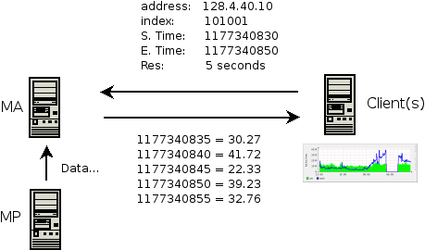
Measurement Archives/Points

Slide 12
Lookup Service
LS Service:
  Use of native XML DB backend (eXist currently, BDB soon)
  Service registration operations
    (Register/De-register/Refresh/Query)
  Lookup request and reply interface, using XPath/XQuery
  Client API to help build XQuery based request messages (In Progress)

Slide 13
Lookup Service
LS Service:
  Currently limited deployment for use in 'single domain' situations ('local' lookup)
  Multi-domain use in development
  Flavors:
    Java
    Perl (In Progress)

Slide 14
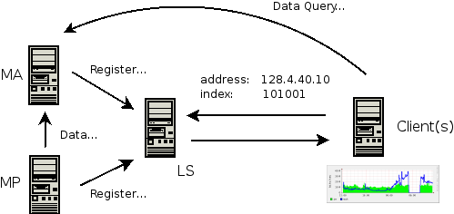
Lookup Service

Slide 15
GUI/Data Presentation
perfSONAR UI
  Visualization tool (Java Client) that allows seamless access to deployed MA instances (utilization data commonly).
Google Maps
  Similar to perfSONAR UI
  Map of Monitored Routers (Long/Lat Based)
  Clickable Utilization Statistics
perfSONAR Speedometer

Slide 16
perfSONAR UI
Easy to use / powerful GUI client
  capable of querying a range of perfSONAR services.
  targets:
    NOC and PERT staff
    Research that demands network performance information
    End-users

Slide 17
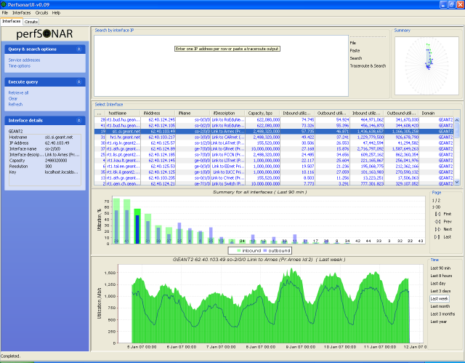
perfSONAR UI

Slide 18
Google Maps
Demo during Performance Update Tomorrow
  Map routers across a gmap based on LOC records
  'clickable' balloons will trigger LS/MA queries for data
  Display Utilization/Summary information

Slide 19
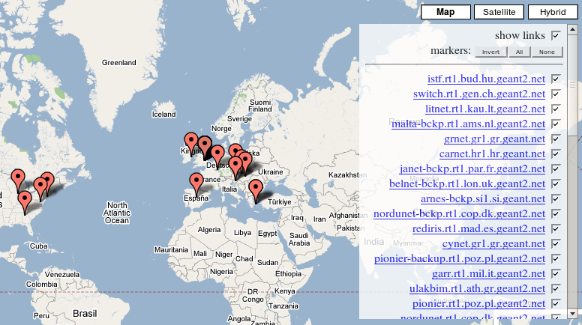
Google Maps

Slide 20
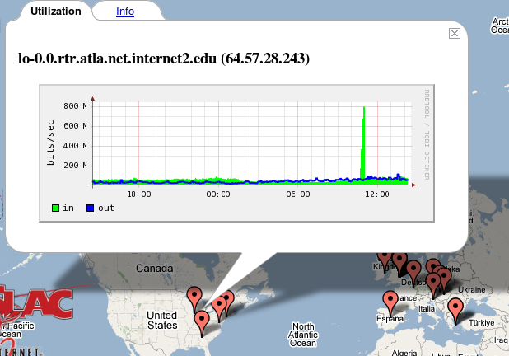
Google Maps

Slide 21
perfSONAR Speedometer
Demo during the HOPI session
  perfSONAR-PS (Perl based) MP/MA to extract and store SNMP Data
  Javascript based GUI to display utilization, current speed

Slide 22
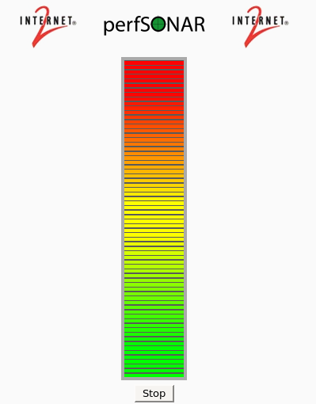
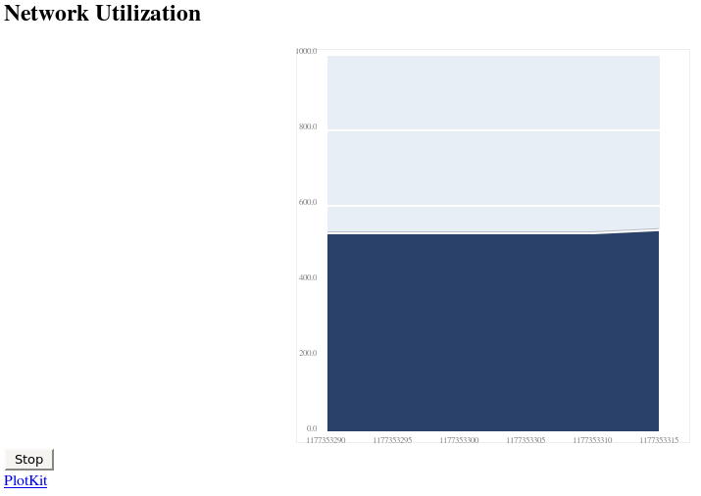
perfSONAR Speedometer

Slide 23
Looking Ahead
Improved installer(s) (Perl, Java)
Deployment to I2, Local Partners
Additional data sets will be come available over time
Visualization Improvements

Slide 24
Resources
Web:
  www.perfsonar.net
  wiki.perfsonar.net
Mailing List:
  mail.internet2.edu/wws/info/perfsonar-user
Me:
  zurawski@internet2.edu

