Slide 1
HIPAA:
Where Atomic Data Collides With
Distributed DNA
Or, why health data and people will
always be a problem and what
can be done to improve it
June 26th, 2005

Slide 2
Defining the Problem
Health Information Usage & Issues
Public sector/ Community Health:
  Government- local, state, federal
  University R&D
Private sector/ Commercial Health Info:
  Patients
  Providers
  Employers/ Payers
  Drugs/ Devices
Technology, Design, Management:
  Secure system design
  Secure operating systems and databases
The Real Problem => “adoption & the inside job”

Slide 3
Defining the Problem
Public Sector/ Community Health Data Drivers
Local, State, Federal Governments:
  More rapid and comprehensive identification of public health issues related to bio-hazards and chronic disease
  Identification of homeland security issues e.g. bio-terrorism outbreaks of anthrax, small pox, etc.
Universities and R&D:
  Need for better, more rapid and comprehensive data related to biotech and disease research
  Identify better potential populations for R&D purposes whether those requirements need diversity or homogeneity.

Slide 4
Defining the Problem
Private Sector/ Commercial Health Data Drivers
\
Patients:
  Want better and safer patient care
  Need ability to maintain data
  Need ability to authorize access to “my health info”
Providers:
  Goal is better care for their patients
  If too efficient, potential loss of revenue (less visits, less labs)
  Lots of data is better clinically, but Catch 22 is efficiency
  “Ownership” of data is competitive advantage
Employers/ Payers:
  Want healthy, productive employees
  Employees need data to manage risk/ costs/ wellness
  Payers have limited data to pay claim (HCFA 1500 form)
  Payers reluctant to release employer’s population data
Drugs/ Devices:
  Want patients to “test”
  Data drives FDA approval
  Need access to diversity/uniformity of patient populations

Slide 5
Defining the Problem
Technology, Design, Management
\
Secure System Design:
  System design is critical to security
  Lack of pervasive security knowledge in healthcare
  Need ability to maintain data on a federated basis
  Patients “OWN” the data (as defined by HIPAA’s PHI definition)
  Need ability to authorize access to “my health info” over heterogeneous systems and networks (a one2many, many2one problem)
Grids, Operating Systems and Databases:
  What is secure- a VOS (grid), an OS or a RDMS?
  Does grid distribution facilitate security (e.g. security obscurity)?
  The “master grid controller” as a point of failure?
  Databases “lockdown” file structures to BIOS/ OS/ VOS, or not?
  Local access vs. remote access?

Slide 6
Defining the Problem
The Real Problem
\
Adoption:
  How many of 785,000 providers have computer systems at work?
  IF AMA’s 98% physician Internet usage is accurate, how many even use computers in their office?
  How many have or even know what an EMR is?
  How many believe a “secure fax” locked in a closet is “good enough”?
The Inside Job:
  How many understand the importance of biometric systems?
  How many use MS Windows 2003 with latest security updates?
  How many providers meet DoD/ NSA security guidelines?
  IF AMA’s 98% physician Internet usage is accurate, how many even have a router or firewall?
  Even if they have an EMR, how secure is it?
  How many even have a policy on logins/ passwords or even know what to do with them?

Slide 7

Traditional Healthcare Environment
Group Health & Occupational Health Markets
Employee
Injuries
& Illness
Benefits &
Lost-time Wages
Provider
Payor/
Employer
Medical Costs

Slide 8
Providing an Answer- Better Data Management
Group Health
Data Warehouse/
Clinical Repository
Interventions
Workers Compensation
Advanced Analytics
Population
Disability
Benefit Integration/
Data Collection
Action
Location
Reporting Suite
Management Reports
Executive Dash-board
Ad hoc Reports
Point and Click Data Map
Occupational Medicine
Individual
Time & Attendance
Clinical Data Collection
and Integration
Clinical Data Warehouse
Interventions
Compile clinical data from all providers
Databases and systems designed for large-scale processing, transactional performance, high availability and “beyond HIPAA” security/ compliance
Real-time measurable data-driven interventions
Prevention, mitigation, management, of disease

Slide 9

Connectivity Improve Outcomes & Costs
Workers’ Compensation, Group Health & Occupational Health Markets
Employee
Quicker Return To Work
Improved
Outcomes
Injuries
& Illness
Benefits &
Lost-time Wages
Provider
Payor/
Employer
Medical Costs
Reduced Cost

Slide 10
What’s Required
An integrated medical management information network that empowers its customers to manage the quality and cost of healthcare through a unique blend of:
  Powerful & Flexible Rules System - apply medical rules, business rules, financial rules and best practices medical guidelines to reduce medical and billing errors.
  Workflow Automation Simplified - Reduces administrative burdens and bottlenecks. Enhances patient flow and expediency of treatment.
  Real-time Employer Business & Clinical Rules - Employer protocols are handled discretely for appropriate medical intervention and process management.
  Integrated Case Management Platform – Case managers, payers and employer/customers have real-time access to clinical data.
  Enterprise-class Performance - Supports mission-critical health operations that require 99.9999% uptime, large-scale and “blink speed 300ms” response (a.k.a. the “grid”).
  HIPAA 2006 Security - Ensures customers of Dept. of Defense-level security down to the individual field in a medical record- “keystrokes” are tracked by all users.

Slide 11
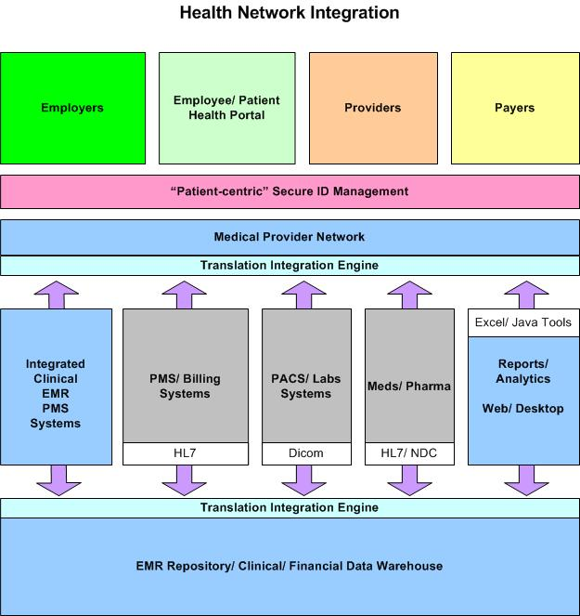
What Must Be Delivered

Slide 12
HIPAA-Grid requirements
Addressing the Solution with “Reasonable Efforts”
Administrative:
  What’s needed from personnel to administer health data
Physical:
  What’s needed for computers/ devices to help people manage health data
Technical:
  What’s really needed to make it all work

Slide 13
HIPAA-Grid requirements
Administrative Safeguards | Implementation Requirements
Security Management Process (164.308(a)(1)) | Risk Analysis Risk Management Sanction Policy Information System Activity Review
Assigned Security Responsibility (164.308(a)(2)) | Qualified Personnel Method to Determine Who It Is
Workforce Security (164.308(a)(3)) | Authorization and/or Supervision Workforce Clearance Procedure Termination Procedures
Information Access Management (164.308(a)(4)) | Isolating Health Care Clearinghouse Function Access Authorization Access Establishment and Modification

Slide 14
HIPAA-Grid requirements
Administrative Safeguards | Implementation Requirements
Security Awareness and Training (164.308(a)(5)) | Security Reminders Protection from Malicious Software Log-in Monitoring Password Management
Security Incident Procedures (164.308(a)(6)) | Response and Reporting
Contingency Plan (164.308(a)(7)) | Data Backup Plan Disaster Recovery Plan Emergency Mode Operation Plan Testing and Revision Procedure Applications and Data Criticality Analysis

Slide 15
HIPAA-Grid requirements
Physical Safeguards | Implementation Requirements
Facility Access Controls (164.310(a)(1)) | Contingency Operations Facility Security Plan Access Control and Validation Procedures Maintenance Records
Workstation Use (164.310(b)) | Local/ Network access Remote/ Network access
Workstation Security (164.310(c)) | Software (Application/ OS) Hardware (BIOS) Biometrics (ID)
Device and Media Controls (164.310(d)(1)) | Disposal Media Re-use Accountability Data Backup

Slide 16
HIPAA-Grid requirements
Technical Safeguards | Implementation Requirements
Access Control (164.312(a)(1)) | Unique User Identification Emergency Access Procedure Automatic Logoff Encryption and Decryption
Audit Controls (164.312(b)) | Tracking Capability Reporting Capability
Integrity (164.312(c)(1)) | Mechanism to Authenticate Electronic Protected Health Information
Person or Entity Authentication (164.312(d)) | Role/ Responsibility Geographical/ Location-based Organizational Network
Transmission Security (164.312(e)(1)) | Integrity Controls

Slide 17
Thank You!
Stuart Johnstone
CEO/ President
CompassCare Inc.
Lake Forest, IL
Ph. 312-224-2692
sjohnstone@compass-care.com

