Slide 1


Healthcare and Life Sciences Standards Overview and Implications
GGF Life Sciences Grids Workshop
March 13,2005
Jill Kaufman, PhD
Program Director
Healthcare and Life Sciences Standards
IBM
Jonathan C. Silverstein, MD, MS, FACS
Director, Center for Clinical Information of
The University of Chicago Hospitals
Senior Fellow, Computation Institute of Argonne National Laboratory and The University of Chicago

Slide 2
Topics
Healthcare Standards Landscape
Overview of Healthcare Standards
Implications for Health Grids

Slide 3
Components of the Standards World
SDO:
Standards
Development
Organizations
e.g. HL7
Standards Influencers
Government/
Regulations/
Guidance docs
e.g. CHI
Standardized
Vocabularies/
code sets:
e.g. LIONC,
SNOMED
Standards Influencers:
Healthcare Consortiums
e.g. Public Health
Data Standards Consortium

Slide 4
Healthcare and Life Sciences Standards Bodies and Industry Consortia- examples
HUPO Proteomics
Standards Initiative
MGED
CDISC
GGF
X12N
Development:
Clinical
Trial
Healthcare
Research
Clinical/
EHR/
Clinical
Genomics
Medical
Imaging
HL7
GGF
Others…
HL7
DICOM

Slide 5
Topic
Life Sciences and Clinical Trial Standards

Slide 6
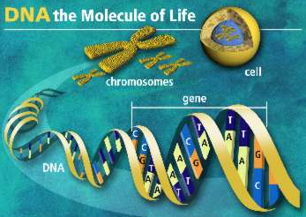
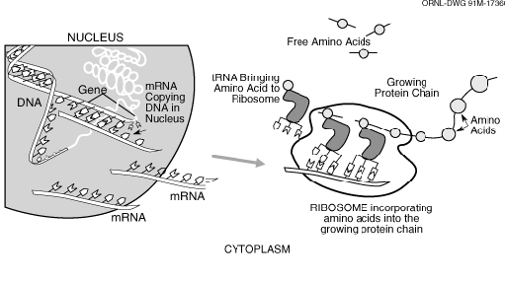
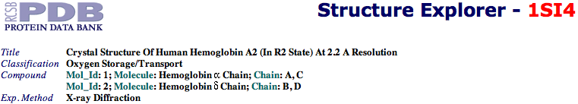
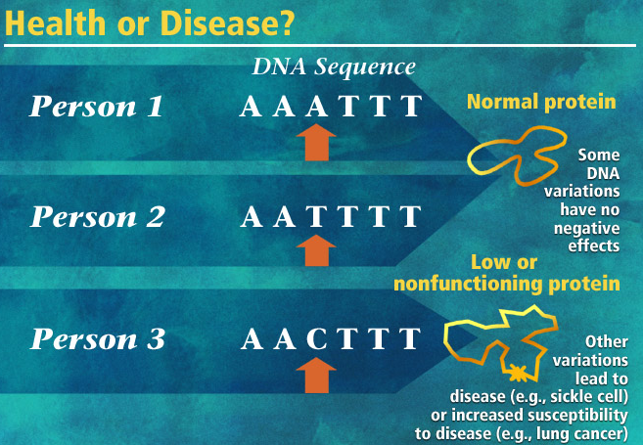
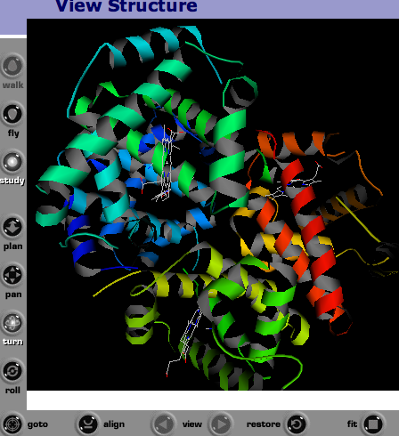
Standards in Life Sciences
http://www.ornl.gov/sci/techresources/Human_Genome/education/images.shtml
MAGE-ML
http://www.rcsb.org/pdb/
BSML
? (VRML)

Slide 7

CDISC
The Clinical Data Interchange Standards Consortium develops the industry standards that support the electronic acquisition, exchange, submission and archiving of clinical trial data.
Submission Data Model, SDS, guides the organization, content
and form of submission data for clinical trials.
Operational Data Model, ODM, describes the format for data collected in a clinical trial to facilitate data exchange and archiving.
LAB describes requirements to improve laboratory data interexchange. Driver to use CDISC Lab standard.

Slide 8
Topic
Healthcare Standards

Slide 9

Health Level Seven
HL7
 | Health Level Seven focuses on the electronic interchange of clinical information among healthcare oriented computers systems. HL7 also works in conjunction with CDISC on clinical trials data exchange standards and DICOM on medical imaging standards. In addition to messages, HL7 also defines architecture of clinical documents that could encapsulate clinical and genomic data.

Slide 10
HL7 “classic” Areas of focus examples
Patient Administration
  Admit, Discharge, Transfer
  Demographics
  Payer Information
Orders and Observations
  Radiology
  Laboratory
  Pharmacy
Systems Administration
  Master Files: procedures, staff, codes
  Financial management

Slide 11
HL7 V2 messages and V3 Reference Info Model
http://www.hl7.org
HL7 version 2.x is essentially an idiosyncratic messaging standard - it is in widespread use today and as such is a true standard
  “While providing great flexibility, its optionality also makes it impossible to have reliable conformance tests of any vendor's implementation and also forces implementers to spend more time analyzing and planning their interfaces to ensure that both parties are using the same optional features.”
HL7 version 3 on the other hand:
  “Version 3 uses an object-oriented development methodology and a Reference Information Model (RIM) to create messages. The RIM is an essential part of the HL7 Version 3 development methodology, as it provides an explicit representation of the semantic and lexical connections that exist between the information carried in the fields of HL7 messages.”
“HL7's primary goal for Version 3 is to offer a standard that is definite and testable, and provide the ability to certify vendors' conformance.”

Slide 12
Electronic Health Record
EHR=patient centric longitudinal (significant info in chronological order) view of care that spans different providers
It is electronic and replaces all paper records, supports all patient care processes, patient centric clinical record of care encounters
Secondary use is public health, population studies, clinical trials and research
Country basis profile
Healthcare provider Dimension, personal health dimension, population health dimension
Goals: improve patient care via better availability of clinical info, reduce medical errors and improve patient safety, control costs thru standards
In 2004, initiative to create USA standards for EHR, by Centers for Medicare and Medicaid Services and Veterans Health Admin – selected HL7. First step a functional model.

Slide 13
HL7 Clinical Trials
Regulated Clinical Research Information Management (RCRIM) Committee
-Focus on clinical trials data exchange.
-Works with CDISC.
-Driver for HL7 Clinical Trial Standards.
-Joint project with Clinical Genomics SIG.

Slide 14
HL7 Clinical-Genomics Current Work
Clinical-Genomics
Tissue Typing
Clinical-Genomics
BRCA
Family
History
Genotype
Shared
Model
Storyboard
Storyboard
Storyboard
Storyboard
Clinical-Genomics
Cystic Fibrosis
Clinical-Genomics
Pharmacogenomics
Clinical
Statement
Shared
Model

Slide 15
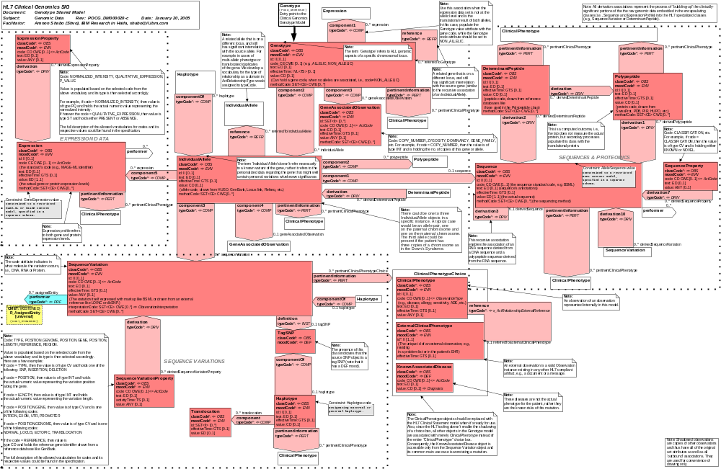
The Genotype Model - Focal Areas:
Expression
Data
The Genotype
and its Alleles
Sequence
and
Proteomics
Sequence
Variations
Clinical
Phenotypes

Slide 16
HL7 Clinical Genomics Standards to date
MAGE-ML
HL7 V3
HL7 EHR
work in progress
BSML
HL7 CDA

Slide 17
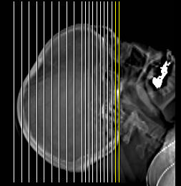
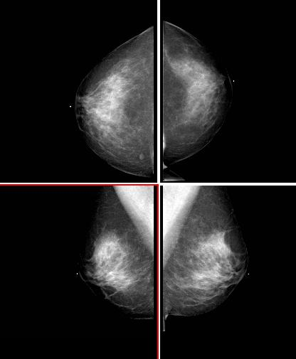
DICOM
The DICOM Standards creates and maintains international standards for communication of biomedical diagnostic and therapeutic information in disciplines that use digital images and associated data. The goals of
DICOM are to achieve compatibility and to improve workflow efficiency between imaging systems and other information systems in healthcare environments worldwide.
DICOM is used or will soon be used by virtually every medical profession that utilizes images. These include cardiology, dentistry, mammography, ophthamology, orthopedics, pathology, pediatrics, radiation therapy, radiology, and surgery.

Slide 18
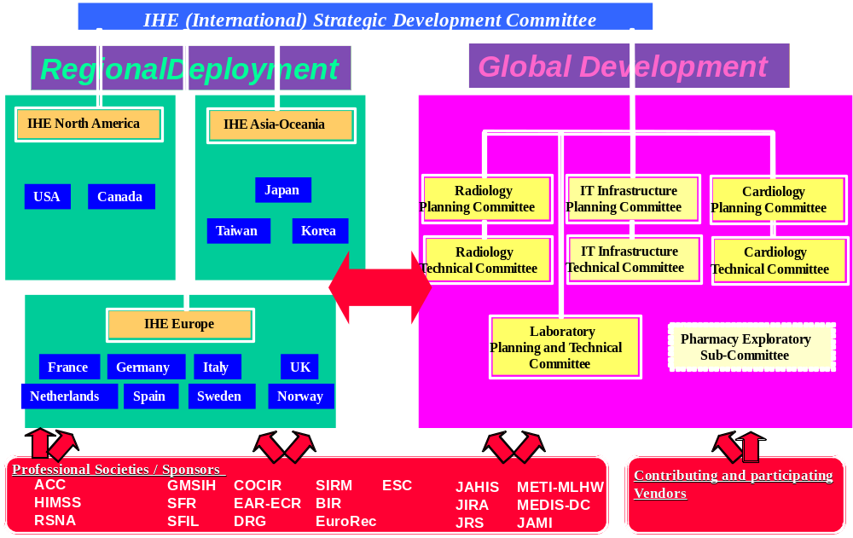
Integrating the Healthcare Enterprise (IHE) Org Chart
http://www.ihe.net/

Slide 19
National Coordinator for Health Information Technology
NHII standards organizations: http://aspe.hhs.gov/sp/nhii/standards.html
National Health Information Technology Coordinator appointed and U.S. Government standards adoption - May 6, 2004 - http://www.dhhs.gov/news/press/2004pres/20040506.html
  Health Level 7 (HL7) vocabulary standards [4] and HL7's Clinical Document Architecture standard for text based reports. (Five standards)
  The College of American Pathologists Systematized Nomenclature of Medicine Clinical Terms (SNOMED CT) for…(Five standards)
  Laboratory Logical Observation Identifier Name Codes (LOINC) to standardize the electronic exchange of laboratory... (One standard.)
  The Health Insurance Portability and Accountability Act (HIPAA) transactions and code sets for electronic exchange… (One standard.)
  A set of federal terminologies related to medications…(One standard.)
  The Human Gene Nomenclature (HUGN) for exchanging information regarding the role of genes in biomedical research ... (One standard.)
  The Environmental Protection Agency's Substance Registry System for non- medicinal chemicals of importance to health care. (One standard.)

Slide 20
RHIOs and the Electronic Health Record
Excerpts from NCHIT address at HIMSS - Feb. 2004
  “EHRs must be connected and have the support systems and technical capacity to transmit and receive information from other devices and applications in a secure and intelligible manner. This means developing the security, authentication, authorization, identification and data location systems that can be cost-effectively deployed on a large-scale basis.”
  “Interoperability standards and policies for the NHIN require immediate attention from the Federal government as well as public and private sector participants.”
  “Colorado, Indiana, Rhode Island, Tennessee and Utah all received federal funds to support statewide health information exchange efforts. More than one hundred first generation RHIOs have been developing across the country, and several of these efforts are statewide. Florida, Wyoming, New Jersey, and Minnesota have all introduced legislation to support the formation of RHIOs.”

Slide 21
Medical Vocabularies / Standards
SNOMED-CT
  College of American Pathologists - hundreds of thousands of terms classified in a single hierarchy - the defacto vocabulary standard
LOINC - Laboratory Logical Observation Identifier Name Codes
  Standardizes the electronic exchange of laboratory information
CPT - Current Procedural Terminology
  American Medical Association - couple thousand codes driving all physician billing in the U.S.
ICD9 and ICD10 - International Classification of Diseases
  World Health Organization - drives billing for hospitals/clinics in U.S.
DRGs – Diagnostic Related Groups- small code list of common diagnoses for Medicaid billing
UMLS integrates them all and others into one semantic network…
Many more in nursing, etc…

Slide 22
U.S. Government efforts in Biomedical Grids
National Cancer Institute - very focused on Grids and Standards
  caCore - open-source foundation upon which the NCI builds its research information management systems
  caBIG - http://cabig.nci.nih.gov - “The cancer Biomedical Informatics Grid, or caBIG, is a voluntary network or grid connecting individuals and institutions to enable the sharing of data and tools...”
    caArray database version 1.0 released Feb. 2005
National Library of Medicine
  NCBI/Entrez - familiar to all in biomedicine - the defacto repository
Federal funding sources and activities expanding but incoherent:
  NLM, BISTI, NIBIB, NHGRI, DOEGenomes, AHCPR, NCI, NSF, DOE, NIAID - probably others

Slide 23
Implications for Grid Standards Development
Good news
  Peer-to-Peer data management and information models are being adopted across biomedicine
  There are many opportunities / timing is very good to build biomedical grid standards as SDOs, professional organizations, and international government efforts are converging
Bad news
  Content and transaction standards are complex in biomedicine
  Biomedical grid standards development communities need to RECONCILE with dozens of SDOs and professional organizations
  Biomedical grid standards development communities need to RECONCILE with fragmented, but active government efforts
Opportunity - issues of scalability largely unaddressed in Healthcare
For links to Biomedical Informatics resources see: http://cci.uchicago.edu
Email Jonathan: jcs@uchicago.edu

Slide 24

Conclusions: Grids with Healthcare Standards for
Clinical Trial Data
HealthCare Data
Research Data

