Slide 1
Dream of Medical Grid in Korea
What can we do for it?
Global Grid Forum13 Workshop
13th Mar 2005
Young-Woo Kim, MD, PhD
Center for Gastric Cancer, National Cancer Center

Slide 2
Areas of Application for Medical Field
Network infrastructure
Research
(e-Science)
Clinical field
(e-Health)
Education
(e-Learning)

Slide 3
Research Area (e-Science)
Biomedical Informatics Infrastructure to share tools, data, resources
Virtual network of research based on human interaction
Primary task → System development, leadership
Engine → Fund, advanced network infrastructure
End point → Generation of knowledge estate

Slide 4
CaBIG
Launched on July 2003
>50 pilot participants (cancer centers) nationwide
Information infrastructure to share tools, data, resources
Voluntary virtual network of cancer research
Specific tools: clinical trial management system, tissue bank, integrative cancer research applications

Slide 5
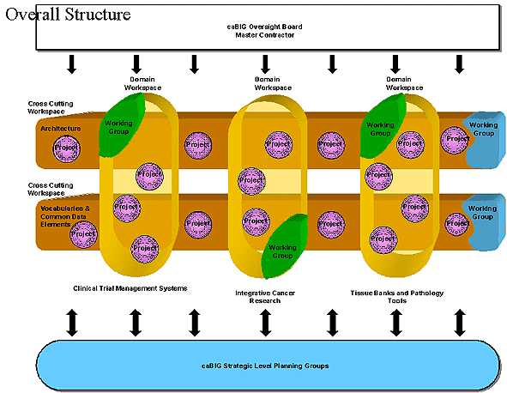
CaBIG

Slide 6
Clinical Area (e-Health)
Clinical Informatics Infrastructure to share patients clinical data (Lifelong e-health record)
Telemedicine - cyber clinic, follow-up, hospice care
Telesurgery - telerobotic surgery, telementoring, telesurgical conference
Telepathology, tele-radiology, tele-endoscopy
Primary task → medical ontology, middleware, Security,
Legal & ethical consideration, media communication
Engine → Fund, advanced network infrastructure
End point → Cost-effective medical System

Slide 7


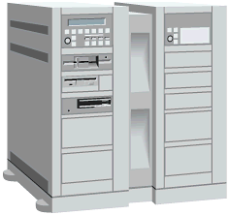

Medical Image Reference Center
Image information
Experts group
Network infrastructure
Data Centers
National Cancer Center
National Cardiovascular Center

Slide 8
Education Area (e-Learning)
Educational Informatics Infrastructure for students, clinician, patients
CME (Continuing Medical Education) accreditation-KMA launched 2004
Medical E-learning Contents Management – VirtualMD co.
Virtual National Library of Medicine
Distance learning – expert sharing for education
Primary task → Contents generation & maintenance
Engine → Strategy, Fund, Human resource
End point → Competent national resource for medical science

Slide 9
Barriers for Collaboration Over Network in Medical Science Field
Network infrastructure
Bandwidth, Penetration of network, QoS , Security
Video conferencing infrastructure
Polycom, DVTS → Access Grid
System for collaboration & sharing resources
Consortium for advanced research environment
Grant support for initiation

Slide 10
Users of Advanced Research Network in Medical Science Field
KOREN
Direct to institute- NCC, Ewha University Mokdong Hospital, SNU Bundang Hospital, Yonse University Hospital, Busan National University Hospital, Inje University Hospital
Indirect connection - Hanyang Univ. Hosp., Seoul National Univ. Hosp., Korea Univ. Hosp., Kyunbuk National Univ. Hosp., Kyungsang National Univ. Hosp., Chonnam National Univ. Hosp.

Slide 11
Basic Requirement for Technology
Bandwidth → 155M- 1G
Network Quality → Packet loss, delay
Expansible → Multi-channel, Multicast (AG)
AV Quality → HDTV, stereo, no echo or noise
Security → protection of patient privacy
VPN

Slide 12
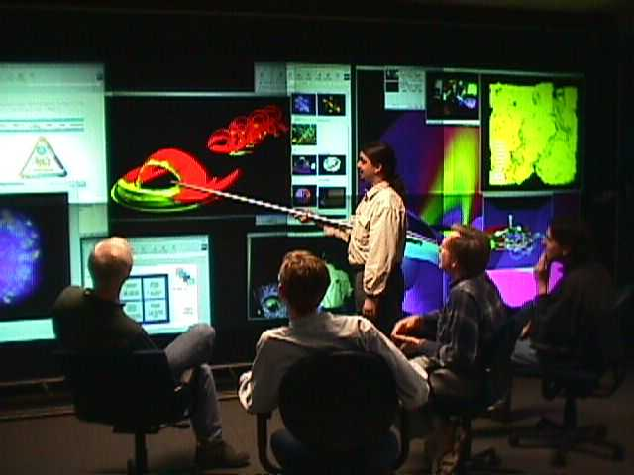
Group to Group Interaction on the Grid
Implementation of AG Concept to Medical Science
Clinical research collaboration
Medical Conferencing for knowledge share
Remote participation for system development
Basic science research collaboration-brainstorming, audit, verification of result of experiment

Slide 13
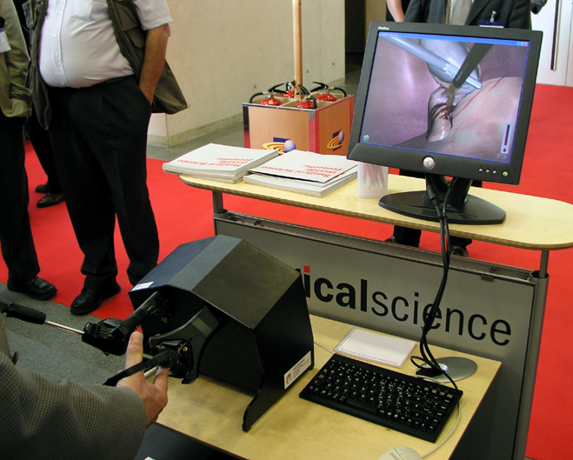
Implementation of AG Concept to Medical Science
Improve the User Experience: Go Beyond Teleconferencing
  Provide a Sense of Presence
  Support Natural Interaction Modalities
Haptic VR interaction for surgical Simulation & training

Slide 14
Implementation of AG concept to Medical Science
Enable Complex Multisite Visual and Collaborative Experiences
  Integrate With High-end Visualization Environments
  ActiveMural, Powerwall, CAVE Family, Workbenches
3-D protein structure modeling
Physiosome modeling for new drug development

Slide 15
Stages of Collaboration Network
Awareness
Interaction
Cooperation
Collaboration
Pioneering
Leadership
Penetration
Collaboration
Virtual Organization
persistent collaborative infrastructure (Persistent Share space; AG Rooms)

Slide 16

AG @ NCC. RE.KR
Coming Collaboration Plan for Cancer Informatics Infrastructure
Cancer Center Network
NCC
: Grid network infrastructure
CBNUH
GSNUH
CNNUH

Slide 17
CBCG:
Cancer Biomedical Collaboration Grid
Primary Goal: Synchronous multiple participation of cancer biomedical experts in complex environments
Infrastructure: Integration of High quality visualization and advanced network technologies for cancer biomedical research, clinical & educational purpose
(AG Rooms for persistent collaboration)
Engine: System, Infrastructure, Fund, Leadership,
Cooperation

Slide 18
Cancer Information Strategy
Cancer Information Grid Network
- Construct systemic interacting cancer information network Government, regional cancer center, research institute, hospital, university, patient, etc
Cancer Biomedical Resource Repository
Construct comprehensive cancer information database Standardization, coordination
Cancer Information Service (CIS)
Provide high quality CIS on all aspects of cancer for those concerned or affected by cancer
Notes:
6

Slide 19
Cancer Information
Comprehensive Cancer Information
DB
Standardization
Coordination
Biological Material DB
Screening DB
Research Result DB
Registry DB
Terminal Care Info. DB
Cancer Info. Service DB
Clinical Trial DB
Clinical Info. DB
Resource DB

Slide 20

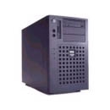

Cancer Information Grid
Data source
Data source
specific center
Research Center
Domain object
NCC
Grid Network
Resource center
Regional Cancer
Center
Research Center

Slide 21
Architecture of Cancer Information Grid
Client
Admin
GUI
Applications
Grid
Grid (Middle ware)
Metadata
Metadata
Data
Specific domain object
Other data source

Slide 22
Requirement for Cancer Information Grid Network in Korea
System development for sharing resources
Model: CABIG in NCI, USA (fund driven leadership)
Advanced Cancer Specific Network Infrastructure
KOREN, KREONET
High quality video and audio communication solution
Access Grid, DVTS, HDV
National strategic investment for infrastructure
High quality data generation and contents development for database to share

