Slide 1
Life Sciences Grid (LSG)
Research Group
LSG Working Sessions at
GGF8 – The Eight Global Grid Forum
24-27 June 2003
Seattle, WA, USA
Building Grids – Obstacles & Opportunities
Abbas Farazdel
Peter Arzberger, Dave Angulo

Slide 2
LSG Working Sessions at GGF8
Wednesday, June 25, 2003
10 a.m. - 11:30 a.m. Pacific Time (GMT-08:00)
East Room - ACCESS GRID
Thursday, June 26, 2003
4 p.m. - 5:30 p.m. Pacific Time (GMT-08:00)
East Room - ACCESS GRID

Slide 3
Why
Life Sciences Grid?

Slide 4
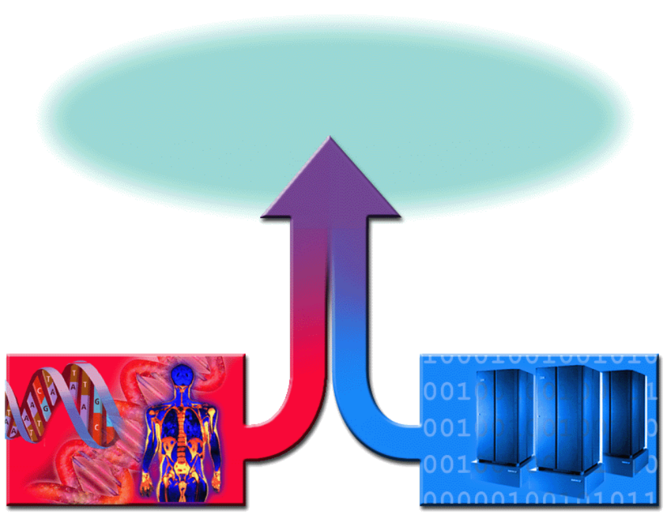
The Challenge
Scientific discovery
New drugs and treatments
Revolution in Healthcare
Bioinformatics & Cheminformatics
Life Sciences
Information Technology

Slide 5
Bad News - Frustration with IT
Current Environment: Distributed, Heterogeneous, Complex
Typical Financial Subsystem Configuration
Sysplex
Complexity,
Total Cost of Ownership
IMS
Data
Network
zSeries
Local
Director
Profile
Capture
Database
Servers
Security
Gateways
DB2
Security
Servers
IMS
Data
Complex
zSeries
Presentation
Business Logic
Gateway
IMS
Data
Sysplex
Netscape
Enterprise
Server
HTTP
WebSphere
Application
Server
JDBC
SNA
zSeries
WebSphere
Application
Server
Security
Client
SNA
MQ
MQ
MQ
SNA
IMS
Data
Sysplex
CICS
Hub Server Group
zSeries
MQ
MQ
IT Utilization Rates
Application
Logging
Gateway
Logging
TPF
Front-end for Web presence for financial services
Back-end
Systems
zSeries

Slide 6
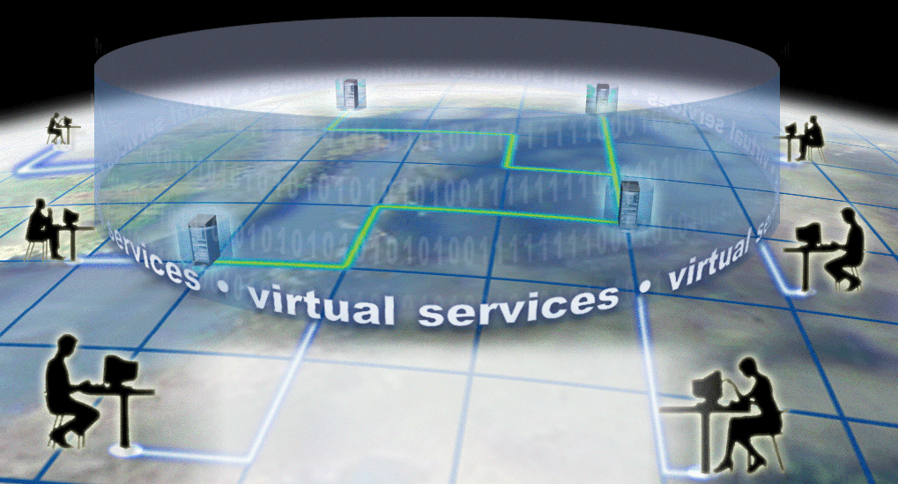
Good News - Grid Infrastructure
Storage
Operating Systems
I/O
Processing
Applications
Data
Instruments
Integrated Open
Virtualized Autonomic

Slide 7
LSG Charter Fulfillment
Progress

Slide 8
LSG is an RG not a WG!
Working Group:
  A WG is generally focused on a very specific technology or issue with the intention to develop one or more specific documents aimed generally at providing specifications, guidelines or recommendations.
Research Group:
  An RG is often longer-term focused, intending to explore an area where it may be premature to develop specifications.
“The Life Sciences Grid Research Group (LSG-RG) provides a
Forum for the above [listed in the charter] topics until
sufficient maturity is reached that result in the formation of
separate Working Groups or Research Groups for further
exploration.”
LSG Charter, Oct 2002
Notes:
To promote and support the development, deployment, and implementation of Grid technologies and applications via the creation and documentation of "best practices" – technical specifications,
user experiences, and implementation guidelines.

Slide 9
Goals / Milestones from LSG Charter
GGF6 (Oct 02): Discussion of the Research Group charter
Actively engage the community of life scientists in this activity (Oct 02 – Mar 03)
Plan and host an active session of the Research Group at GGF7 (Mar 03)
Prepare a survey of grid activity in Life Sciences (Sep 03 or sooner)
Prepare a survey of Life Sciences specific requirements for grids (Sep 03 or sooner)

Slide 10
GGF7 LSG Symposium Objectives
Identify different solution areas and classify them
Explore possible reference architectures for each solution area
Identify clear examples and the diverse use of the grid within the life sciences
Discuss issues of access to data within life sciences
Discuss state of standards, within subdisciplines and between subdisciplines
Identify how the grid is being challenged by the life sciences, and where there is need for activity
Identify linkages to other research and working groups
LS Apps
Current and new
GGF
WGs and RGs
Map to

Slide 11
Some Linkages to other GGF Groups
APME
  Grid Checkpoint Recovery (GridCPR-WG)
    On demand computing in Telescience
  Grid Remote Procedure Call (GridRPC-WG)
  Advanced Collaborative Environments (ACE-RG)
    PRAGMA, GBIF, Telescience
  Advanced Programming Models (APM-RG)
  Applications and Test Beds (APPS-RG)
  Grid Computing Environments (GCE-RG)
  Grid User Services (GUS-RG)
  Life Sciences Grid (LSG-RG)
  Production Grid Management (PGM-RG)
  User Program Development Tools for the Grid (UPDT-RG)
ARCH
Data
  Database Access and Integration Services (DAIS-WG)
    GBIF, BIRN
  GridFTP-WG
  Data Replication (REP-RG)
  Data Transport
  Grid High-Performance Networking (GHPN-RG)
  Persistent Archives (PA-RG)
ISP
P2P
SEC (numerous apps)
  Authorization Frameworks and Mechanisms (AuthZ-WG)
  CAOPs (CAOPs-WG)
  Grid Certificate Policy (GCP-WG)
  Grid Security Infrastructure (GSI-WG)
  Open Grid Services Architecture (OGSA) Security (OGSA-SEC-WG)
  Site Authentication, Authorization, and Accounting Requirements (SAAA-RG)
SRM
  Distributed Resource Management Application API (DRMAA-WG)
  Grid Economic Services Architecture (GESA-WG)
  Grid Resource Allocation Agreement Protocol (GRAAP-WG)
  OGSA Resource Usage Service (RUS-WG)
  Scheduling Dictionary (SD-WG)
  Usage Record (UR-WG)

Slide 12
Agenda for Wednesday June 25
Consolidate information from materials presented at the ggf7 life sciences workshop
  Varied Life Science Examples
  Grid Challenges
  Linkages to other working and research groups
Follow through on the life sciences grid survey (update and what we might learn from it)
Other issues to be discussed tomorrow
Note that the discussion on these topics has a
strong chance of appearing in the Special Issue
of the New Generation Computing Journal

Slide 13
Agenda for Thursday June 26
Prioritize other activities outlined in the Charter
Technical topics as possible LSG focus area
  Reference Architectures for Life Science Grids
  LSG requirements document
  Workflows
Next Steps: Future GGFs

Slide 14
Diverse Uses of Grid
Telescience: Access to high-end resources to gain better understanding (neurobiology, BioGrid))
BIRN: Linking data to leverage: Relation of shape to clinical condition
Biodiversity: Heterogeneous data
Systems Biology: Understanding cells and organisms (cardiac physiology)
Structural Biology: Workflow (EOL, iGAP, myGRID), tool by Karp Joo Jeong), launching many jobs, others (BioGrid)
Quantum to continuum Mechanics: Highly compute intensive
Immunology: Compute and data intensive
Health Grids
Genetic sequence data source discovery (OBIEnv )
…

Slide 15
How is Grid is being challenged by life sciences
Diversity and Heterogeneity of Data
  Storage
  Query
  Finding (intelligent linkage)
  Integration (e.g. Toolpath, Toolbus, OBIGrid)
Computing
Control of instruments
Workflows / Portals
  Standard interfaces (for portals/workflows)
Collaborative Tools and Environments (e.g. REALISTE)
Security Issues
  Giving access
Impulse (on-demand) Computing
Policy Issues: Privacy, IPR, National Security

Slide 16

Call for Papers
New Generation Computing welcomes
contributions for a special issue:
Grid Systems for Life Sciences
Planned for Vol.22, No.2, February 2004
IMPORTANT DATES:
- Paper submission deadline: May 31, 2003
- Notification of paper acceptance (by e-mail): September 30, 2003
- Camera-ready copies of accepted papers due: October 31, 2003
14 papers submitted
http://www.ohmsha.co.jp/ngc/

Slide 17
Chart of Interactions
LS Issue | Technology Need | WG1 DAIS | WG2 GRIDCPR | WG3 ?
Biodiversity; BIRN | Data Integration | x
Telescience | Impulse computing |  | x
Structural Genomics | Workflows

Slide 18


Upcoming GGF Meetings
GGF8 (June 24-27, 2003) - Seattle, WA, USA.
GGF9 (Oct 5-8, 2003) - Working Sessions ONLY - Chicago, IL, USA.
GGF10 (March 2004) - Working Sessions ONLY - Frankfurt, Germany.
GGF11 (June 2004) - Honolulu, Hawaii, USA.
LSG
Tasks
LSG
Tasks
LSG
Tasks

Slide 19
Suggested committees
Varied LS Solutions Leader
  Discovery? TBD
  Medical Imaging? TBD
  Medical Informatics? TBD
  ??? TBD
LS Grid Reference Architecture Rick Stevens?
Requirements Documents TBD
Workflows Carole Goble?
Survey Arun Krishnan?
???

