Slide 1
caGrid Security Architecture Version 0.5
Life Sciences Grid Workshop @ GGF14
June 27, 2005
Stephen Langella
Ohio State University
langella@bmi.osu.edu

Slide 2
Agenda
caBIG Overview
Security Requirements
Security Architecture Overview
Security Architecture Core Components
  Authorization Manager
  Grid User Management Service
  caGrid Attribute Management Service
  Grid Virtual Organization Service (GVOS)
Status and Future

Slide 3

caBIG Overview
cancer Biomedical Informatics Grid (caBIG™)
  Voluntary network or grid connecting individuals and institutions to enable the sharing of data and tools, creating a World Wide Web of cancer research. The goal is to speed the delivery of innovative approaches for the prevention and treatment of cancer. The infrastructure and tools created by caBIG™ also have broad utility outside the cancer community. caBIG™ is being developed under the leadership of the National Cancer Institute's Center for Bioinformatics.
caGrid
  Reference Grid implementation of caBIG
More Information
  https://cabig.nci.nih.gov

Slide 4
Security Requirements
Secure Communication
  Authentication - Parties involved can be assured of one another identity
  Message Integrity –Message sent by either party is guaranteed to same message when it is received.
  Privacy – Communication between the two parties can only be interpreted by the two parties
Single Sign On
  Users and Grid Services should have one method of authenticating themselves to the grid, all service in the grid should accept this method.
Access Control on caBIG Services
  caBIG services should be able to determine, which users or services may access them.
User/Organizational Attribute Management
  Services should have a method for determining the attributes of a requesting party. Such attributes may be needed to service the request, for example a username and password is needed to perform a query on a relational database on the party’s behalf.
  Attribute should be standardized such that they may be used across institutional boundaries.
Delegation
  caBIG services, should be able to interact with other caBIG services on a user’s behalf.
User/Organization Management

Slide 5
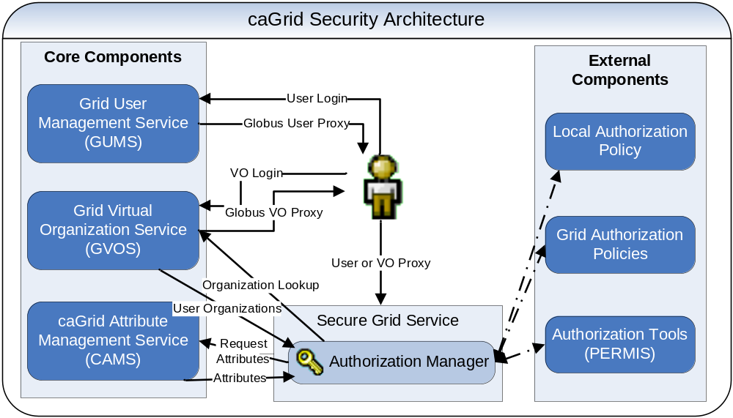
Big Picture

Slide 6
Security Architecture Components
Core Components
  GSI
  Authorization Manager
  Grid User Management Service (GUMS)
  caGrid Attribute Management Service (CAMS)
  Grid Virtual Organization Service (GVOS)
External Components
  Local Authentication/Authorization Systems
  General Authorization Systems (ie PERMIS)
  Grid Authorization Services

Slide 7
Authorization Manager
Authorization Manager Overview
  Extends the Globus Toolkit to provide more dynamic authorization
  Abstracts away some globus related details.
  A a general interface in which a caGrid service calls to determine if a user is authorized to perform operation X on resource Y.
  A caGrid service is configurable to use a specific implementation of the AuthorizationManager interface.
  Authorization Managers can be used to integrate grid security with external authentication/authorization systems.
    Local/Legacy systems
    Other authorization systems.
  Authorization Managers enable authorization in a diverse ever changing dynamic environment.
    ie. Allow this user access from his work computer during work hours and from his home computer during non work hours.

Slide 8
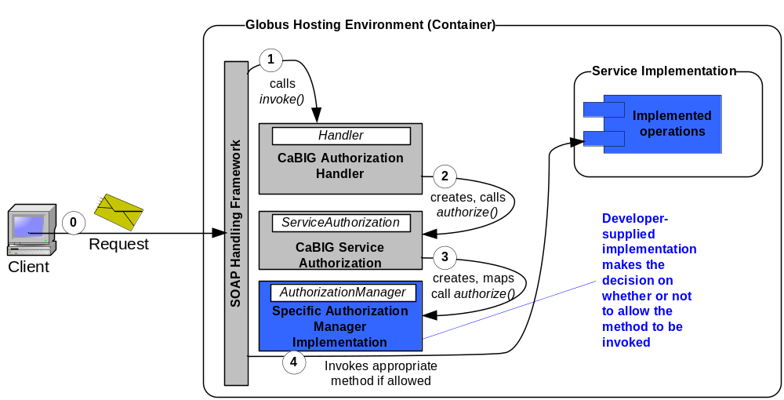
Authorization Manager
Authorization Manager’s Globus3.2.1 Integration
  Add Additional ServiceAuthorization implementation to SOAP Workflow (CABIGServiceAuthorization)
    Maps Globus Authorization into calls into the Authorization Manager
    Instantiates and Authorization Manager and calls into it.
  Provides operations level authorization
  Does NOT provide resource level authorization.

Slide 9
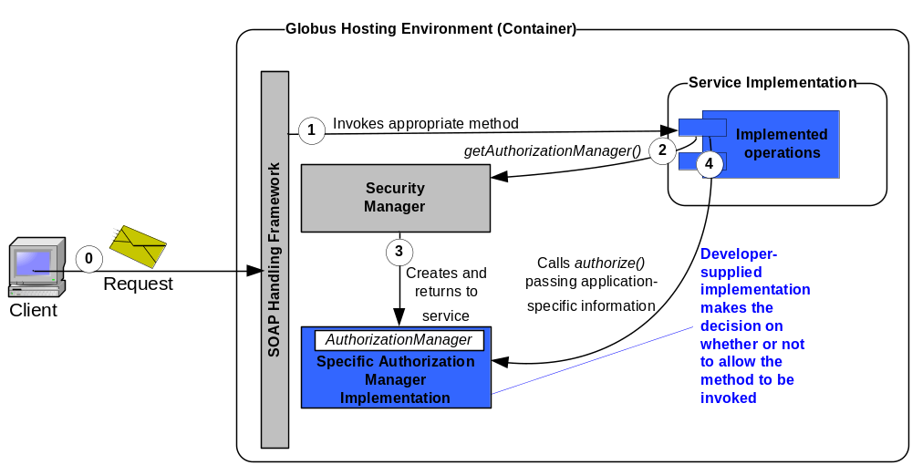
Authorization Manager
Authorization Manager and Resource Level Authorization
  Authorization Manager is obtained and called from the grid service implementation
  Allows application specific decisions to be made on resources etc.

Slide 10
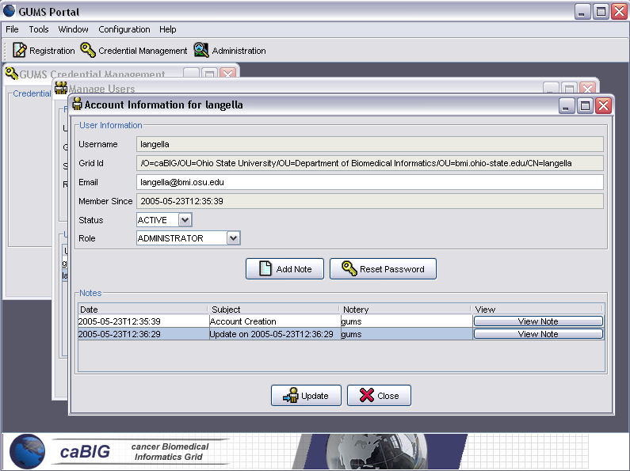
Grid User Management Service
Grid User Management Service (GUMS)
  Grid Service that coordinates the process of creating and managing grid users.
    Manages the simpleCA Certificate Authority
    Manages Grid certificates for users.
  Provides a method for users to register for a grid account.
  Administrators may specify and define attributes that are required to be supplied by the user at the time of registration
  Administrators can approve or reject a users application.
    Approval creates an account, which includes the generation of grid credentials.
  Users authenticate with the system via username and password.
  Allows users to create/get grid proxies from anywhere.

Slide 11
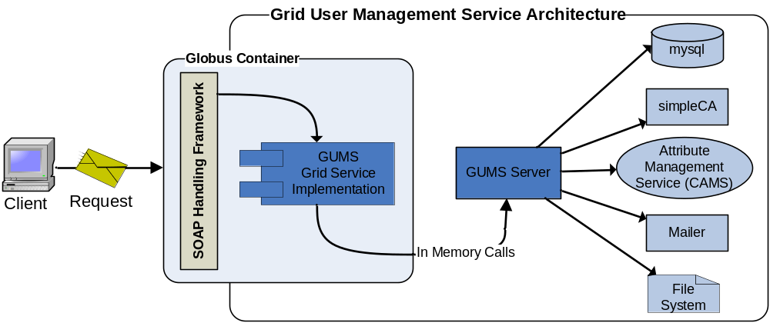
Grid User Management Service
Architecture Overview
  Runs as a Globus Grid Service.
  Grid Service implementation interacts with Server through in memory server API calls.
  Uses globus simpleCA for Certificate generation and management.
  Utilizes the Attribute Management Service (CAMS) to store required attributes.
  MySQL is used for account persistence.
  Requires an SMTP mail server for mailing user’s information regarding their account.

Slide 12
Grid User Management Service
Globus Client
  GUMS can be interacted with through the Globus Client API
GUMS Client API
  Rich API for interacting with GUMS, consist of three core classes.
    GumsRegistrationClient – Implements Registration interface, provides operation for registering with GUMS.
    GumsUserClient – Implements User Interface, provides method for performing user operations on GUMS (Create,Get,Destroy Proxy).
    GumsAdministratorClient – Implements Administrative Interface, provides methods for administering GUMS.

Slide 13
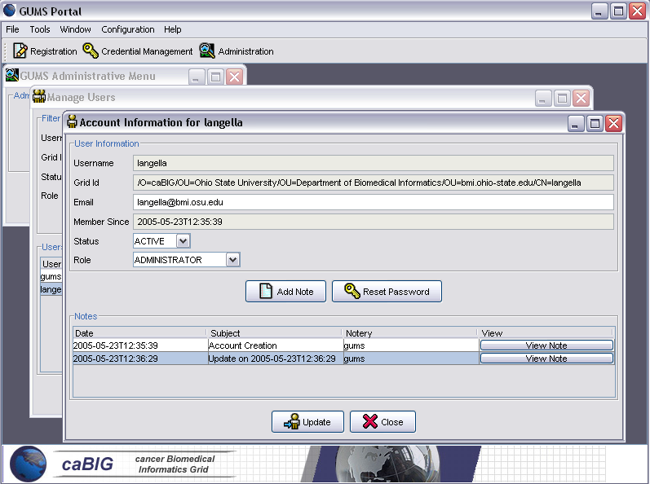
Grid User Management Service
Command Line Tools (Uses Client API to allow command line functionality)
  GridProxyInit – Creates and obtains a proxy for GUMS and stores it locally for use with other Grid Services.
  GetGridProxy – Gets an already existing grid proxy on GUMS and stores it locally for use with other Grid Services.
  GridProxyInfo – Gets information about a user’s existing grid proxy on GUMS.
  GridProxyDestroy – Destroys the user’s proxy both on GUMS and locally.
GUMS Portal GUI
  Graphical User Interface for interacting with GUMS.
    Built using the GUMS Client API.

Slide 14
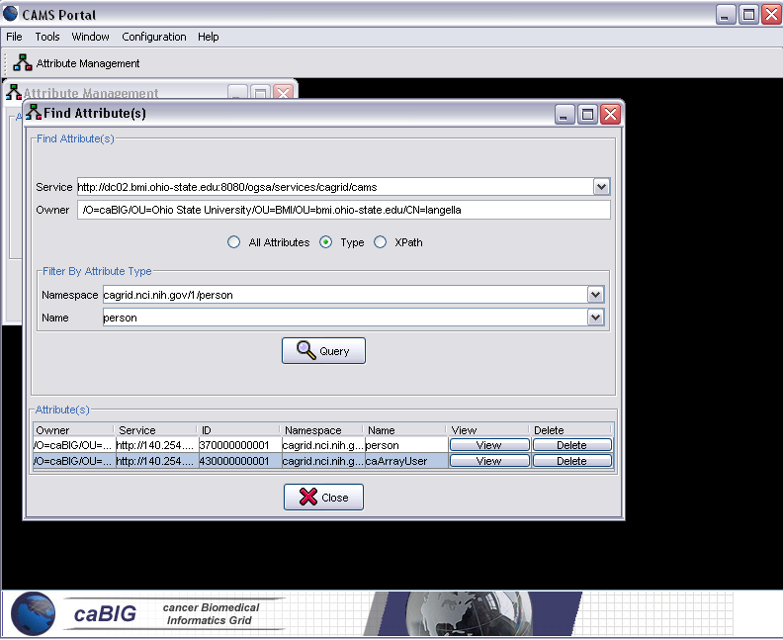
caGrid Attribute Management Service (CAMS)
caGrid Attribute Management Service (CAMS)
  Manages attributes for users/virtual organization.
  Users/Services may request attributes of a given user or VO.
    Requestor must be authorized to view the requested attributes.
  Authorization Managers can use CAMS for requesting attributes for making dynamic decisions.
    ie. If tom can access a given resource from his work computer from 9-5 and from his home computer all other times and the current time is 2pm, I can grab the MAC address of Toms work computer from the attribute service and compare it to the MAC address making the request to determine if Tom is at his work computer.

Slide 15
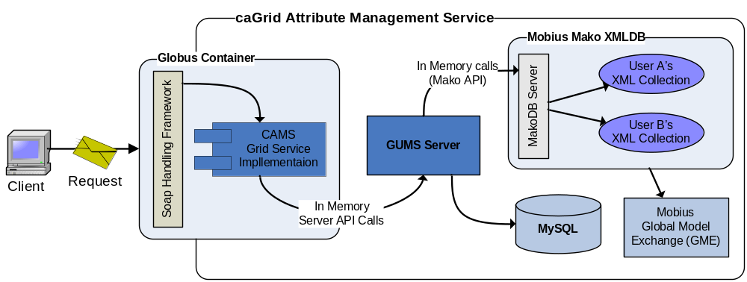
caGrid Attribute Management Service
Runs as a Globus Grid Service
Grid Service implementation makes calls into the CAMS server API
CAMS uses Mobius Mako XML DB for storing attributes.
  User attributes are organized into XML collections
  An XML collection is created for each user.
  Mako uses the Global Model Exchange to resolve XML schemas for validating attributes.
CAMS uses mysql to manage access control permissions on attributes.

Slide 16
caGrid Attribute Management Service
Globus Client
  CAMS can be interacted with through the Globus Client API
CAMS Client API
  Rich API for interacting with CAMS.
  AttributeManagementClient
    Complete implementation for invoking all CAMS operations.
CAMS Portal
  Graphical User Interface for interacting with CAMS.
  Uses CAMS Client API to invoke CAMS operations.

Slide 17
Security Architecture Core Components
Grid Virtual Organization Service (GVOS)
  Manages a set of virtual organizations.
  Administrators can create Virtual Organizations
  Virtual Organization consist of users and other Virtual Organizations
  Users which are members of a VO can request a proxy for the VO.
  Users/Services can enquire whether or not a user is a member of a VO.

Slide 18
Big Picture

Slide 19
Status and Future
Authorization Manager
  Prototype caGrid0.5 Deliverable
  Initial Prototype Completed
  July 2005
    Test and Refine Prototype
    Integration with caGrid0.5 Framework
Grid User Management Service (GUMS)
  Prototype caGrid0.5 Deliverable
  Initial Implementation Completed
  July 2005
    Test and Refine Implementation
    Integrate with Prototype Attribute Management Service

Slide 20
Status and Future
Attribute Management Service
  Prototype caGrid0.5 Deliverable
  Initial Implementation Completed
  July 2005
    Complete Design of Prototype
    Implement Prototype
    Integration with caGrid0.5 Framework
Grid Virtual Organization Service (GVOS)
  NOT a caGrid0.5 Deliverable.
  Summer/Fall 2005
    Review Existing Technologies
    Design Prototype
    Implement Prototype
    Integration with caGrid Phase II Framework

Slide 21
caGrid Team
National Cancer Institute
  Peter Covitz
  Krishnakant Shanbhag
  Tara Akhavan
SAIC
  Manav Kher
  William Sanchez
  Ruowei Wu
  Jijin Yan
Ohio State University
  Shannon Hastings
  Tahsin Kurc
  Stephen Langella
  Scott Oster
  Joel Saltz
Booze | Allen | Hamilton
  Manisundaram Arumani
*** Blue denotes members of the security architecture sub team. ***

