Slide 1
OGSA-WG
ogsa logging system subgroup
changes to 0.6
(draft-ggf-ogsa-logservice-0.6-intro-0.3.ppt)
Bill Horn
IBM
October 15, 2003

Slide 2
OGSA Logger System: Requirements
Legacy Logger Systems
- eg zOS System Logger, NT events, and UNIX syslog
- semantics & (potentially) implementation
Decoupling of Message Supplier from Message Consumer
- eg audit, management, problem determination
Collection and Distribution Patterns
- multiple suppliers / multiple consumers
Filtering
- as close to source as possible
Persistency
- fundamental requirement, retention determined by consumers
Support for sequential writes
- no requirement for updating log artifacts
- synchronous & asynchronous write semantics
Representation of Log Artifacts / OGSA Events *
- standard xsd for log artifacts
Coexistence w/ OGSA Messaging *
- push-based and pull-based patterns
- OGSA Messaging provides the fabric
Ordered Logs
- TBD, but at least a partial ordering based on writes within a connection
QoS
- performance (requirements for very high performance)
- availability (requirements high availability)
- duplexing (requirements for recovery)
Security
- TBD
Support for SQL-like queries?
* dependency on other OGSA Systems

Slide 3
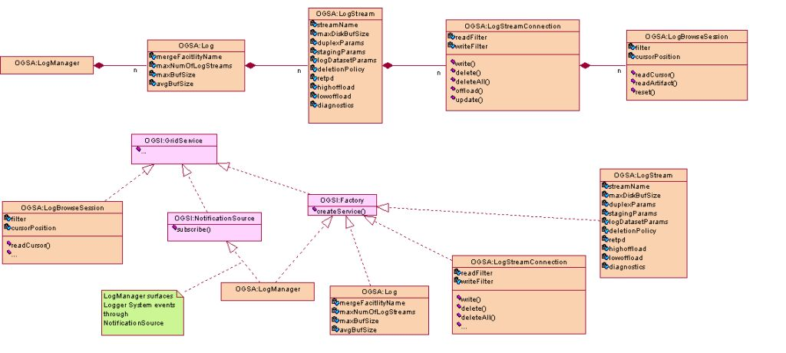
OGSA Logger System (V0.6++)
merge
mechanism
read
cursor
logstream
connect

Slide 4
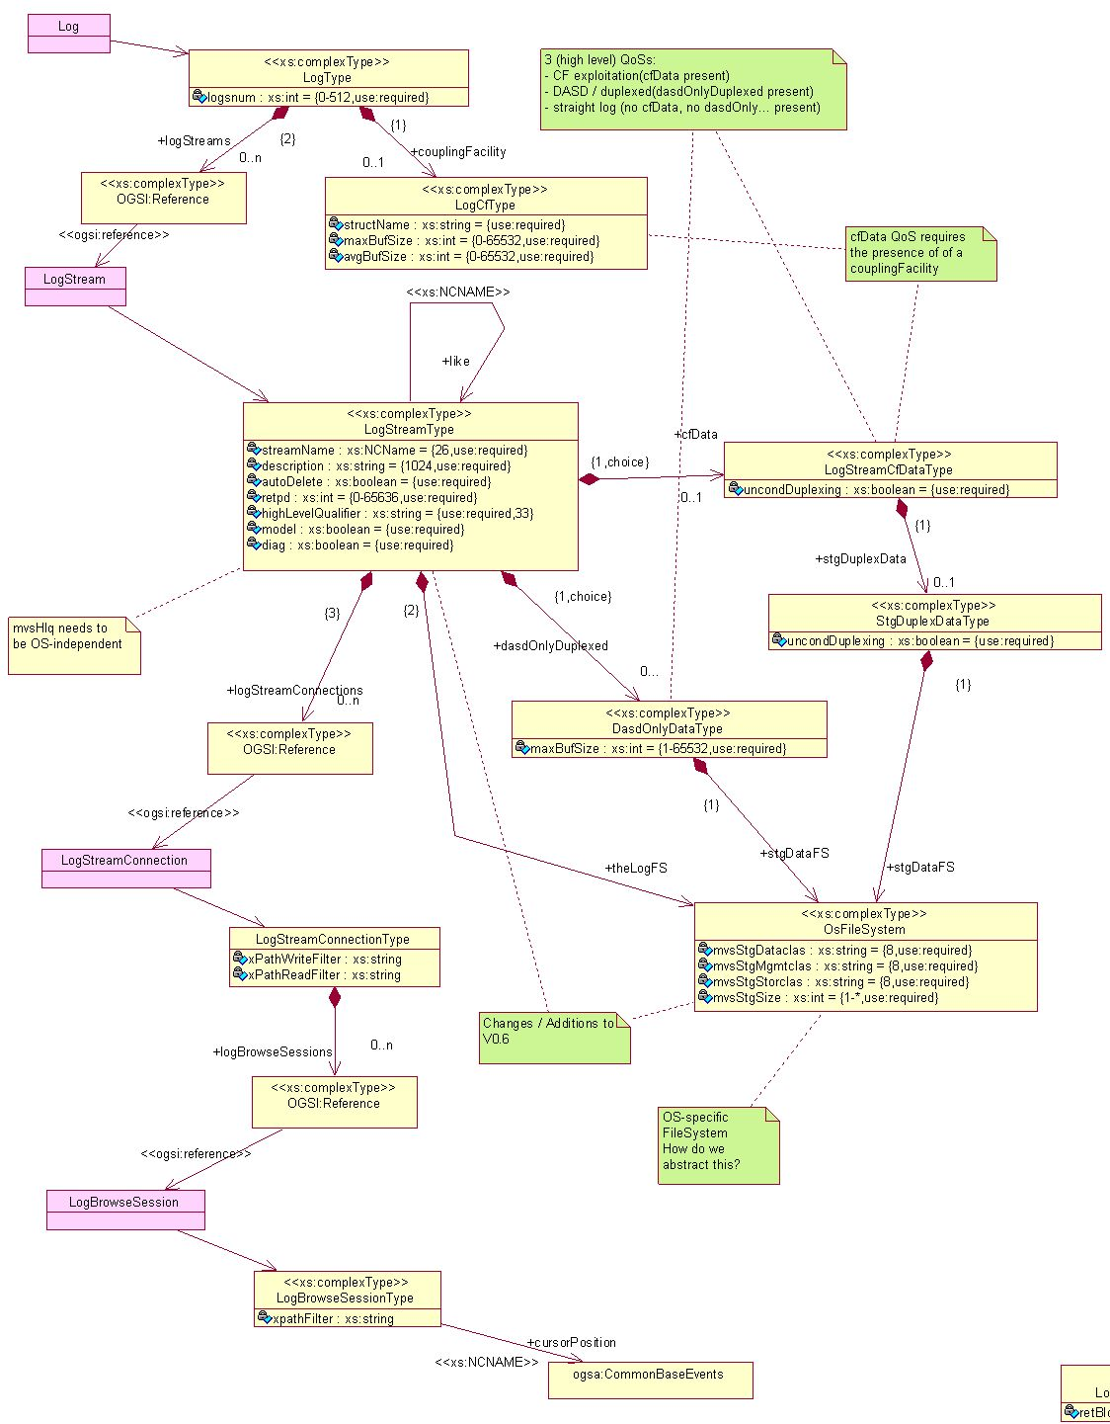
OGSA Logger System Service Data (V0.6++)
merge
mechanism
logstream
connect
read
cursor

Slide 5
OGSA Logger System: unix syslog
kern.debug | /usr/sbin/klogpp /var/adm/SYSLOG
kern.debug | /usr/sbin/klogpp /dev/console
user,mail,daemon,auth,syslog,lpr.debug /var/adm/SYSLOG
kern.err @ginger
*.emerg *
*.alert eric,beth
*.alert;auth.warning ralph
distributed
logging
from: http://www.mcsr.olemiss.edu/cgi-bin/man-cgi?syslogd+1

Slide 6
OGSA Logger System:
z/OS logger subsystem on a parallel sysplex
Sys 1
App X
Coupling Facility
Log Data Sets
Structure A
Sys 2
App Log Stream
App Y
adapted from: IBM SA22-7625-03

