Slide 1
OGSA - Service Oriented Architecture for Grids
Ravi Subramaniam
OGSA-WG
November, 2005

Slide 2
Agenda
Introductions
Introduction to Grids
Discuss OGSA and motivations
OGSA Organization
OGSA Process and Progress
OGSA and standards landscape
OGSA – Description
OGSA – Timeline
Summary

Slide 3
Introductions
Ravi Subramaniam
  Enterprise architect at Intel
  Over 12 years of distributed computing, cluster, HPC (architecture/development)
  Lead architect of Intel’s internal Grid solutions and an Intel representative for Grid standards activities. Also Intel’s representative on the board of the Globus consortium
  OGSA core team member since inception
Acknowledgements
  Andrew Grimshaw, David Snelling, Hiro Kishimoto, Tom Maguire, Fred Maciel, Mike Behrens, OGSA core team

Slide 4
Requirements for robust, enterprise solutions
Interoperable implementations
Standards-based
Simple
Secure
Scalable
Extensible
Site Autonomy
Multi-Language
Legacy Support
Transparency in multiple dimensions
  Naming schemes critical
Fault-tolerance & Exception Management
Modular and composable
Success Requires an integrated model at the foundation.
Complexity Management!!

Slide 5
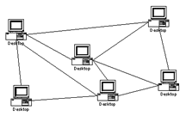
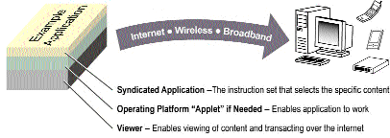


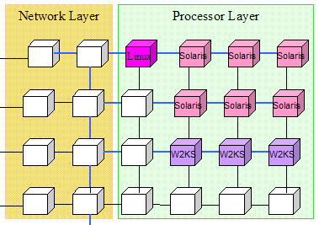
What is a Grid System?
A Grid is a system consisting of
distributed but connected resources and
software and/or hardware that provides and manages logically seamless access to those resources to meet desired objectives
Examples of Distributed Resources:
Simple to tera-scale computers
Handheld devices
Devices with embedded processing resources such as digital cameras and phones
Interconnects like network
Computing elements within a data center
Software components like web servers
Logical entities like licenses
Virtualizations like OS containers
R2AD

Slide 6
Concepts and usecases
Concepts
  IT resource virtualization
    Complexity hiding
    Sharing resources
  Virtual Organization
    Dynamics
    User defined (user-centric) security
  Administration cost reduction
  …
Usecases
  Computation Grid
  Data Grid
  Data center management
  Virtual Collaboration
  …

Slide 7
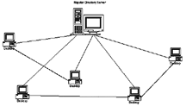

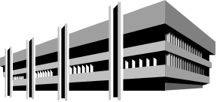





Some characteristics of Grid systems
Numerous Resources
Ownership by Mutually
Distrustful Organizations
& Individuals
Connected by
Heterogeneous,
Multi-Level Networks
PTP
System
Different Security
Requirements
& Policies Required
Different Resource
Management
Policies
Unreliable resources and environments
Geographically
Separated
Resources are
Heterogeneous

Slide 8
OGSA - Organization

Slide 9
OGSA Working Group History
Announced at GGF4 (2/02)
WG created (9/02)
Group rejuvenated by Hiro Kishimoto (Fujitsu) (3/03)
Declared as GGF’s flagship architecture at GGF10 (3/04)
OGSA roadmap draft at GGF12 (9/04)
OGSA Usecase document publication (11/04)
OGSA document v1 and glossary publication (3/05)
OGSA roadmap submitted to GGF14 (6/05)
2+ regular weekly teleconferences
> 300 mailing list subscribers

Slide 10
OGSA Aims and Perspective
Goals
  Interoperable solutions to Grid based applications
  Addressing loosely coupled distributed computing
Approach
  Standardization at the Architectural level
    Similar to profiling.
    Developed before and/or during standards development
  Use existing standards and technology where possible
  Use case driven gap analysis
  Gaps are filled proactively
    Not exclusively within the GGF.
Philosophy
  Can’t do it all – extensibility
  Separation of policy and mechanism
  No play, no pay

Slide 11
OGSA Contributors
Industry
  Fujitsu
  IBM
  HP
  NEC
  Intel
  Hitachi
  Platform
  Northrop-Grumman
  EMC
  others
Government/Academia (UK e-Science, CERN, Argonne, Virginia, ISI, …)

Slide 12
OGSA Process
Use Case Driven
  21 Detailed Use Cases (~ 6 pages each)
    Tier 1 Available at: http://www.ggf.org/documents/GWD-I-E/GFD-I.029.pdf
Distributed Specification and Standardization
  Identify and/or develop open and accessible standard specifications
  Active current work in GGF, OASIS, W3C, and DMTF.
“Design Team” Working Model
  Facilitate cross fertilization within and outside GGF.
  Avoid redundant work applicable efforts
  Focus mind share (the most valuable commodity)
    e.g. DAIS-WG and OGSA-Data Design Team
  Design teams: EMS, Resource Mgmt., Security, Information Svc.
Iterative Refinement
  Abstract service evolving to concrete specifications
Documents:
  OGSA: Use Cases, Informal Specification, Recommendation

Slide 13
OGSA document structure
Roadmap
document
Architecture
Document
Usecase
document
inform
and
guide
Root document
Scenario
Service
Description
feedback
informational
Modeling
guidelines
inform
and
guide
consistent
Proposed
recommendation
feedback
Candidate Profile
Profile
OGSA-WG documents
Information
models
Documents produced
by other GGF WGs
or other SDOs
refer
Actual
specs

Slide 14
Open Grid Service Architecture (OGSA)

Slide 15
OGSA motivations
Understand the elements of the spectrum of Grid systems and models
Develop the architectural framework for standards in Service Oriented Grids
Validate current standards for applicability in Grids
Provide directions and motivations for spawning new standard activity to realize seamless interoperable Grids

Slide 16
OGSA
Open service-oriented architecture
  Resources as first class entities
  Dynamic service/resource creation and destruction
Coarse-grained encapsulations
  Elements of the architecture are pluggable
Customizable
  Support for dynamic, domain-specific content, ...
  Within the same standardized framework
Built on a Web Services infrastructure layer
GGF’s flagship architecture and the blueprint for industry standard grid computing

Slide 17

Why Use a SOA?
Logical view
Coarse grained reusable functionality
Extensibility
Platform neutral
Logical view
  Provide an abstracted and logical view of desired functionality
Coarse grained reusable behaviors
  Encapsulate complex behaviors inside of services (e.g. FT, parallelism)
  Service composition to construct new behaviors
Extensibility
  Provides a natural framework and constructs for extending functionality
Platform neutral
  Interactions and functionality constructed in a standardized platform agnostic manner

Slide 18
Why Use Web Services?
Strong industry support
Speed time to value
  Harness robust development tools for Web services
  Reduce learning ramp and implementation fragmentation
Embrace and extend
  Leverage the significant effort in developing and driving consensus on standards
  Focus limited resources on augmenting/adding standards in areas where necessary

Slide 19
OGSA and standards landscape

Slide 20
OGSA Specifications Landscape
SYSTEMS
MANAGEMENT
GRID
COMPUTING
UTILITY
COMPUTING
Use Cases &
Applications
Distributed query processing
Data Centre
Collaboration
Persistent Archive
ASP
Multi Media
VO Management
OGSA Self Mgmt
OGSA-EMS
WS-DAI
Information
Generic Mgmt
Discovery
GGF-UR
Data Model
Naming
Core Services
Privacy
Trust
Others ...
Service Groups
Notification
WS-I BP
WSRF-RAP
WS-Security
SAML/XACML
X.509
Basic Profile
WS-Addressing
HTTP(S)/SOAP
WSDL
WSRF-RL
WSRF-RP

Slide 21
Of particular relevance to OGSA…
W3C
  WS-Addressing
OASIS
  WSRF and WS-Notification
  WS-Security, etc.
  WSDM
DMTF
  Utility Computing
  CIM
  Server management

Slide 22
OGSA-* WG
CY
2002
2003
2004
2005
2006
OGSA-WG
Usecase
Arch 1.0
Roadmap
OGSA-Data WG
OGSA
debut
OGSA-AuthZ WG
OGSA-RSS WG
OGSA-BES WG
OGSA-ByteIO WG
WSRF BP 1.0
OGSI-WG
OGSI 1.0
WSRF TC
WSRF 1.0
WSRF
OGSA-Naming WG

Slide 23
OGSA – Description

Slide 24
Profiles
Define a usage pattern and include specifications developed by working groups both within and external to GGF.
Issue: How mature and “widely adopted”?
(Ravi: extension of, and styled as, WS-I profiles)
Three “in the pipe”
  OGSA WSRF Basic Profile
  OGSA Basic Security Profile
  OGSA Basic Security - Secure Channel Profile
Expected Profiles
  Data
  Execution Management

Slide 25
OGSA Service Domains
Resources
Naming
Security (also includes organization and trust)
Policy
Information services
Data and Data management - of all types
Execution Management Services – EMS

Slide 26
Distributed naming is a well-understood area - properties
Unique
Provide identity
Comparable
Location portable
Widely adopted
Scalable – high performance
Extensible
Dynamic binding
….
Two and three level name schemes dominate

Slide 27
Naming - Three level schemes
Human -> abstract -> address
In OGSA,
  Human -> address and Human -> abstract will likely be handled by RNS – Resource Naming Service being developed by the GGF GFS-WG
  AbstractName - > address is being handled by WS-Naming efforts
    EPR annotated with AbstractName URI and optional resolution handle

Slide 28
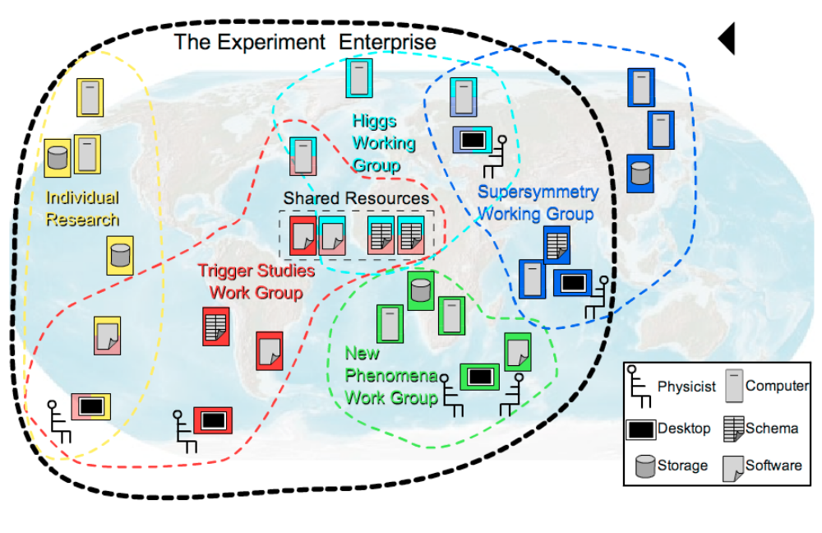
Security Services
Authorization, Roles, and Access Privileges
  Locally (site) managed
  SAML and XACML Basis
  Credential mapping provided by implementations.

Slide 29
Security
Built on WS-Security standards, X.509, etc.
Working with Security areas in GGF
Two documents
  Attributes used in OGSA Authorization
  Use of SAML for OGSA Authorization
Two profiles
  Resolves interplay between WS-Addressing and WS-Security
  Provide certificate startup
  OGSA Basic Security Profile
  OGSA Basic Security - Secure Channel Profile

Slide 30
OGSA Data
Use case driven
Many different data “types” and use scenario’s from HEP to business intelligence
Strong consensus emerging with some issues still around meta-data and information dissemination
OGSA-ByteIO, RNS, and DAI are leading efforts.

Slide 31
Execution Management Services
Basic problem: provision, execute and manage services (including legacy applications) in a grid
  Some use cases
    start up a cache service
    on-demand, utility computing
    start up and manage a set of legacy applications
Want to be able to “instantiate” a service and have the grid figure it out, and provide management interfaces throughout the lifetime of the service

Slide 32
EMS addresses issues such as:
Where can a service execute?
Where should the service execute?
Prepare the service to execute.
Get the service executing.
Manage (monitor, restart, move, etc.).
Notes:
Where can a service execute? What are the locations it can execute because of resource restrictions such as memory, CPU and binary type, available libraries, and available licenses? Given the above, what policy restrictions are in place that may further limit the candidate set of execution locations?
Where should the service execute? Once it is known where the service can execute, the question is where should it execute? This may involve different selection algorithms that optimize different objective functions or are trying to enforce different policies or service level agreements.
Prepare the service to execute. Just because a service can execute somewhere does not necessarily mean it can execute there without some setup. Setup could include deployment and configuration of binaries, libraries, staging data, or other operations to prepare the local execution environment to execute the service.
Get the service executing. Once everything is ready, actually start the service and register it in the appropriate places.
Manage (monitor, restart, move, etc.). Once the service is started in must be managed and monitored. What if it fails? Or fails to meet its service agreements. Should it be restarted in another location? What about state? Should the state be “checkpointed” periodically to ensure restartability? Is the service participating in some sort of fault-detection and recovery scheme?

Slide 33
Typical Pattern
Candidate Set Generator (Work -Resource mapping)
Provisioning
Deployment
Configuration
Information Services
Execution Planning Services
Reservation
Service
Container
Persistent State Handle Service
Job Manager
Accounting Services

Slide 34
OGSA Management Framework
Many types and levels of interfaces
  See CMM-WG document (GFD-I.45)
  for details
Functional
interfaces
Domain-specific capabilities
Specific
manageability
interfaces
OGSA capabilities
Execution
mgmt. svc.
Data
services
Security
services
Generic [svc.]
manageability
interface
E.g., WSDM MOWS
Base
manageability
interface
WSRF, WSDM MUWS, WS-Man
Resources
Native
interfaces

Slide 35
OGSA – Timelines

Slide 36
OGSA Schedule
2004
2005
2006
Base document
OGSA-WG
Architecture V1.0 (GFD-I.30)
OGSA-WG
V1.5
Scenarios & service descriptions
Data architecture
OGSA-Data
WSRF Basic Profile
OGSA-WG
Recommended
Profile
JSDL (GFD-R-P.56)
JSDL
ByteIO
OGSA-ByteIO
Normative
specifications
Basic Execution Service
OGSA-BES
RNS
GFS
WS-DAI
WS-DAI
Left edge: public comment start, Right edge: GFD publication

Slide 37
Summary
Building robust, distributed, applications is a challenge with a number of significant issues that need to be solved.
Interoperability is key. Thus OGSA is defining a set of core services designed to work together – but at the same time providing implementation flexibility.
We do not think the current set is the end of the road – just the beginning.

Slide 38
Backup

Slide 39
W3C: World-Wide Web Consortium
W3C is an international consortium where Member organizations, a full-time staff, and the public work together to develop Web standards.
Founded in 1994, ~80 published recommendations, staff on 3 continents
Members of W3C range from leading technology companies to non-profit organisations and individuals.
Best known for fundamental web standards, including:
XML
XML Schema
XHTML
XSL/XSLT
MathML
SSML
CCS
OWL
Several working groups are relevant to grid standards projects including:
WS-Addressing
WSDL 2.0
Binary data

Slide 40
DMTF: Distributed Management Task Force
DMTF is an industry organization leading the development of management standards and integration technology.
Founded in 1992
Best known for standards that address system management in enterprise and Internet environments, including:
CIM
WBEM
DMI
Several working groups are relevant to grid standards projects including:
CIM Core
Utility Computing
Server Management

Slide 41
OASIS: Organization for the Advancement of Structured Information Standards
OASIS is a member-led, international nonprofit standards consortium concentrating on structured information and global e-business standards
Founded in 1993, ~65 projects, staff on 3 continents
Members of OASIS are
  Vendors, users, academics and governments
  Organizations, individuals and industry groups
Best known for e-business standards that address real world business requirements, including
UDDI
SAML
ebXML
WS-Security
WSRP
WS-Reliability
SPML
XACML
UBL
Host for key grid standards projects including
WSDM
WSRF
WS-N

Slide 42
WS-Naming
A profile on WS-Addressing EPR’s
Adds two extensibility elements
Existing tooling that uses EPR’s would also work using WS-naming EPR’s

Slide 43
Two elements
AbstractName
  Unique in space and time
  Strings <uri/iri>
  Comparable == only
ReferenceResolver
  Must be able to map abstract name to an EPR if it is possible (named entity may no longer exist)
  Is also an EPR
  EPR resolve([EPR])
  EPR resolve(AbstractName)

Slide 44
Simple example
<wsa:EndpointReference
xmlns:wsa=”http://www.w3.org/2005/02/addressing”
xmlns:name=”http://tempuri.org/”>
<wsa:Address>http://tempura.org/example</wsa:Address>
<wsa:Policies>
<name:AbstractName>urn:guid:B94C4186-0923-4dbb-AD9C-39DFB8B54388</name:AbstractName>
</wsa:Policies>
</wsa:EndpointReference>

Slide 45
More Complex Example
<wsa:EndpointReference
xmlns:wsa=”http://www.w3.org/2005/02/addressing”
xmlns:name=”http://tempuri.org/”>
<wsa:Address>http://tempura.org/example</wsa:Address>
<wsa:Policies>
<name:AbstractName>urn:guid:B94C4186-0923-4dbb-AD9C-39DFB8B54388</name:AbstractName>
<name:ReferenceResolver>
<wsa:Address>http://tempura.org/resolver1</wsa:Address>
</name:ReferenceResolver>
</wsa:Policies>
</wsa:EndpointReference>

Slide 46
Most complex example
<wsa:EndpointReference
xmlns:wsa=”http://www.w3.org/2005/02/addressing”
xmlns:name=”http://tempuri.org/”>
<wsa:Address>http://tempuri.org/example</wsa:Address>
<wsa:Policies>
<name:AbstractName>urn:guid:B94C4186-0923-4dbb-AD9C-39DFB8B54388</name:AbstractName>
<name:ReferenceResolver>
<wsa:Address>http://tempura.org/resolver1</wsa:Address>
<wsa:ReferenceParameters>
guid:8733111B-84FA-4da8-89FE-417932B3B92C
</wsa:ReferenceParameters>
<wsa:Policies>
<name:AbstractName>urn:guid:55AD06F6-2F35-409a-9DCE-E5F304E557AA</name:AbstractName>
<name:ReferenceResolver>
<wsa:Address>http://tempura.org/resolve2</wsa:Address>
</name:ReferenceResolver>
</wsa:Policies>
</name:ReferenceResolver>
</wsa:Policies>
</wsa:EndpointReference>

Slide 47

Replication
Transfer
VO
Mgmt
Context Services
Data
Services
Integration
Policy
Mgmt
Access
Information Services
Context
Services
Execution Mgmt Services
Data
Services
Info
Services
Monitoring
Event
Mgmt
Discovery
Logging
Execution
Workflow
Mgmt
Workload
Mgmt
Execution
Planning
Job
Mgmt
Execution
Mgmt
Services
Infra
Services
WSRF
WSN
WSDM
Naming
Infrastructure
Services
Reservation
Configuration
Deployment
Provisioning
Rsrc Mgmt
Services
Self Mgmt
Services
Security
Services
Resource Mgmt Services
Heterogeneity
Mgmt
Authentication
Self
Mgmt
Services
Optimization
Authorization
Security
Services
Service Level
Attainment
Integrity
QoS
Mgmt
Boundary
Traversal

Slide 48
E.g. OGSA Data working group
Brings together:
  Domain experts within OGSA
  Chairs of other WG/RGs
Output is included in OGSA specification

Slide 49
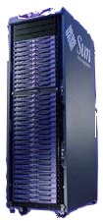
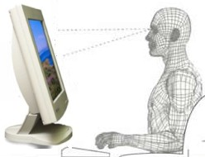

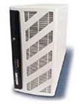
Typical Grid Layers
Grid-Enabled Applications
Grid
Development
Grid Visualization
Grid Workflow
EMS
- Grid RPC
- Grid MPI
- MDA
Scheduler
Manager
Packaging -ACS
Grid Security
Grid Middle Ware Engine
Grid VMs, Cache
High Performance & Secure Grid Networking
Physical Network Layer
Org-A
Org-B
Org-C
Org-D
Source: Adapted from NaReGI-PSE National Grid Initiative slides from GGF - ACS-WG, OGSA Standardization Process

Slide 50
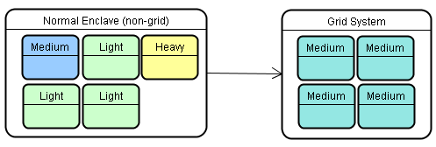
Grid Operating Environment (GOE)
Dynamic Automated Virtual Global Grid
The Grid Operating Environment is a concept infrastructure framework and system supporting secure coordinated resource sharing between geographically dispersed, heterogeneous and dynamic virtual organizations.
R2AD
Dynamic Automated Virtual Global Grid
Autonomic management is provided by the Service Oriented Grid Infrastructure based on OGSA standards.
Source: http://www.r2ad.com/presentations/DoDSoftwareTransformation-v2.pdf

