Slide 1
Maintaining and Searching Metadata
Mario Antonioletti, Shannon Hastings, Peter Kunszt, Stephen Langella, Simon Laws, Susan Malaika, Gavin McCance, Alex Woehrer.

Slide 2
What Is Metadata About
Data about the data in the data resource,
  e.g. its provenance or structure
Data about the data resource,
  e.g. its type and capabilities
Data about the web service that provides an interface to the data resource,
  e.g. its WSDL
Data about the relationship between web service and data resource,
  e.g. its lifetime
Data about the organization and relationships of the web service and data resource with others
  e.g. a data service resulted from a web service operation

Slide 3
Where Is Metadata Found
Data held and managed by the data resource,
  e.g. a database schema
Data held and managed by the web service,
  e.g. the service WSDL.
Data held by a third party but referring to the web service or the data resource,
  e.g. annotations, audit or provenance information

Slide 4
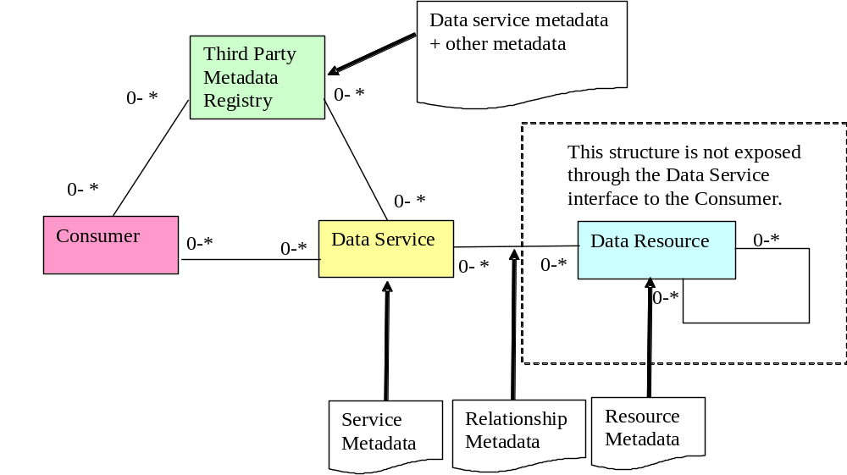
Metadata
Data service metadata

Slide 5
Actors
Metadata Registry
Gridbot
Client/Service
Data Service
Client

Slide 6
Data Service Metadata Operations
Data
Service
Query
Update
Augment
Delete
Subscribe

Slide 7
Metadata Registry Metadata Operations
Metadata
Registry
Query
Publish
Update
Augment
Classify
Delete
Manage
Subscribe

Slide 8
Querying Metadata
Assume publishing Metadata as XML
Assume Metadata Registry contains:
  All/Part/None of the Metadata
  Metadata service can query other services for Metadata

Slide 9
Hierarchies
R
Virtual Organization
R
R
DS
DS
Virtual Organization

Slide 10
Issues
Security/Trust
Coherency
Rate of change of Metadata
Should we support other query mechanisms
  e.g. SQL, …
Do we need to distinguish between third party publishing?
Need to examine UDDI
If we assume that metadata is logically bound to the data service
  what does this mean in relation to augmented metadata

Slide 11
Metadata Roadmap
Stage 1:
  Data Service
    Query/Delete/Update
Stage 2:
  Metadata Registry
    Publish/Query/Delete/Update
Stage 3:
  Metadata Registry
    Classify
Stage 4:
  Augment
Stage 5:
  Subscribe

Slide 12
Words for the Glossary
Metadata
Registry
Catalogue
  What's the difference between the two?

Slide 13
Stories
move data (e.g. a file) from one service to another
connect output from one service to input of another
access a remote file
add, rename, delete files at a different location (i.e. directory services)
add, rename, delete database content at a different location
maintain a replica of a file at a different location (for availability)
maintain a replica of an RDBMS at a different location (for availability)
maintain a replica of a file at a different location (for performance)
maintain a replica of an RDBMS at a different location (for performance)
create a local cache of remote data
access a remote a file
query a (non-stream) resource with a synchronous reply
query a (non-stream) resource with a asynchronous reply
third-party delivery
setting up process & data pipelines
batching a set of tasks over data.
triggered data movement
submit a query to a stream resource
federate several data resources
query a federated resource
maintain a user's personal distributed data area
discover data
register data

Slide 14
Questions
What meta data do you need to achieve the scenario
  E.g. DB schema
Is there metadata that someone has already invented
  E.g. CIM
Where do you get it from
  E.g. Data Services

Slide 15
Example
query a (non-stream) resource with a synchronous reply
What meta data do you need to achieve the scenario
  E.g. DB schema
Is there metadata that someone has already invented
  E.g. CIM
Where do you get it from
  E.g. Data Services

Slide 16
Coherence is a separate issue
  Policy will dictate
maintain metadata for a service
  Up, down
  It represents a relational database
    schema
maintain metadata for a group of services
search metadata for group of services

