Slide 1

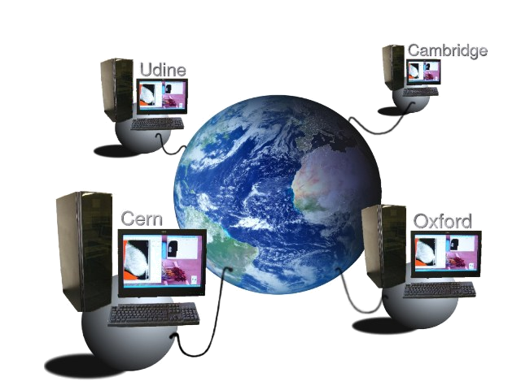

Firewall Issues: The MammoGrid Case Study
www.mammogrid.com
David Manset
UWE

Slide 2

About MammoGrid
EU FP5 funded project, start: 2002, end:2005
To build a grid-powered European mammography database and evaluate its use in a clinical environment
Participants:
  Medical Institutions:
    Udine University Hospital; Addenbrookes Hospital, Cambridge; Oxford University
  Academic Institutions, commercial partners:
    UWE Bristol, CERN, Mirada Solutions Ltd,
    UNIPI Pisa, UNISS Sassari

Slide 3
Key Objectives
Acquisition of large sample of mammograms
Standardization of mammograms (SMF)
Annotation of mammograms by humans as well as
CADe software
Distributed data management system, cross-institute, cross-country queries
Sharing of computing resources
  data storage optimization
  execution of computing-intensive algorithms
Proof of concept with active clinical participation

Slide 4
The MammoGrid Proof of
Concept Prototype

Slide 5
What was Delivered
A set of tested and configured Grid-Boxes deployed in hospitals.
Network infrastructure suitable to hospitals and the Grid application
Secure Medical Infrastructure Services

Slide 6
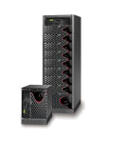
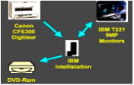
System Architecture
Dev. Workstations
Workstations
MG Wst
(MAS/MWS)
GRID
CERN
Oxford
MammoGrid Data
MammoGrid Data
GridBox
GridBox
MammoGrid Data
MammoGrid Data
GridBox
GridBox
Udine
Cambridge
MG Wst
(MAS/MWS)

Slide 7
Software Security
The MammoGrid SOA
Client
MammoGrid SOA
Dicom
SCU
TLS
Dicom SCP
Interface
AliEn / gLite
Site Services
MAS
Auth
HTTPG
HTTP
Portal
CE
SE
FTD
MWS
HTTPG
bbFTP
SSL
Query Manager
SSH tunnel
AliEn / gLite
Central Site Services

Slide 8
Conclusion
Overall Security
Medical Infrastructure Services
  All services are exposed through secure protocols
Firewall
  The whole system infrastructure is firewalled
    Firewall for internal connections to Grid-Boxes
    Firewall for external connections between Grid-Boxes
Conclusion
  Satisfactory level of Security for a proof of concept

Slide 9
Conclusion
Remaining Issues
File Transfer Protocols
  not really firewall friendly
Network Requirements for Grid
  Can disturb network policies in hospitals
  Bandwidth requirements can also be an issue
Certificate based Authentication
  Can be disturbed when having to move servers (change of IP address)
Need for a VPN Infrastructure
  Cheap hardware solutions & well suited for our project

