Slide 1
NAREGI-PSE: Problem Solving Environment with ACS based on Grid Services
S.Kawata¹⁾, H.Usami²⁾ , H.Kanazawa³⁾⁴⁾, M.Yamada³⁾, Y.Miyahara³⁾, Y. Itou³⁾, Y.Hayase⁵⁾, S.Hwang²⁾
¹⁾Utsunomiya University
²⁾National Institute of Informatics
³⁾FUJITSU Limited
⁴⁾Kanazawa University
⁵⁾Toyama National College of Maritime Technology
Notes:
Thank you for your kind introduction.
My name is Hiroyuki Kanazawa.
I will talking about ‘Problem Solving Environment based on Grid Services’ which called NAREGI-PSE.

Slide 2

Intellectual Property Policy
I acknowledge that participation in GGF16 is subject to the GGF Intellectual Property Policy.
Intellectual Property Notices Note Well: All statements related to the activities of the GGF and addressed to the GGF are subject to all provisions of Section 17 of GFD-C.1 (.pdf), which grants to the GGF and its participants certain licenses and rights in such statements. Such statements include verbal statements in GGF meetings, as well as written and electronic communications made at any time or place, which are addressed to: the GGF plenary session,
any GGF working group or portion thereof,
the GFSG, or any member thereof on behalf of the GFSG,
the GFAC, or any member thereof on behalf of the GFAC,
any GGF mailing list, including any working group or research group list, or any other list functioning under GGF auspices,
the GFD Editor or the GWD process
Statements made outside of a GGF meeting, mailing list or other function, that are clearly not intended to be input to an GGF activity, group or function, are not subject to these provisions.
Excerpt from Section 17 of GFD-C.1 Where the GFSG knows of rights, or claimed rights, the GGF secretariat shall attempt to obtain from the claimant of such rights, a written assurance that upon approval by the GFSG of the relevant GGF document(s), any party will be able to obtain the right to implement, use and distribute the technology or works when implementing, using or distributing technology based upon the specific specification(s) under openly specified, reasonable, non-discriminatory terms. The working group or research group proposing the use of the technology with respect to which the proprietary rights are claimed may assist the GGF secretariat in this effort. The results of this procedure shall not affect advancement of document, except that the GFSG may defer approval where a delay may facilitate the obtaining of such assurances. The results will, however, be recorded by the GGF Secretariat, and made available. The GFSG may also direct that a summary of the results be included in any GFD published containing the specification.
GGF Intellectual Property Policies are adapted from the IETF Intellectual Property Policies that support the Internet Standards Process.

Slide 3
Outline
Introduction
  “NAREGI”, the grid research and development project
NAREGI-PSE
  Use Case
  NAREGI-PSE and ACS
Conclusions
Notes:
This is the outline of my talk.
First, I will introduce NAREGI, the grid research and development project.
Next, I will talk about NAREGI-PSE.
NAREGI-PSE is a part of NAREGI project. And it is now being developed for first version of the software, The version is called ‘beta version’. It will be released in the spring of 2006.
About NAREGI-PSE, its objectives, its usage or typical use case will be discussed.
Then I will try to illustrate its mechanism, focusing structure of data.

Slide 4
Research Themes in NAREGI
WP1: Lower and Middle-Tier Middleware for Resource Management
  ( Scheduler, Broker, Auditing, Accounting, Grid Virtual Machine )
WP2: Grid Programming Middleware
  ( Grid RPC, Grid MPI )
WP3: User-Level Grid Tools, including PSE <= Gateway Services
  ( Workflow GUI, Visualization Tools, PSE )
WP4: Data Grid Environment
  ( Grid wide file system )
WP5: Networking, Security & User Management
  (Traffic Measurement, Optimal Routing Algorithms, Robust TCP/IP Protocols, Grid security infrastructure, Virtual Organization)
WP6: Nanoscience Applications using grid middleware
  ( Parallel Structure, Granularity, Resource Requirement, Coupled Simulation )
Notes:
These are grid middleware Research themes of NAREGI in National Institute of Informatics.
And these are also subgroups of NII.
Subgroup is called “work package”, and the number is attached from 1 to 6.
WP1 researches Lower…
Such as Scheduler…

Slide 5
NAREGI Software Stack
GatewayServices
WP6: Grid-Enabled Nano-Applications
WP2: Grid Programming
-Grid RPC
-Grid MPI
WP3: Grid Visualization
WP3: PSE
WP4:
Data Grid
Environment
WP3: Grid Workflow
WP1: Super Scheduler
WP1: Distributed
Information Service
（OGSA)
WP1: Grid VM
WP5: High-Performance & Secure Grid Networking
High throughput network for
research and education (SuperSINET)
NII
IMS
Research
Organizations
Universities
Computing Resources
Notes:
This slide shows the middleware stack of NAREGI,
and each research group advances the research and development while closely cooperating.
There is computing resources of each site most below. The computing resources is connected by high through put and nation wide network called SuperSINET.
The project test bed of middleware is depend on this network.
In addition, the target of the project is to develop the middleware that operates on this network.
I will indicate the software components that is the close relation to PSE
First, Grid Workflow is a visual tool for seamlessly preparing, submitting, and querying distributed jobs running on remote computing resources. It handles programs and data explicitly. Complex workflow descriptions such as loops and conditional branches are supported.
Next, Super Scheduler, which is usually called SS, is a scheduling system for large-scale control and management of a wide variety of resources shared by different organizations in the grid environment. The feature of SS to be a dynamic resource allocation and the reservation based scheduling
Next, Distributed Information Service, which is usually called IS, is a secure, scalable resource information management service.

Slide 6
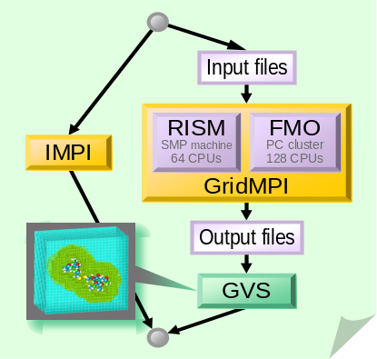
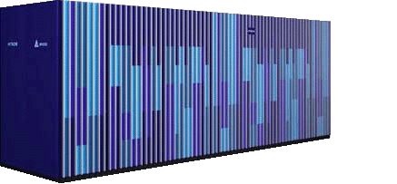
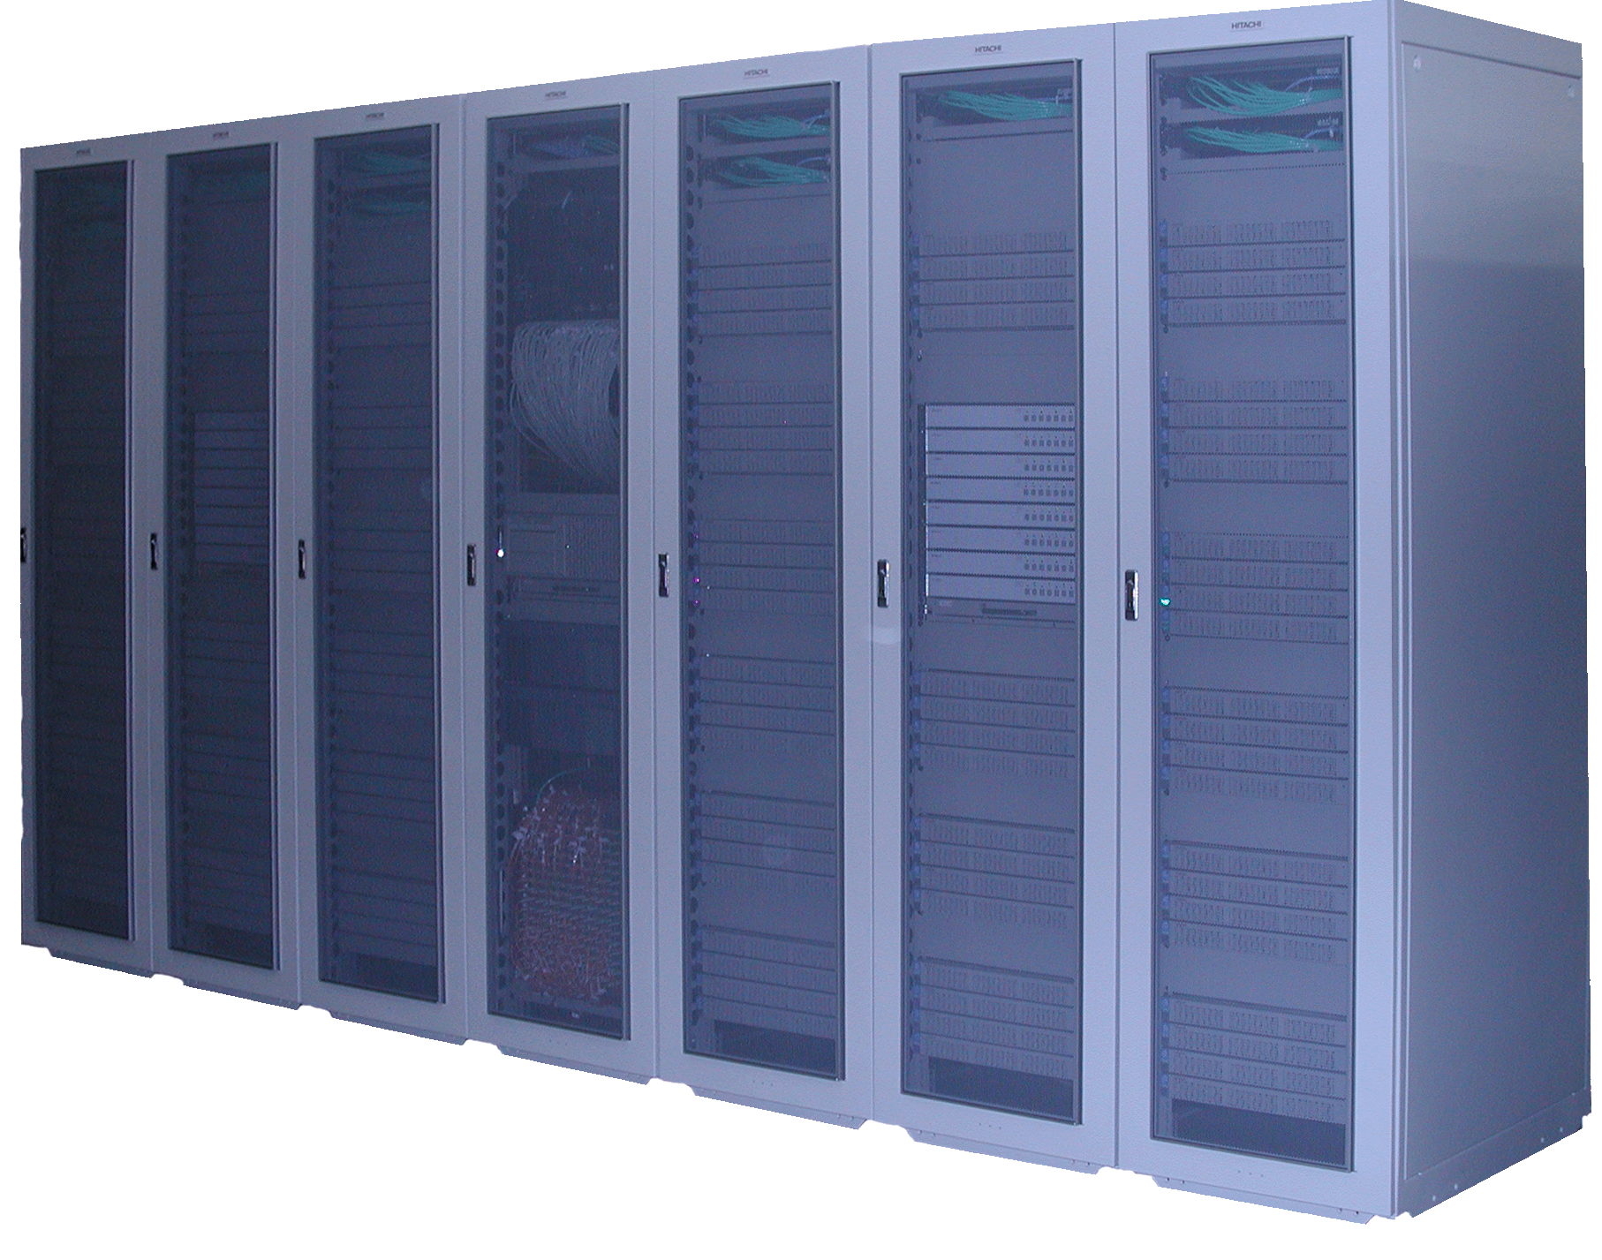

Scenario for Multi-site MPI Job Execution
RISM
source
Application requirement definition
FMO
source
Work-
flow
… Multi-Physics
simulation (MPI).
a: User
Registration
b: Deployment
c: Edit
CA
PSE
Grid Workflow
8: Visualization
1: Submission
Super
Scheduler
2: Resource discovery
Information
Service
5: IMPI starts
3: Negotiation
Agreement
9: Accounting
GridVM
GridVM
Co-Allocation
GridVM
6: MPI job starts
4: Reservation
Local
Scheduler
Local
Scheduler
Local
Scheduler
IMPI
Server
RISM
Job
7: MPI init.
FMO
Job
2: Monitoring
Solvent
simulation
Solute
simulation
GridMPI
Site A
Site B
(SMP machine)
Different
(sub) Jobs
Site C
(PC cluster)
Notes:
In this picture, One of the applications researched and developed by the NAREGI project showed the appearance that operated with the grid middleware.
I think that it can be understood a lot of middleware is related to the complexity.

Slide 7
NAREGI-PSE Concept
Provide a framework to distribute users’ applications on grid
  Users can register, deploy and retrieve applications by using NAREGI-PSE.
  Application developers distribute their applications to research communities without a hard task.
  Application users do not want to care about grid for using application.
Focus on a legacy application
  Deploy application binaries for specific targets
  Compile source programs, if needed

Slide 8


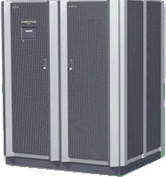
Use Case I (Registration, Compilation and Deployment)
NAREGI-PSE
Enter
Application Info.
Application
Developer
Application Pool
= ACS(ApplicationRepository)
+Application Information
Upload files
Source programs
Compile script
etc.
Deployment
Info.
Application
files
Compile
Info. Service
Resource
Info.
Resource
Info.
Application
Files(binaries)
Server#1
Server#2
Server#3
Compile
OK!
NG!
Post process
Post process
OK!
Notes:
I am talking about usage of NAREGI PSE. This figure shows application registration to PSE, and compile it, and then deploy application on each computer nodes.
Registration
Upload files (e.g., source code/executables, compile script, post-process script, initial input files, etc.) to the PSE application pool
Upload information (e.g., description, system requirements, etc.) associated with the uploading application to the application pool
Compilation (if needed)
Select an application. And then select a server for compilation matching to resource requirement.
PSE transfers necessary files (e.g., source code) from the application pool to the compile server
PSE compiles and verifies them on the server
PSE transfers files (e.g., executable) from the compile server to the application pool
Deployment
Select an application and servers that meet the system requirements for application deployment
PSE transfers the executable in the application pool to the selected servers
(Optional) Execute a post-process defined by user to configure and/or verify deployment on each servers
PSE registers information on the deployed servers to the information service

Slide 9
Application Deployment Information
When an application is deployed, NAREGI-PSE stores deployment information into Information Service.
Notes:
Distributed Information Service of NAREGI is based on Common Information Model, called CIM, which is specified by Distributed Management Task Force, Inc. (DMTF).

Slide 10
Use Case II (Retrieval and Execution)
Grid Workflow
NAREGI-PSE
Application
User
Retrieve
Application
ACS +
Application Info.
System
Requirements
etc.
Compose
WF
Application
Info.
WF execution
request (job submission)
Application
Deployment
Info.
Info. Service
Super
Scheduler
Resource
Info.
Dynamic
Resource
Info.
Execute on the suitable resource
Server#1
Server#2
Server#3
Deployed
Not deployed
Deployed
Load: high
Load: low
Load: low
Notes:
Application Retrieval
Retrieve application using GUI
Import the information of selected application (system requirements - JSDL, etc.) from application pool to workflow icon of Grid Workflow
Execution
Compose a workflow job from the registered workflow icon
PSE submits a job to Super-Scheduler
Super-Scheduler dispatches resource referring the resource information provided by Information Service

Slide 11
Application Pool with
Application Contents Services (ACS)
NAREGI-PSE
Application Pool
=
Application Information
Including
Resource Requirements (JSDL)
+
ACS (Application Repository)
Application
Producer
Create, Read, Update, Delete
Signature
AA Descriptor
Application Archive (AA)
Application
contents
Application
Repository
Contents
Application
Pool
Interface
Application
Consumer
Notes:
Application Contents Services
In this use case,
Application Producer create application archives in a application repository using application repository interface.
Then Application Consumer is getting application contents from application archives.
ACS working group in Global Grid Forum had released ACS specification draft version one in last November.
We have started developing PSE, based on working draft of ACS specification at August.
We will modify our ACS implementation later to based on released draft document.
ACS
NAREGI-PSE stores application files to Application Repository.
The application with different resource requirement is stored respectively as another application archive.

Slide 12
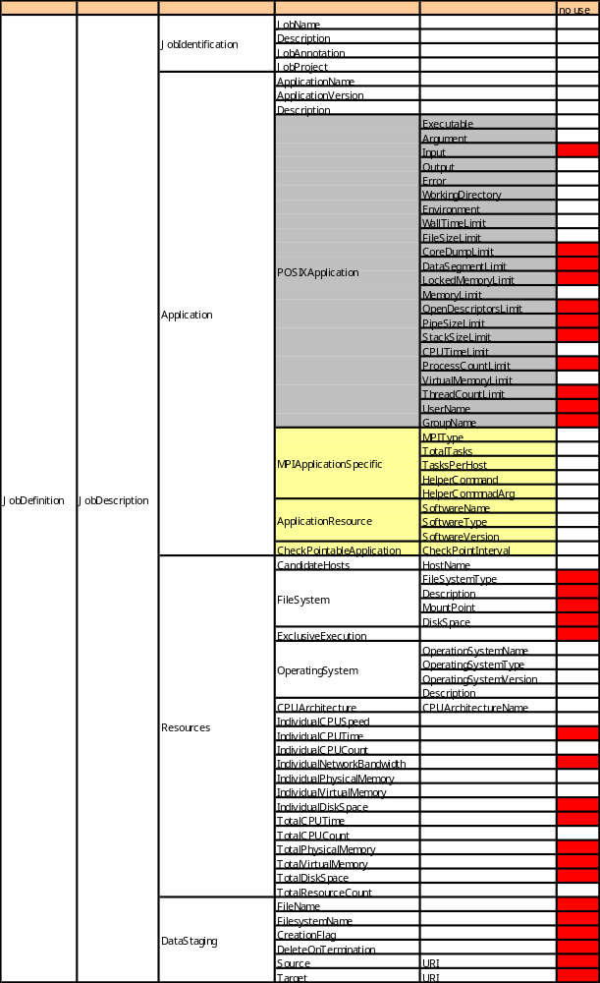
Job Submission Description Languages (JSDL)
Application element is extended:
POSIXApplication
MPIApplicationSpecific
ApplicationResource
CheckPointableApplication
JSDL Overview in GGF drafts:
<JobDefinition>
<JobDescription>
<JobIdentification ... />
<Application ... />
<Resources... />
<DataStaging ... />
</JobDescription>
</JobDefinition>
DataStaging element
is not used. Described
in Workflow.
Notes:
Overview of Job Submission Description Languages specification version 1 is shown in left squre.
Right table contains Job Submission Description Languages of NAREGI.
The main differences are Application element and DataStaging element.
Application element is extended to describe MPI parallel applications.
DataStaging is not used, because Datastaging is described in Workflow modeling Languages in NAREGI.
This slides shows Job Submission Description Languages in NAREGI.
in left square, it shows overview of JSDL specification.
JobIdentification element contains job name , description and so on.
Application element contains Application name, argument, working directory and so on.
Resources contain hardware resources such as CPU architecture.
DataStaging element contain FileName, Source, Target and so on.

Slide 13
Resource Requirements
Resource requirements of applications in NAREGI-PSE are:
  Described based on Job Submission Description Language (JSDL).
PSE refers to resource requirements of the applications:
  to determine what nodes/systems are used for compilation/deployment.
  Application users can copy JSDL in PSE to Grid Workflow. They can modify JSDL to match their specific purposes in the Grid Workflow.

Slide 14
Application Model of NAREGI-PSE
Common
application description
initial data files
With
Source
code
source files
(code, makefile, etc.)
executables
resource requirements
(JSDL)
configuration description
build description
(shell script)
executables
resource requirements
(JSDL)
configuration description
…
…
…
executables
resource requirements
(JSDL)
configuration description
Without source code
(ex. executable binary is registered. Pre-installed application.)
executables
resource requirements
(JSDL)
configuration description
Workflow
Workflow
(WFML)
(WFML is abbreviation of Work Flow Modeling Language. WFML consists of JSDL of each application and relation of application.)

Slide 15
Application Contents Services (ACS)
Signature
NAREGI-PSE
Application Pool
=
Application Information
Including
Resource Requirements (JSDL)
+
ACS (Application Repository)
AA Descriptor
Application Archive (AA)
Application
contents
ACS ( Application
Repository )
ACS ( Application Repository ) includes
Source + shell script, Binaries, Post script, WF(WorkFlow)
Notes:
Application Contents Services
In this use case,
Application Producer create application archives in a application repository using application repository interface.
Then Application Consumer is getting application contents from application archives.
ACS working group in Global Grid Forum had released ACS specification draft version one in last November.
We have started developing PSE, based on working draft of ACS specification at August.
We will modify our ACS implementation later to based on released draft document.
ACS
NAREGI-PSE stores application files to Application Repository.
The application with different resource requirement is stored respectively as another application archive.

Slide 16
NAREGI-PSE and ACS
ACS
  NAREGI-PSE stores application files into Application Repository (ACS-AA).
  The application with a different resource requirement is stored as another application archive.
  AA relation may be important to describe a relation between a source code and binaries
AA
Source code
AA
AA
AA
Binary
Executable A
Binary
Executable B
Binary
Executable C

Slide 17
Conclusions
Beta version of NAREGI will be released at spring of 2006.
NAREGI-PSE is implemented with ACS.
Beta version of NAREGI-PSE enables users
  to register their own applications,
  to compile and deploy the applications on the grid,
  to retrieve the application information,
  to copy the application information to Grid Workflow for execution.

