Slide 1


Network Centric Operations
Industry Consortium
Overview
Network Centric Operations
Industry Consortium
www.ncoic.org
Version 9.0
Notes:
The Network Centric Operations Industry Consortium will transform the way industry cooperates on common standards, collaborative engineering, shared customer knowledge, and ultimately, industry and customer culture. Most importantly, NCOIC brings industry's key players together to provide consistency and commonality around network-centric operations. We are viewed as the industry subject matter experts and technologists for NCO and therefore our customers are looking to us to come together on this issue and provide meaningful guidance.
Here is our story.

Slide 2
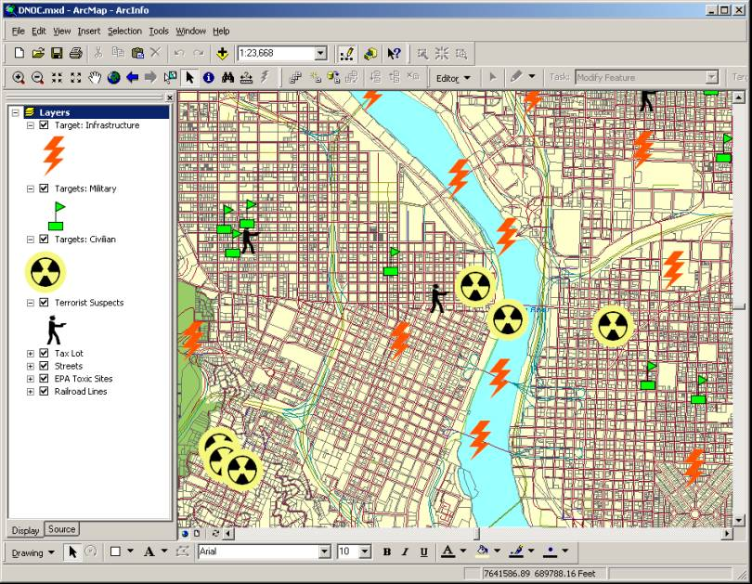
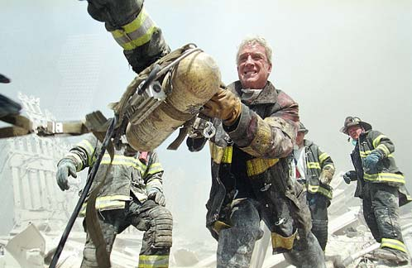



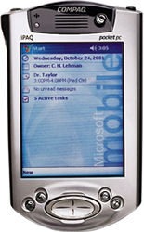


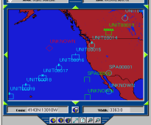

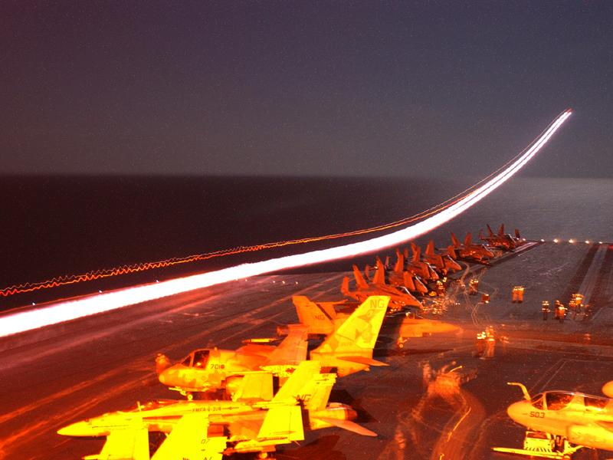
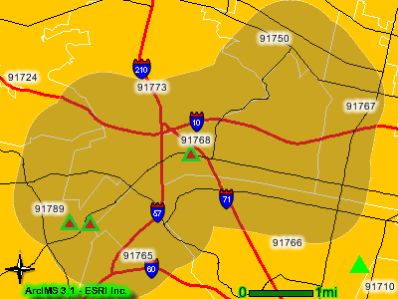


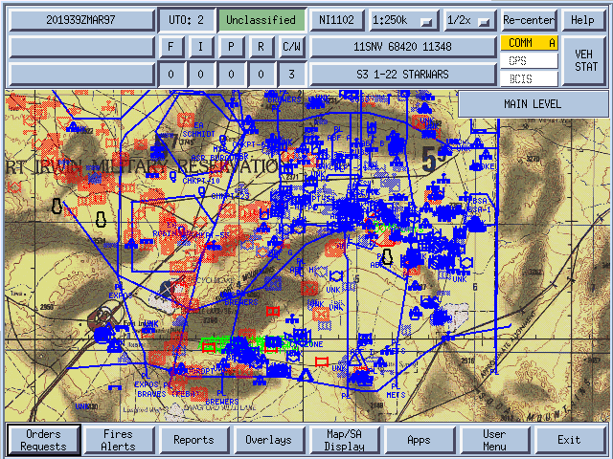
Our Scope
DoD, DHS, NATO and MoD
International Force Transformation
NCO is the underlying foundation of “Force Transformation” at the DoD and throughout the armed forces of our allies.
Force Transformation is a new strategic context
  New Theory of War based on Information Age principles and phenomena
New relationship between operations abroad & homeland security dealing with a considerably broadened threat context:
  State/Non-State
  Nodal/Non-nodal
  Symmetric/Asymmetric
  Traditional/Unrestricted
Notes:
Network-centric operations are an evolving set of principles based on the tenets of network-centric warfare. These are, first, a robustly networked force improves information sharing. Second, information sharing enhances the quality of information and shared situational awareness. Third, shared situational awareness enables collaboration and self-synchronization, and enhances sustainability and speed of command. And fourth, these, in turn, dramatically increase mission effectiveness. When these principles are broadened beyond the military application to the intelligence, law enforcement and first responder communities, as well as to industry, you have a network-centric environment.
NCO is not the goal - Force Transformation is the goal. NCO enables Force Transformation. The NCOIC is working to support the technical standards and practices that will underpin emerging NCO practices to enable Force Transformation.
NCO is a crucial aspect of providing our forces (US and allies) persistent, disproportional situational advantage against any adversary, any where in the world.
The NCOIC is aggressively addressing the threat context internationally in a proactive, systematic manner that is consistent with the NCO needs of our government stakeholders.

Slide 3
Why the NCOIC?
Industry Leadership to Reduce NCO Time-To-Market
A Forum for Subject Matter Experts to Collaborate on NCO Initiatives:
  Better Understand Customer’s NCO Vision, Goals, and Objectives
  Exchange strategies and proven approaches to enhance system delivery
An Organization Committed to Establishing Open, Interoperable Systems using Common Best Practices and Systems Engineering Techniques:
  Facilitates Consistency Across Industry
  Advocates for Open and Interoperable Systems Design
Companies Committed to Meeting the Government More Than Half-Way:
  Understanding Industry’s Responsibilities and Acting
  Addressing the Problem, Taking Initiative, Understanding the Requirement
  Seeking close collaboration with Government and the rest of industry.
This consortium exists to exchange ideas and produce process and technology deliverables that facilitate force transformation through NCO.
Notes:
We believe NCO enables transformation. We are working with government and one another to find an open way to demonstrate how NCO enables transformation and accelerates those efforts.
We’ll have a predominantly technical focus because that’s what our companies do—but we realize a significant aspect of transformation is cultural. We can’t do business in the same way we have been and therefore hope to achieve an interoperable future.

Slide 4
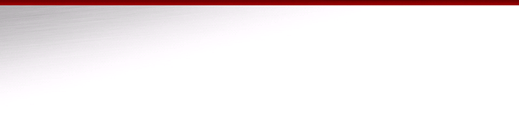
NCOIC Members – June 24, 2005
Total Members: 73 Additional Pending Members: 0
Active Inquiries: 77
Tier 1 Members (24)
BAE Systems North America
Boeing
CACI
Cisco Systems
EADS
EFW
EMC
General Dynamics
Harris Corporation
Hewlett-Packard
IBM
Intel Corp.
ITT Industries
L-3 Communications Integrated Systems
Lockheed Martin
Northrop Grumman
Oracle
Raytheon
Rockwell Collins
Saab
SAIC
Sun Microsystems
Thales
Themis Computer
Tier 2 Members (3)
Alcatel Government Solutions
Factiva
Israel Aircraft Industries
Tier 3 Members (46)
The Aerospace Corporation
AeroVironment Inc
Anteon Corporation
Argon ST
Ball Solutions Group
Bay Microsystems Inc
BearingPoint
Camber Corporation
CB Technologies
Ciena Government Solutions
Cryptek, Inc
Crystal Group
EDISOFT S.A.
Engenio Information Technologies
Ericsson
Finmeccanica
FlightSafety International
Honeywell
INDRA
Innerwall
Innovative Concepts, Inc
Institute for Defense Analyses
Johns Hopkins U. Applied Physics Lab
Marconi Communications Federal Inc
MBL International, Ltd.
McDonald Bradley, Inc
Microsoft
MITRE
Motorola
Objective Interface Systems, Inc.
PTC
Real-Time Innovations, Inc
Rheinmetall Defence Electronics GmbH
SRI International
RUAG Electronics
SAP Labs, Inc.
Sikorsky Aircraft
Smiths Aerospace
Software Engineering Institute/Carnegie Mellon University
SPARTA, Inc
SuprTEK
Systematic Software Engineering A/S
Terma A/S
Wakelight Technologies, Inc
West Virginia High Tech. Consortium Foundation
Wind River Systems

Slide 5
Consortium Operations
Advisory
Council
Executive Council
Advisory
Affiliates
Members
Affiliates
Executive
Director
Business
Council
Affiliates
The Open Group
Functional Teams & Working Groups
Functional Teams & Working Groups
Technical
Council
Affiliates
Functional Teams & Working Groups
Functional Teams & Working Groups
Notes:
The Consortium operations is made up of several different organizational elements, each composed of contributing member representatives, and each with an integral and specific role in the operation of the Consortium.
The Open Group, which serves the Consortium as a vendor-neutral service provider, plays a managerial and consulting role within each of the organizational entities.
The key to the Consortium are the functional teams and working groups. These teams comprise the prime development entities for our deliverables in direct support of the NCOIC mission.
The respective chairs of these teams comprise the Business and Technical Councils, the core of the Consortium.

Slide 6
Current Composition of Advisory Council
Dr. Paul G. Kaminski AC Chairman
LTG Steven W. Boutelle, USA Army
VADM (USN Ret) Arthur K. Cebrowski OFT
Lt Gen (USAF, Ret) James R. Clapper, Jr. NGA
Mr. Bill Dawson Intelligence Community
Dr. Vitalij Garber OUSD (A, T, &L)
Ms. Priscilla E. Guthrie OASD (NII)
Lt Gen William T. Hobbins, USAF Air Force
Mr. Lee Holcomb DHS
VADM James D. McArthur, Jr., USN Navy
Gen (USAF, Ret) James P. McCarthy USAFA
Mr. Arthur L. Money At large
Maj Gen (ret) Staffan Näsström Swedish DMA
Lt Gen Harry D. Raduege, Jr., USAF DISA
LtGen Robert M. Shea, USMC JCS
Maj Gen Ruud van Dam, AF Netherlands CT
LTG Robert W. Wagner, USA JFCOM
Dag Wilhelmsen NC3A Directorate General Manager
Maj Gen Georges D’hollander NATO Director NHQC3S
Notes:
Led by Dr. Paul Kaminski, former U.S. Undersecretary of Defense for Acquisition and Technology, this unique assembly of key leadership within our government stakeholders will:
Advise Consortium leadership on customer NCO/NCW issues, needs, requirements and direction
Provide thought leadership to the Consortium in developing innovative concepts and strategic direction
Encourage Consortium participation of NCO/NCW thought leaders, industry, and associated organizations
Encourage and leverage openness of communication at all levels of the consortium

Slide 7
Technical Council Structure
TECHNICAL COUNCIL
Chair: Mike Curtis (IBM) Vice: Sheryl Sizelove (Boeing) Emeritus: Alan Murdoch (NGC)
STANDING TEAMS
Architectures and Standards Analysis
Customer Requirements
Education and Outreach
Chair: Steve Russell (L-3)
Vice: Rob Biddlecomb (NGC)
Exec Sponsor: TBD
Working Groups:
- Stakeholders ID Serialization
TBD ( )
- Initiative ID & Analysis
TBD ( )
- Mission Thread/Use Case Analysis
TBD ( )
- Automation & Analysis Tools
TBD ( )
Chair: Bob Lawrence (BAE Systems)
Vice: Frank Miller (Rockwell)
Exec Sponsor: TBD
Working Groups:
- Position Paper / Lexicon
Paul Mangione (Boeing/GBA)
- Open Standards / Patterns
Mark Bowler (Boeing)
- NCOIC Interop Framework (NIF)
Frank Miller (Rockwell)
- NCO Analysis Tool (NCAT)
Fred Mervine (IBM)
Vish Dixit (Boeing)
- Mobile Networks
Jim Bound (HP)
Steve Kobierowski (Boeing)
- Information Assurance
James Ross (Boeing)
- Systems and Information Interop
John Yanosy (Rockwell)
Hans Polzer (Lockheed)
Chair: John Poladian (HP)
Vice: Al Nauda (Raytheon)
Exec Sponsor: TBD
Working Groups:
- OSD/OFT
Krishna Sankar (Cisco)
- W2COG
John Poladian (HP)
- Distance Learning
TBD ( )
Engineering Processes
Building Blocks
Chair: Tim Wellman (Raytheon)
Vice: Ken Cureton (Boeing)
Exec Sponsor: TBD
Working Groups:
- System Engineering Processes
- Collaboration Processes
- Modeling, Simulation, & Demos
Chair: Steve Haken (Sun)
Vice: James Burke (Lockheed Martin)
Exec Sponsor: TBD
Working Groups: (To be launched)
- Web Services; Category Definition
Partner Management
Notes:
Technical Team Charter: To lead, manage and coordinate the Technical resources and activities of the Consortium to accomplish the technical work products and deliverables
Primary Objectives:
Provide technical Leadership and inter-team coordination
Generate the Near and Long term Technical Roadmaps
Ensure Teams and Working Groups are appropriate, are effectively staffed, work within their charters, and adhere to deliverable schedules
Five “parallel” activities are supported by the 5 teams
The teams are identified here. Company affixations have been left on the chart to demonstrate the diversity of the leadership of the teams
It was mentioned before that the technical activities being performed by each of the teams is occurring in “parallel” and are closely interrelated. - Next Slide
NOTE TO THE PRESENTER: THE BRIEFING CONTENT FOR THIS SLIDE ARE THE INDIVIDUAL FUNCTIONAL TEAM SLIDES IN THE BACK-UP SECTION. THE FUNCTIONAL TEAM SLIDES ARE UPDATED AS APPROPRIATE TO ENSURE CURRENCY.
RECOMMEND THAT THIS SECTION OF THE PRESENTATION BE TAILORED TO THE AUDIENCE, NAMELY, BRINGING FORWARD ANY FUNCTIONAL TEAM SLIDE(S) THAT MAY APPLY TO YOUR PARTICULAR AUDIENCE, OR PROVIDE GREATER EMPHASIS ON A PARTICULAR ISSUE THAT IS THE FOCUS OF YOUR PRESENTATION.
FURTHER RECOMMEND THAT PRIOR TO MAKING THE PRESENTATION, CONTACT THE TECHNICAL COUNCIL CHAIR / VICE-CHAIR OR THE APPLICABLE FUNCTIONAL TEAM CHAIR TO RECEIVE ANY LAST MINUTE UPDATES AND INSTRUCTIONS ON CONTENT THAT MAY APPLY TO YOUR AUDIENCE.

Slide 8
Summary
Industry working together with our customers to achieve interoperability
Open participation across industry
Advisory and Affiliates Councils are key contributors
Engineers working together to enable interoperability
www.ncoic.org

