Slide 1

Extended Grid Communities
Bob Marcus (robert.marcus@sri.com)

Slide 2
Two Examples of Extended Grids
Global Information Grid
  Network Centric Operations Industry Consortium (NCOIC) Modeling, Simulation and Demo Working Group
Regional Community Grids
  Colorado Grid Computing Initiative (COGrid)

Slide 3
Global Information Grid and NCOIC

Slide 4
Global Information Grid
HPC Modernization Program http://www.hpcmo.hpc.mil/
Global Information Grid http://ges.dod.mil/about.html
Net-centric Enterprise Services NCES http://www.disa.mil/main/prodsol/cs_nces.html

Slide 5
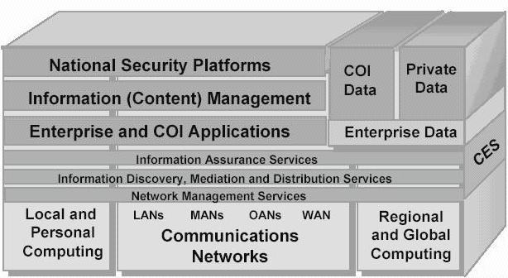
Global Information Grid

Slide 6
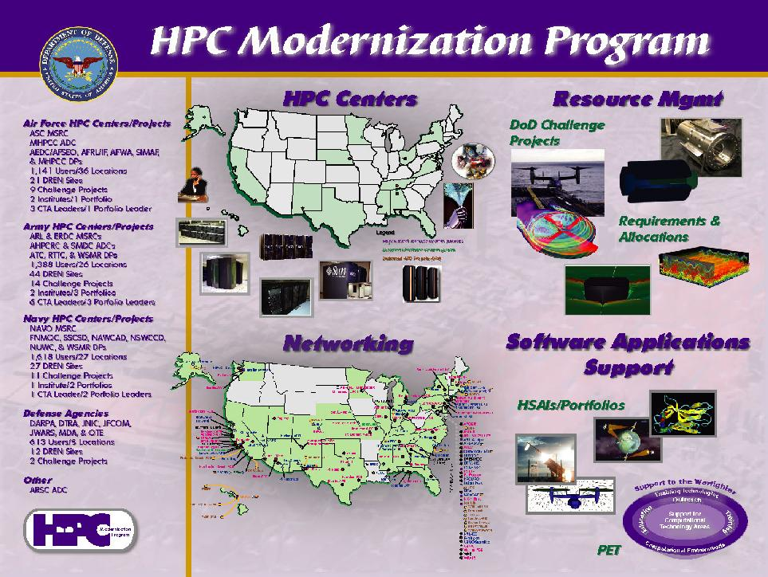

Slide 7
Some Interoperability Activities
NCOIC Modeling, Simulation and Demo Group http://www.ncoic.org
HLA/RTI https://www.dmso.mil/public/transition/hla/
XML Modeling and Simulation Framework(XMSF) http://www.xmsf.org
Joint Training Experimentation Program (JTEP) http://www.jtepforguard.com/
Multilateral Interoperability Programme http://www.mip-site.org/
Horizontal Fusion Portfolio Initiative http://horizontalfusion.dtic.mil/

Slide 8
Interoperability at Multiple Levels
  Network and Communication Protocols
  Data Transport Mechanisms
  Data and Metadata Representations
  Data And Function Sharing Policies
  Non-functional Capabilities e.g. IA, QoS
  Interface Protocols and APIs
  Functions and Composite Processes
  Semantic Representations

Slide 9
Regional Grids and
Colorado Grid Computing Initiative (COGrid)

Slide 10
Regional Grids
Economic Development Grid in Cleveland - http://www-1.ibm.com/grid/grid_press/pr_051805.shtml
Global Grid Exchange in West Virginia - http://www.globalgridexchange.com/index.jsp
Texas - http://www.tacc.utexas.edu/grid/
North Carolina - http://www.mcnc-gcns.org/
Cluster Ohio - http://www.osc.edu/hpc/cluster_ohio/
Capital Area Wireless Integration Network - http://www.capwin.org

Slide 11
COGrid Activities
COGrid -http://www.gridtoday.com/04/0531/103306.htm
CSU USDA project - http://newsinfo.colostate.edu/
Digital Colorado - http://ist.colostate.edu/posters/pellicane_digital_colo.pdf
Colorado Regional Grid -http://cogrid.colostate.edu/project/newsfiles/news_cit.cfm

Slide 12
The Great Global Grid is universal access to shared applications, data and hardware resources when authorized
Free Book - (http://www.great-global-grid.com)

