Slide 1

Network Services Interface
Introduction to NSI
Guy Roberts

Slide 2
OGF IPR Policies Apply
“I acknowledge that participation in this meeting is subject to the OGF Intellectual Property Policy.”
Intellectual Property Notices Note Well: All statements related to the activities of the OGF and addressed to the OGF are subject to all provisions of Appendix B of GFD-C.1, which grants to the OGF and its participants certain licenses and rights in such statements. Such statements include verbal statements in OGF meetings, as well as written and electronic communications made at any time or place, which are addressed to:
    the OGF plenary session,
    any OGF working group or portion thereof,
    the OGF Board of Directors, the GFSG, or any member thereof on behalf of the OGF,
    the ADCOM, or any member thereof on behalf of the ADCOM,
    any OGF mailing list, including any group list, or any other list functioning under OGF auspices,
    the OGF Editor or the document authoring and review process
Statements made outside of a OGF meeting, mailing list or other function, that are clearly not intended to be input to an OGF activity, group or function, are not subject to these provisions.
Excerpt from Appendix B of GFD-C.1: ”Where the OGF knows of rights, or claimed rights, the OGF secretariat shall attempt to obtain from the claimant of such rights, a written assurance that upon approval by the GFSG of the relevant OGF document(s), any party will be able to obtain the right to implement, use and distribute the technology or works when implementing, using or distributing technology based upon the specific specification(s) under openly specified, reasonable, non-discriminatory terms. The working group or research group proposing the use of the technology with respect to which the proprietary rights are claimed may assist the OGF secretariat in this effort. The results of this procedure shall not affect advancement of document, except that the GFSG may defer approval where a delay may facilitate the obtaining of such assurances. The results will, however, be recorded by the OGF Secretariat, and made available. The GFSG may also direct that a summary of the results be included in any GFD published containing the specification.”
OGF Intellectual Property Policies are adapted from the IETF Intellectual Property Policies that support the Internet Standards Process.
Notes:
IPR Notices Note Well for OGF meetings

Slide 3
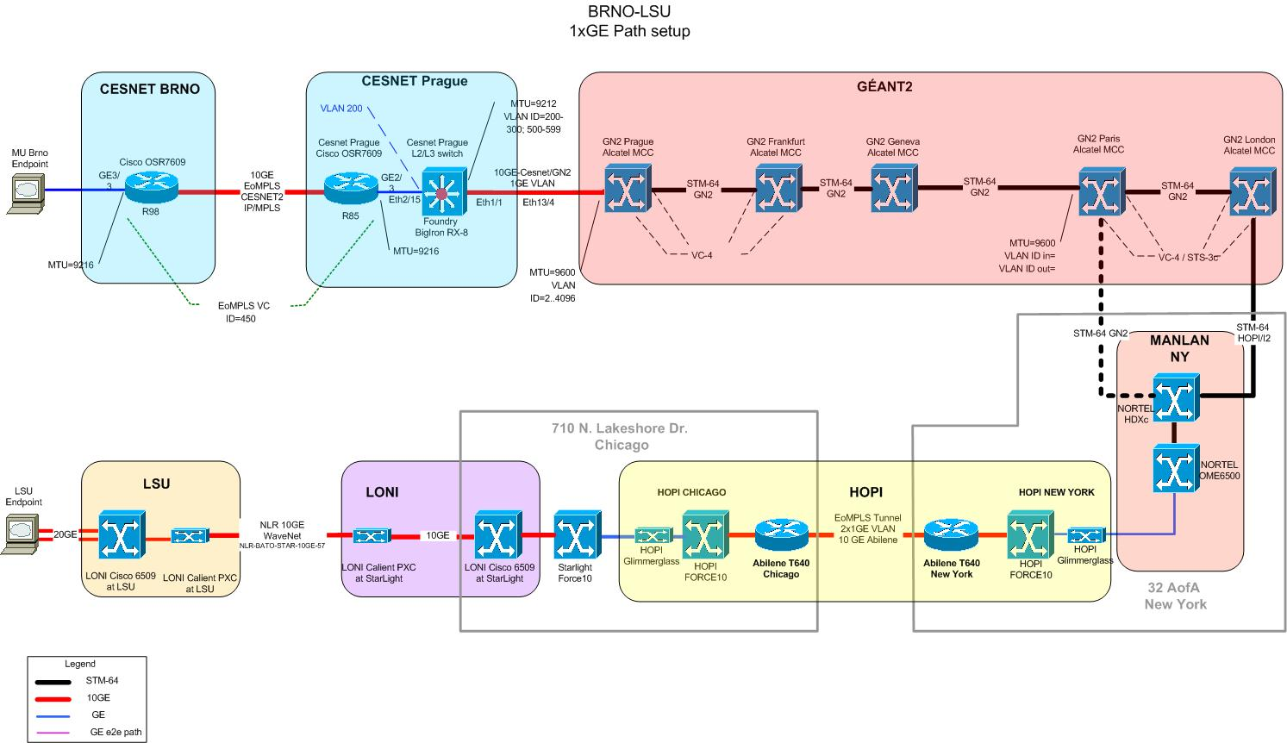
Light paths
Transport networks provide connection oriented capabilities to applications that require performance levels unavailable in connectionless networks.
Typically ‘Light paths’ may be created using on-demand using management or control plane within a single domain.
Light paths that transit multiple operators are currently ‘stitched together’ manually.
Can take many weeks to negotiate and de-bug.
Notes:
IPR Notices Note Well for OGF meetings

Slide 4
What’s new in NSI?
NSI is intended to complement and extend existing standards
Standards such as IETF GMPLS support single operator on-demand connection creation.
GRID middleware needs to be able to request complex network services
Key is to integrate these requirements by defining new interface on a new plane:
  Multi-operator needs
  Grid middleware-to-network interface
Network Service Interface operates in the Service plane
Notes:
IPR Notices Note Well for OGF meetings

Slide 5
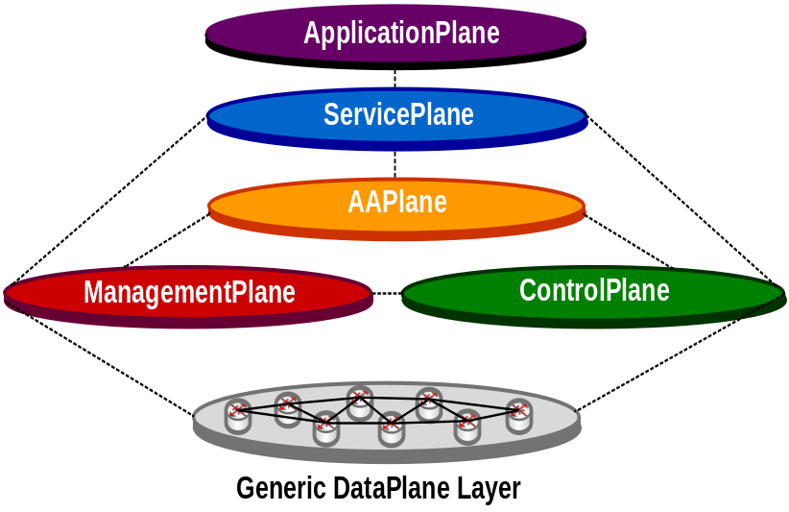
Service plane concept
The NSI operates in a separate plane that may be distinguished from existing management, control and data planes.
The NSI is considered to be operating in the Service Plane.
The Service Plane is defined as the set of systems and processes that are geared towards providing services to users and maintaining state on those services.
Notes:
IPR Notices Note Well for OGF meetings

Slide 6
NSI Architecture
Two instances of NSI are defined:
  Between an application and a network operator.
  Between two network operators.
Middleware - Operator
Operator - Operator
Requestor
Agent (RA)
Requestor
Agent (RA)
Requestor
Agent (RA)
Request
Network Service Agent (NSA)
Network Service Agent (NSA)
NSI
Response
NSI
Network Service Agent (NSA)
Network
Transport Network
Transport Network
Transport Network

Slide 7
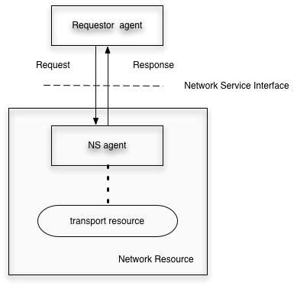
NSI concepts
Transport resource defines a network element or set of network elements that has the ability to setup connections between ports.
The Network Service Agent (NS-Agent) is an agent that has control over the Transport Resources and supports resource allocation and scheduling, policy implementation for resource allocation, and federation with other agents.
The term Network Resource in this recommendation refers to a transport resource with an NS-agent that exposes the capability to instantiate, schedule, track and announce its resources over a service interface.
The Requestor Agent requests reservations and connections from the Network Service Agent
Service plane
Transport plane

Slide 8
NSI functionality
To support reservation of resources across multiple operators, NSI must support the messaging services:
Topology exchange service
Path computation service
Signalling (schedule, reserve, negotiate, instantiate) service
Authorization and Authentication service
Monitoring service

Slide 9
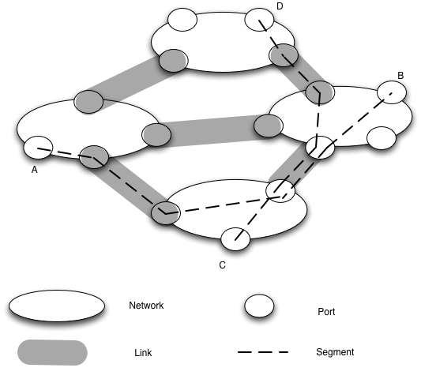
Transport topology
NSI in conjunction with NML has come up with a generic topology description which will support end-to-end connection creation.
Network – a group of transport resources that can provide resources to create connections between its ports
Link – transport resource that can allocate connections on resources between ports on different networks
Port – a resource where segments can initiate, terminate or be carried through.
Connection –A connection is a subset of resources between ports.
Segment – a connection between ports that is concatenate to other segments to make a longer connection

Slide 10
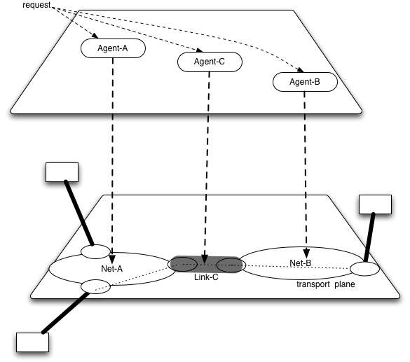
The big picture
In a multi-operator environment, the transport resources exist on the transport plane, each transport resource is controlled by single Agent
The Agent may be interconnected on the service plane via the NSI interface. These agents may exchange requests.
Alternatively a middleware requestor agent may initiate a centralized connection request.
Service plane
Transport plane

Slide 11
Full Copyright Notice
Copyright (C) Open Grid Forum (2008-2009). All Rights Reserved.
This document and translations of it may be copied and furnished to others, and derivative works that comment on or otherwise explain it or assist in its implementation may be prepared, copied, published and distributed, in whole or in part, without restriction of any kind, provided that the above copyright notice and this paragraph are included on all such copies and derivative works.
The limited permissions granted above are perpetual and will not be revoked by the OGF or its successors or assignees.
Notes:
OGF Full Copyright Notice if necessary

