Slide 1
Operating Framework of Connection Networks
OGF/NSI Working Group
Chicago
Oct. 10, 2012
John Vollbrecht
Leon Gommans

Slide 2
Quick Introduction
This presentation is intended to help provide a basis for defining AA requirements for NSI
We would like feedback about whether this helps promote NSI AA and what could be improved or explained better
This presentation uses the Network Provider Group [NPG] Framework to describe the organization of a group of provider networks collaborating to create connections between edgepoints of the networks
NPG is an instance of Service Provider Group [SPG] Framework which has been developed by examining services provided by groups of autonomous organizations
The NPG Framework describes how a group of network organizations can collaborate to provide connections between edge points

Slide 3
Network Provider Group Basics
NPG is a group of network providers organized to offer connections to users
NPG has two dimensions
  User view
  Provider view
Three functional levels + oversight
  Enterprise (managerial)
  Policy
  operational

Slide 4
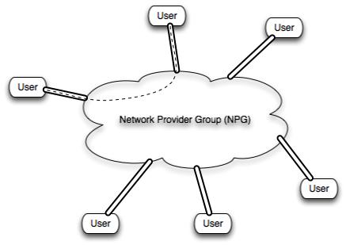
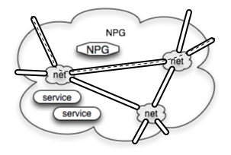
NPG Dimensions
User view –
    User gets connedtion from NPG
Provider view
    Includes provider nets, service providers such as topology, pathfinding, monitoring. Policy

Slide 5
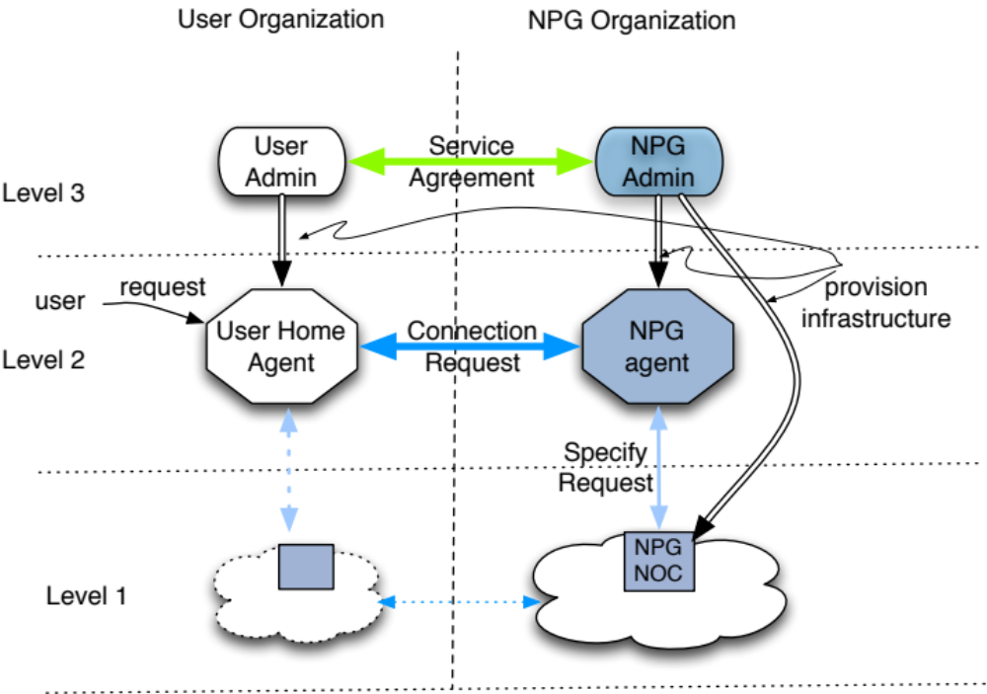
NPG User Dimension

Slide 6
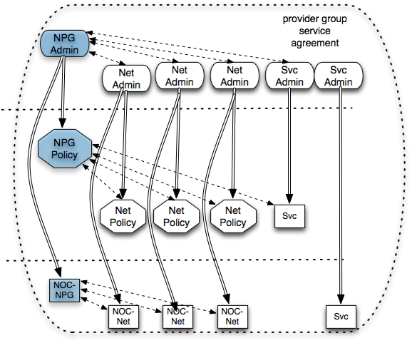
NPG Provider View
NPG is overlay on set of Providers
NPG coordinates agents to provide
service
Provider org may be part of more than one NPG
Mapping to NSI terms
Admin – provider org
Policy – NSA
NOC – NRM
Actions may be human or automated or combination

Slide 7

NPG Provider Dimension
Mapping to NSI
Conn.
Service
Topology
Service
Discover
Service
Monitor
Service
NPG
Service
NSI Framework
NSA
CS State
Mach.
TS
State
Mach.
MS
State
Mach.
NPG
State Mach
NPG
Policies
TSDB
NSA
NRM
Modified from Inder’s slides from Delft
Blue boxes show NPG services – Green services coordinated by NPG
Notes:
Blue is addition to Inder’s slide

Slide 8
NPG Levels
Enterprise level - management
  Defines, builds and monitors business architecture of collaborating providers
    Includes managers of each network and service providers as well as NPG manager
  Each enterprise actor reports to the principal of its organization
Policy level – NSA level
  executes policy using infrastructure and rules defined at Enterprise level
  Monitors Policy level for compliance with Enterprise rules
  Each policy actor reports to its enterprise owner
  Policy actors specify connections to participating operation level
Operation control level – NRM level
  Provides connection specified by Policy level using infrastructure defined by Enterprise Level
  Operates using infrastructure and rules defined at Enterprise level
  Instantiates Connections specified by Policy level
  Monitors and reports on connection compliance with policy and enterprise rules
Notes:
Infrastructure could be all computerized, all human or some combination

Slide 9
NPG Assumptions
Provider preconditions
Organization of NPG
A set of interconnected networks- potential provider networks
Each provider net has an operation level NOC/ NRM
Each provider network has a Policy Agent / NSA
Each network has a business manager agent at enterprise level
NPG coordinates a group of networks and service providers
Each organization, including NPG, has a principal and associated Directorate which is accountable for its activities
NPG has agents that enable and monitor functions at all levels
NPG uses Service providers [e.g. topology server] are used by NPG to enable NPG functions

Slide 10
Principal/Directorate and Accountability
Every organization has a principal that is accountable to other principals The Principal may have a “Directorate” that acts at an executive level for the Principal
A principal may act alone, or may have an organization to whom it delegates functional responsibility
Principals of organizations are ultimately responsible for defining and executing policy and are accountable for the results of policy.
Principals of organizations participating in an NPG delegate authority to enterprise agents who in turn delegate some of their authority to policy and operation agents
When acting for a principal, an agent must be demonstrate that it has been delegated the authority from the principal. Principal is the head of the authority chain for the organization
NPG Agents report on performance of functional activity so that Principal can take corrective action as needed
Notes:
Is this slide needed?

Slide 11
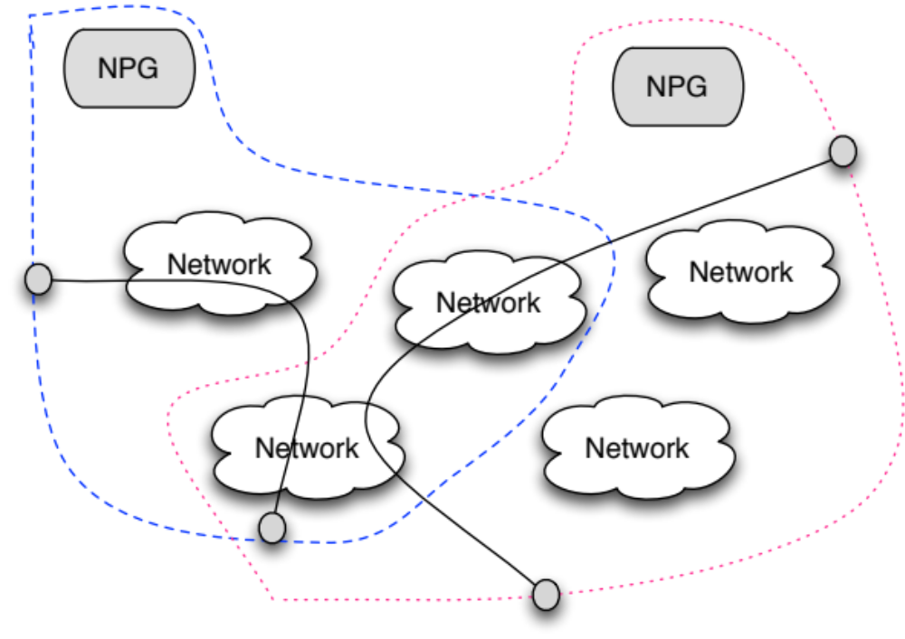
Mutiple Networks and Multiple NPGs
NPGs can be created using the same Provider networks
Having a number of networks with standard agents means they are able to join different NPGs as appropriate

Slide 12
NPG Principal/Directorate
An NPG Principal is created when an NPG is created
An NPG Principal is ultimately accountable for commitments the NPG makes to users and for enforcing agreements among members
NPG Principal could be a corporation operating the way MasterCard and Visa coordinates CC services for banks
Could be an executive group formed by a set of networks – perhaps formed by GLIF
Could an executive from a group of National networks who interconnect to provide service to other nets
NPG Principal creates NPG Directorate with agents
NPG delegates authority to its agents
Notes:
Raci matrix – responsible, accountable, consulted, informed
See wikipedia

Slide 13
Service Agreements Principals risk/reward
The Principal of each organization is responsible for service performance, and accepts risks with associated rewards and penalties.
  In a small business it might be the owner
  In a corporation it is the board of directors
The principal delegates responsibility to agents, is accountable for agent actions
Service agreements are between principals
Service agreements define how costs and benefits are allocated
An agent must be able to prove it is acting for (authorized by) a particular principal to participate in protocol between agents
Notes:
Principal of group is accountable to the group use to lead into what the principal of NPG does

Slide 14
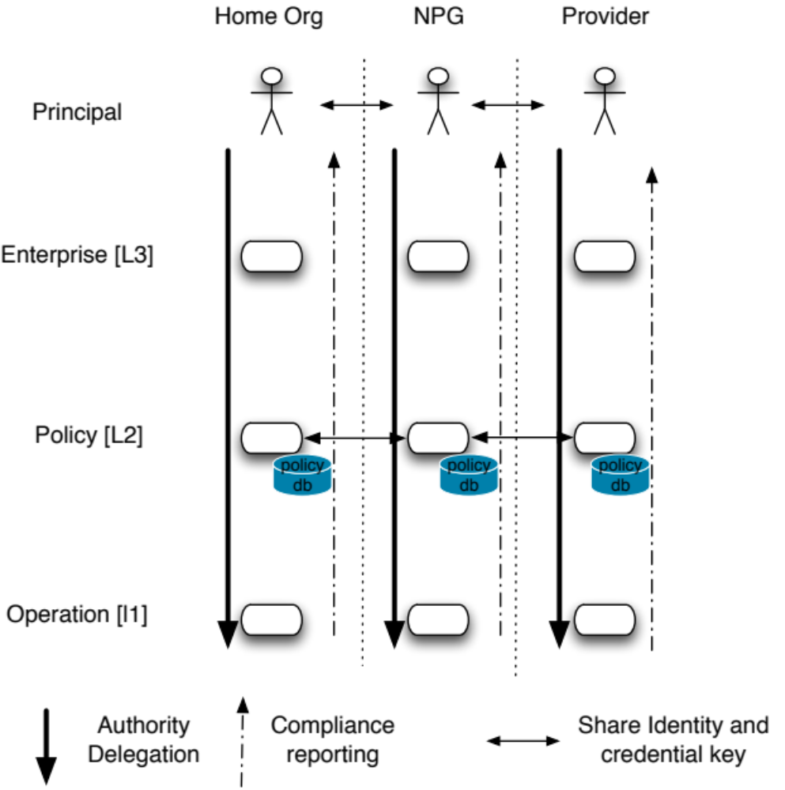
Authorization and Responsibility

Slide 15
Risks and Rewards
For the principal of an NPG two basic types of risk exist - it is accountable to user for both, allocates partial responsibility and liability to providers
Business Risk
  e.g. Use may not be as high as expected or
  may use some feature more than expect
  This is a Risk evaluated at Enterprise level
Operational Risk
  e.g Infrastructure may refuse valid requests or
  may not be able to handle the volume of requests or
  may accept fraudulent requests
  This is a risk of infrastructure and protocol
  Infrastructure and protocol can limit cost of risk
  Enforcement of operational requirements can limit cost of risk

Slide 16
Summary
Multiple networks collaborating to provide connections to users - need an NPG to define and oversee how they collaborate
NPG agents are in all three levels
NPG Principal is accountable for connections provided by NPG
NPG functional infrastructure is protocol based, but may be all human, all automated or some combination evolving

Slide 17
Thanks for listening
Questions?
  Some that might be good to discuss
Is it really necessary for NPG to have its own principal
Can the same topology service be used by multiple NPGs?
is it possible to define authority chain needed in Policy level messages in PKI terminology?
  What does the above mean?
What does the Enterprise level really do?

