Slide 1

OGF NSI WG
Architecture Issues
John Vollbrecht
jrv@internet2.edu
Sept 15 2008

Slide 2
NSI Architecture Deliverable
The following is a discussion of NSI architecture
Some concepts as I understand them
Some ideas for future work
This is to start discussion
  WG can take these as one hopefully helpful input

Slide 3
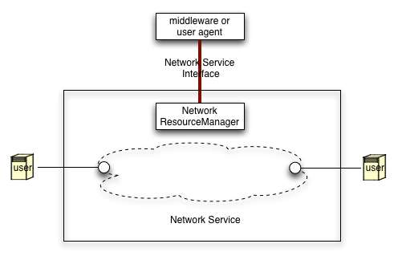
Request Architecture
Users connect to Network at network edge points
Connections across a network are controlled by a Network Research Manager NRM
Users request service via middleware or agent
[agent may be incorporated in User or NRM]
NSI Architecture describes interface to a NRI i

Slide 4
NRI Architecture Elements
Definition of Request Elements
  Naming – devices connecting to network and network edge points
  Describing path of circuit across network
  Messaging on NSI – circuit properties and attributes, protocol sequences

Slide 5
Circuits crossing multiple network domains
Network Domains interconnect to allow creation of circuits between endpoints on different Domains
User request must include edge points and MAY include path information between edge points
NSI supports requests in either chained or tree sequece between domains – as described in next slides

Slide 6
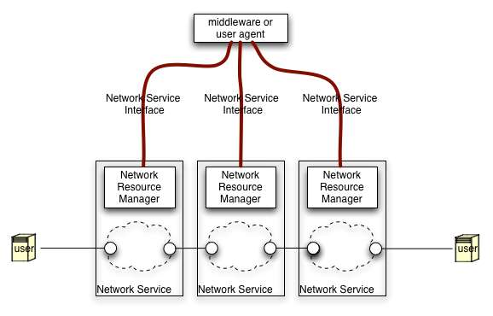
Multi network request hierarchical (tree) model
Middleware or Agent makes connections to multiple networks, concatenates connections to make ete circuit
Middleware must know how networks interconnect

Slide 7
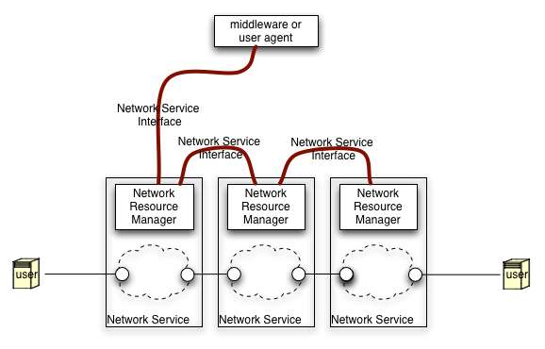
Multi network request
Chained model
Middleware requests connection from its network
Networks interoperate to find ete connection
Neworks know connectivity to other networks
Similar to first case for middleware/ agent

Slide 8
AA and Trust Requirements
Trust is required between elements using NSI
  Architecture defines trust requirements for different deployments and how these are supported in NSI
Authorization is done by each domain
  Architecture describes how multiple authorizations work together
Policy requires information about requestor
  Architecture defines what attributes about requestor are required and how they are verifie

Slide 9
Some assumptions to be validated
Requirements for middleware to net interface are subset of net to net interface
Tree and chain requests may be used to satisfy a request
Trust and AA requirements may be different in the two models

Slide 10
Interface Elements
Request Connection
    Required attributes and responses
    Naming of end points
    Sequencing of network requests
Instantiate circuit
    Required attributes and responses
    Validate circuit performance and integrity
Topology exchange
    Reachability of end points
    Network topology descriptions
    Combining topologies from multiple domains

Slide 11
Collaboration with other standards
Naming of elements and topology from NML working group
AA and trust infrastructure from OGF AA groups
    IdP and Authorization servers
    Policy and identity across multiple domains
Monitoring of connections from NM-wg
Other references to Scheduling, Accounting, Path finding as appropriate

Slide 12
Existing implementations
Compare existing implementations
  GLIF GNI work as one source for this
Adapt existing work where possible
Need input from developers and users
Role of charging policy

Slide 13
Architecture Next Steps
Decide on initial set of editors
Set up subgroup with regular call
Create Framework
  Collaborate to write sections
  Review
Build spec from sections
Additional items / suggestions ?

Slide 14

Discussion?
John Vollbrecht
Notes:
End Slide

