Slide 1

NSI Architecture subgroup
Status Update – John Vollbrecht

Slide 2

OGF IPR Policies Apply
“I acknowledge that participation in this meeting is subject to the OGF Intellectual Property Policy.”
Intellectual Property Notices Note Well: All statements related to the activities of the OGF and addressed to the OGF are subject to all provisions of Appendix B of GFD-C.1, which grants to the OGF and its participants certain licenses and rights in such statements. Such statements include verbal statements in OGF meetings, as well as written and electronic communications made at any time or place, which are addressed to:
    the OGF plenary session,
    any OGF working group or portion thereof,
    the OGF Board of Directors, the GFSG, or any member thereof on behalf of the OGF,
    the ADCOM, or any member thereof on behalf of the ADCOM,
    any OGF mailing list, including any group list, or any other list functioning under OGF auspices,
    the OGF Editor or the document authoring and review process
Statements made outside of a OGF meeting, mailing list or other function, that are clearly not intended to be input to an OGF activity, group or function, are not subject to these provisions.
Excerpt from Appendix B of GFD-C.1: ”Where the OGF knows of rights, or claimed rights, the OGF secretariat shall attempt to obtain from the claimant of such rights, a written assurance that upon approval by the GFSG of the relevant OGF document(s), any party will be able to obtain the right to implement, use and distribute the technology or works when implementing, using or distributing technology based upon the specific specification(s) under openly specified, reasonable, non-discriminatory terms. The working group or research group proposing the use of the technology with respect to which the proprietary rights are claimed may assist the OGF secretariat in this effort. The results of this procedure shall not affect advancement of document, except that the GFSG may defer approval where a delay may facilitate the obtaining of such assurances. The results will, however, be recorded by the OGF Secretariat, and made available. The GFSG may also direct that a summary of the results be included in any GFD published containing the specification.”
OGF Intellectual Property Policies are adapted from the IETF Intellectual Property Policies that support the Internet Standards Process.
Notes:
IPR Notices Note Well for OGF meetings

Slide 3
NSI-WG architecture subgroup
Has had calls bi-weekly since January
Large number of participants
Much of discussion on basic architecture issues
We have created an Issues folder based on discussions on the call
    Different editors for each “issue”
    http://forge.gridforum.org/sf/docman/do/listDocuments/projects.nsi-wg/docman.root.drafts
Goal is to create a “first cut” at an architecture doc for the Chapel Hill OGF in May

Slide 4
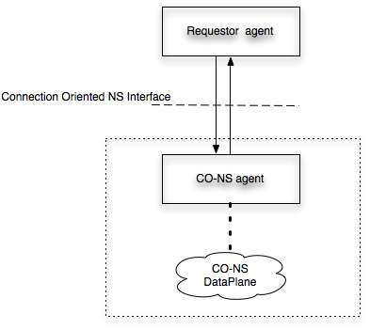
NSI Interface
Connection Oriented Network Service Interface
Interface is between Requestor Agent and NS Agent

Slide 5
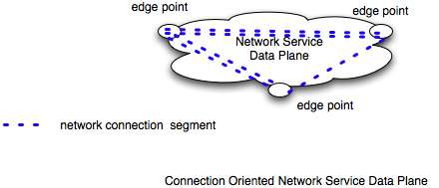
Network Service
What a CO Network Service Provides is a segment between edge points of its network

Slide 6
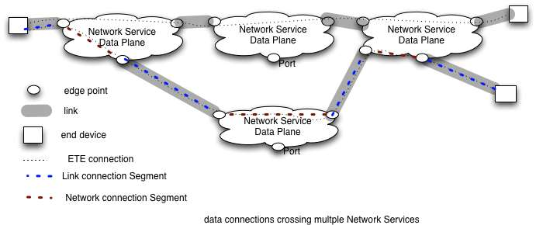
Connecting Network Services to each other and to end devices

Slide 7
Architecture sub group - issues
Generic architecture and scope
  Focus of most of this talk
  Discuss basic architectural constructs
  High level definition of Network Service and Network Service Interface
Network vs application centric
  Separate talk by Radek Kryswania
  Describes inter NS path setup in “tree” vs “chained” model
Abstract vs technology specific
  Separate talk by Guy Roberts
  Issues about technology vs abstract parameters for NSI messaging

Slide 8
More Issues
    Scheduling and Book ahead
      Separate talk by Tomohiro Kudoh
      Different kinds of scheduling, calendars,
    Sharing topology information
      Separate talk by Joan Antoni Espin Garcia
      What is required from NSI some discussion of global topology for federated NSs
    Not covered in separate talks
      Negotiation /editor Jerry Sobieski
      Path Finding/ no editor
      Endsite Involvement / Chin Guok
      Trust, authentication, authorization, policies / no editor
      Separating resource reservation and connection instantiation/John Vollbrecht
    These are covered briefly in following slides

Slide 9
Negotiation
Issues
  what needs to be negotiated
  When negotiation happens
    NS can’t meet request but can do something
    NS has to downgrade reservation or connection
  How negotiation happens – some possibilities
    Messages that tell what is available
    Parameters that tell why connection fails or that more is available
    Requests that have min and max

Slide 10
Trust and AAA
Trust is needed between sides of NSI
Policy is performed by NS agent
  All agents of resources must approve a reservation request for it to be accepted
NSI group will use Trust and policy capabilities from other groups
Will have interface with parameters to trust capabilities – standard if there is an appropriate one.

Slide 11
Separate resource reservation from connection instantiaton
Resources reservation may be for multiple simultaneous connections or different connections over time
Reservation of resources needs to happen in an all or nothing (perhaps with some negotiation) – requires named reservation block – perhaps JOB
Instantiation of connections as a sequence of segments – need to identify each connection to monitor debug and track connection usage

Slide 12
End site involvement –Issues
Are endsites part of network topology
  At the least they can be
Are endsites invoked prior to scheduling resources
  In SIP like call endsite negotiate before establishing connection – should NSI do the same
  Do we need common attributes among users to allow negotiating with each other
Do endsites participate in Control Plane

Slide 13
NS Model Concepts
NS conceptual entities
    Network Service
      Creates connection segments (segments for short)
      Between edge points (switch or concatenation points)
    Link
      Connects NS to another NS or edge device
      Carries connection segments between edge points
    Edge Point
      Points where networks and Links attach segments
      Cross connects / concatenates segments
    Connection segments
      Connection between two edge points
      Links and NS carry segments between edge points
      Concatenated segments are also segments

Slide 14
NS Levels
NSI defines connections as abstract concepts
Connections may happen at different levels
  Examples
    VLAN layer – VLANS carried on Links
    Wave layer – Waves carried on links
    Fiber layer – Fiber in Fiber bundles
Levels are different than protocol layers

Slide 15
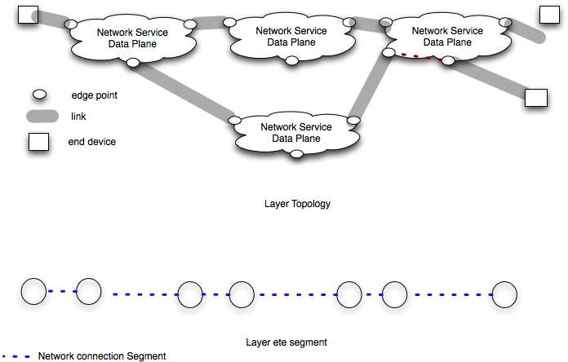
What is a NS Level
Level consists of a topology of NSs connected with Links
And segments which may be concatenated to create ete connection segments

Slide 16
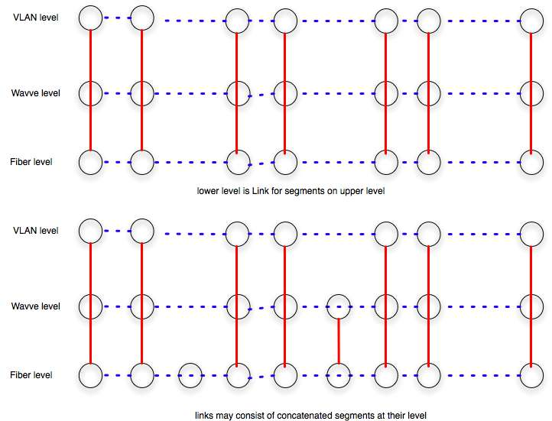
Relationship between NS Levels

Slide 17
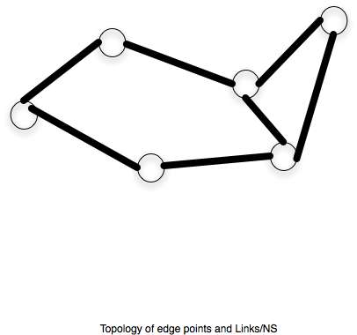
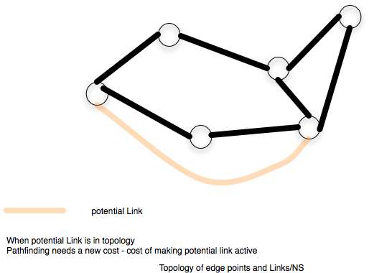
Multi-layer routing

Slide 18
Next Steps for NSI
Work on model of Network Service
Work on User cases and how to describe user cases
Create first draft of Architecture doc (rough) by OGF in Chapel Hill (May)
  Informed by “issues” doc
Define required collaborations
  NML
  Security
  Job Scheduling
  Others?

Slide 19
Full Copyright Notice
Copyright (C) Open Grid Forum (applicable years). All Rights Reserved.
This document and translations of it may be copied and furnished to others, and derivative works that comment on or otherwise explain it or assist in its implementation may be prepared, copied, published and distributed, in whole or in part, without restriction of any kind, provided that the above copyright notice and this paragraph are included on all such copies and derivative works.
The limited permissions granted above are perpetual and will not be revoked by the OGF or its successors or assignees.
Notes:
OGF Full Copyright Notice if necessary

