Slide 1

Network Services Interface
OGF 36, Chicago
Protocol versioning and interface discovery
John MacAuley, SURFnet
10th October 2012

Slide 2
Best practices
Protocol versioning
    Must be able to distinguish between versions of the protocol
Protocol version control
  Prohibit systems with non-compatible version of a protocol from communicating
Protocol version negotiation
  Allow two systems to negotiate a mutually supported version of the protocol (typically the highest common revision)
Capability discovery
  Dynamically discover the (protocol) capabilities supported by a system

Slide 3
Why are these important?
Managing new versions of NSI-CS protocol
  At the moment we all must upgrade simultaneously, or statically manage which version of NSI-CS a peer can support
Introducing new NSI interfaces and capabilities
  As new NSI protocol interfaces are introduced (OAM, Topology, etc.) we need to determine what a peer NSA can support

Slide 4
Protocol versioning
SOAP, WSDL, and XML support protocol versioning through the use of “namespaces”
targetNamespace attribute in WSDL service definition indicates the version of the protocol
  http://schemas.ogf.org/nsi/2011/07/connection/provider
  http://schemas.ogf.org/nsi/2011/10/connection/provider
  http://schemas.ogf.org/nsi/2012/03/connection/provider
Note: We are forced to up version the schema version if a behavioural change occurs in the protocol.

Slide 5
Protocol version control
SOAP implementations enforce namespace compatibility
Format of the URL is not important as an exact match is required
Namespace information is passed in the SOAP message along with the target SOAP endpoint, the operation selected, and the operation body
If the receiving SOAP endpoint does not exist, or does not support the namespace version, then the request is rejected

Slide 6
Strategy
Describe interfaces, versions, capabilities, and associated SOAP endpoints
Keep it simple and never change it (or rarely)
Provision SOAP endpoint of discovery service on peer NSA, all other interface information is discoverable
Peer NSA can dynamically discover all other endpoints and WSDL documents
An NSA then uses the document to guide version decisions, understand capabilities, and locate SOAP endpoints

Slide 7
Basic Request/Response
The Discovery service uses a basic request/response messaging model with an HTTP/SOAP binding:
  HTTP POST carries the discovery request operation
  HTTP 200 OK response carries result of the operation
  HTTP socket blocks until result it returned (synchronous)
We use a synchronous model since data set is small and hosted on the target NSA (no tree or chaining required)
HTTP POST (SOAP getServicesRequest)
Requester
NSA
Provider
NSA
200 OK (SOAP getServicesResponse)

Slide 8
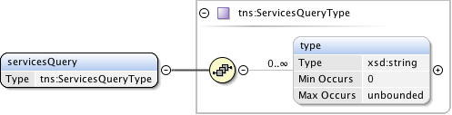
queryServices() operation
Request targets the NSA to be discovered
Request can filter on service types
  i.e. ConnectionService, TopologyService

Slide 9
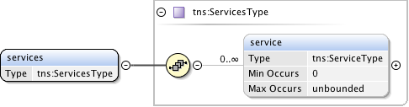
queryServices() response
Returns a list of available services and versions supported by the target NSA
Requesting NSA uses the returned list of service versions to determine the highest common version implemented by both requester and provider NSA for each required service

Slide 10
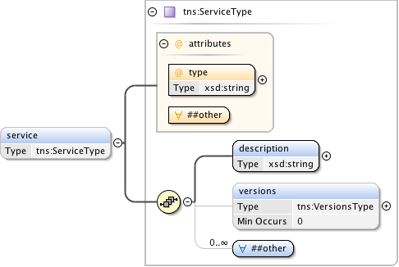
Service interface definition

Slide 11
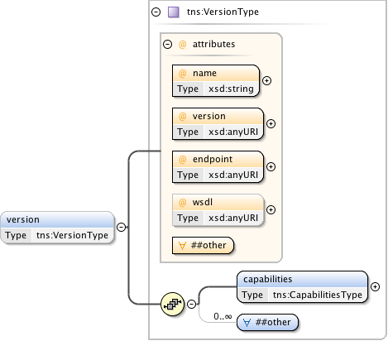
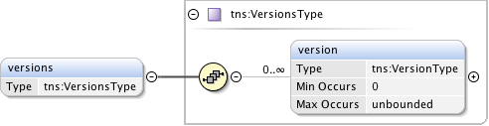
Service versions

Slide 12
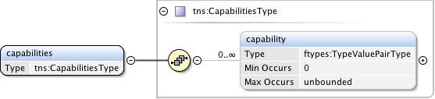
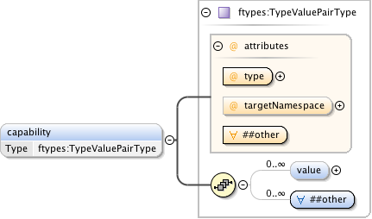
Capabilities schema

Slide 13
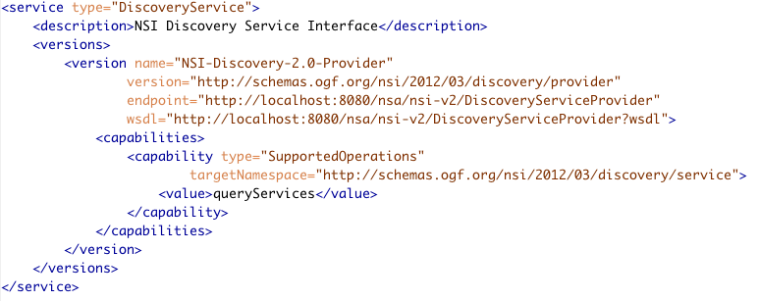
Example result contents
Service type
Service description
Name of specific version
Unique namespace for this version
SOAP endpoint
Location of WSDL for this version
Flexible capabilities definition

Slide 14
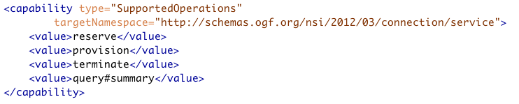
Capability definitions
Provides a flexible type/value pair mechanism to describe capabilities associated with a specific service version
Supported operations for a specific service version can be described using this mechanism

Slide 15
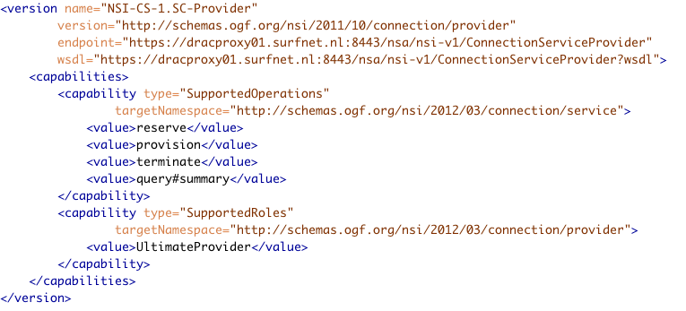
OpenDRAC CS 1.sc support

Slide 16

Discussion?
Questions?

