Slide 1

Network Services Interface
OGF 34, Oxford
Proposed NSI-CS version 1.1 restructuring
John MacAuley, SURFnet
12th March 2012

Slide 2
What is the problem?
Coding against 1.rio and 1.sc definitions revealed structural duplication
Common protocol header fields required dedicated handling code for each operation
Restructuring can considerably reduce the number of element definitions in WSDL

Slide 3
SOAP message
Standard SOAP message contains a header and body components
  Header contains security, routing, and operation action information
  Body typically contains document data related to the operation
  Today NSI exclusively used the SOAP body
<env:Envelope xmlns:env='http://schemas.xmlsoap.org/soap/envelope/’>
<env:Header>
… WS-* features …
</env:Header>
<env:Body>
… NSI message contents …
</env:Body>
</env:Envelope>

Slide 4
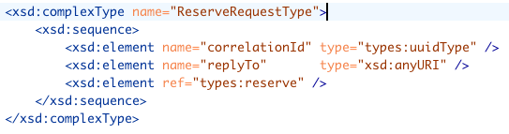
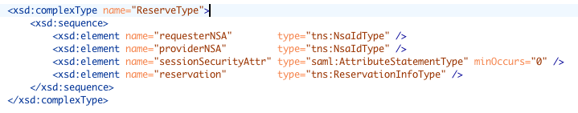
Current NSI request layout
Included in every request message

Slide 5
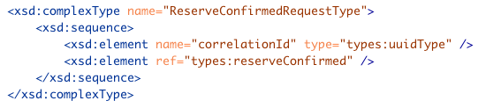
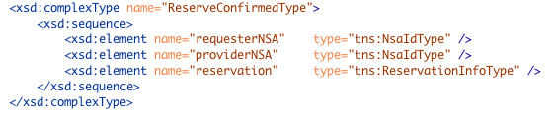
Current NSI response layout
Included in every response message

Slide 6
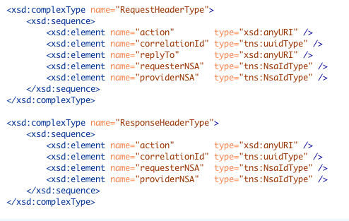
Refactor XML representation
Refactor the common fields into new structure to simplify handling

Slide 7
Separation of concerns
NSI architecture document defines common NSI header and separate operation specific payload
We can support this model by placing NSI header contents in SOAP header, and NSI operation in SOAP body
Similar to WS-Addressing concepts

Slide 8
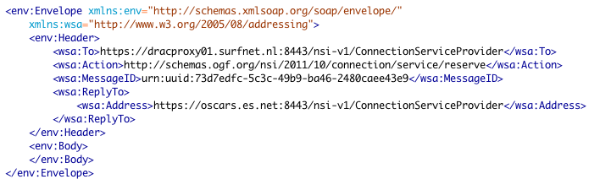
WS-Addressing

