Slide 1

NSI Topology
OGF 34, Oxford
NSI working group, 15th March 2012

Slide 2
NSI Topology
STP/SDP concept is good for end-users
Provides simple, abstract, user friendly strings
Simplifies identification of network edge ports for a user to request bandwidth
Effective for simple path finding
Less value for detailed, constraint based path finding

Slide 3

How do we balance…
Need for simple path finding with a high level of abstraction
VS
Need for detailed path finding with fine grained detail

Slide 4


Abstraction

Slide 5
So do layers…
Shrek: NO! Layers. Onions have layers. Ogres have layers. Onions have layers. You get it? We both have layers.
Donkey: Oh, you both have LAYERS. Oh. You know, not everybody like onions. What about cake? Everybody loves cake!
Shrek: I don't care what everyone else likes! Ogres are not like cakes.
Donkey: You know what ELSE everybody likes? Parfaits! Have you ever met a person, you say, "Let's get some parfait," they say, "Hell no, I don't like no parfait"? Parfaits are delicious!
Shrek: NO! You dense, irritating, miniature beast of burden! Ogres are like onions! End of story! Bye-bye! See ya later.
Donkey: Parfait's gotta be the most delicious thing on the whole damn planet!

Slide 6













NSI Topology Example
PSNC
Network
Network (NML Network)
NDN.EFDX
NDNi
Pionier-o
NDNo
Pionier-i
STPs (NML Ports)
Internet2-i
Internet2-o
NetherLight-o
Internet2
Network
NDNo
NDNi
NetherLight-i
SDPs (NML Links)
NetherLight
Network
NDNi
NDNo

Slide 7
Is NSI not really NML?
STP and SDP are just user friendly “aliases” to NML objects (port and link)
NML effectively models
  Nested networks
  Nested ports
  Nested links
  Nested Nodes
  Adaptations

Slide 8
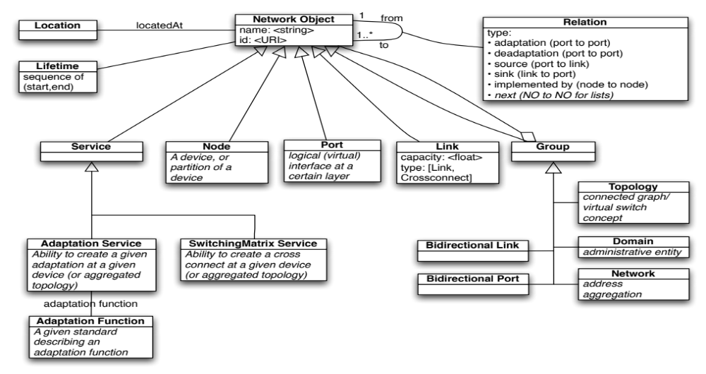
NML Model

Slide 9











Nested Networks
Do sub-networks not violate the principle of a single NSA managing a network?
NDN.EFDX
PSNC
NDNi
Pionier-o
NYC
NDNo
CPHo
CPH
Pionier-i
IONi
NYCi
POZo
CPHi
IONo
NYCo
POZi
Blue links are mapped relationships indicating a direct relationship in the topology
Internet2-i
AMSi
AMSo
Internet2-o
NetherLight-o
Internet2
NDNo
NDNi
NetherLight-i
NetherLight
NDNi
NDNo

Slide 10


NML Nodes
NDN.EFDX
PSNC
NDNi
Pionier-o
NDNo
STP are mapped relationships to NML ports
CPHo
NYC
POZo
Pionier-i
IONi
NYCi
CPHi
CPH
IONo
NYCo
POZi
Yellow lines are NML links mapped from NSI SDP. Similarly, the ports are direct mappings from STP.
Internet2-i
AMSi
AMSo
Internet2-o
NetherLight-o
Internet2
NDNo
NDNi
NetherLight-i
NetherLight
NDNi
NDNo

Slide 11
Decisions
STP bundles shall be supported but we need a common algorithm for generation of STP ID between connected endpoints (to generate SDP)
Similarly, we need a common dynamic way to map these generated STP alias to underlying NML structures
For those who what to expose internal network topology the standard NML node object should be used in combination with ports and links
STP/SDP can be used inside a network as a helpful alias to the NML port/link objects
Nested networks can be used, but we recommend node objects as an alternative to avoid excessive layering
The STP-to-STP “alias” for can be easily handled using the “mapsTo” relationship from one STP to another

