Slide 1

Network Services Interface
OGF 40, Oxford
Guy Roberts, Inder Monga, Tomohiro Kudoh 15-17 Jan 2014

Slide 2
OGF IPR Policies Apply
“I acknowledge that participation in this meeting is subject to the OGF Intellectual Property Policy.”
Intellectual Property Notices Note Well: All statements related to the activities of the OGF and addressed to the OGF are subject to all provisions of Appendix B of GFD-C.1, which grants to the OGF and its participants certain licenses and rights in such statements. Such statements include verbal statements in OGF meetings, as well as written and electronic communications made at any time or place, which are addressed to:
    the OGF plenary session,
    any OGF working group or portion thereof,
    the OGF Board of Directors, the GFSG, or any member thereof on behalf of the OGF,
    the ADCOM, or any member thereof on behalf of the ADCOM,
    any OGF mailing list, including any group list, or any other list functioning under OGF auspices,
    the OGF Editor or the document authoring and review process
Statements made outside of a OGF meeting, mailing list or other function, that are clearly not intended to be input to an OGF activity, group or function, are not subject to these provisions.
Excerpt from Appendix B of GFD-C.1: ”Where the OGF knows of rights, or claimed rights, the OGF secretariat shall attempt to obtain from the claimant of such rights, a written assurance that upon approval by the GFSG of the relevant OGF document(s), any party will be able to obtain the right to implement, use and distribute the technology or works when implementing, using or distributing technology based upon the specific specification(s) under openly specified, reasonable, non-discriminatory terms. The working group or research group proposing the use of the technology with respect to which the proprietary rights are claimed may assist the OGF secretariat in this effort. The results of this procedure shall not affect advancement of document, except that the GFSG may defer approval where a delay may facilitate the obtaining of such assurances. The results will, however, be recorded by the OGF Secretariat, and made available. The GFSG may also direct that a summary of the results be included in any GFD published containing the specification.”
OGF Intellectual Property Policies are adapted from the IETF Intellectual Property Policies that support the Internet Standards Process.
Notes:
IPR Notices Note Well for OGF meetings

Slide 3
6 NSI Sessions @ OGF40
NSI session 1: Wed. 15th Jan, Time: 13:30, Room 2
NSI session 2: Wed. 15th Jan, Time: 15:30, Room 2
NSI session 3: Thurs. 16th Jan, Time: 9:00, Room 2
NSI session 4: Thurs. 16th Jan, Time: 10:45, Room 2
NSI session 5: Thurs. 16th Jan, Time: 13:30, Room 2
NSI session 6: Fri. 17th Jan, Time: 9:00, Room 2

Slide 4
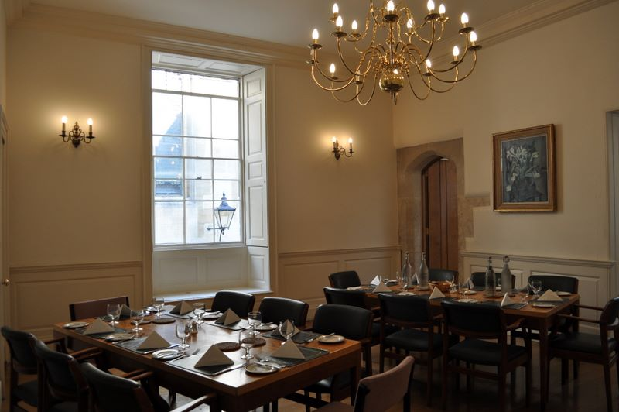
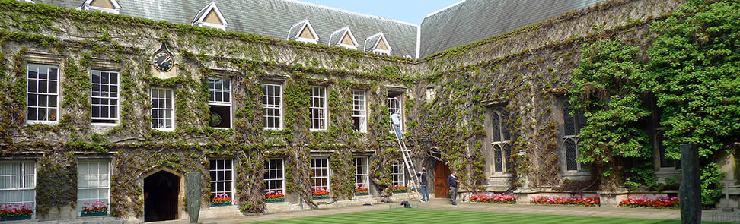
NSI dinner @ Lincoln
The NSI dinner will be at Lincoln College on Wednesday.
Starts with pre-dinner reception at 7pm
18 participants: Tomohiro K. +1 AIST, Hans T., Guy R., Richard HJ., Diederik V., Freek D., Henrik TJ., Kim K., Tangui C., Brian B., Kostas S., Radek K., Chin G., Inder M., Lars F., John M., Jerry S.

Slide 5
Wednesday
NSI session 1: Wednesday 15th Jan, Time: 13:30, Room 2
  Agree agenda (10 min)
  CS document status update: Guy Roberts, Richard H-J (20 min)
  Next steps: Making NSI v2.0 work John M. (10 min)
  BoD service roadmap, Tangui C. (20 min)
  NSI implementation in BoD, Radek K. (20 min)
NSI session 2: Wednesday 15th Jan, Time: 15:30, Room 2
  OpenDRAC/Surfnet implementation Hans T. (20 min)
  OpenNSA implementation Henrik T-J. (20 min)
  OSCARs NSI implementation update. Chin G. (20 min)
  G-lambda/A implementation Atsuko Takefusa (20 min)

Slide 6
Thursday
NSI session 3: Thursday 16th Jan, Time: 9:00, Room 2
  Pathfinding in NSI. John M. (20 min)
  Service Definitions – Documenting service definition John M. (20 min)
  Discovery Service, John M. (10 min)
NSI session 4: Thursday 16th Jan, Time: 10:45, Room 2
  Monitoring Kostas Stamos, (15 min)
  NML topology update. Freek D. (20 min)
  NSI topology exchange. Chin G/John M. (60 min)
NSI session 5: Thursday 16th Jan, Time: 13:30, Room 2
  OCCI and NSI Thijs Metsch 15 min
  Network Service Interface Conformance Test Suite, Radek K. (20 min)
  AAI implementation in DRAC/AutoBAHN Hans T. Tangui C. (20 min)

Slide 7
Friday
NSI session 6: Friday 17th Jan, Time: 9:00, Room 2
  NSI developers workshop, NSI best practices, AAI
  AIST experiments plans for using NSI to control optical transmission equipment. T. Kudoh-san

Slide 8
NSI-WG: next NSI events
NSI meeting?
GLIF meeting?

Slide 9
Full Copyright Notice
Copyright (C) Open Grid Forum (2008-2014). All Rights Reserved.
This document and translations of it may be copied and furnished to others, and derivative works that comment on or otherwise explain it or assist in its implementation may be prepared, copied, published and distributed, in whole or in part, without restriction of any kind, provided that the above copyright notice and this paragraph are included on all such copies and derivative works.
The limited permissions granted above are perpetual and will not be revoked by the OGF or its successors or assignees.
Notes:
OGF Full Copyright Notice if necessary

