Slide 1

Network Services Interface
Policy
John MacAuley, Esnet
28th September 2015

Slide 2
The problem

Slide 3
Link Ownership
In some situations a network’s demarcation point is not considered the edge of their network, but the end of the link connected into the far end network.
In the diagram below we see Link A is owned by Network A and Link B is owned by Network B.
Exchange Network X cannot make a connection on port X.A without the approval of Network A, and similarly, cannot make a connection on port X.B without approval of Network B.
At the moment, NSI CS would permit Exchange X to connect X.A to X.B without their knowledge, potentially blocking bandwidth that maybe required in the future.
Network A
X.A
Exchange
X
Network B
X.B
Link A
Link B

Slide 4
Transit policies
Transit policies dictate what traffic may transit a network based on source and/or destination network.
An example of transit policies:
  Network A allows Network B and Network C to connect through to any of client Networks A1, A2, and A3.
  Network A allows client networks A1-A3 to connect without restriction.
  Network A disallows connections between Network B and C.
Network A3
Network
C
Network A2
Link C1
{ ! to Network B }
Link A3
Link C2
Link A2
Network A1
Network
A
Network
B
Link A1

Slide 5
Link restrictive transit policies
For example, Exchange X has a policy that allows traffic between Network A and Network C via Links A and C1, but not using Links A, B, and C2.
Network
C
Link C1
Link C2
Network A
Exchange
X
Network
B
Link A
Link B
{ ! to Network C }

Slide 6
Resource restrictive transit policies
An example of a resource based transit policy is Exchange X allowing a maximum bandwidth between Network A and Network C independent of the path.
Network
C
Maximum bandwidth Link C1 + Link B for src Network C == 10 Gbps
Link C1
Link C2
Network A
Exchange
X
Network
B
Link A
Link B

Slide 7

Resource allocation policies
Restrictions on the path a reservation may take through the network based on the segmentation of allocated resources within the network to specific groups of users.
In the example below, Link C1 is tagged for use by user group 1 only, while all other links are tagged for cooperative sharing. Only users that are members of group 1 may use link C1 in reservation requests.
Network
C
Link C1
{ group 1 }
Site 2
User group 1
Link C2
{ all }
Network A
Exchange
X
Network
B
Link A
{ all }
Link B
{ all }
Site 1
User group 1

Slide 8
Preferred link policies
Due to transit policies within Network C, transit traffic from Network A to Network D should use preferred Link D1 until capacity is consumed, while transit traffic between Network B and Network D should use preferred Link D2.
Network A
Link A
Link D1
Network
C
Network
D
Network
B
Link D2
Link B

Slide 9
Preferred path policies
There are two equal distant paths between Network A and Network D; however, Network A has a preferred link policy such that any traffic between Network A and D must transit Network C via Link AC, the preferred route.
Network A
Network
C
Network
D
Link AC
Link CD
Link BC
Link AB
Link BD
Network
B

Slide 10
Selective Reachability
This type of policy restricts the traffic that can terminate in a network, along with transit rules for associated traffic
  A should be able to reach B+D
  B should be able reach all.
  C should be able to reach B+D
  D should be able to reach A+B+C.
That is, A and C are not exchanging traffic, but C provides transit to D, and D has transit to A through B and C
Network A
Network
B
Network
C
Network
D
Link AB
Link BC
Link CD

Slide 11
Policy-based routing
These examples of policy-based routing decisions introduce three new requirements for path finding and for the uPA process of reservation approval
  How does a path finder learn of these policies such that it can rule out paths that would possibly violate the policies?
  How does a uPA learn enough of the proposed end-to-end path such that it can make a decision on whether to approve the local reservation segment?
  How does an exchange determine that adjacent networks have approved a connection which would utilize their links?

Slide 12

Authorization in NSI
Control plane is considered secure transport.
Policy-based routing can utilize user information for path resolution.
Service Plane
AG
User/Application
TLS
TLS
AG
uPA
uRA
AG
TLS
TLS
TLS
Network
Resources
TLS
AG
TLS
TLS
Does user have access to network resources?
Does user have access to NSI connection services?
uPA
uPA
TLS
uPA
Network
Resources
Network
Resources
  The NSI architecture does not dictate where the network resource Policy Enforcement Point (PEP) is implemented, just that there is one “associated” with the uPA.
Network
Resources

Slide 13
Requirements (1 of 3)
A mechanism MUST be supported in the NSI CS protocol so that a uPA understands the proposed end-to-end path so that it can make a decision on whether to approve the local reservation segment.
Where a reservation is rejected for policy reasons, there MUST be a mechanism to report this back to the uRA so that it can terminate the full end-to end reservation.
The NSI CS policy MUST assume that the responsibility for terminating Connections is held with the uRA, this allows the uRA to make decisions on what to do under the failure scenario.
Where a reservation is rejected for policy reasons, there MUST be a mechanism to provide information back to the uRA about the reason for the rejection so that the uRA can try alternative Connection requests.

Slide 14
Requirements (2 of 3)
The NSI CS policy solution MUST use the existing NSI protocol and behaviors where possible to reduce protocol churn and allow for solution inclusion in the existing protocol framework.
The NSI CS policy solution MUST assume that in TREE mode, full inter-network path resolution can be performed at the root aggregator, and that in CHAIN mode; either source or hop-by-hop routing can be performed.
Network routing policy information MUST be made available to pathfinders for more effective route resolution.
The NSI CS policy solution MUST assume that the act of holding resources associated with a reservation can be done without approval, but the committing of a reservation will not occur without all uPA path segments confirmed.

Slide 15
Requirements (3 of 3)
The NSI CS policy solution MUST assume that the service plane is trusted and that the NSA will behave correctly in the context of the NSI protocol.

Slide 16
support for policy-based routing

Slide 17
TREE source routing reserve message flow
uRA
1. uRA issues reserve() message
2. Root AG resolves full path using available policy information
3. reserve() is sent down TREE with full path in NSI header
AG
AG
AG
uPA
uPA
uPA
uPA
5. reserveConfirmed() is sent up TREE as approval of path and securing of resources
4. uPA validates policies and secures resources

Slide 18
TREE Solution: Source Routing
uRA creates the initial reserve message and sends it an aggregator NSA that will act as the root for this reservation.
Root aggregator resolves full path for the reservation using available policy information.
Reserve request messages are created for Individual path segments with the fully resolved path stored in the NSI header along with the and root aggregator’s NSA identifier (informational in this proposal).
Root aggregator then routes these individual reservation messages to their next hop NSA on the control plane.
Any aggregator NSA receiving a reservation segment sees that the full path is already present in the header, will perform no further path finding (unless it is a special NSA hiding networks behind it), and will pass equivalent reserve message to the next hop NSA.

Slide 19
TREE Solution: Source Routing
uPA receives reserve request and uses full path information from header to determine if request meets policy requirements.
  If the proposed path violates any policy a reserveFailed message is retuned with appropriate serviceException information.
  If the proposed path passes all policies, and the reservation criteria can be met, resources are held and a reserveConfirmed message is returned.
The reserveConfirmed and/or reserveFailed message proceed up the tree to the root aggregator as per the existing protocol specification.
If a policy was violated the root aggregator will inform the uRA of the reservation failure due to policy error, and the uRA can abort the reservation as per the standard, and try again at a later time.
OR
The root aggregator can take corrective action itself, aborting the existing path segments, and using the learned policy information to compute an alternative path.

Slide 20
Chain – Source Routing
2. Head-end NSA resolves full path using available policy information, and secures local resources
4. Tail-end NSA validates policies and secures resources
1. uRA issues reserve() message
3. reserve() message issued to next hop NSA
uRA
NE
NE
5. reserveConfirmed() is sent back up CHAIN to head-end as approval of path and securing of resources

Slide 21
Chain – Hop-by-Hop Routing
2. Head-end NSA computes local path segment using available policy information, adds to path segment to header, and secures local resources
4. Tail-end NSA computes local path segment, validates policies, completes path in header, and secures resources
1. uRA issues reserve() message
3. reserve() message issued to next hop NSA
uRA
NE
NE
5. reserveConfirmed() is sent back up CHAIN to head-end with completed path as approval of path and securing of resources
6. Full path is validated against local policies, and if valid, reserveConfirmed() is sent to uRA.

Slide 22
CHAIN Solution
The CHAIN solution functions similar to the TREE solution except source routing is not required if hop-by-hop is desired.
As the reserve request propagates from source network to destination network
  Hop-by-hop routing (distance vectors, etc) is used to determine the outgoing SDP in each network.
  Resources associated with the reservation are held in the local network by the uPA (if available).
  The proposed local path segment is added to the NSI header and the reserve is propagated to the next peer NSA in the chain.
When the destination network is reached
  The uPA resolves the local path segment and hold associated resources (if available).
  Adds the local path segment to the existing path in header to complete the full path.
  Evaluates local policies against the full computed path, and if it is valid from its perspective, adds the full path to NSI header and returns a reserverConfirmed to the next peer in the return path.
As the reserveConfirmed messages propagate back from destination to source each NSA performs policy evaluation against the full path within the NSI header before issuing a reserveConfirm to the next peer.
At any point if an NSA fails policy evaluation a reserveFailed is generated thereby failing the reservation as per standard protocol behaviors.
Once the source NSA approves the full computed path the reserveConfirmed can be returned to the originating uRA.

Slide 23
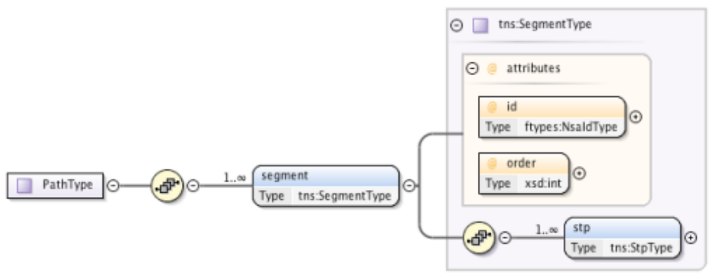
Path Schema

Slide 24
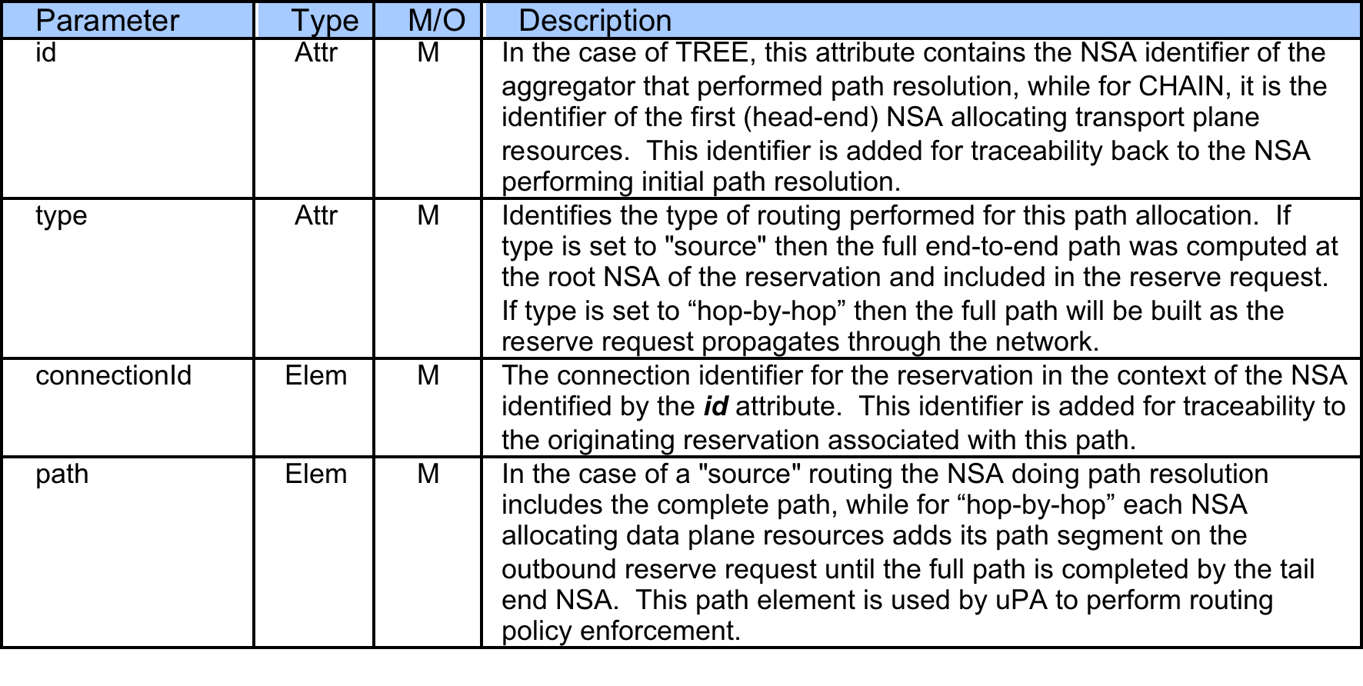
PathType Description

Slide 25
Example path
reserve(stpA, stpZ)
uRA
urn:ogf:network:grenada.net:2013:nsa-requester
User/Application
urn:ogf:network:aruba.net:2013:nsa-aggr
AG
AG
urn:ogf:network:grenada.net:2013:nsa-aggr
urn:ogf:network:aruba.net:2013:nsa
urn:ogf:network:curacao.net:2013:nsa
urn:ogf:network:bonaire.net:2013:nsa
uPA
uPA
uPA
stpA
Network
Aruba
Network
Bonaire
stpZ
Network
Curacao
toCuracao
toAruba
toBonaire
toCuracao
urn:ogf:network:aruba.net:2013:
urn:ogf:network:curacao.net:2013:
urn:ogf:network:bonaire.net:2013:

Slide 26
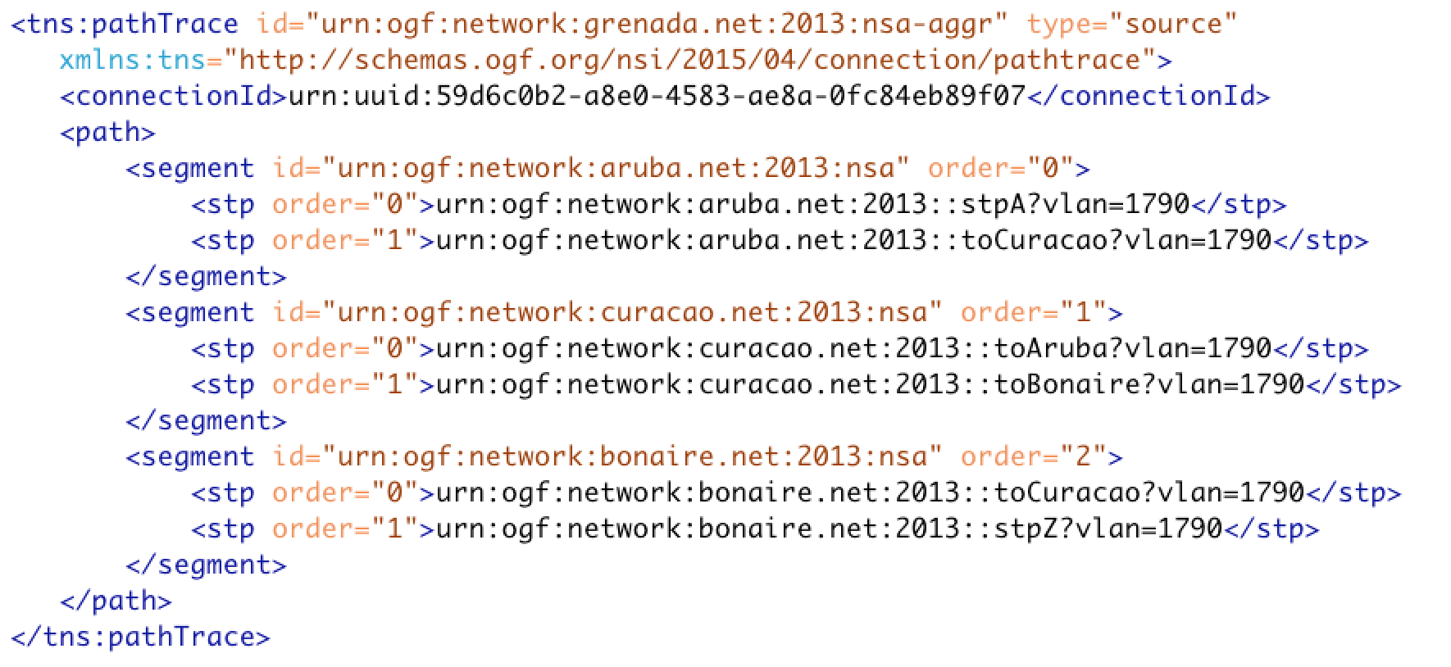
Example pathTrace element

Slide 27
But Chin doesn’t like this
Concerned at the lost of hop-by-hop routing in TREE scenario results in a loss of consistency with CHAIN solution.
Confusion between ERO and pathTrace when source routing used
  Which takes precedence?
  What happens if there is conflicting information?

Slide 28
Alternative proposal
We can relax the TREE requirement for source routing if we can live with the final path approval occurring during the reserveCommit phase.
Would need to move creation of digital signatures out of CS message workflow (if we want them).
ERO is used to specify the path, while pathTrace only records the resulting path.

Slide 29
Alternative mechanism
We use the reserveConfirm to collect all the reserved path segments from the uPA
  uPA determine if resources are available and if their local path segment is valid, holding the resources if it is.
  uPA populate their path segment in the reserveConfirm response header, with aggregators aggregating these path segments into more complete lists as the response moves up the tree.
  The root aggregator will end up with a complete end-to-end path which it stores against the reservation.
When the uRA issues the reserveCommit, the root aggregator will add the complete path into the NSI header which then gets propagated to each uPA.
uPA then apply policy to the path
  If path violates any policy a reserveCommitFailed is issued with an appropriately populated serviceException.
  If the path does not violate any policy then the reservation is committed and a reserveCommitConfirmed is issued.
If the path is approved we will end up with a committed reservation, otherwise we will have failed segments that will result in a terminate of the schedule by either the uRA or root aggregator.

Slide 30
Phase 1 - Reserve
uRA
1. uRA issues reserve() message
2. Root AG resolves path using available policy information and populates ERO if desired.
3. reserve() is sent down TREE with optional ERO
7. Root AG collects and stores detailed pathTrace.
AG
AG
4. Intermediate AG can do additional path finding.
AG
uPA
uPA
uPA
uPA
6. reserveConfirmed() is sent up TREE with local path segment populated in pathTrace.
5. uPA validates local policies and secures resources.

Slide 31
Phase 2 - ReserveCommit
uRA
1. uRA issues reserveCommit() message.
2. Root AG adds pathTrace to message header.
3. reserveCommit() is sent down TREE.
AG
AG
4. Intermediate AG propagate pathTrace.
AG
uPA
uPA
uPA
uPA
6. reserveConfirmed() is sent up TREE as indication of connection approval.
5. uPA validates policies and commit resources.

Slide 32
Changes?
Remove
X
Add connectionId?

Slide 33
The end

