Slide 1

NSI Service Definition
Federation of providers
A group of network providers get together and decide that they wish to offer a multi-domain connection services using NSI. They first have to implement an NSA in each network.
Provider
Luggnagg
Provider
Lilliput
Provider
Laputa
Gulliver - Group of NSI enabled Network Providers
Common end-to-end service
The providers need to agree among themselves the service they wish to offer to the customer. For example they may wish to offer an Ethernet VLAN Transport Service (EVTS). The service must be common to all providers and all providers must agree in advance a minimum service level that they are all able to meet.
Characteristics of a service are defined by a set of attributes, these attributes are common across the common service area and treated semantically in the same way by all providers.
Common capabilities
The networks that are part of the common service area must support a common set of network capabilities. E.g Carrier Ethernet requires all providers to support Ethernet QinQ ‘adapatation’

Slide 2


NSI Service Definition
Build an XML service definition instance
The provider federation must create a common service definition instance that describes the requestable elements of multi-domain service that they wish to offer. The service definition instance defines the parameters of the service request, their optionality, modifiability, and the range of allowed values for each.
Some example parameters: Connection startTime, endTime, capacity, VLAN ranges, and MTU.
The SD also describes attributes of the service that are not specified in the reservation request but describe features of the service being offered.
Lastly, the SD describes service specific errors and their meanings.
Service Definition instance:
EVTS.Gulliver
NSI CS schemas, service specific schemas, and SD template
The NSI includes a suite of schemas that form a set of types, parameters and attributes that must be used when building an XML SD instance. The schemas include:
NSI CS Schema: a schema of NSI CS message and data types (core protocol parameters).
Service Specific Schema: schema for generic services, eg pt2pt, Ethernet 802.1q Trunk.
A schema describing the format of the XML SD instance document.

Slide 3
Terminology
SD instance is an XML document that is created by a federation of provider to describe a commonly agreed service.
SD schema: is an XML schema that needs to be completed to create an SD instance. The SD schema includes a set of type definitions that MUST be used in the SD instance.
Schemas:
Service Specific Schema: a schema for generic services, eg pt2pt, Ethernet 802.1q Trunk.
NSI CS Schema: a schema of NSI CS message and data types (core protocol parameters).
SD attributes: This is a list of attributes that can be referenced in the SD instance. Attributes CANNOT be requested, they are only descriptive of the service.

Slide 4
Building an SD instance
The SD instance is created on a per-service basis.
The SD instance describes the service specific schema and associated parameters that can be included in a Connection reservation request.
The SD instance is the definitive source of type (via service specific schema), and units/range definitions for the service.
If a parameter of the Service Specific Schema is not contained in the SD instance then it is not supported for this profile.
Likewise, parameters defined in the SD instance must be selected from the supporting service schemas.
The ranges for the parameters are selected to suit the service being described.
Attributes within the SD instance are unrestricted and can be defined as needed.
Service Errors
Parameters
STP_RESOLUTION_ERROR
STP_UNAVALABLE
startTime
endTime
NSI CS schema*
Parameters
STPs
MTU
Capacity
Service specific schema
monitoring
SD Instance created by filling out the SD schema template*
EVTS.Gulliver
framing
SLA, technology specific attributes, etc.
Attributes
* Mandatory documents
An SD instance is built up by referencing parameters and attributes from the schemas

Slide 5
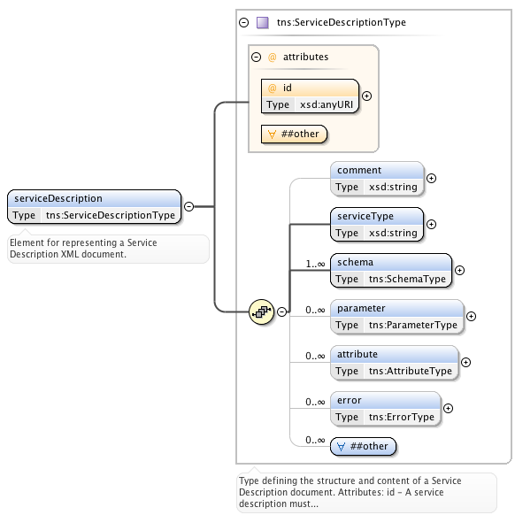
NSI SD schema template
NSI Services Definition schema
An XML schema document describing the OGF NSI Service definition template.
ServiceDescriptionType
Type defining the structure and content of a Service Definition document.
Attributes: id
Elements: Comment, serviceType, schema, parameter, attribute, error.
ServiceDefinitionName
Unique identifier of the Service Definition
SchemaType
This type identifies the specific service XML schema element specified in a reservation. There can be multiple schema entries for a service if they require multiple schema in a reserve request.
Attributes: name, required, namespace, type.
Elements: comment
ParameterType
Parameter definitions for the service and their values. These reflect the XML schema definitions and any local range restrictions. The associated service XML schema is the definitive source for and type and range definitions. If a parameter of the service is not contained in this service Definition then it is not supported for this profile.
Attributes: name, units, modifiable, namespace, type.
Elements: comment, minInclusive, maxInclusive, increment, default
AttributeType
Attributes are aspects of the service that are not specified in the XML schema for the service. The can be as detailed as parameters, but are not specified in the reservation request.
Attributes: name, units, namespace, type
Elements: comment, minInclusive, maxInclusive, increment, default
ErrorType
Models an error defined for this service.
Attributes: id, text
Elements: comment

Slide 6
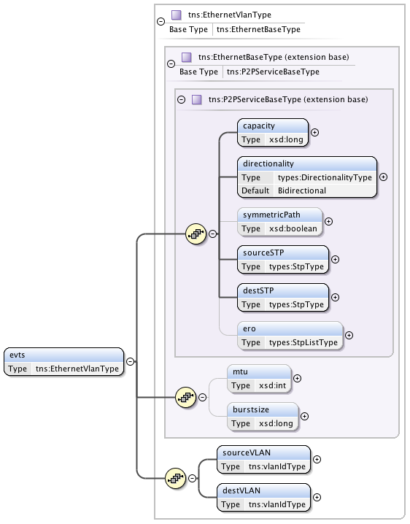
NSI service specific schema: Point2Point
This is an XML schema document describing the OGF NSI point-to-point service types.
Examples of Poin2Point Schema
P2PServiceBaseType (P2PS)
Type defining a generic point-to-point service specification. At the moment this type supports a unidirectional or symmetric bidirectional service.
Elements: capacity, directionality, symmetricPath, sourceSTP, destSTP, ero
EthernetBaseType (EVS)
Point-to-Point Ethernet service definition.
Elements: capacity, directionality, symmetricPath, sourceSTP, destSTP, ero, mtu, burstsize
EthernetVlanType (EVTS)
Point-to-Point Ethernet VLAN service definition.
Elements: capacity, directionality, symmetricPath, sourceSTP, destSTP, ero, mtu, burstsize, sourceVLAN, destVLAN

Slide 7
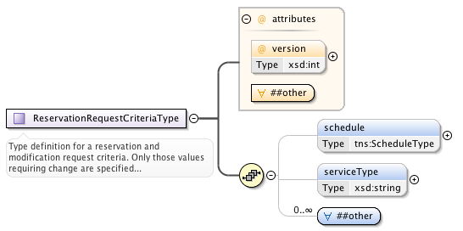
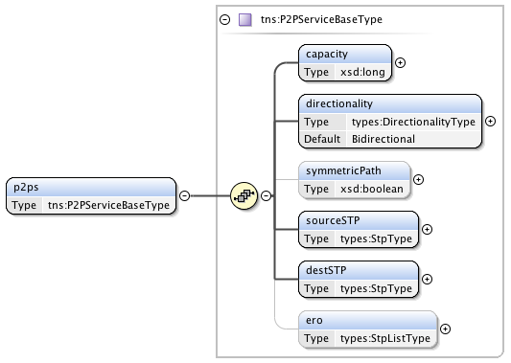
NSI Connection request: Simple point-to-point
NSI Core Parameters
Parameter | M/O | Description
version | M | The version number assigned by the RA to this reservation instance.
schedule | M | Time parameters specifying the life of the service.
serviceType | M | A string representing the offered service that maps to the service definition.
other | M | Carries the service specific elements as specified by serviceType.
Service Specific Parameters
Parameter | M/O | Description
capacity | M | Capacity of the service (units specified in SD).
directionality | M | The (uni or bi) directionality of the service.
symmetricPath | M | An indication that both directions of a bidirectional circuit must fallow the same path. Only applicable when directionality is "Bidirectional". If not specified then value is assumed to be false.
sourceSTP & destSTP | M | The source and destination end points of the service.
ero | O | A hop-by-hop ordered list of STP from sourceSTP to destSTP representing a path that the connection must follow. This list does not include sourceSTP or destSTP.
The user initiates a Connection by sending an NSI CS reserve message. The user enters the desired values for their service into the Criteria, specifying the serviceType, core parameters, and service specific parameters.
The SD instance is then used to validate that the request is within scope of the service. If the request is valid the NSA can begin scheduling the reservation.

Slide 8
Creating an NSI Connection request
RA Steps:
The requesting agent can utilize an SD to determine types of services features of the service, parameters required, and ranges for those parameters.
The requesting agent decides which service to use and populates the serviceType value (“P2PS.SuperDuper”).
In this example the user wishes to request a P2P service, so enters the data for the P2PServcieBaseType.
Request is sent to provider agent.

Slide 9
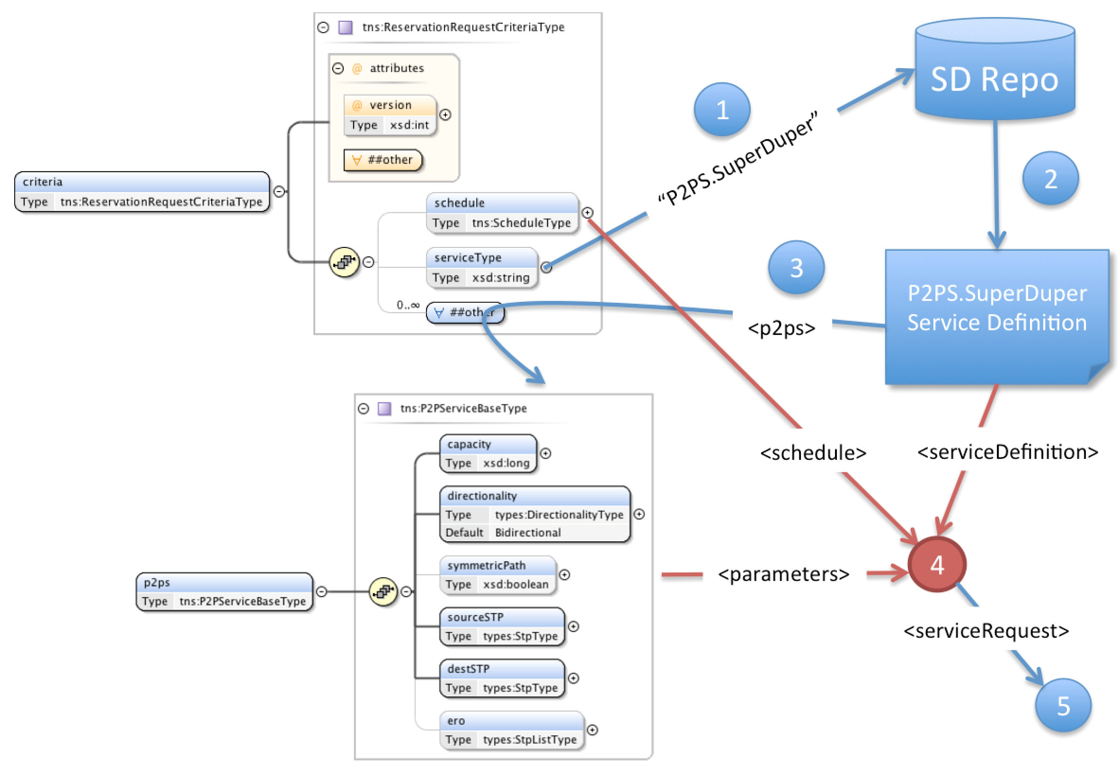
Actions when receiving a reserveRequest
Steps:
When reserveRequest arrives extract the serviceType value.
Fetch the Service Definition corresponding to the serviceType.
Extract the specific service elements from criteria as specified in SD.
Use the Service Definition to validate request.
Process using both the supplied service parameters and additional information as needed from the Service Definition document.

Slide 10

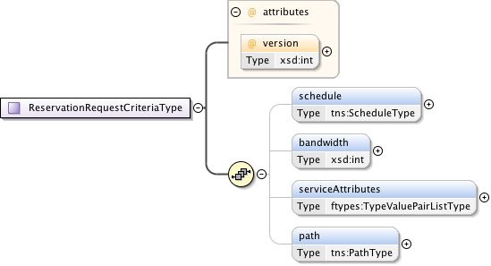
NSI SD workflow
Steps:
Enter values into the reserveRequest. Service specific parameters must match the parameters in the SD.
The reserveRequest serviceType element must identify the SD to which the request is directed.
The first NSA to receive the reserveRequest will parse the request against the nominated SD instance to validate the request.
Once validated, the reserveRequest will then be passed to the path computation element.
A successful path computation will result in a Connection being scheduled.
If the Connection transits another Network, the new reserveRequest will use the same SD (maybe not if adaptation is performed) as the one from the uRA.
reserveRequest
EVTS.Gulliver
EVTS.Gulliver
Provider
Lilliput
Provider
Luggnagg

Slide 11
Additional Notes
An NSA must be coded to understand a specific type of service, the parameters associated with that service (schema), the errors generated by that service, and any attributes within an SD that must be processed by the NSA as part of the service.
The Aggregator can decide to use a different SD than requested by the RA for component services, especially if a peer network does not offer an identical SD.

Slide 12
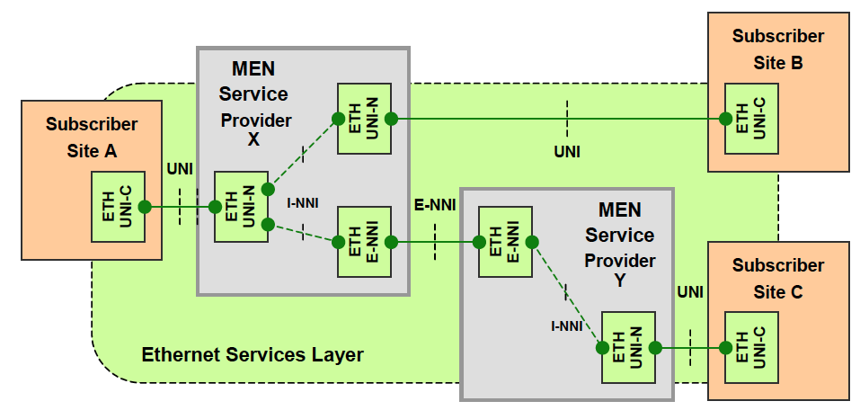
Metro Ethernet Forum Reference Architecture
Define a set of client Ethernet services (UNI) classified into three groups: E-Line (EPL, EVPL), E-LAN (multi-point) and E-Tree.
Define the external network-to-network service interface (E-NNI).
How would NSI CS support these types of service requests?

Slide 13
Ethernet Private Line (EPL)
I want an Ethernet Private Line (EPL) from Site A (UNI-C) to Site B (UNI-C)
NSI connection
STP X1 to STP X2
Ethernet Virtual Connection (EVC)
STP X2
STP X1
STP X3
STP Y1
STP Y2
RA sends reserveRequest with serviceType=“MEF.EPL”, sourceSTP=“X.X1”, and destSTP=“X.X2”.
Aggregator does not need to segment request so passes down serviceType=“MEF.EPL”, sourceSTP=“X.X1”, and destSTP=“X.X2” to the PA.

Slide 14
Ethernet Private Line (EPL)
I want an Ethernet Private Line (EPL) from Site A (UNI-C) to Site C (UNI-C)
NSI conn #1
NSI conn #2
STP X2
STP X1
STP X3
STP Y1
STP Y2
RA sends reserveRequest with serviceType=“MEF.EPL”, sourceSTP=“X.X1”, and destSTP=“Y.Y2”.
Aggregator needs to break RA request into two segments, however, SDP X.X3/Y.Y1 is not an EPL link so how is the “MEF.EPL” request issued to the PA in each network?

Slide 15
Adaptation/Encapsulation
STP X2
802.1Q
Service Provider X
Service Provider Y
STP Y2
802.1Q
STP X1
802.1Q
STP X3
802.1AH
STP Y1
802.1AH
SDP X3/Y1
RA
serviceType=“MEF.EPL”, sourceSTP=“X.X1”, and destSTP=“Y.Y2”.
Aggregator
serviceType=“MEF.EPL-AH”, sourceSTP=“X.X1”, and destSTP=“X.X3”.
serviceType=“MEF.EPL-AH”, sourceSTP=“Y.Y1”, and destSTP=“Y.Y2”.
uPA X
uPA Y

