Slide 1
Issues of Network Control Plane
Interactions with Grid Applications
Admela Jukan
jukan at uiuc.edu
March 15, 2005
GGF 13, Seoul

Slide 2
Outline
Motivation
Issues of Network Control Plane
  Modelling
  Interactions with Applications
  Some Architectural Considerations
Summary
Notes:
Well, the current set-up of this talk is motivated by the Kumar’s talklast week where he said “physical world meets computing”. This is sooo very true for what I am currently doing and I appreciated that one thing that my research has in common with the wireless systems research you have here.

Slide 3
Motivation

Slide 4
What is Network Control Plane?
“Planes”
“Swim lanes”
APPLICATIONS
ControlPlane
Management Plane
ControlPlane
Control plane
Control Plane
Control Plane
Data Plane
Networks
“NETWORKS”
Application
NMI-C = Network Mgmt Interface for Control plane
Network-wide, global, comprehensive, distributed, fully automated software system that enables responsiveness, interoperability flexibility, enhanced access to network resources, and, speed and efficiency gains
NMI-T = Network Mgmt Interface for Transport plane
CCI = Connection Control Interface
UNI = User Network Interface
RA = requesting agent, aka client (e.g., IP router, ATM switch)

Slide 5
State of the art
In Internet
  Research community has just started to recognize that there is need to have control of the network “network wide”
  Industry is promoting a massive use network virtualization to improve organization operations
In physical layer networks
  Optical networks already separate routing from optical routers, perform automatic discovery, etc. - control plane development advanced;
  In wireless: a lot of potential developments there
Researchers are starting to “extend” networking
  Network into application
  Network into the physical layer
Notes:
Internet community has just started to recognize that network-wide view is important, papers,…etc.

Slide 6
Why should we care?
The time is right!
  Internet is moving from “Network for All”, to “Network for You” - a lot of specialized infrastructures out there
  Physical layer advances
Opportunity for the Grid community - to pioneer the control plane concepts that enable application responsiveness
  Not only responsiveness, but also guaranteed performance
  Potential to improve operations (commercial world is interested)
Usability of network for applications is everything
  Applications are free to stay unaware of networks, but not vice-versa
Network Control Plane - key to assure application awareness,
responsiveness to application needs and efficient usage
and usability of network resources

Slide 7
How do the Grid applications matter?
Some Grid applications characteristics
  Very large data sets, terabytes, petabytes, etc.
    Means extending network into the physical layer (lambda grid)
  High-end computing resources, teraflops, super computers, cluster computing, etc.
    Coordinated Grid resource management with the management of the network resources
  Remote instrumentation and sensors for data collection
    Means extending network more into the physical layer (wireless)
  Powerful visualization tools for analysis
    Geographical distribution is an important dimension
  Sometimes highly dynamic
    Time is becoming an important dimension, too.

Slide 8
Design Space
Applications
Network Control Plane
Application
Networking
Grid Resources
Time? Space? Ownership?
Bulk Data
Computing
Sensors
Storage
Instruments
CPU
Visualization
Grid
Wireless
Lambda
Multi-layer
Internet
Networks

Slide 9
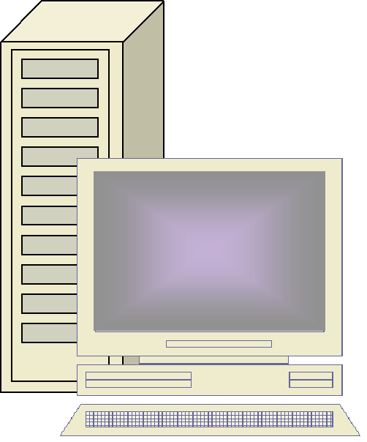
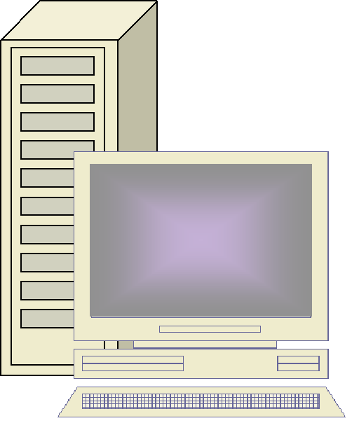
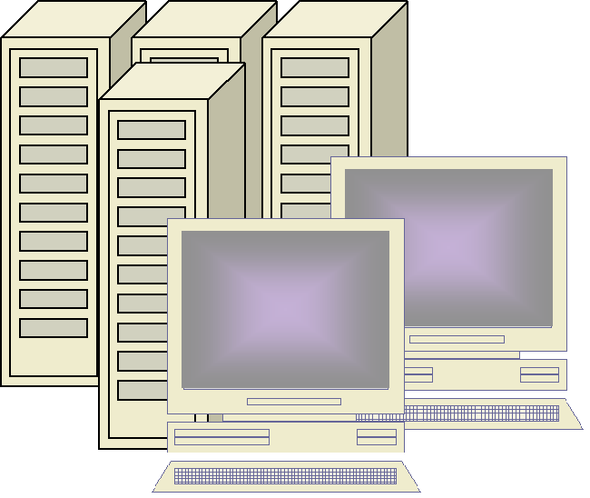

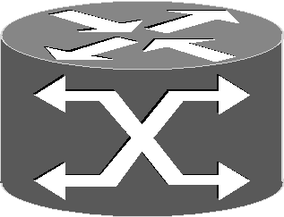
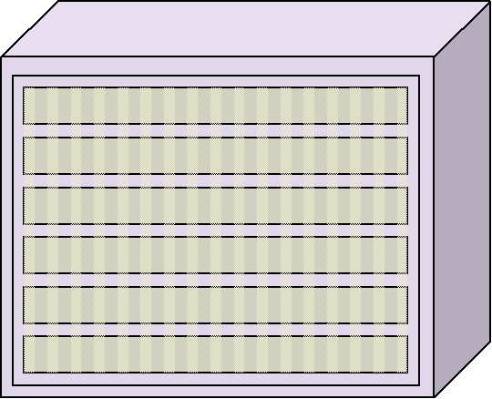
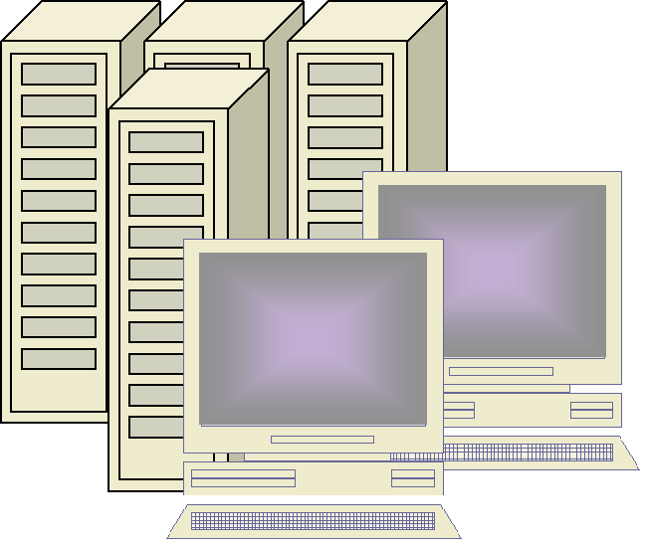
Applications
How do we model/represent the Grid Applications in a way useful to network?
  We need communication patterns (required performance, end-to-end points, time)
  Issues of advance reservation and coordination
storage
CE
CE
PE
PE
PE
PE
CE
CE
storage
CPU
CPU

Slide 10
“Pipe” Application in Optical Grids
storage
t1 - sends job to “CPU”
Duration: T
At t1+T+∆toffset
CPU sends the data
to “Storage”
PE
gS1
gS1
CPU
CPU
storage

Slide 11
“Pipe” Application in Optical Grids
gS1
gS1
storage
CE
t1 - send job to CPU
Duration: T
CE
PE
PE
At t1+T+∆toffset
CPU sends the data
to “Storage”
gS1
PE
PE
CE
gS1
CE
storage
CPU
CPU
What is the dynamics of advance reservation? (Do you release the green resources before you use the yellow ones?)
How is the advance reservation designed? (How big is the waiting time in between t1 and t1+T+∆toffset?)
Is the LOCALITY of Grid resources important? (Can you use any storage/computation etc.?)

Slide 12
“Pipe” Appl. Model: Task Graph
x
x, y, z
A
B
C
x, y
Communication
taken once
periodical
continuous
x amount of data transferred from A to B
xy amount of computations performed at B
xyz resulting data from the computation
Good models of application communication patterns needed
End-points (A, B, C)
Performance required (x, xy, xyz)
Time (at x, xy, xyz)
Models for combination of multiple end-points, resources, etc.

Slide 13
Design Space
Applications
Network Control Plane
Application
Networking
Grid Resources
Time? Space? Ownership?
Bulk Data
Computing
Sensors
Storage
Instruments
CPU
Visualization
Grid
Wireless
Lambda
Multi-layer
Internet
Networks

Slide 14
Networks - Traffic
storage
t1 - Grid app2
* link utilization 70%
t2 - Grid app2
Link utilization 80%
Background traffic
CPU
CPU
storage

Slide 15
Networks - Traffic
storage
t1 - Grid app2
* link utilization 70%
t2 - Grid app2
Link utilization 80%
Background traffic
What is the traffic model and performance of the Green and Yellow apps?
But also, what is the traffic model and performance of the background traffic in the presence of Grids apps generated traffic?
CPU
CPU
storage

Slide 16
Networks - Locality
storage
Questions
What is “closer”?
Is “closer” what has more storage space (Yellow) or what is reachable through less number of hops (Green)?
CPU
CPU
storage

Slide 17
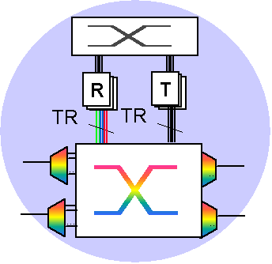
Networks - Granularity
Using resource visibility information the Grid service control plane instance can construct multi-hop or single hop virtual topology.
What is “closer” here?
Is “closer” what uses less network resources or what traverses less line cards?
(Whichever it is) Can it be changed during the application lifetime (“pipe”)?
CE

Slide 18
Network Control Plane Partitioning
CPU
storage
CPU
storage
CPU
CPU
storage

Slide 19
Network Control Plane Partitioning
CPU
storage
CPU
storage
CPU
CPU
storage

Slide 20
Network Control Plane Partitioning
CPU
storage
CPU
storage
CPU
CPU
storage

Slide 21
Network Control Plane Partitioning
CPU
storage
Storage
CPU
CPU
Network
storage
Questions
What to partition? How to partition? How to define interactions between partitions?
CPU
CPU
storage

Slide 22
Design Space
Applications
Network Control Plane
Application
Networking
Grid Resources
Time? Space? Ownership?
Bulk Data
Computing
Sensors
Storage
Instruments
CPU
Visualization
Grid
Wireless
Lambda
Multi-layer
Internet
Networks

Slide 23
Time (Issues of Scheduling)
t1
t2
t3
Time
Processing resource scheduling
Grid Application Layer
∆t1
∆t2
tN1
tN2
Network Layer
Time
Bandwidth

Slide 24
In Summary
Network Control Plane - application-responsive, global, distributed, automated, resilient
  Internet - application driven control to create virtualized infrastructure with guaranteed performance
  Application-driven networking is moving into the physical layer - optical Control Plane as a pioneering approach, and the first test/study case
Designing the NCP in the dimensions between
  Applications
  Networks
  Grid resources
  And consider new dimensions (time, ownership, locality,…)
Good models and architectural decisions needed
  Modeling of applications’ communication patterns
  Multi-level control plane architectural decisions (how to separate or unite the resource visibility in between heterogeneous networks and heterogeneous Grid resources)

Slide 25
Special Issue on Optical Control Plane
Architectural framework for optical control plane in Grid Networks; Innovative test-beds and visionary network architectures;
Optical control plane as it relates to signaling, provisioning and recovery with special emphasis on interactions with applications;
Optical resource discovery, advanced resource reservation and interaction with other Grid resources (CPU, Storage)
Optical control plane for inter-domain Grid networking
OGSA integration and WEB services in the context of Optical Control Plane
Feature Topic IEEE Communication Magazine
Deadline June 20, 2005
Guest Editors: Gigi Karmous-Edwards and Admela Jukan

Slide 26
Thank you

