Slide 1

DMTF Utility Computing Workgroup for OGSA
July, 2005

Slide 2
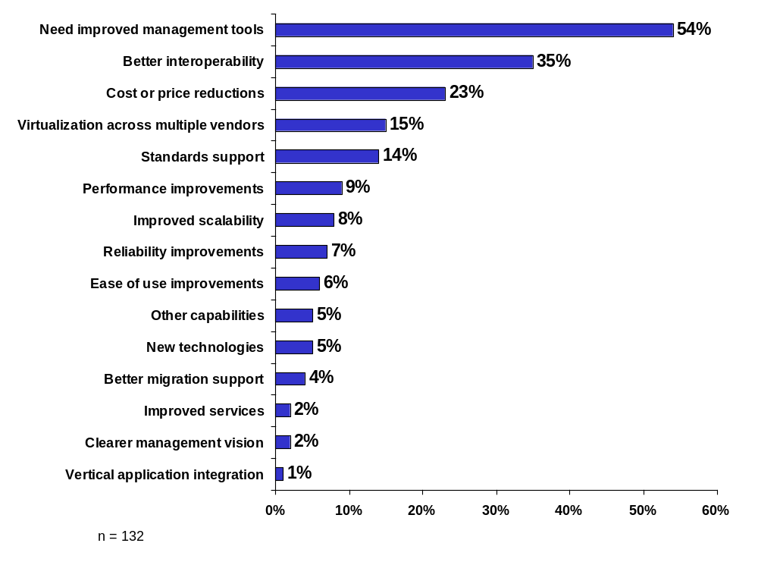
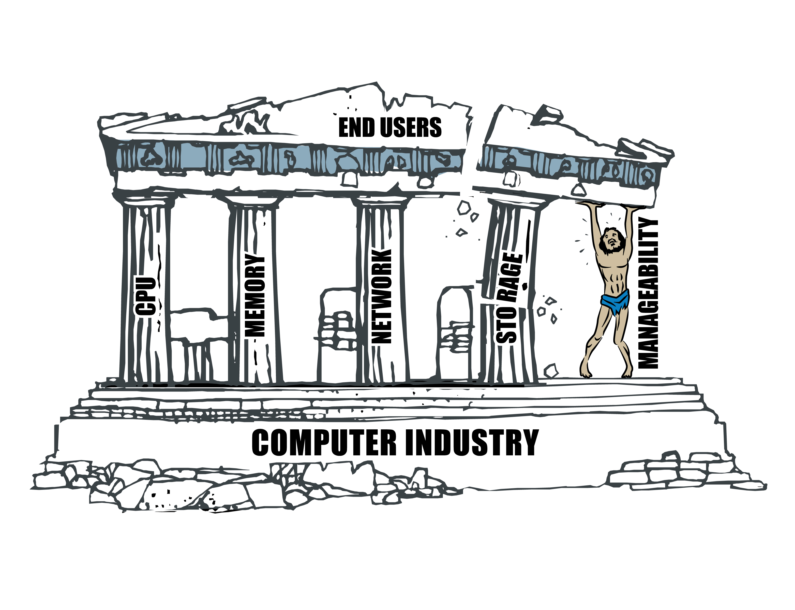
IT Customer Demands

Slide 3
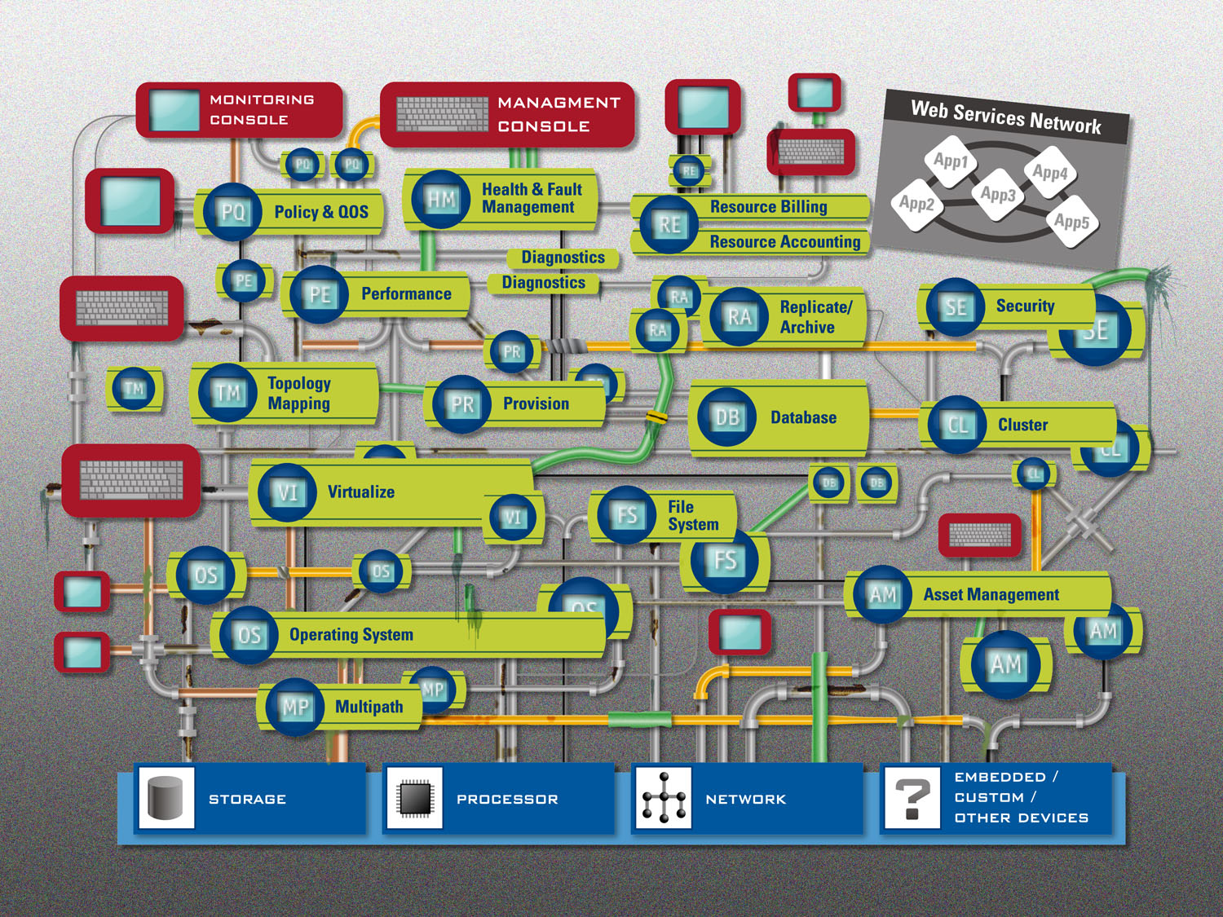
Utility Computing without Standards

Slide 4
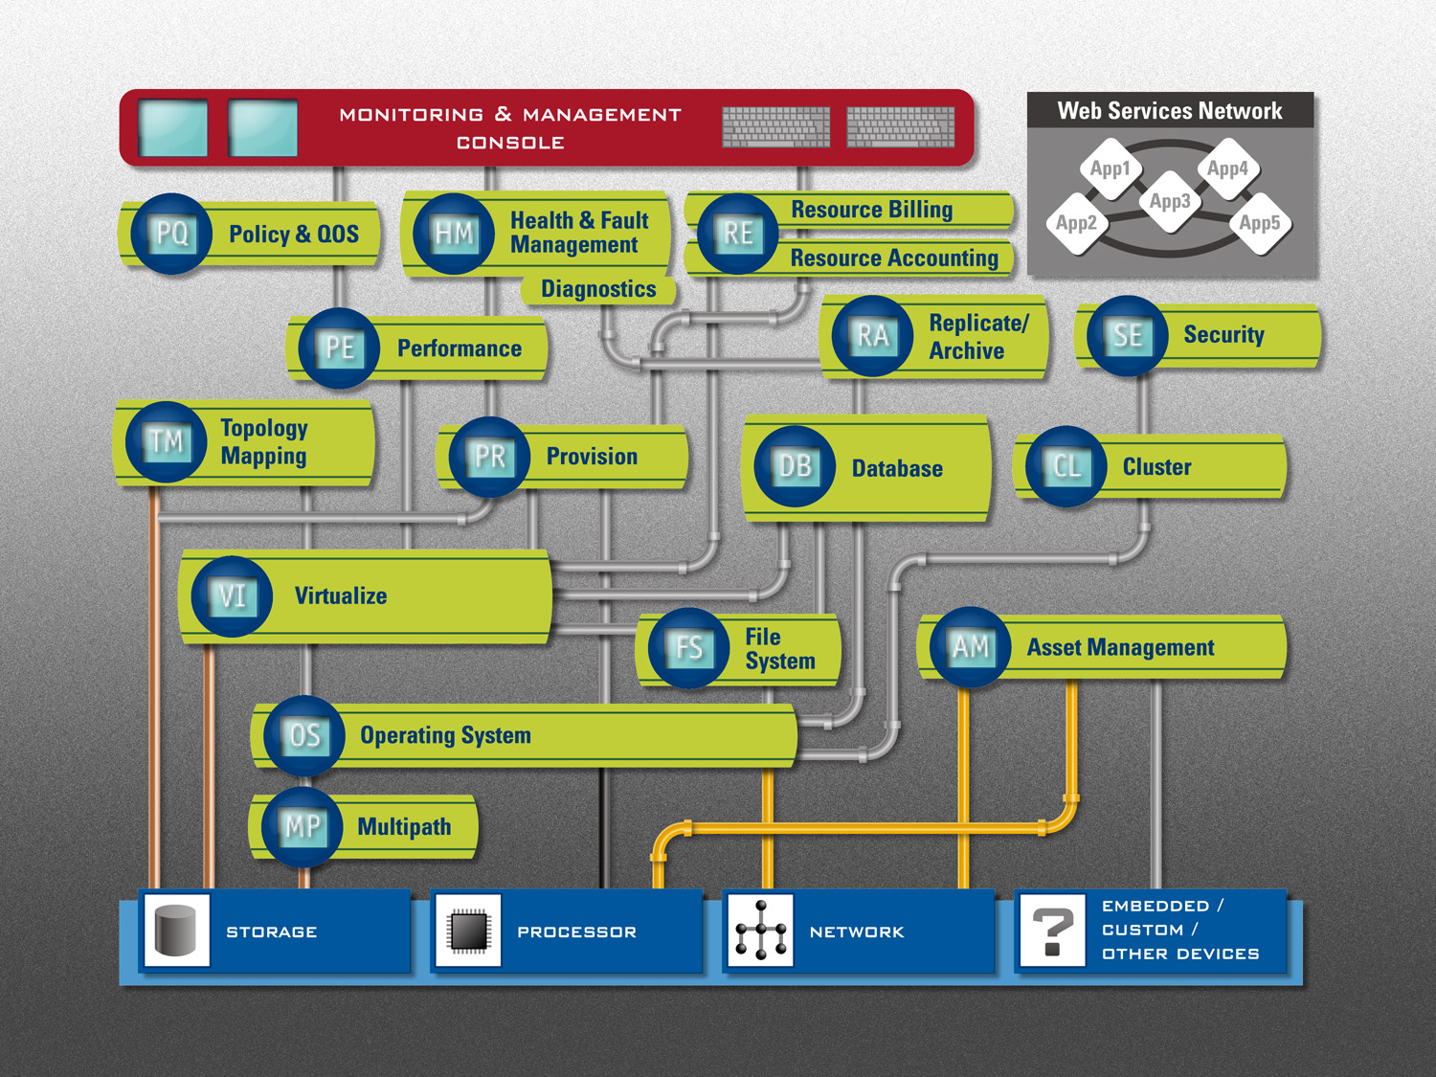
Utility Computing with Standards

Slide 5
Management App. Developer’s Dilemma
Management Application
Integration Infrastructure
Policy Engine
Discovery
Object Model Mapping
Security
Service
Protocol Mapping
Service
Transport Mapping
SNMP
Command
CORBA
SCSI
XML
.
.
.
.
Telnet
C
.
.
.
.
TCP/IP
Line
.
Java
.
.
RPC
C++
Mode
DTD
.
Library
.
Socket
Library
Library
Page
FC
-
GS
Device Types
Processor
Application
Array
Many Other
Vendor
Unique
Object
Models
Notes:
Today, to deliver a comprehensive network storage management application, a developer is burdened with the tedious task of integrating the incompatible interfaces of multiple device vendors. These disparate interfaces utilize a variety of transport technologies, protocols, underlying object models, event notification systems, security features, durable naming systems, and discovery systems. The result of this integration task is a large and expensive custom integration infrastructure that yields:
• Final customer visible management functionality that is the “least common denominator” of the functionality integrated across multi-vendor implementations of a given device.
• Slow time-to market integrating new devices and new features in devices.
• Hi overhead installing and upgrading the management application in customer environments.
• Inconsistent and unreliable operation when mapping large and dynamic storage networks.
These factors lead to high support cost and general customer dissatisfaction, both of which affect profitability negatively. Moreover, as time goes on, more devices with more interfaces are introduced, even as users demand more functionality. Management application complexity increases, with corresponding worsening of time to market and robustness.
As the slide suggests, a comprehensive storage network management application requires support for multiple object models for each type of device supported, as well as for the management and transport protocols required to communicate with each. In addition, each component to be supported must be qualified with its object model and protocol infrastructure.
The cost of developing and maintaining this complex management infrastructure is not recoverable as increased revenue. Users don’t pay for infrastructure; they pay for value to their information technology operations, in the form of functionality, coverage, and simplicity. Thus, today, management vendors who strive to integrate a large number of multi-vendor devices/subsystems and seek a related market advantage are forced into building less competitive products.

Slide 6
Tuscany Product Hierarchy
Business Services Control
Administration/management of service groups in an enterprise including job control, scheduling, resource requirements modeling, metering
Application Server Farm Manage a farm of App Servers
Cluster
Topology, Real-time Application Fault Management
Web Server Farm
Manage a farm of Webservers
Database
Table to storage mapping, Log Mgmt, App. quiesce, Perf.
Data Replication & Migration Management of data redundancy/Sync.
Other ….,,,,,,,,,,,,,,,,,,,,,,,,,,,,,,,,,,,,,,,,,,,,,,,,,,,,,,,,,,,,,,,,,,,,,
Server Virtualization
Server Provisioning and Allocation
Storage Virtualization & Provisioning (SMI-S)
Network Virtualization & Provisioning (TBD)
Server Hardware Management (SMASH - API)
Storage Device/Subsystem Management (SMI-S)
Network Device/Subsystem Mgmt (TBD)
Server Base System Processor Config., LPARs, Connectivity, Mem Resource, Boot Ctrl. Firmware, Blades,,,,
Storage Device/Subsystems Array, Switch, NAS, HBA, SML, Router, DAS, JBOD
Network Infrastructure Switch, Router, Firewall, DHCP Server,

Slide 7
Tuscany Product Hierarchy
Business Services Control
Administration/management of service groups in an enterprise including job control, scheduling, resource requirements modeling, metering
Application Server Farm Manage a farm of App Servers
Cluster
Topology, Real-time Application Fault Management
Web Server Farm
Manage a farm of Webservers
Database
Table to storage mapping, Log Mgmt, App. quiesce, Perf.
Data Replication & Migration Management of data redundancy/Sync.
Server Virtualization
Server Provisioning and Allocation
Storage Virtualization & Provisioning (SMI-S)
Network Virtualization & Provisioning (TBD)
Server Hardware Management (SMASH - API)
Storage Device/Subsystem Management (SMI-S)
Network Device/Subsystem Mgmt (TBD)
Server Base System Processor Config., LPARs, Connectivity, Mem Resource, Boot Ctrl. Firmware, Blades,,,,
Storage Device/Subsystems Array, Switch, NAS, HBA, SML, Router, DAS, JBOD
Network Infrastructure Switch, Router, Firewall, DHCP Server,

Slide 8
Server Virtualization and Provisioning
License Mgmt Engine
SVP = Pooling Engine
Network Config Engine
Storage Config Engine
HP AIX @ Remote DT Site with Old O.S. Revision
X86+ Win + App2 and App3 on Net4
VMM Config Engine
LPAR Config Engine
HP AIX @ Remote DT Site
X86+ Win + App2 and App3
Pool Policy Engine
IBM Geo Disperse Parrallel Sysplex
O.S. Install Engine
HP Fault Tolerant
X86+Solaris Pool
App Install Engine
IBM Grid
HP VMScluster
X86+VMM + Solaris + Windows Pool
Security Engine
OS Image Rep Engine
IBM MVS DB2
HP Perf of 1098
X86+ Win + App1 for User A
Resource Allocator
IBM LPARs Pool
HP Perf of 567
X86+ Win + App1 for User B
Software Config
IBM Pool
HP Pool
Sun Pool
X86 Pool
Job Control
Patch Distribution
Primordial Pool All Server Resources First Auto-Discovered Enter This Container
Bill/Metering
System History

Slide 9
SMASH Relationship
Globally Unique IDs for Servers (no persistent repository)
Indications if a server is changed and violates pool constraints
LPAR
VMM
Complete boot target Information
Programmatic interface with fast/robust auto-discovery

Slide 10
SMI-S Pooling Concepts to Leverage
Separate objects for raw blocks in pool (pool) and blocks allocated into writable LUNs (Storage Volume) – also primordial and concrete pools.
Three states for pool allocation (unassigned, assigned, allocated). Is assigned when enters a concrete pool.
Both use the same storage settings class
Pool management policy – autofills concrete pools from primordial pool (supports auto-grow)
Resource Ownership – Establish rights for a given client to allocate resources (pools or volumes). Legislates multi-client access to a resource.
Redundancy Group (cluster): groups of extents in pools that comprise a raidgroup of some kind
Actions on StorageConfigService may be async or sync depending upon vendor implementation. Use concrete job with async.
Performance Function: Capacity Planning, Problem Isolation, Workload Analysis, Performance Tuning.
Sparing of devices which accounts for hardware configuration constraints
Access control – some clients or access ports can only see some volumes.

Slide 11
Profile/Subprofile/Package Stack
Profiles
  SVP (basic pool +capabilities)
  CIM Server (Top level identity for discovering Subprofiles/packages)
Subprofiles
  Pool management policy
  Job Control
  Health and Fault Management
  Object Manager (defines protocol adapters to CIM server)
  Indications (support unsolicited event notification)
  Security (handle authentication, encrypt, authorization)
    Authorization (RBAC)
    Security Resource Ownership (multi-client simultaneous access)
    Identity management
    Credential management
  Storage Config
  Network Config
  VM subprofile
  OS subprofile (can use SMASH)
  Apps subprofile
  Software configuration
  Server Performance Capabilities
  Server Availability Capabilities
  Monitoring & Metering
    Performance (inc scaling)
    Availability
    Each
    Actual Of Processor
    Actual Of Pool
    Required of Processor
    Desired for pool (goal)
  Snapshot Configuration
  System History
  Accounting/Billing
  LPAR
  Patch Distribution
  Redundancy Group (cluster)?
  Any SMASH Profiles re Server Management,,, there are lots…Base server, physical configuration, software identity, etc.
Packages
  Any of the above IF multiple subprofiles need them.

Slide 12














Utility: Cross Platform Management
Consistent application of durable names
Cross stove pipe association/correlation
Predictable profiles for basic interoperability
Storage
Application
Database
Web Server
SQL
INDEX
TABLE
DATAFILE
LVM
I/O
I/O
CHANNEL
LUN
DISK
Alerts & alarms
JSP
EJB
SERVLET
JDBC
SQL
Users
URL
HTML
JPEG
GIF
JSP
Initiate
configuration
changes
Correlation & root cause analysis
Notes:
Lets start with the Application Performance Management solution. Precise “I Cubed”.
A user initiates a transaction.
If you are running screen show, hit enter.
Precise INDEPTH™ traces/logs a transaction from the user through the various levels of the application infrastructure (from web, application, and database servers all the way to storage devices). It isolates performance degradation/bottlenecks at any point in the “maze”.
If you are running screen show, hit enter again.
If a performance issue has been identified, Precise INFORM™ alerts administrators and suggests corrective actions. This allows businesses to proactively resolve potential service issues and deliver consistent and committed quality of service.
If you are running screen show, hit enter again.
Precise INSIGHT™ focuses on user experience of service, and delivers end to end application performance management
SEGUE: Lets take a look at the specific application performance products that Precise has to offer in more detail… (move to next slide)

