Slide 1

Firewall Issue Research Group
Status of the documents
Thijs Metsch
German Aerospace Center – DLR e.V.

Slide 2

Outline
Overview
Status
Next steps
Abstract from
the charter
Current
contributions
/
Working
process
Action items
for the next
documents

Slide 3
The next documents
Submit informational documents that describe (Abstract from Goals & Milestones):
  An inventory of the type of issues when Grid jobs have to deal with middle-box functions, application level gateways, VPN style gateways, etc. Describe and classify the issues in document #1
  An evaluation of existing IETF middle-box (signaling-) protocols and functions. Recognize possible limitations and produce a list of requirements towards the IETF in document #2
  An evaluation of approaches and solutions such as application level gateways, host based firewalls, VPN style gateways etc. Capture results in document #3

Slide 4


The next documents (2)
Firewall vendor contributions
Existing
Solution
Description &
Analyses
Grid Firewall
Issues &
Analyses
Grid community
Documents
2 & 3
Emerging/
New
Solution
Description &
Analyses
Document #1
Vendor
community

Slide 5
Working process
Currently working on document 2 & 3
Close collaboration with the developers of solutions
All contributions will be evaluated before they flow into the documents
Wiki for collecting information and entry point for “research work”
Procent done
Gather requirements from our first document
Evaluate the requirements
Gather available solutions
Evaluate the contributions
Match solutions and requirements
Work on missing parts
Documents 2 & 3

Slide 6
Current contributions
High speed firewalls
Load balancing firewalls
Dyna-Fire
Cooperative On-Demand Opening
Generic Connection Brokering
UDP Hole Punching
Application Level Gateway / Proxies
A framework for Token Based Firewalling in Hybrid GMPLS networks

Slide 7
Timeline & To-Dos
Next step will be further evaluation of the requirements coming from document #1
After that do an evaluation of the contributions and map them to the requirements
Work on other topics like “firewall as grid resource”
First draft of our documents by next OGF
OGF19
OGF20
First draft of documents
Collect solutions
Gather requirements
Evaluation / Mapping
Further work
1
2
3
4
5
6
7
8
9
10
11
12
13
14
15
16
17
18
19
20
21
Jan
Feb
Mar
Apr
May

Slide 8
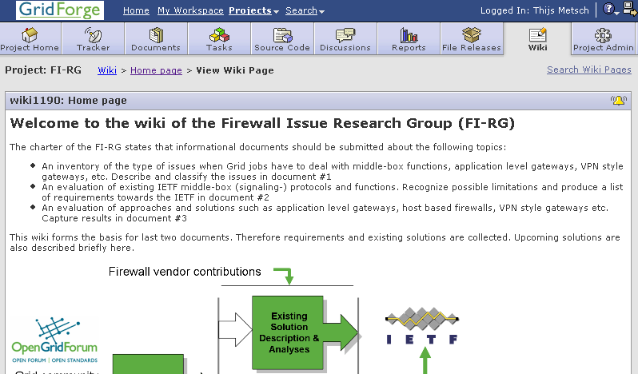
Questions & Suggestions
https://forge.gridforum.org/sf/projects/fi-rg!

