Slide 1
Updates from the EUGridPMA David Groep, March 8th, 2010

Slide 2
Updates from the EUGridPMA
Towards even more EMEA coverage
Novel CA architectures
Federation-backed SLCS and MICS CAs
Auditing progress
Authorization Operations WG
Distribution and fetch-crl
OpenSSL 1and distribution format change

Slide 3
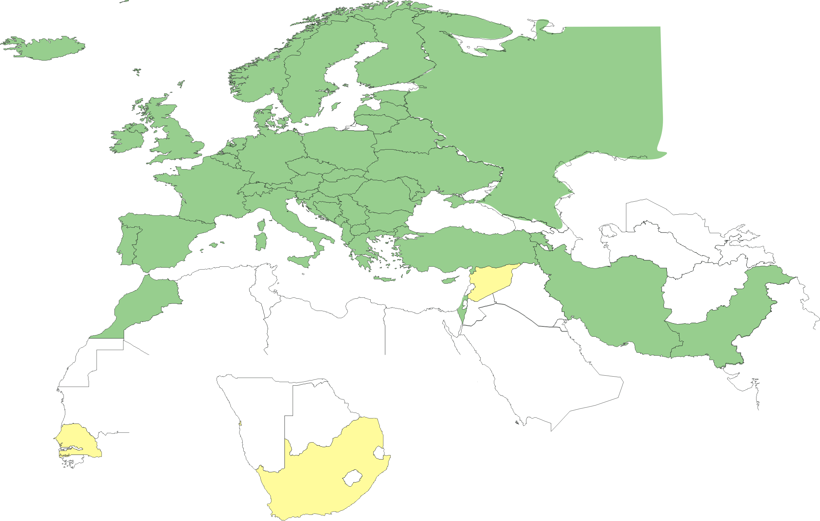
Geographical coverage of the EUGridPMA
25 of 27 EU member states (all except LU, MT)
+ AM, CH, HR, IL, IR, IS, MA, ME, MK, NO, PK, RO, RS, RU, TR, UA, SEE-GRID + CERN (int), DoEGrids(US)*
Pending or in progress
SY, ZA, SN

Slide 4
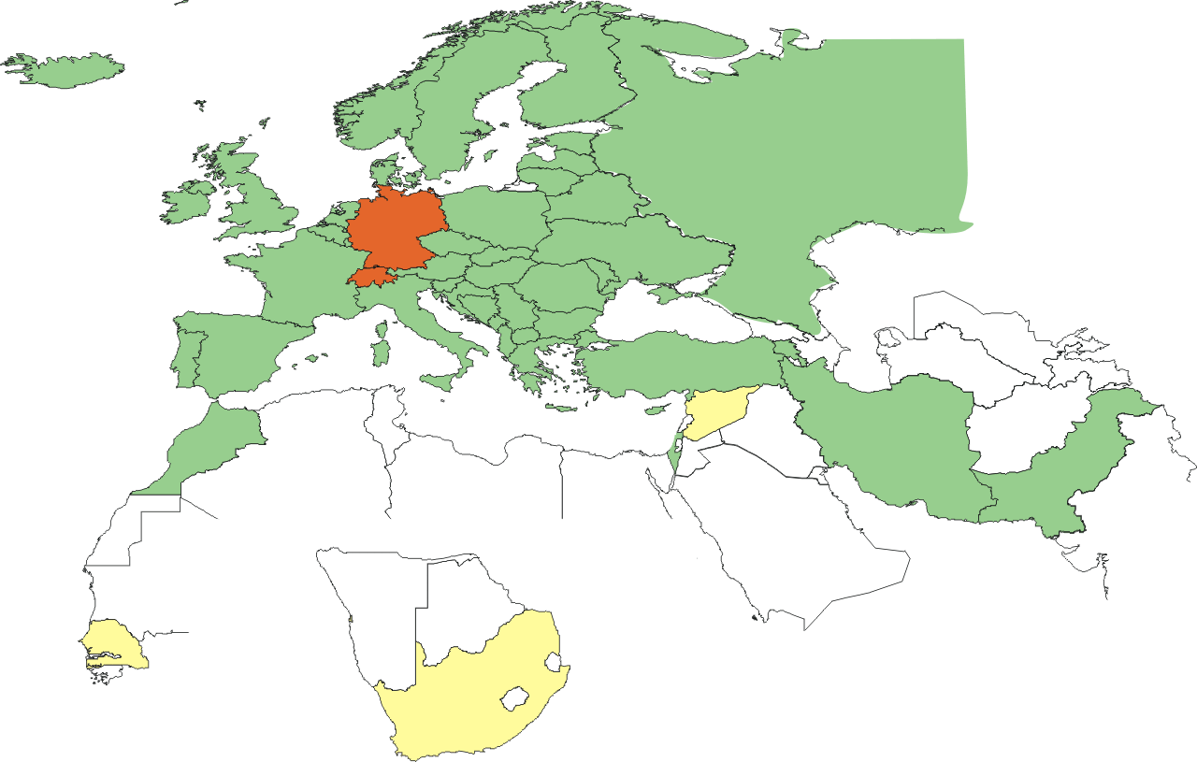
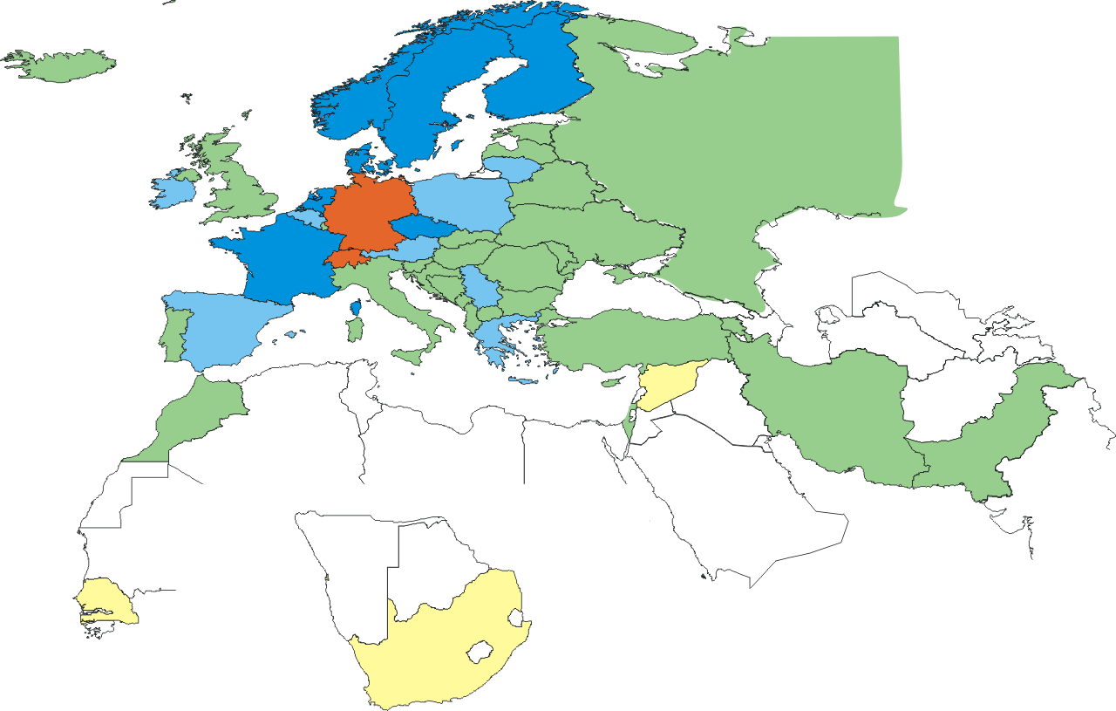
New federated MICS CAs
Already had 2 federation-backed SLCS CAs: CH, DE
Recently (2010-02-01) accredited a multi-national federated MICS CA:
TERENA managed, with a Comodo back-end
Common portal for user applications shared by NL,NO,DK,SE,FI,FR
Leverages federations, but also requires institution to have high-quality IdM
Upcoming: multi-national server CA for e-Science applications
Also managed by TERENA, with Comodo back-end

Slide 5
Auditing status
Now done or pending: BalticGrid CA, NIIF CA, PK-grid, CAPolishGrid CA, CERN CA, IUCC, LIPCA, UK eScience CA, pkIRISGrid, ArmeSFo CA, SRCE CA, AEGIS CA
Status
Self audits are done rigorously and usually on time
Implementation of recommendations takes a bit of time (3-6 months)
Review of the self-audit by peers takes a really long time (>12 months), mainly because of overloaded peer reviewers
https://www.eugridpma.org/review/selfaudit-review

Slide 6
Addressing scalability: three directions
Facilitating the issuance process (“Federated CAs”)
Short-lived and MICS issuance
Leverage (existing) high-quality identity systems
Mainly centered around research/educational federations
Facilitate user key management and hygiene (“Private Key Protection guidelines”)
Provide key management tools
Outsource end-user key management
Private Key Protection protocol
Relieve users of the key management problem (“Approved Robots”)
Since many user may only a few ‘canned’ tasks anyway
Funnel user experience through a portal
Have the portal take care of identity and PKI

Slide 7
AuthZ operations policy WG
Foster trust by improving operation of AuthZ Auth
New scoping of the AuthZ Working Group
For now: maintain technical focus on VOMS
AASPs will not be 'accredited' by any particular body, but
Write guideline against which AASPs can assess their implementation and subsequently claim compliance.
Relying parties: either implement post-factum assessment or require pre-auditing of acceptable AASPs
Interaction with issuance of 'AA issuing certificates' by IGTF CAs remains open question
Further discussions
wider consultation with (technical) people and VO reps
focus on AA assertions and infrastructures where actual signature on the assertion is used in the validation

Slide 8
IGTF Release Process and Web
Release Process
Releases moved to (preferably) Monday or Tuesday
More documentation of the process still needed
More checks are now built into the process (Debian!)
End use: https://dist.eugridpma.info/distribution
https://www.apgridpma.org/distribution
EUgridPMA site has off-site warm spare – which will be used in July-August during building change
Monitoring and alarms
Nagios: http://signet-ca.ijs.si/nagios/ (guest/guest)
Similar setup by Yoshio
PMA Distribution Warnings by email 4 times/day
It helps, but reaction to the warnings is down again …

Slide 9
Fetch-CRL
New versions available
2.7.2: even more paranoid about installing in face of AFS file systeminstabilities
2.8.2: all of the above, as well as a random wait option
2.8-series fetch-crl packaging
RPMs now Fedora/EPEL compliant
Included in Koji testing repository
Start testing it now: it integrated better with native OS
Builds: EL4, EL5, F11,12,13
Thanks for Steve Traylen!
https://admin.fedoraproject.org/updates/fetch-crl

Slide 10
OpenSSL1
Structure of the trust anchor directory
Hash functions and code

Slide 11
Structure of the trust anchor store
bosui:certificates:1008$ cd /etc/grid-security/certificates/
bosui:certificates:1008$ ls -l|grep 16da
-rw-r--r-- 1 root root 5341 Oct 26 21:02 16da7552.0
-rw-r--r-- 1 root root 40 Oct 26 21:02 16da7552.crl_url
-rw-r--r-- 1 root root 442 Oct 26 21:02 16da7552.info
-rw-r--r-- 1 root root 630 Oct 26 21:02 16da7552.namespaces
-rw-r--r-- 1 root root 4842 Jan 13 08:17 16da7552.r0
-rw-r--r-- 1 root root 342 Oct 26 21:02 16da7552.signing_policy
bosui:certificates:1009$ ls -l policy-*
-rw-r--r-- 1 root root 2633 Oct 26 21:03 policy-igtf-classic.info
-rw-r--r-- 1 root root 152 Oct 26 21:03 policy-igtf-mics.info
-rw-r--r-- 1 root root 256 Oct 26 21:03 policy-igtf-slcs.info
bosui:certificates:1010$ cat policy-igtf-mics.info
# @(#)policy-igtf-mics.info - IGTF mics authorities
# Generated Monday, 26 Oct, 2009
version = 1.32
requires = TACC-MICS = 1.32, \
NCSA-mics = 1.32

Slide 12
Hashes
Hashes used for lookup of the issuing CA for a given certificate
Independent from the ‘fingerprint’
$ openssl x509 -noout -subject -issuer \
-fingerprint -sha1 -hash \
-in 16da7552.0
subject= /C=NL/O=NIKHEF/CN=NIKHEF medium-security certification auth
issuer= /C=NL/O=NIKHEF/CN=NIKHEF medium-security certification auth
SHA1 Fingerprint=E5:FA:C3:3B:44:8F:26:1B:3D:D1:DE:BA:5F:EC:ED:35:A9:3F:23:21
16da7552

Slide 13
Code changed in OpenSSL 1 betas
unsigned long X509_NAME_hash(X509_NAME *x)
{
unsigned long ret=0;
unsigned char md[SHA_DIGEST_LENGTH];
/* Make sure X509_NAME structure contains valid cached encoding */
i2d_X509_NAME(x,NULL);
EVP_Digest(x->canon_enc, x->canon_enclen, md, NULL, EVP_sha1(), NULL);
ret=( ((unsigned long)md[0] )|((unsigned long)md[1]<<8L)|
((unsigned long)md[2]<<16L)|((unsigned long)md[3]<<24L)
)&0xffffffffL;
return(ret);
}
unsigned long X509_NAME_hash_old(X509_NAME *x)
{
unsigned long ret=0;
unsigned char md[16];
/* Make sure X509_NAME structure contains valid cached encoding */
i2d_X509_NAME(x,NULL);
EVP_Digest(x->bytes->data, x->bytes->length, md, NULL, EVP_md5(), NULL);
ret=( ((unsigned long)md[0] )|((unsigned long)md[1]<<8L)|
((unsigned long)md[2]<<16L)|((unsigned long)md[3]<<24L)
)&0xffffffffL;
return(ret);
}

Slide 14
Impact of change
Today: lookup will fail if a new OpenSSL is used
Lookups happen
via the system OpenSSL, dynamically linked
Via application-specific OpenSSL versions
Via statically linked openssl libraries
Via other implementations of the hash algorithm e.g. in the TrustManager Java implementation or in Apache, or ...
Both implementations will co-exist on single system
Will thus require
separate trust stores
A single trust store that supports both algorithms

Slide 15
Changes to the IGTF distribution
For installation bundles, tar-balls and RPMs: all CAs and files are named after their alias from the info file
Symlinks are used to generate the structure for both versions of OpenSSL
installation bundle (the "./configure && make && make install" tarball) will create both symlinks
pre-installed bundles have both hashes, also using symlinks

Slide 16
What gets into /etc/grid-security/certificates?
393f7863.0 -> AEGIS.pem
393f7863.info -> AEGIS.info
393f7863.namespaces -> AEGIS.namespaces
393f7863.signing_policy -> AEGIS.signing_policy
AEGIS.crl_url
AEGIS.info
AEGIS.namespaces
AEGIS.pem
AEGIS.signing_policy
cc5645bd.0 -> AEGIS.pem
cc5645bd.info -> AEGIS.info
cc5645bd.namespaces -> AEGIS.namespaces
cc5645bd.signing_policy -> AEGIS.signing_policy

Slide 17
Dual packaging
Pro
Target system does not need to run c_rehash
Works for hybrid deployments, with some software linked to 0.x, others to 1.0, and others have built-in hashing codes
Con
Symlinks may upset (or be messed up by) locally running c_rehash
Unclear which one is used - when the links are severed different programs will react differently
Doesn’t work on filesystems that do not support symlink

Slide 18
Fetch-crl
locationFiles=`${ls} \
"${locationDirectory}"/*.${crlLocationFileSuffix} \
2>/dev/null`
Will find all files with a “.crl_url” suffix
Use the OpenSSL in the path (since v2.7) to compute the hash locally
Caveats
The .r0 files will be hashed according to openssl version used by fetch-crl, not target software
make symlinks locally to get a dual-use CRL?
Should we provide a script, or an update to fetch-crl?

Slide 19
Collateral changes
Update RPM format to v4.4 series
Update Java keytool to Java6
Now supports CA keys with keysize > 2048
Keys will not work with old (pre-Java5) tools with Sun JCE
Auto-generated sequence numbers support multiple CAs with the same subject name but different aliases
Alias MUST be unique for each trust anchor
Still not supported in fetch-crl, though
And it’s dangerous anyway (see issues related to the two UTNUserFirst-Hardware CA certs, one self-signed and one by Comodo AAA)

Slide 20
Implementation plan
Careful migration to dual-version support:
For 1.33 .. 1.36 releases: both versions available
with the old style as the advertised one for 1.33 .. 1.35
For 1.36 release, have both versions available with the new style as the advertised one
No earlier than summer 2010
For 1.37+ release, just have the new one, since it’s fully backward-compatible anyway
But also no earlier than Q4 2010
RPs: start testing the new dual-stack now, please

Slide 21
Some dates for you to remember and schedule
19-21 April 2010: SigmaNet Riga, LV
20-22 September 2010: SRCE, Zagreb, HR
January 2011: RedIRIS, Madrid or Sevilla, ES
September 2011: IJS, Ljubljana, Slovenia

